Slide 1
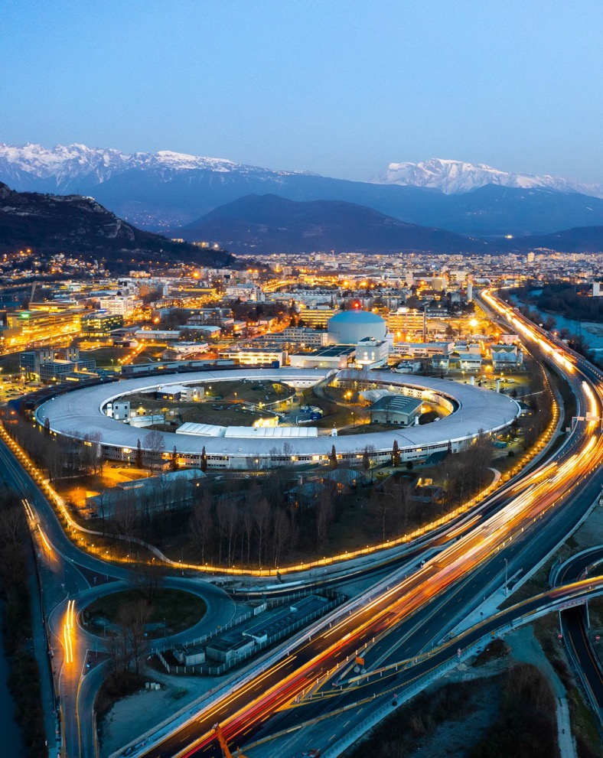

ESRF Status Report
40th Tango Community meeting at ALBA
Théo Rozier
Accelerator Control System Engineer, ESRF

Slide 2








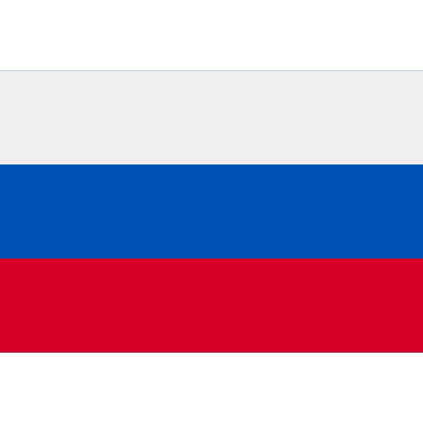










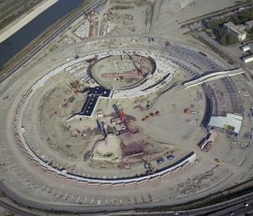
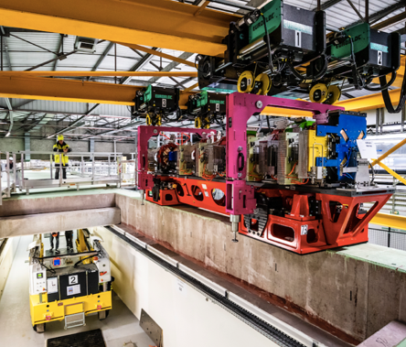
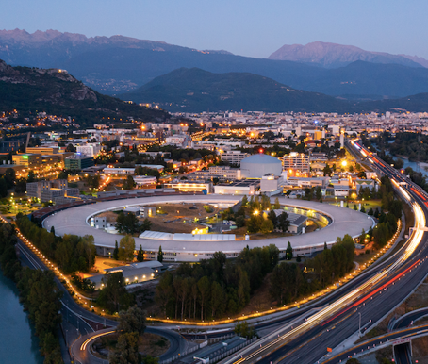
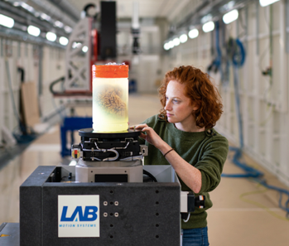
1994 - 2026: >30 years of science, 6 years of EBS
Construction:1988-1994
Operation: 1994-2018
Upgrade Programme:
2009-2022
Operation with ESRF-EBS:
25 AUGUST 2020
June 2026
ESRF, the first 3rd-generation synchrotron: 11 European countries joining forces to open new vistas in synchrotron science
ESRF UPGRADE PROGRAMME (2009-2022) launched by
the ESRF’s 21 partner countries.
UP PHASE-I delivered in 2015
on time and within the budget
Delivery of ESRF-Extremely Brilliant Source (EBS), a game changer: the first of a new generation of high-brilliance
X-ray sources
32 years of operation
Almost 6 years of successful operation of ESRF-EBS
BRINGING NATIONS TOGETHER TO ENABLE SCIENTIFIC EXCELLENCE AND TO ADDRESS GLOBAL CHALLENGES
Page 2
40th Tango Community meeting at ALBA | 08/06/2026 | Théo Rozier

Slide 3
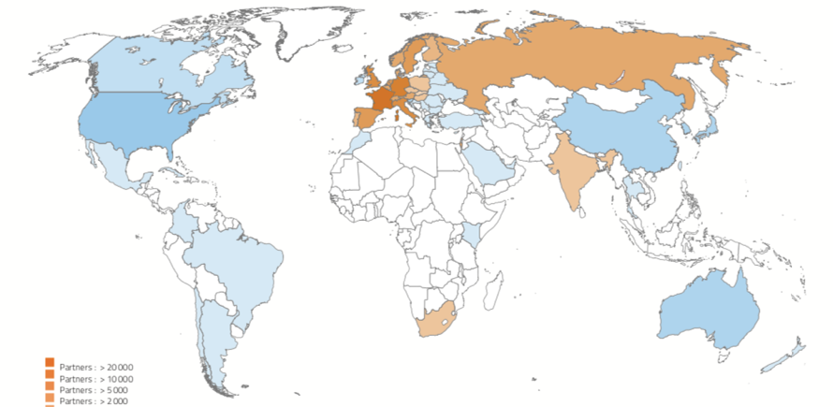
ESRF: an international HUB To pioneer science
19 PARTNER COUNTRIES
FROM 2015 TO 2024
68 000 USER VISITS FROM 67 COUNTRIES
7 000 INDIVIDUAL LABS OR UNIVERSITIES
ESRF MISSIONS
Bring nations together through science and advance knowledge
Pioneer synchrotron technology to tackle global challenges
Develop and operate state-of-the-art X-ray facilities and provide value to all partner countries
Foster the use of x-rays for industry
Train the next generations
6 GeV
34 + 12
2
Synchrotron
Beamlines
(public + CRG)
CryoEMs
10 000
6
1500
10
> 300
Scientific
visitors each year
Nobel prizes to ESRF users
Scientific
publications/year
ERC grants based
on ESRF-EBS
Industrial
clients
Page 3
40th Tango Community meeting at ALBA | 08/06/2026 | Théo Rozier

Slide 4
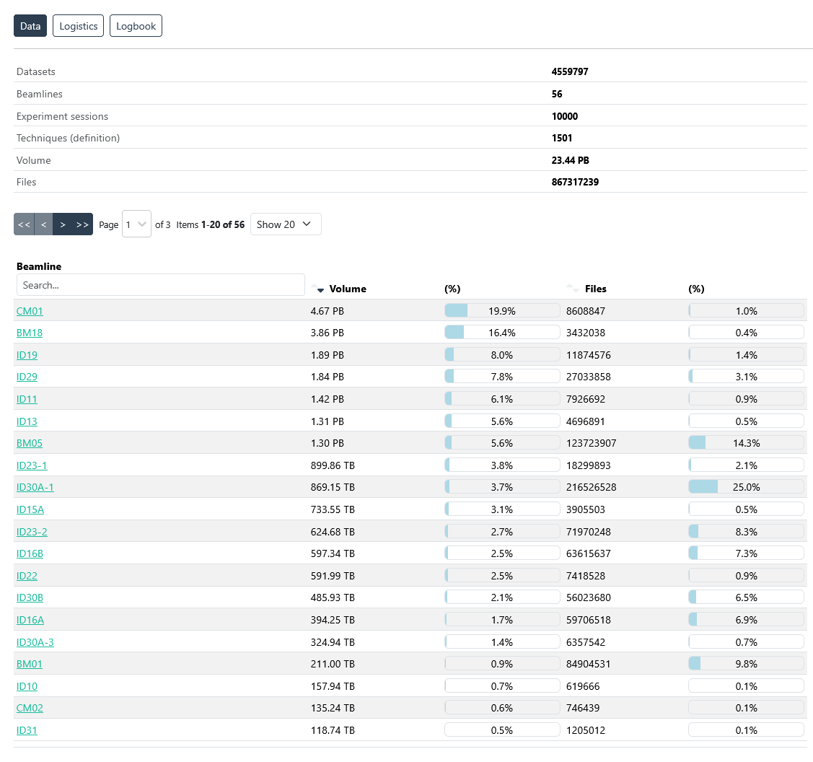
DATA PRODUCTION
> 23 Petabytes
of data curated since 2015
4.67 PB for Cryo-EM CM01 (19,9%)
3.86 PB for BM18 (16,4%)
1,89 PB for ID19 (8%)
1.84 PB for ID29 (7,8%)
1.5 PB
downloaded in 2024
4.4 million datasets
DATA WORKFLOW
@ THE ESRF
Page 4
40th Tango Community meeting at ALBA | 08/06/2026 | Théo Rozier

Slide 5
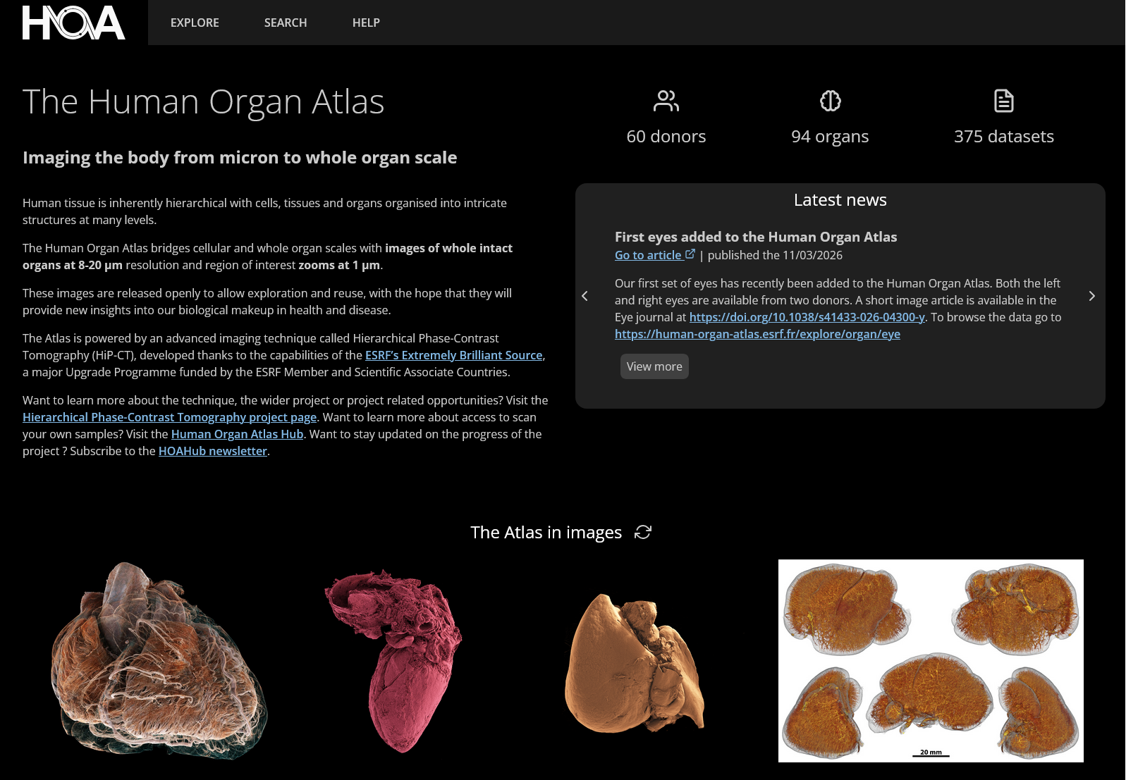
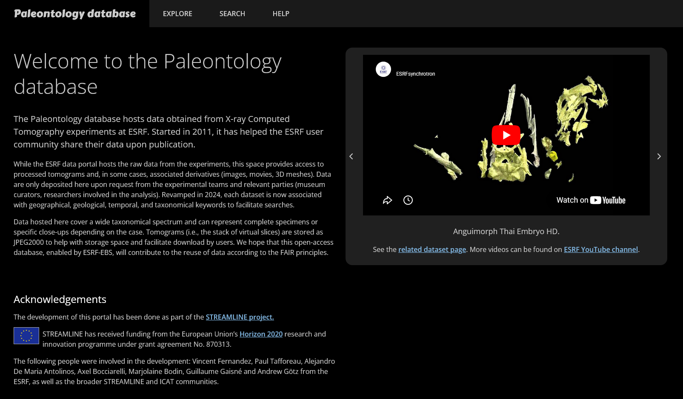
OPEN DATA PORTALS
https://human-organ-atlas.esrf.eu/
An open-access database developed as part of PaNOSC
177 datasets on the open-access database
with 13300 downloads since 2021
28 publications from users
+ 8 publications from open data
https://paleo.esrf.eu/
Hosts FAIR data from X-ray Computed
Tomography experiments since 2011
Of 399 articles published:
  342 direct publications
  57 linked to open data (16% of all Paleo publications)
Page 5
40th Tango Community meeting at ALBA | 08/06/2026 | Théo Rozier

Slide 6
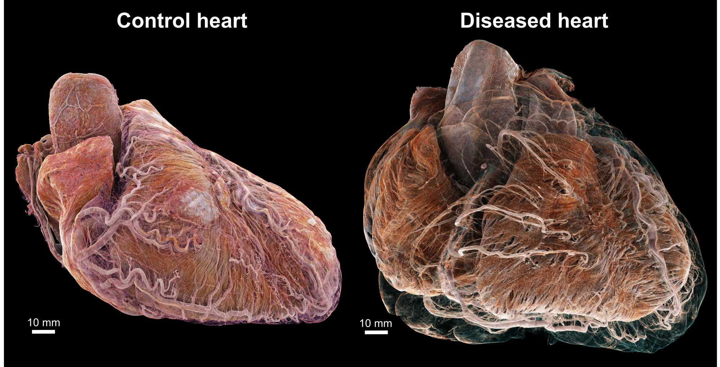
Adult human hearts in heal and disease
Page 6
Bunet et al., Radiology, 2024 Data: UCL led ESRF BM18 Beamtimes MD1290 and MD1389
40th Tango Community meeting at ALBA | 08/06/2026 | Théo Rozier (slide: Hector Dejea)

Slide 7
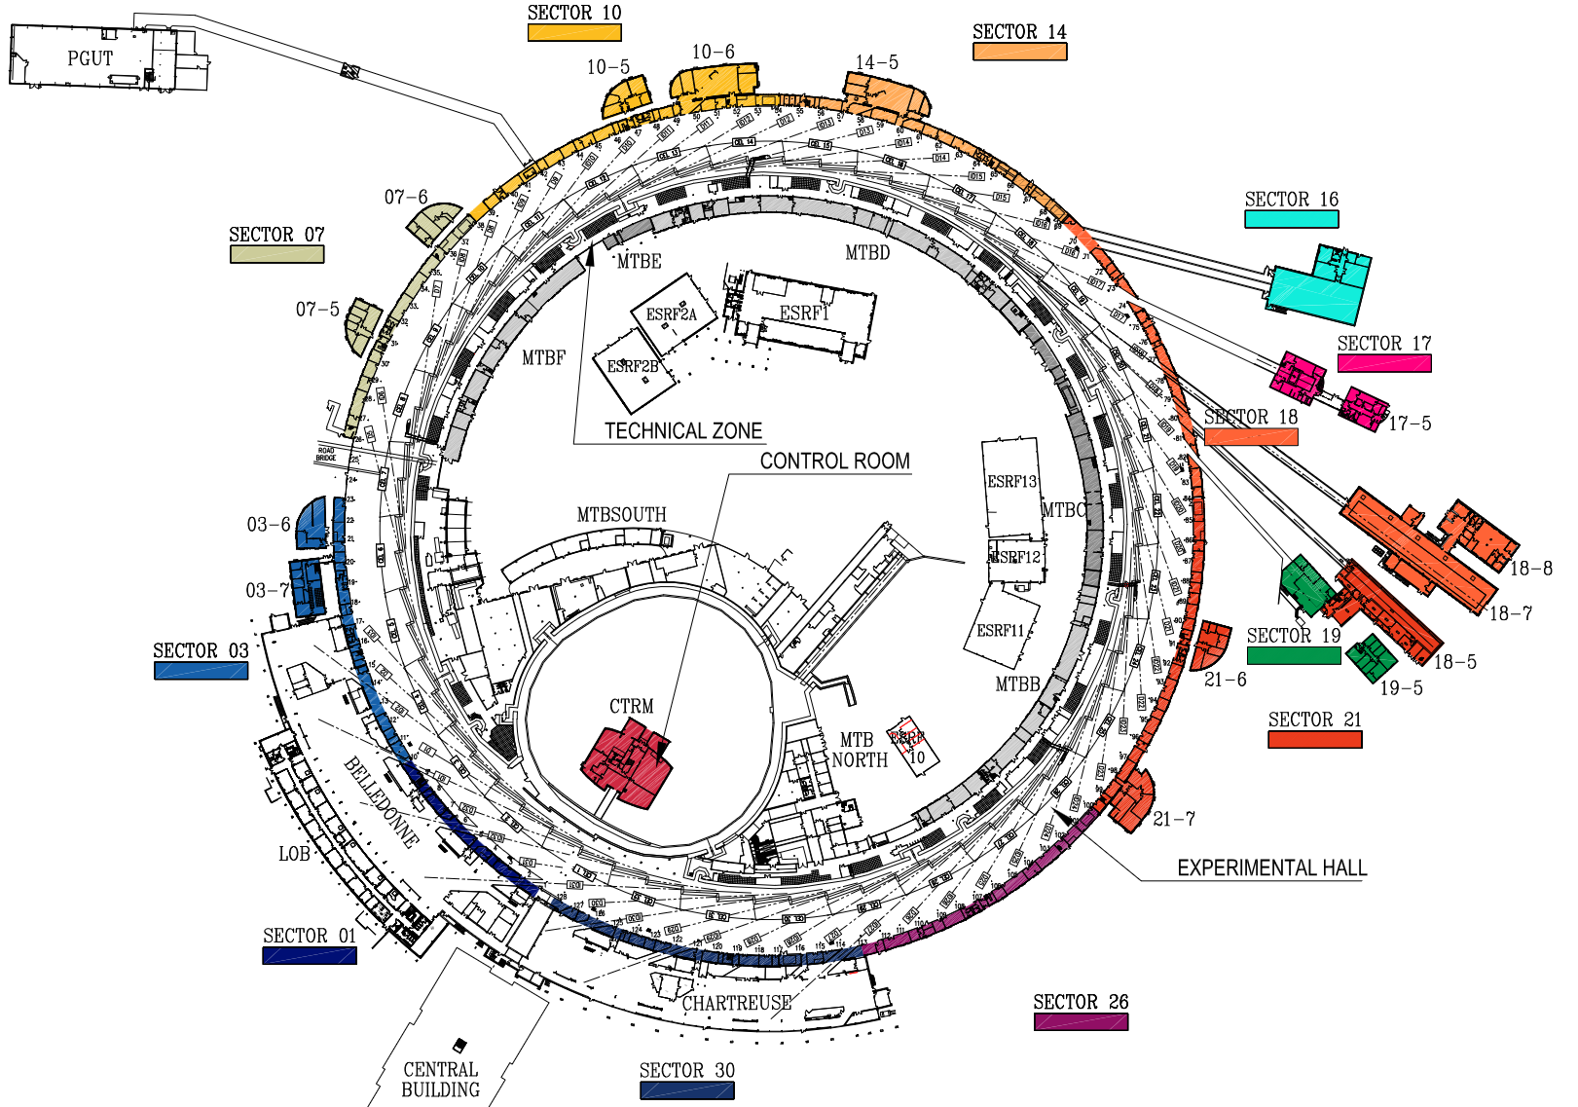
Accelerator upgrade plans
Non-Linear Kicker
Currently tested in cell 08
COLD Project
Cold copper Operation linac Demonstrator
In collaboration with:
SLAC, CERN, LNF, Cornell, PSI
Linac Refurbishement
Upgrades
Page 7
40th Tango Community meeting at ALBA | 08/06/2026 | Théo Rozier

Slide 8
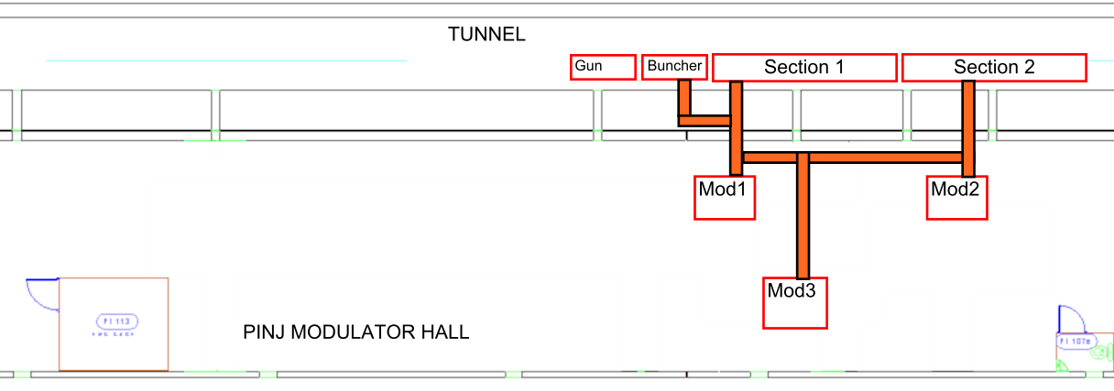
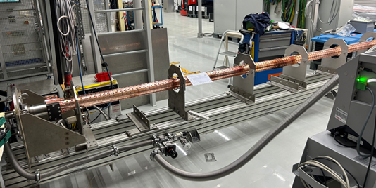
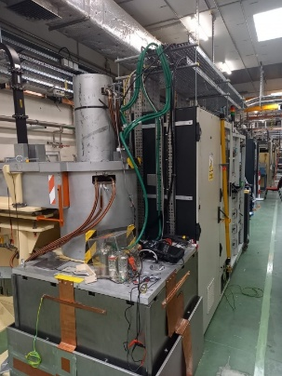
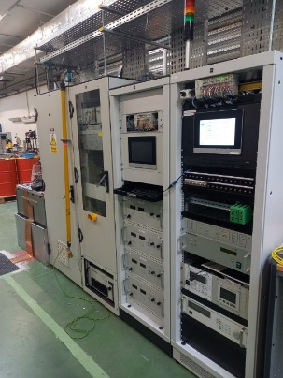
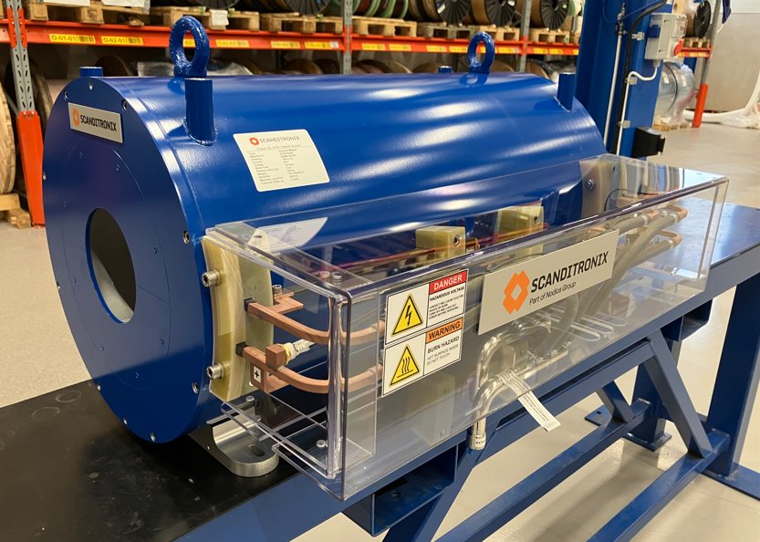
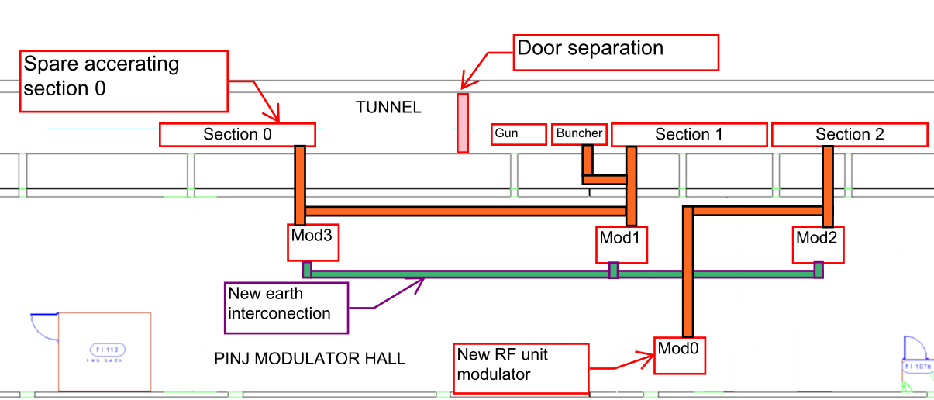
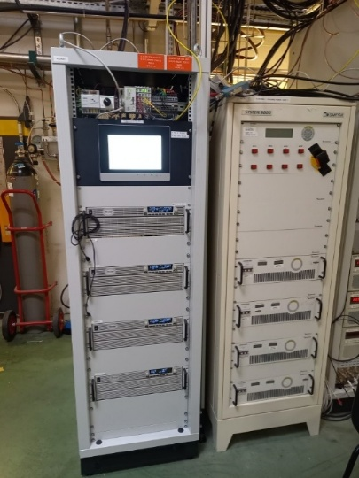
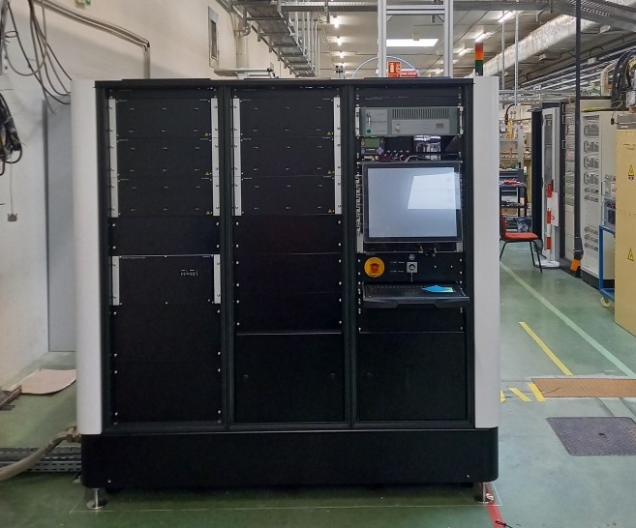
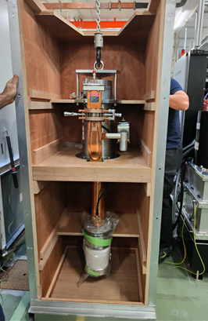
Accelerator upgrade plans – Linac Refurbishement
New accelerating section
Modulator 3
New power supplies
Old power supplies
Scandinova modulator
Page 8
Photos: M. Morati (ESRF)
40th Tango Community meeting at ALBA | 08/06/2026 | Théo Rozier

Slide 9

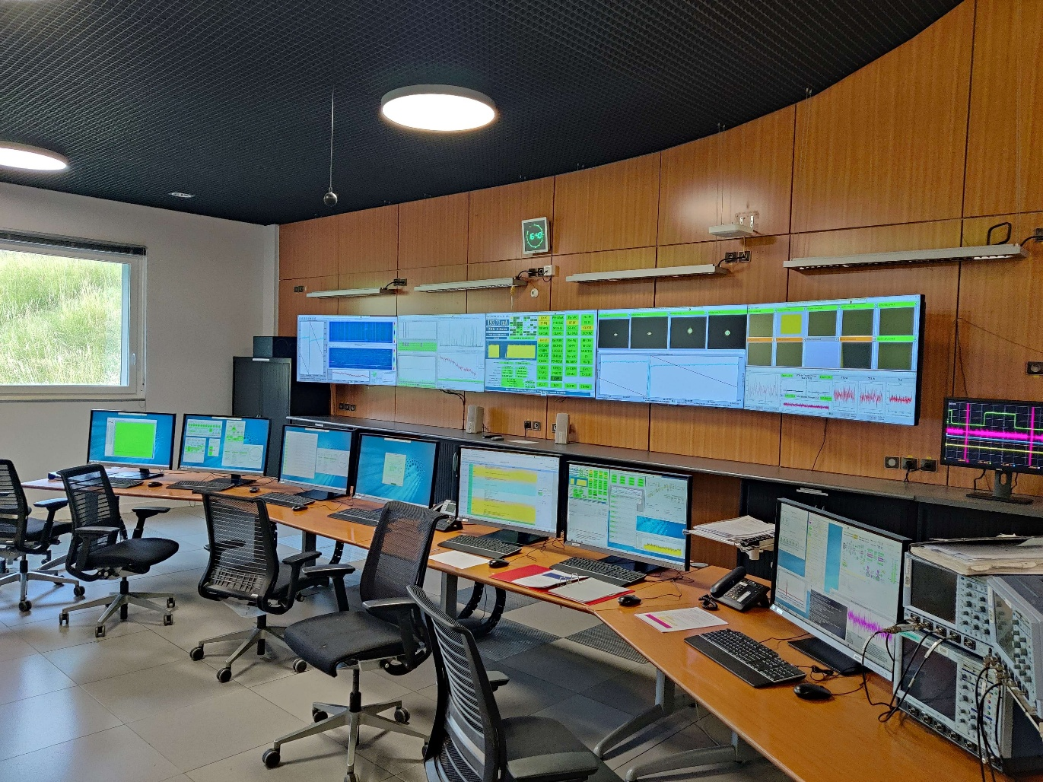
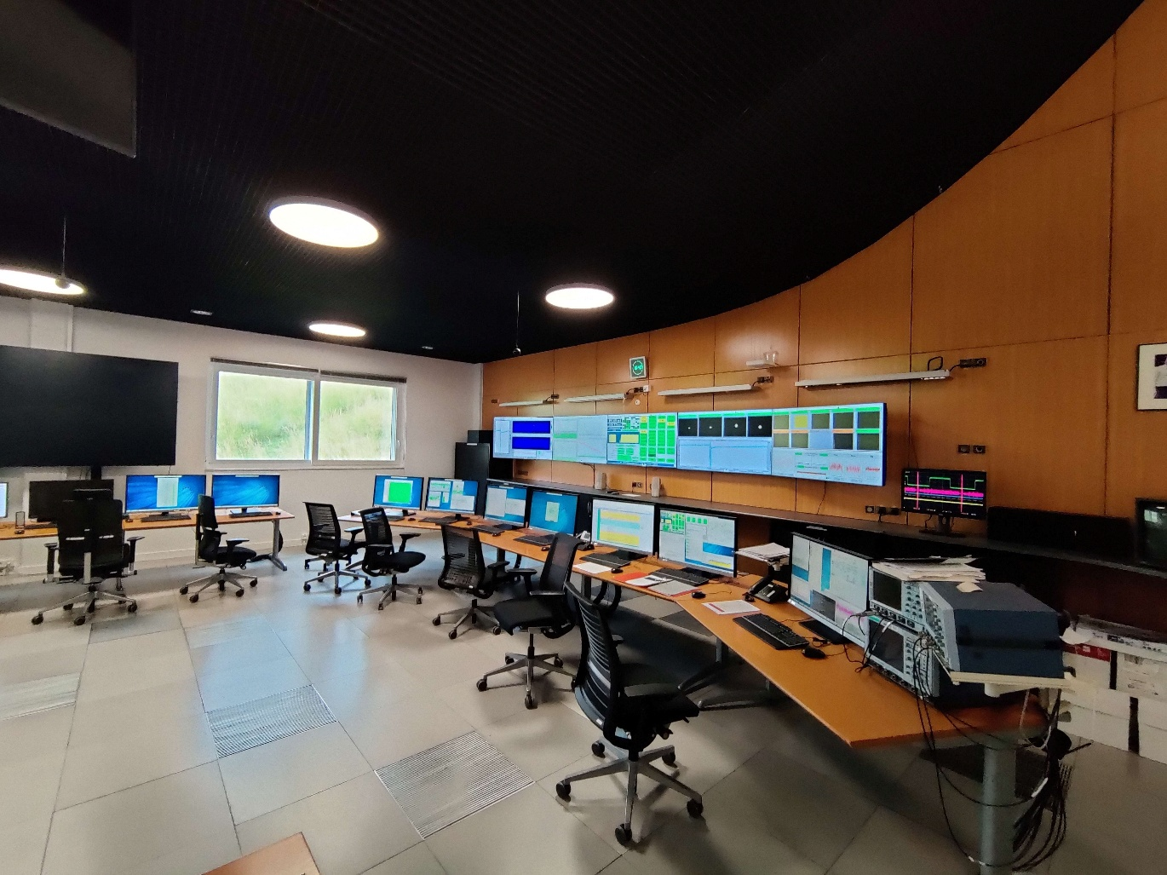
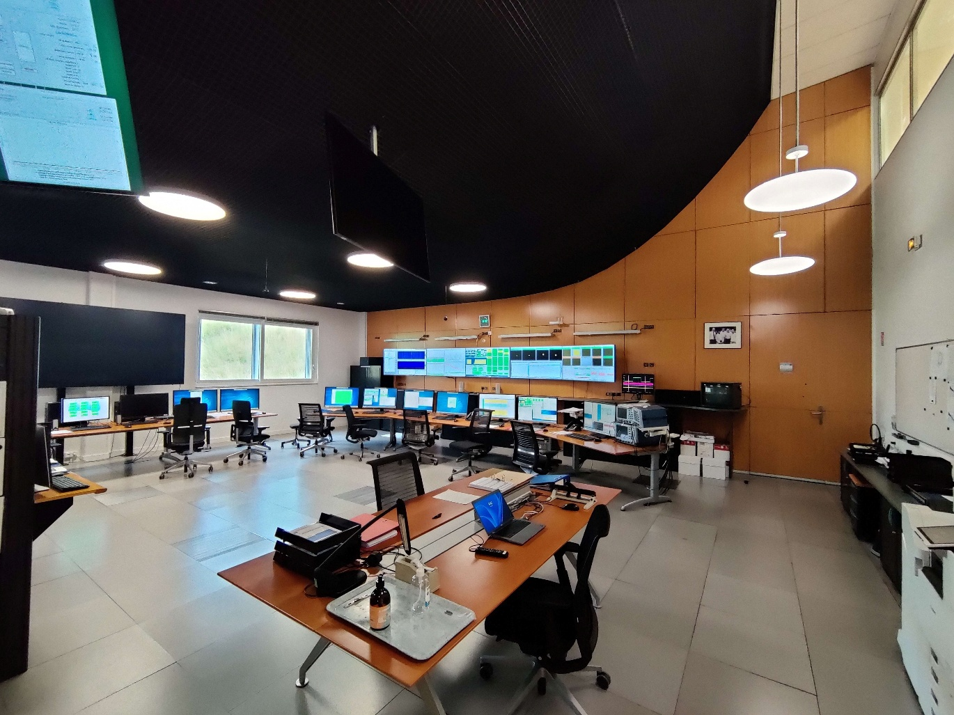
TANGO AT ESRF
Tango facts:
Used for accelerator and on every beamlines
Tango 9.3 LTS
cppTango for device servers
JTango and ATK for applications
Few pyTango servers and applications
~27k devices in use
~3k servers in use
~440k defined properties
HDB++ facts:
9 TB for the database
~20k attributes from ~7k devices
700 events/second
Control room at ESRF
Page 9
40th Tango Community meeting at ALBA | 08/06/2026 | Théo Rozier

Slide 10

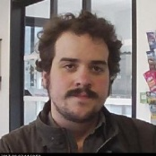
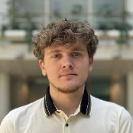
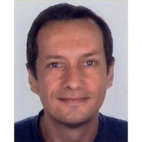
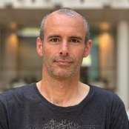
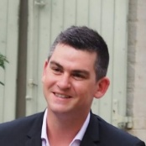
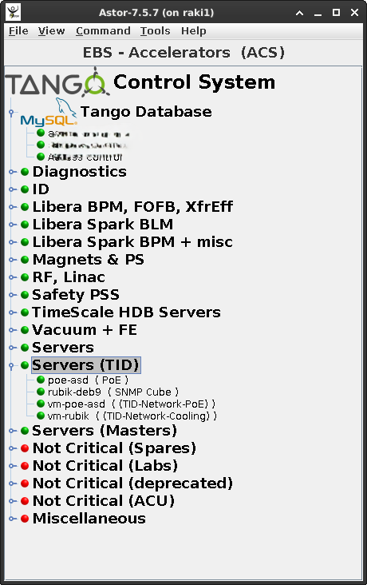
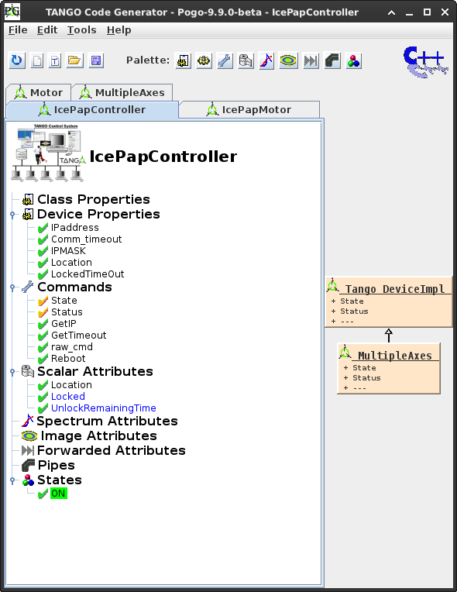
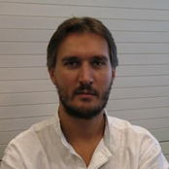
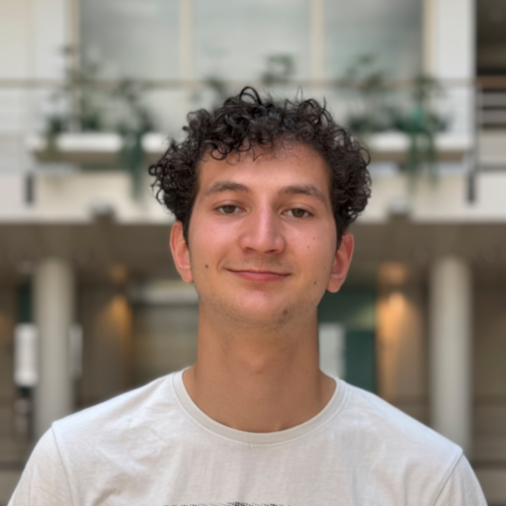
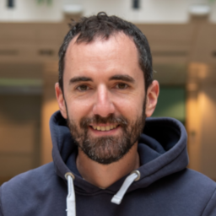
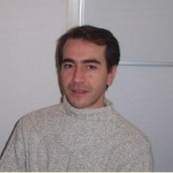
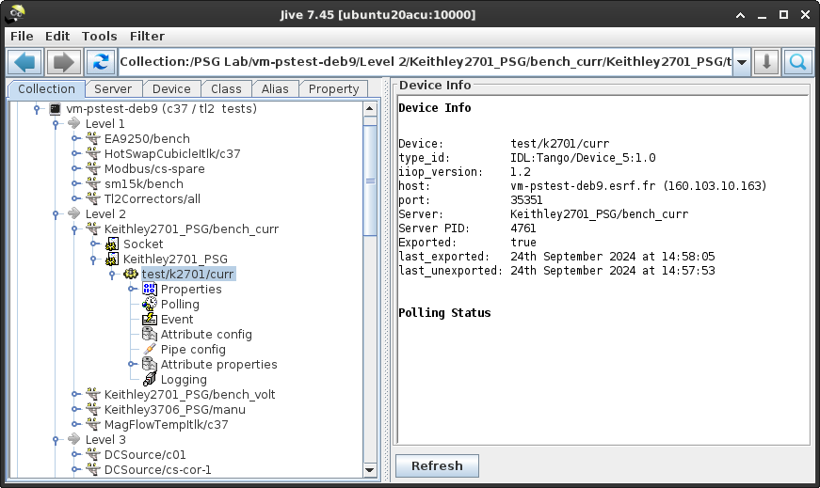
TANGO-CONTROLS COLLABORATION
ACU Team contributing to development and maintenance of Tango.
R. Bourtembourg
cppTango
D. Lacoste
cppTango, pogo,
HDB++
T. Rozier
cppTango
J.-L. Pons
Jive, Astor
N. Vergara
Taurus
integration
N. Tappret
Starter, Astor
A. Le Meillour
Testing
E. Michel
Pogo
G. Communie
J. Juan Nistal
Tango libraries (cppTango, pyTango, JTango)
Tango tools (jive, astor, pogo)
Subcontractors follow-up
ESRF chairman of Tango collaboration
Page 10
40th Tango Community meeting at ALBA | 08/06/2026 | Théo Rozier

Slide 11
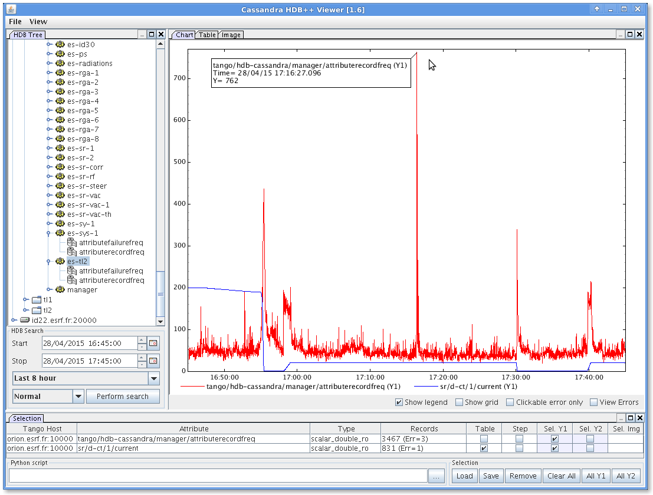



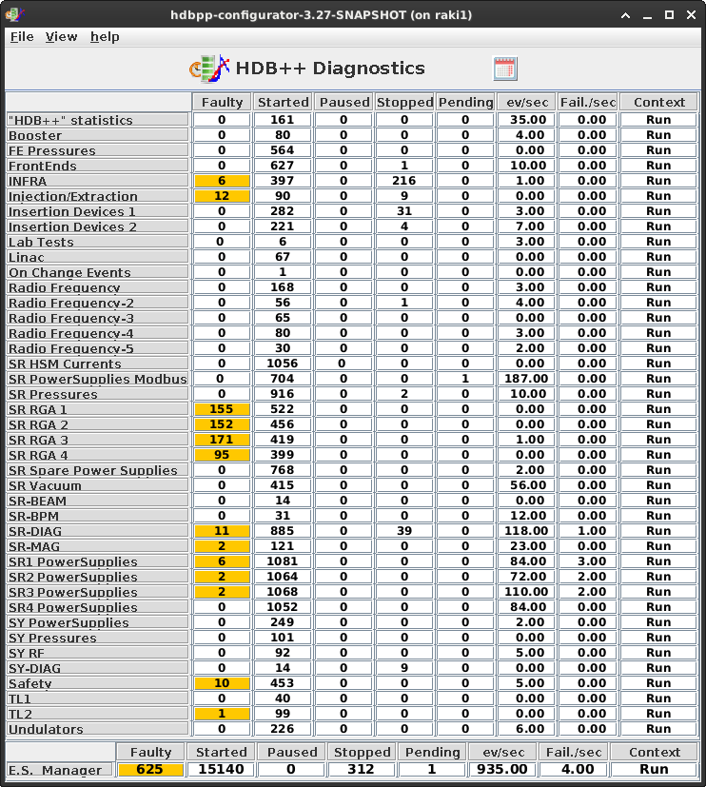




HDB++ COLLABORATION
More information on Tuesday 12:00
HDB++ status report with Damien Lacoste
Page 11
40th Tango Community meeting at ALBA | 08/06/2026 | Théo Rozier

Slide 12



ACCELERATOR Control system upgrade plans
We need to upgrade our accelerator control system!
Moving toward Tango 10 and prepare for future Tango 11 LTS
Mainly for telemetry and version information on devices
Improving testing, deployment and integration with GitLab
Better release cycle for our OSes (Debian 9 -> Ubuntu 24/26)
Introducing Taurus as an alternative framework to ATK
While continuing to support our user: the accelerator
We need to continuously upgrade and develop servers
(Taurus)
Page 12
40th Tango Community meeting at ALBA | 08/06/2026 | Théo Rozier

Slide 13



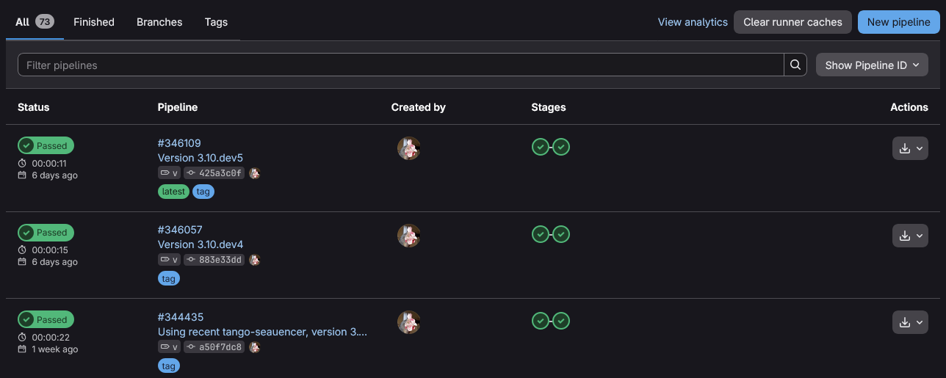
ACCELERATOR Control system upgrade plans
Where we are today…
Introducing GitLab CI/CD for migration to cppTango 10+
Many Ubuntu 22, 24 and testing 26
Two servers in operation with pyTango 10.1, others with 10.0
Standardized packaging of Python packages
Project management with UV and using CI/CD
Proposal for on-host installation of packages
Using Ansible and CI/CD
(UV)
Page 13
40th Tango Community meeting at ALBA | 08/06/2026 | Théo Rozier

Slide 14
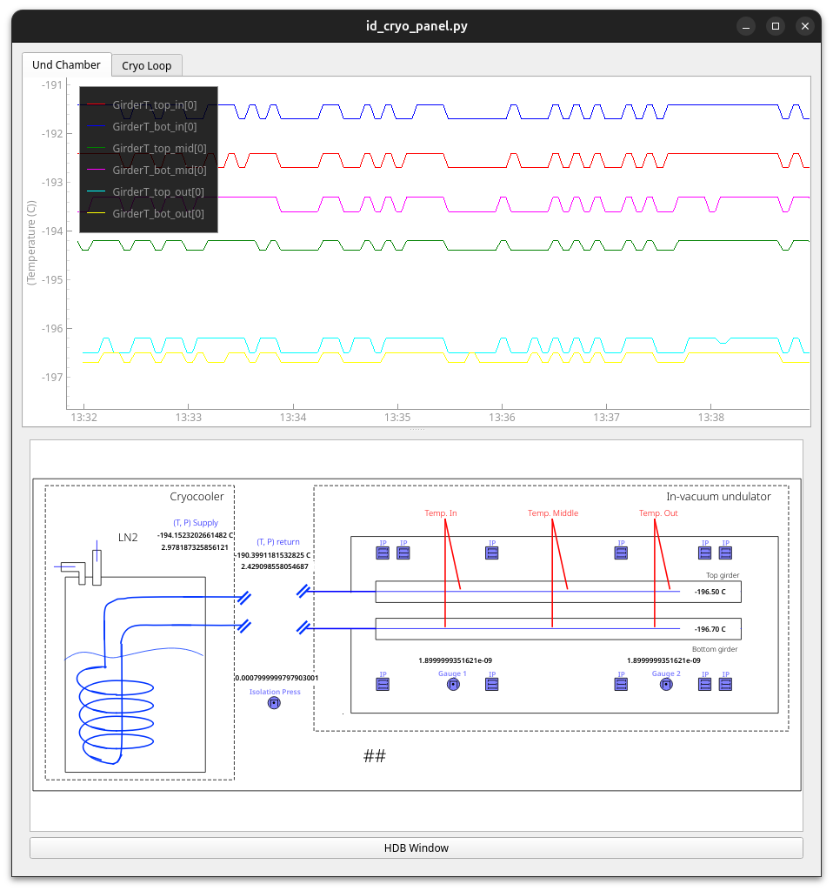
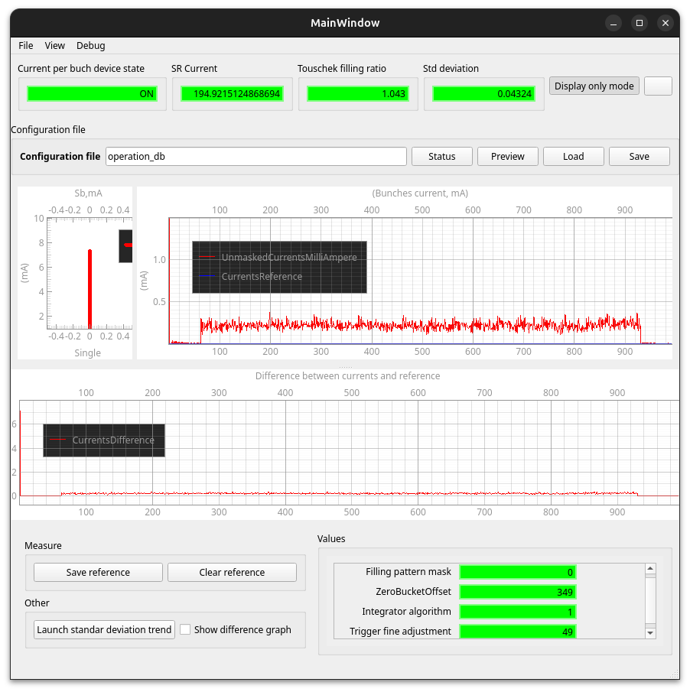
Regarding Taurus
We are starting to see Taurus at ESRF…
Available for beamlines with a new Taurus scheme for BLISS
Done by the Beamline Control Unit, will be externally published when ready!
Available for operators in the control room
Contributing to Taurus to improve compatibility with our existing system: color chart, missing features
Done by Natxo Vergara
Filling pattern application (PoC)
Application for Cryo Insertion Devices (in development)
Page 14
Credit: N. Vergara (ESRF)
40th Tango Community meeting at ALBA | 08/06/2026 | Théo Rozier

Slide 15
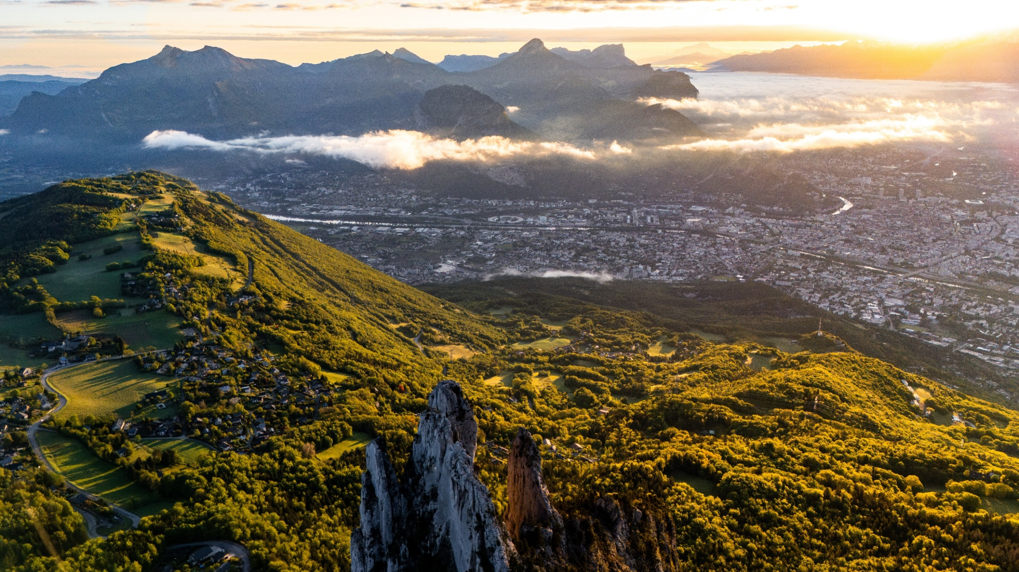
Thanks for listening
Page 15
Credit: TAS2CAILLOUX @ https://tas2cailloux.com/
Thanks to R. Bourtembourg, V. Ray Bakaikoa and A. Goetz for their help on this presentation
40th Tango Community meeting at ALBA | 08/06/2026 | Théo Rozier

