Slide 1
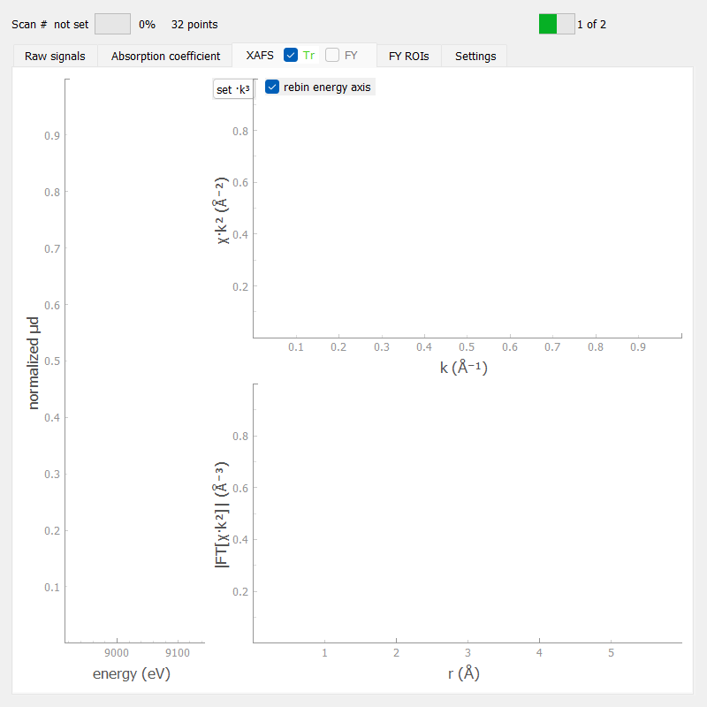
Multimodal Tests at Balder Beamline: Preliminary Results
Sardana workshop 2026
Carla Takahashi
Marcelo Alcocer
Milica Zivkovic
Vanessa Silva
Wojciech Kitka
Software, electronics, cpo and s2innovation

Slide 2
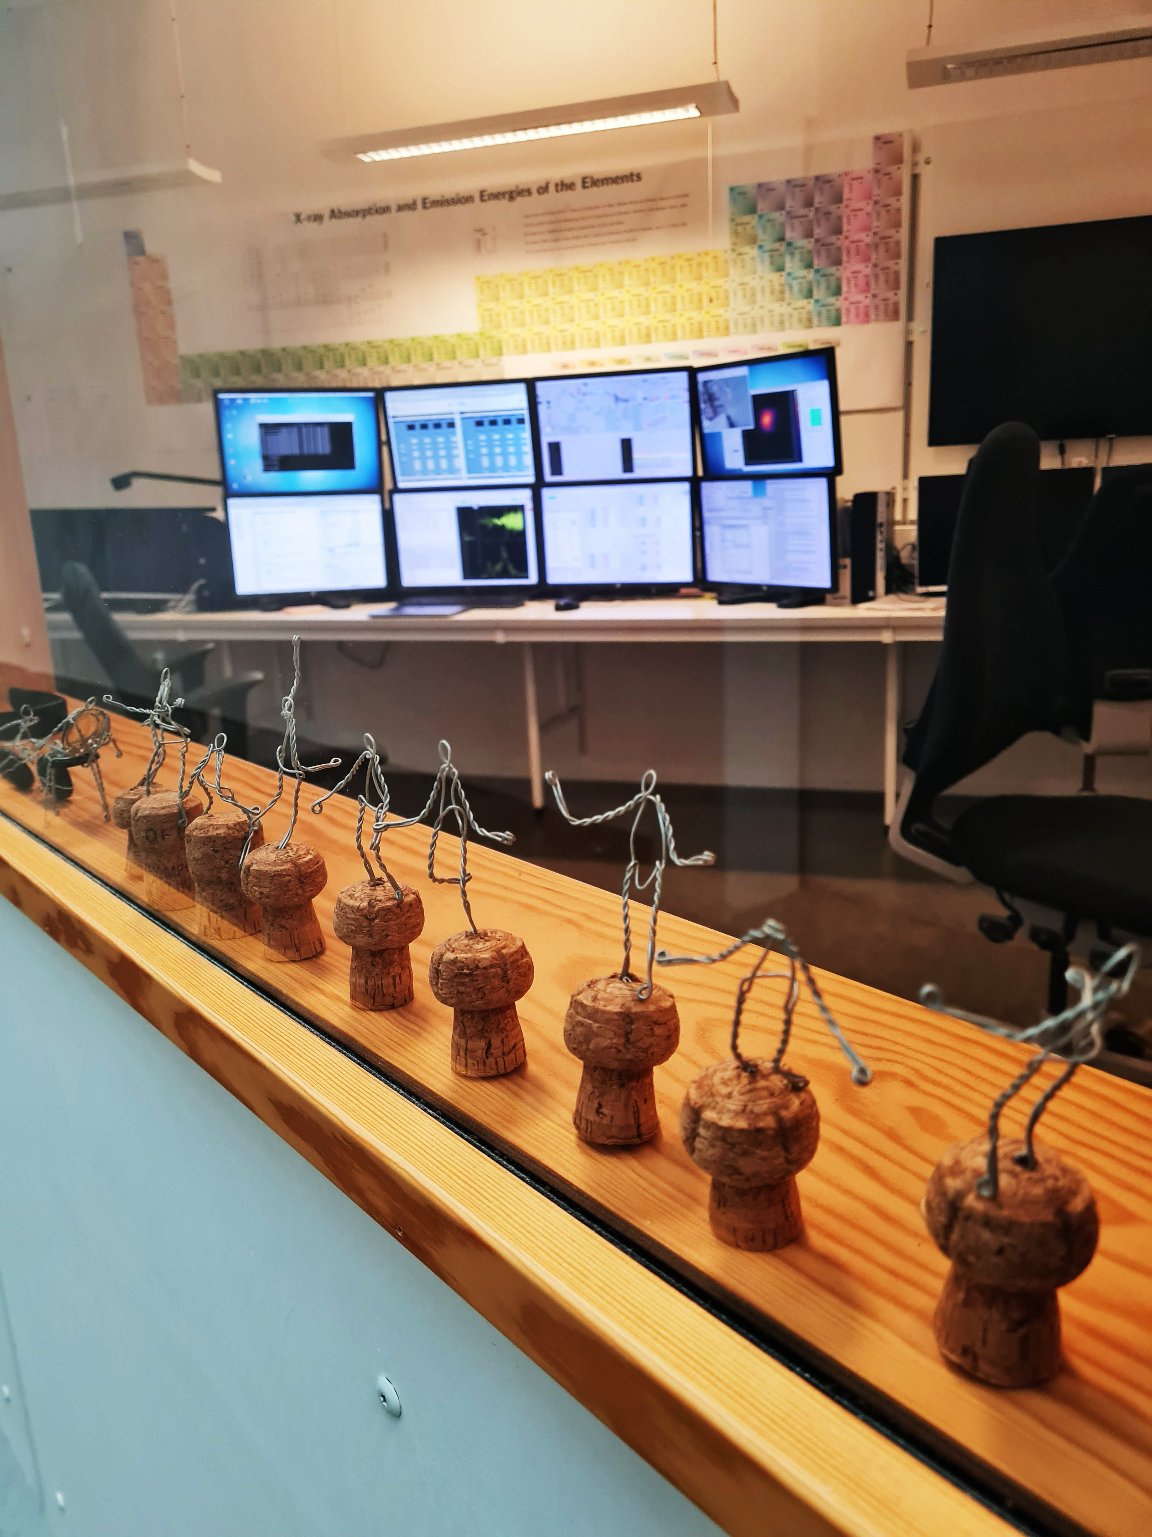
INTRODUCTION
Balder beamline

Slide 3
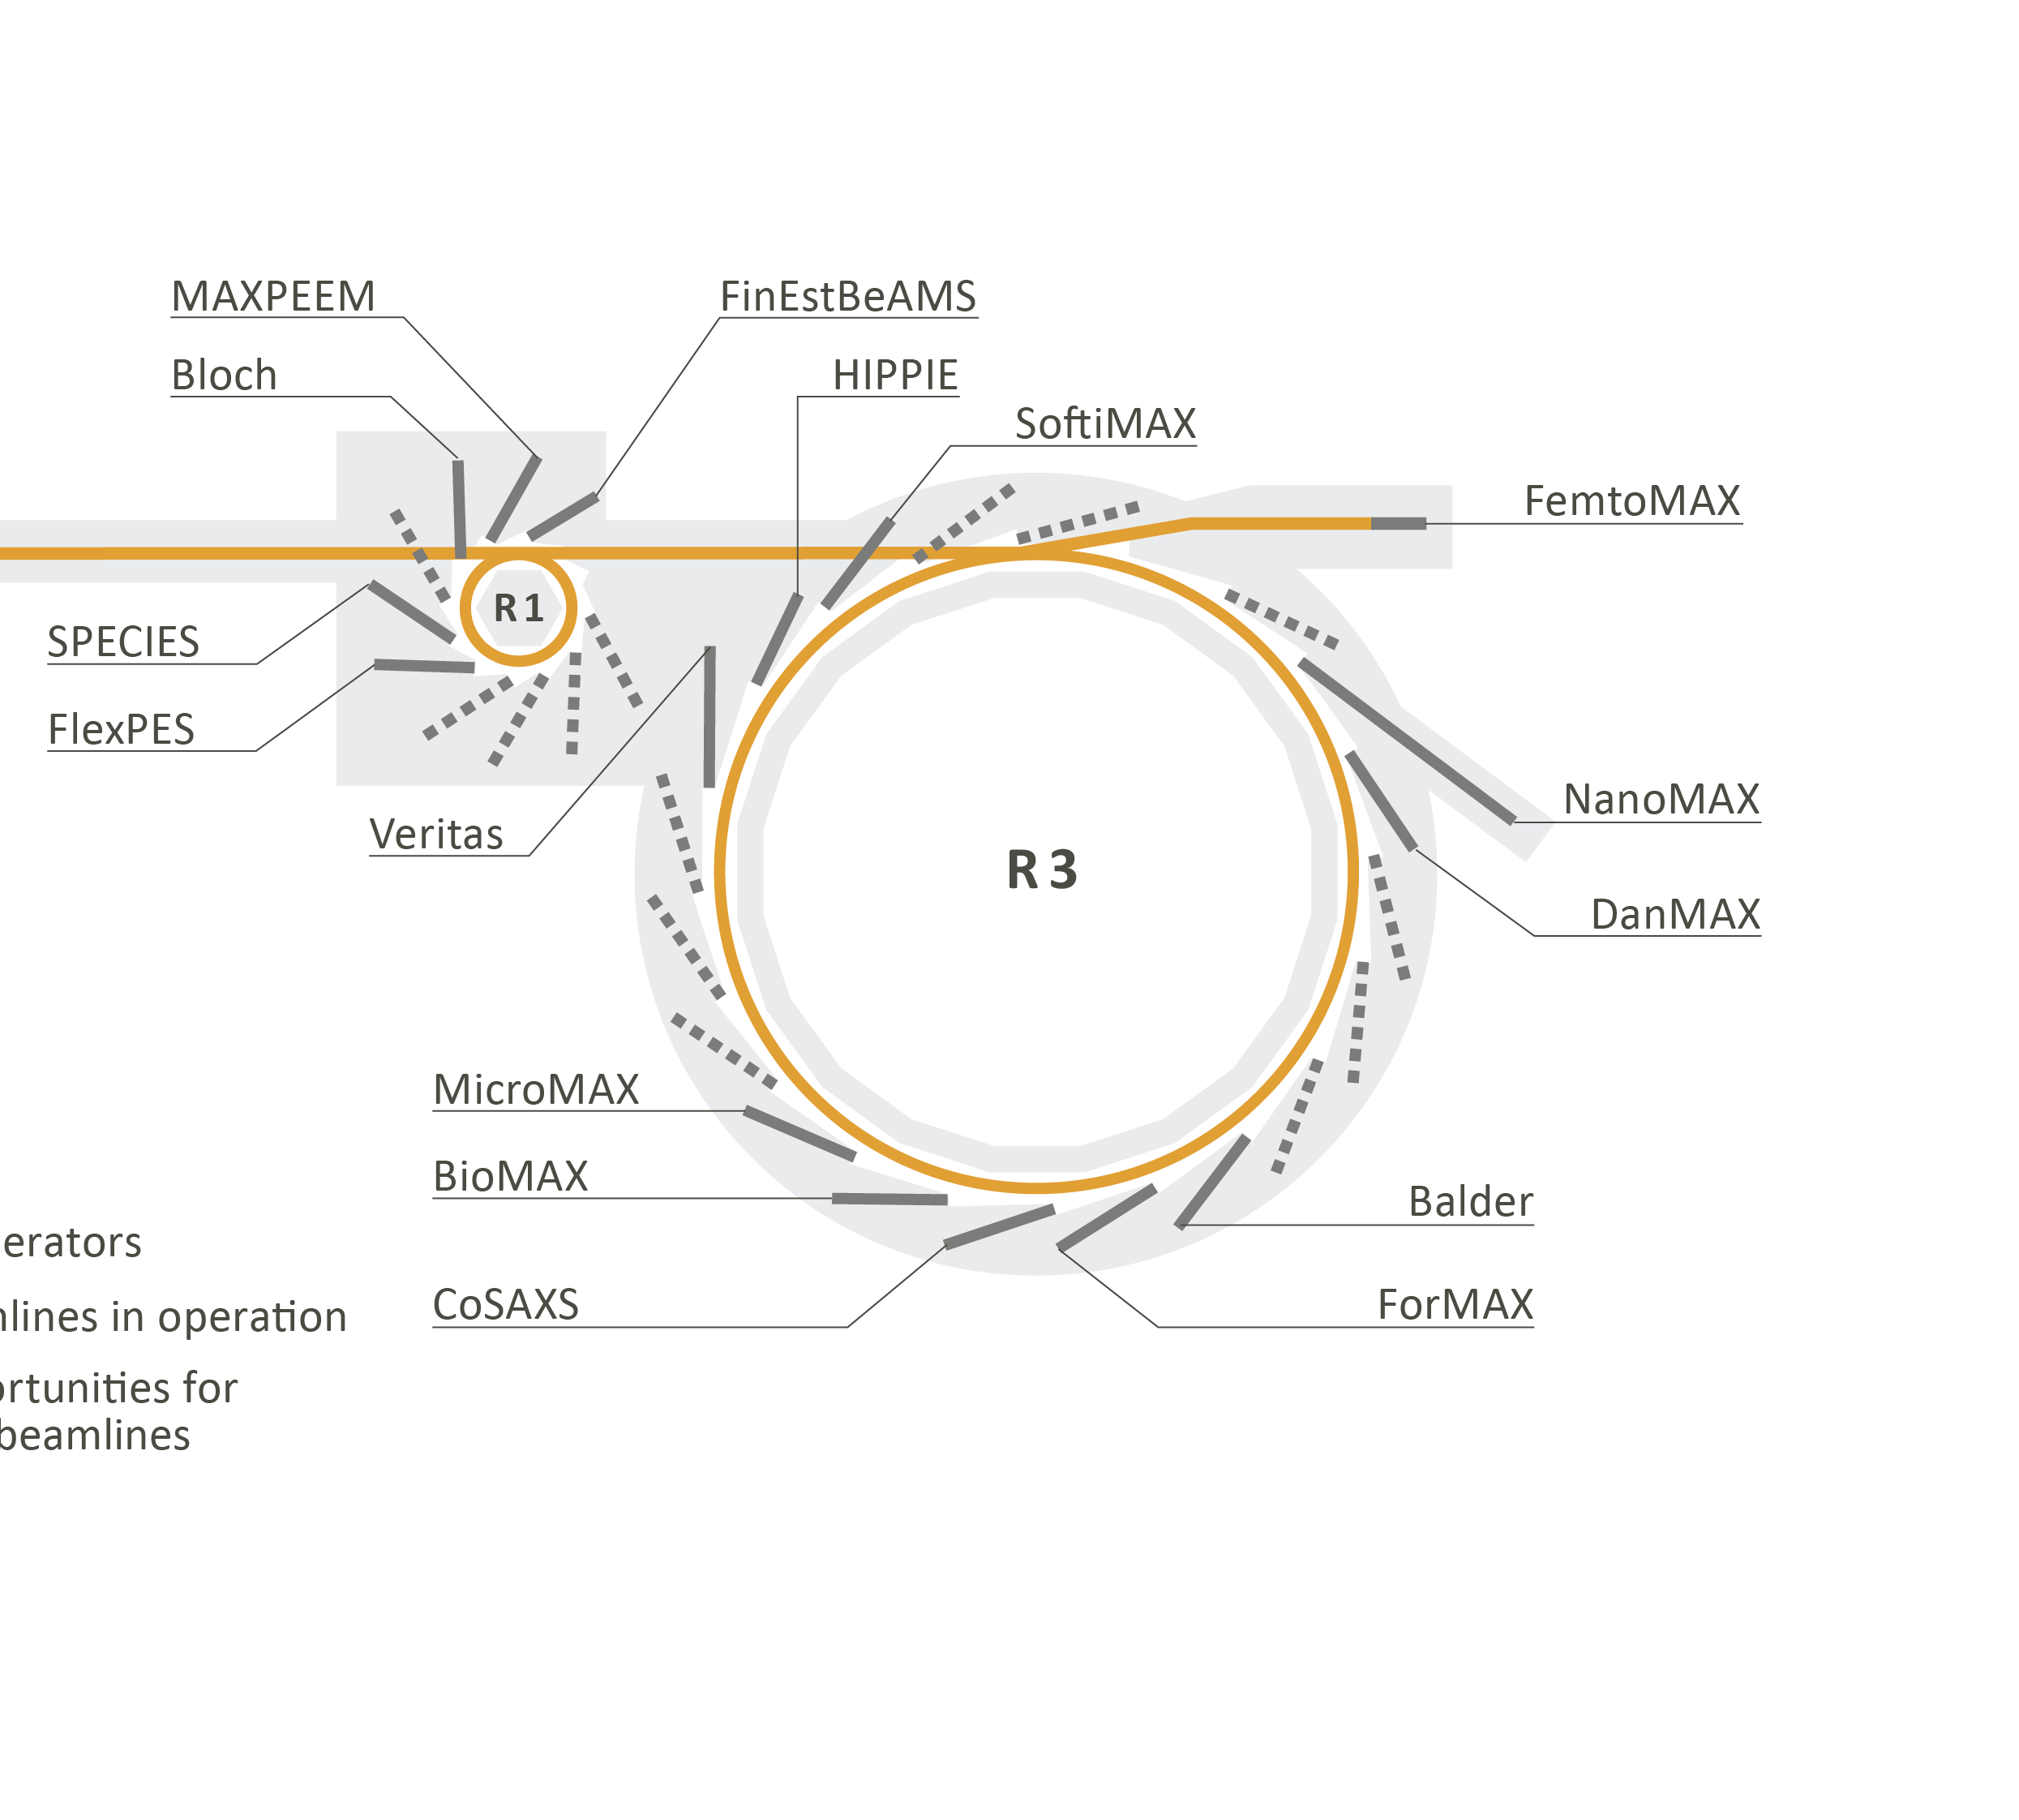
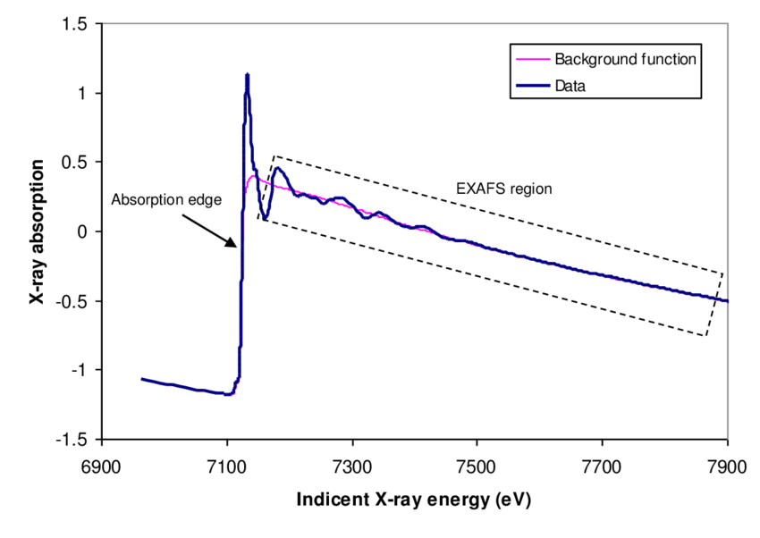
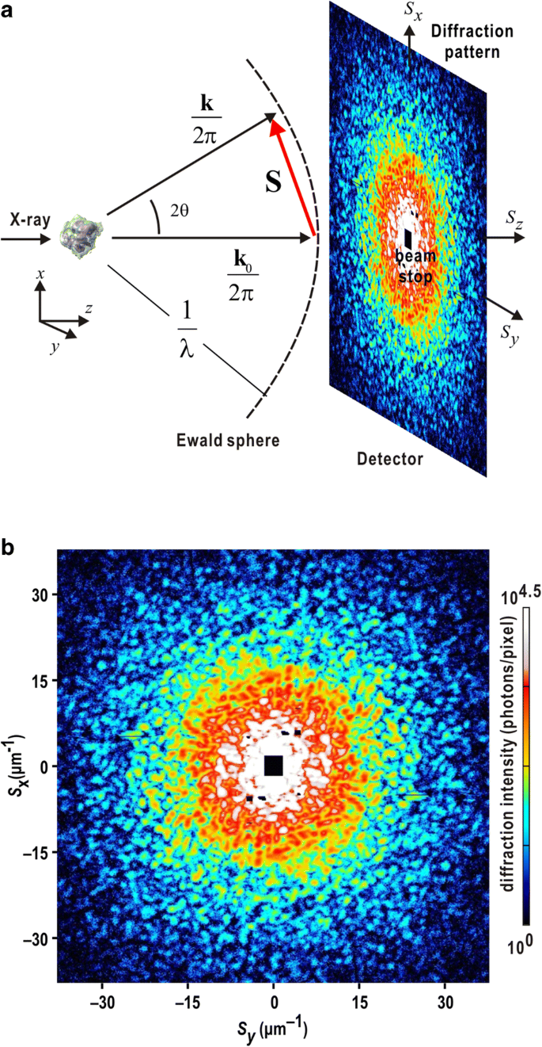
Balder Beamline
  Tests were performed on the Balder beamline at MAX IV
  Balder is a multimodal hard X-ray spectroscopy beamline: XAS and XES are primary techniques; XRD and XRF can be used as secondary techniques.
Combined
XAS
XRD

Slide 4
Test goals
Be able to execute the multimodal experiment with multi synch description feature and capabilities
Validate Sardana multimodal data publishing to Redis in a real beamline environment
Check the target data path: Sardana -> Redis streams -> blissdata/blisswriter -> HDF5 file
Expose compatibility and synchronization issues during multimodal integration testing

Slide 5
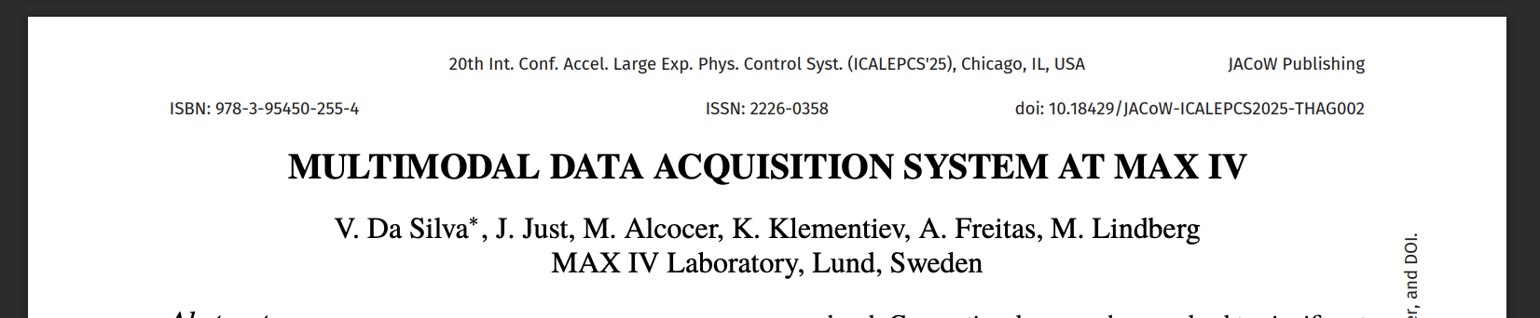
Test goals

Slide 6

EXPERIMENTAL SETUP
Multimodal
Installation in a dedicated environment
Software

Slide 7


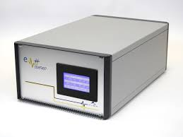

Devices and Redis
Scan
  Redis
  The setup process took significantly longer than expected due to package version and dependency issues.
pre-scan hook
configure albaem redis stream and start redis writer
Modified AlbaEM with streaming support
Modified PandA PCAP with streaming support
albaem ctrl
PrepareOne
Start Redis external stream
Why from the Tango Device?
@command
StartExternalStream
AlbaEM Tango Device
Enable direct ALBA EM2 frame publishing to a Redis stream.

Slide 8
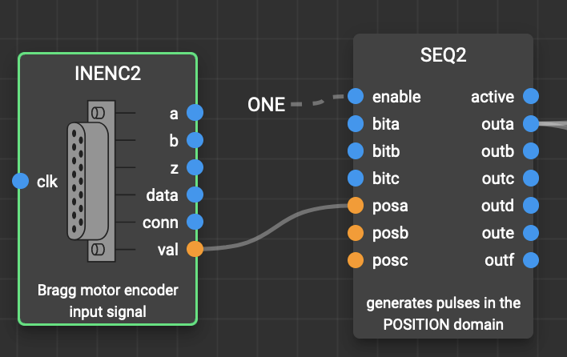
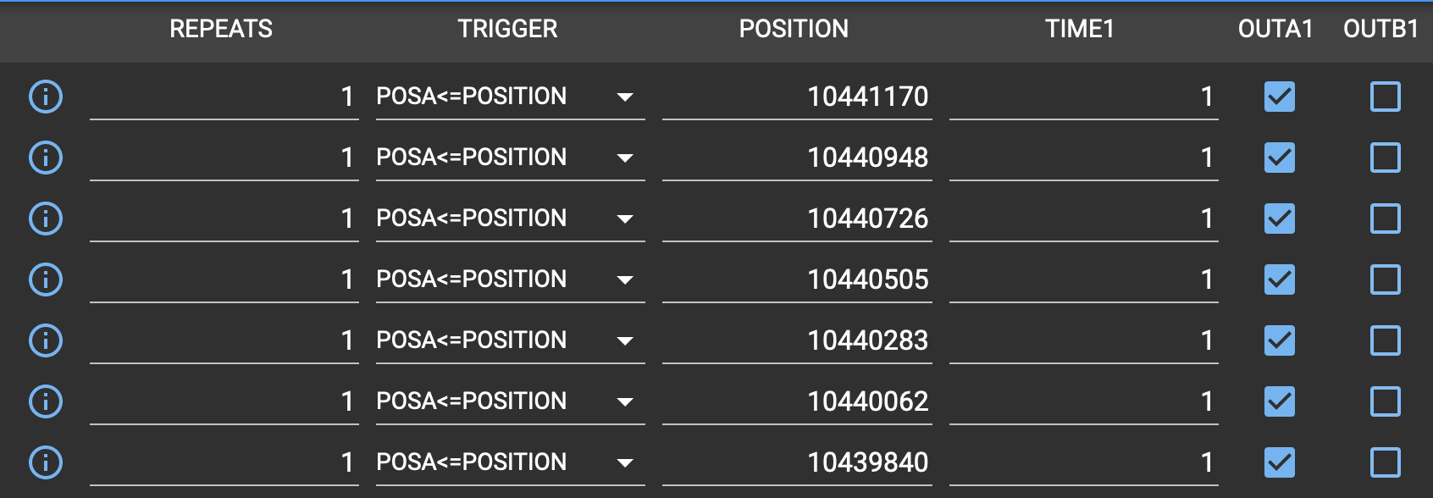

Synchronization
trigger gate ctrl axes
Bragg Motor
total triggers
AlbaEM-01
single point meas.
AlbaEM-02
Eiger-01
Eiger-02
PCAP

Slide 9
Synchronization
trigger gate ctrl axes
Bragg Motor
total triggers
AlbaEM-01
single point meas.
AlbaEM-02
Eiger-01
Eiger-02
PCAP

Slide 10
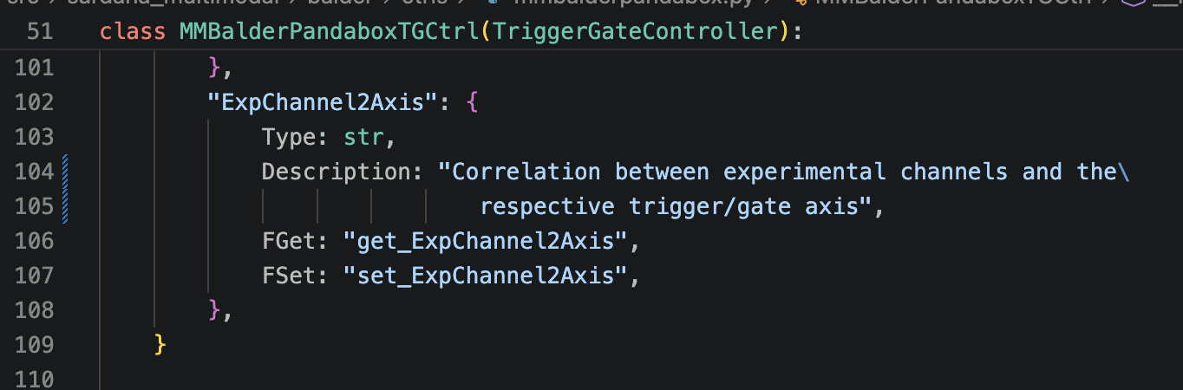
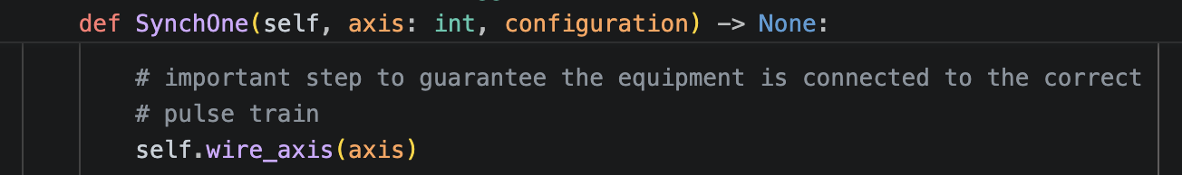
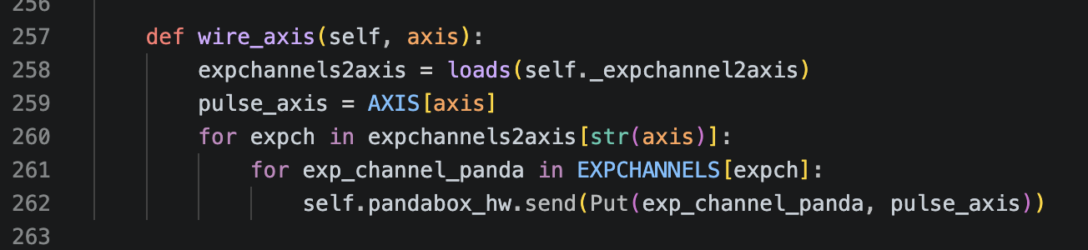
Synchronization
Modified existing Sardana TG controller to be able to support the multiple axes

Slide 11
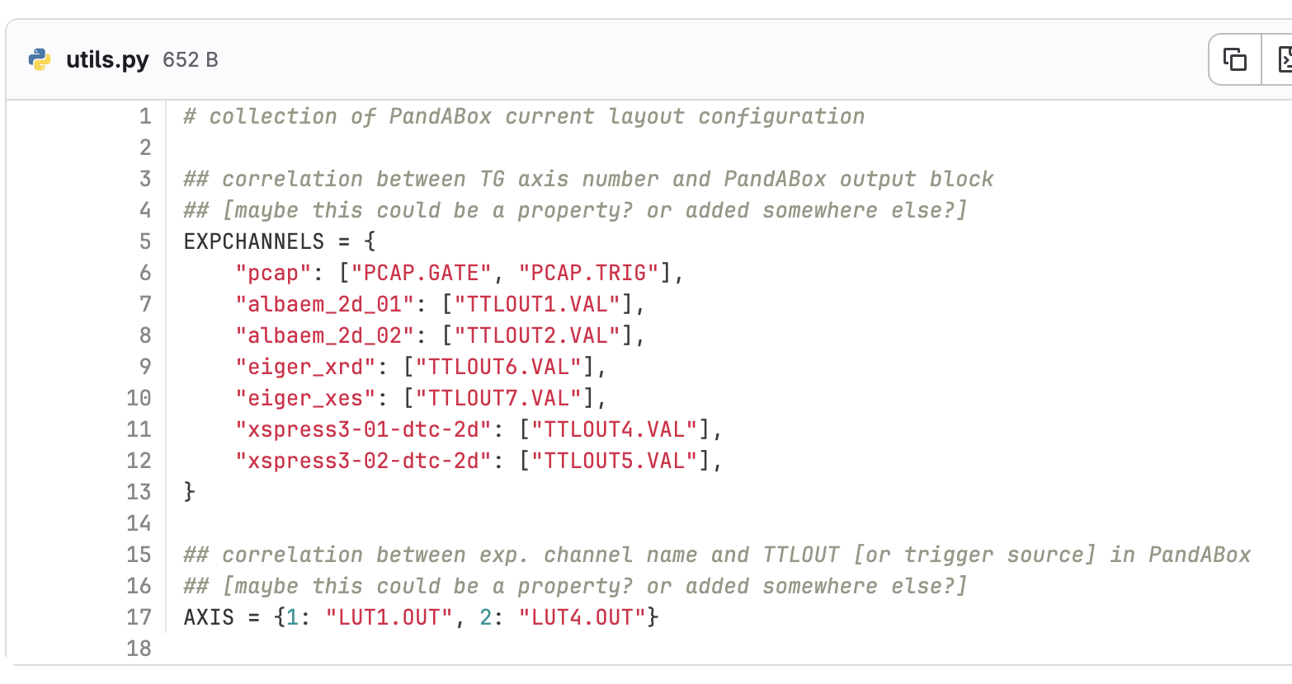
Synchronization
Correlation between PandABox layout and Sardana exp. channels and axes
We need to find a better way to make this configuration/correlation

Slide 12
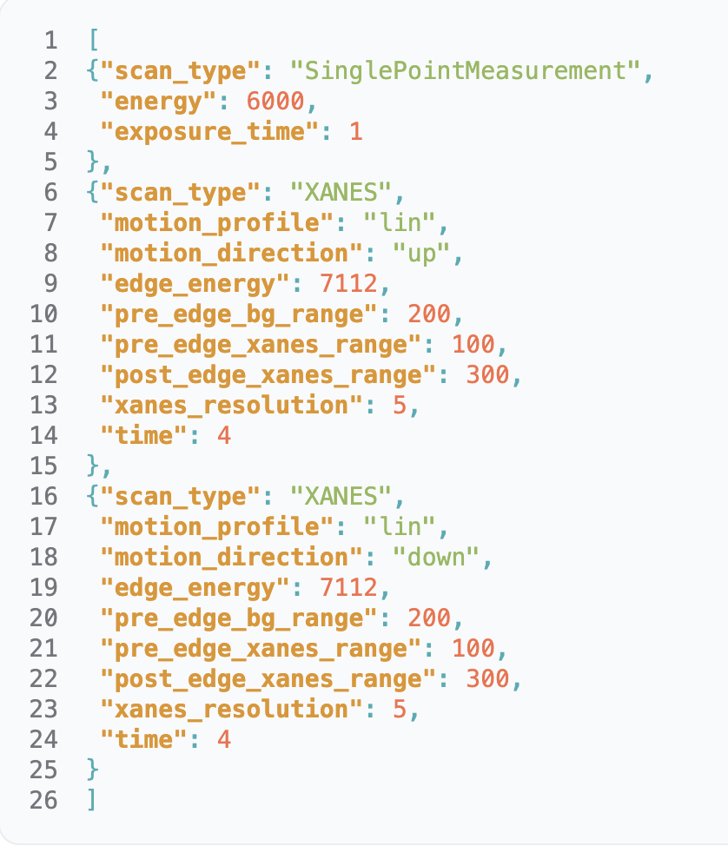
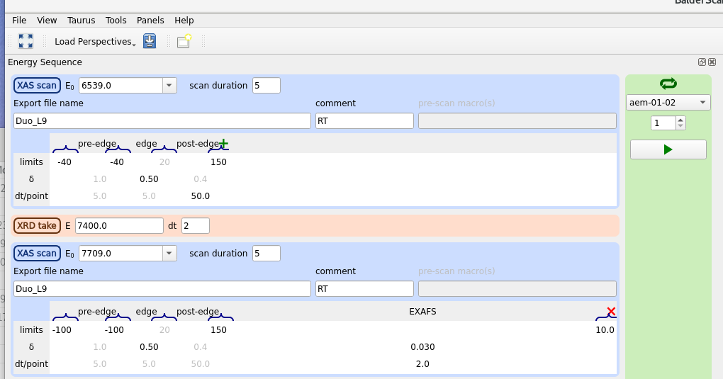

Orchestration
config_file
Multi Modal Hardware Motion Orchestrated Scan
mmhmoscan <config_file> <nb_repeats> <latency_time:Optional>
JSON format

Slide 13
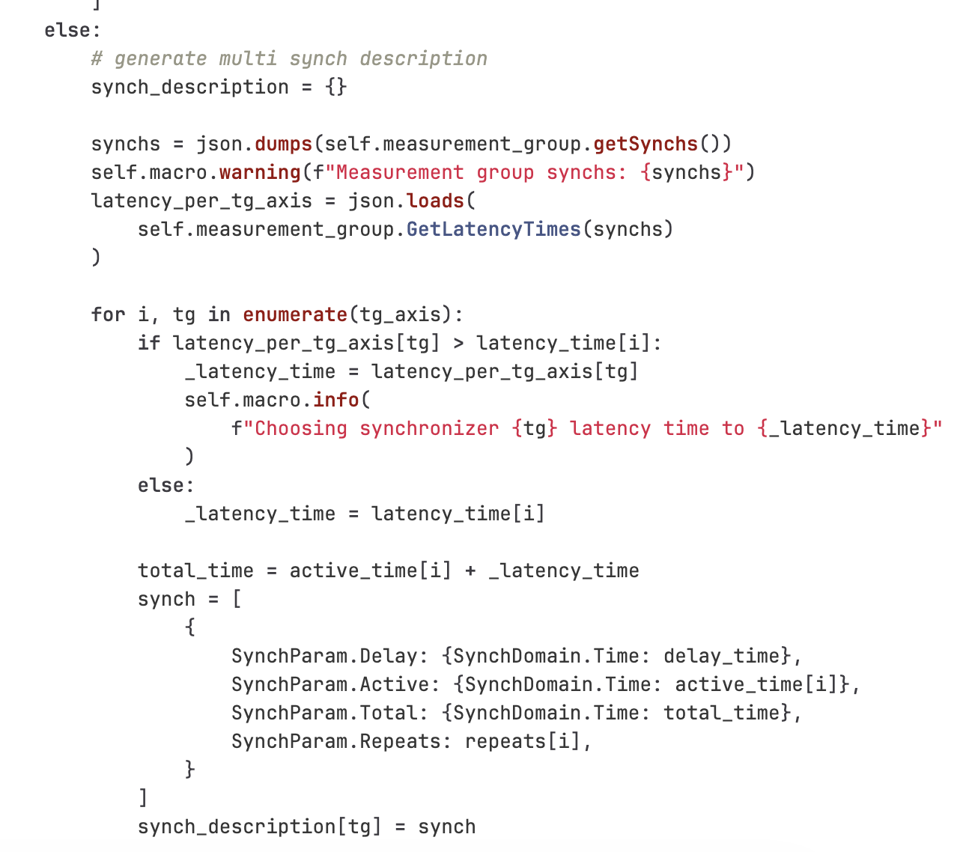
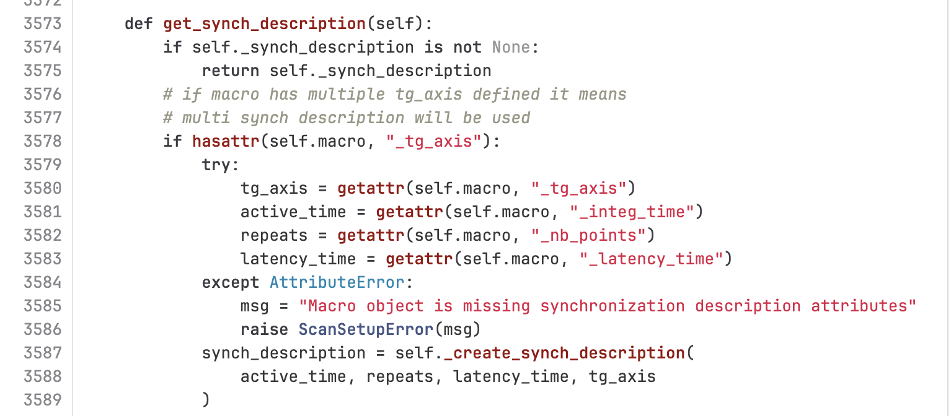
it uses modified TScan to handle multi synch description
MultiSynchDescription supported in the same TScan class used for timescan currently

Slide 14
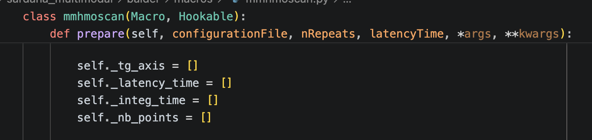
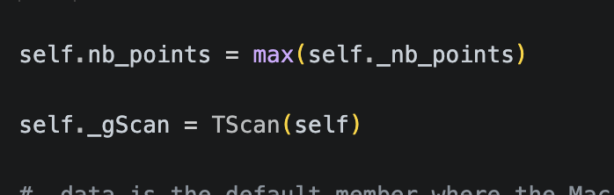
nb_points used by recorder and other parts of the framework. No support for nb_points as an array

Slide 15
How were the tests run
  We started from the multimodal-tests-cw10 branch previously used during the tests at the lab
  Test scans were executed with Sardana writing scan data to Redis Streams to perform combined XAS and XRD techniques
  The Redis payload format was adjusted and checked against blissdata / blisswriter expectations
  A Sardana version with Redis stream support was prepared and tested for data publishing
  A custom Tango Redis-to-HDF5 writer was used to validate writing Redis data into .h5 output

Slide 16
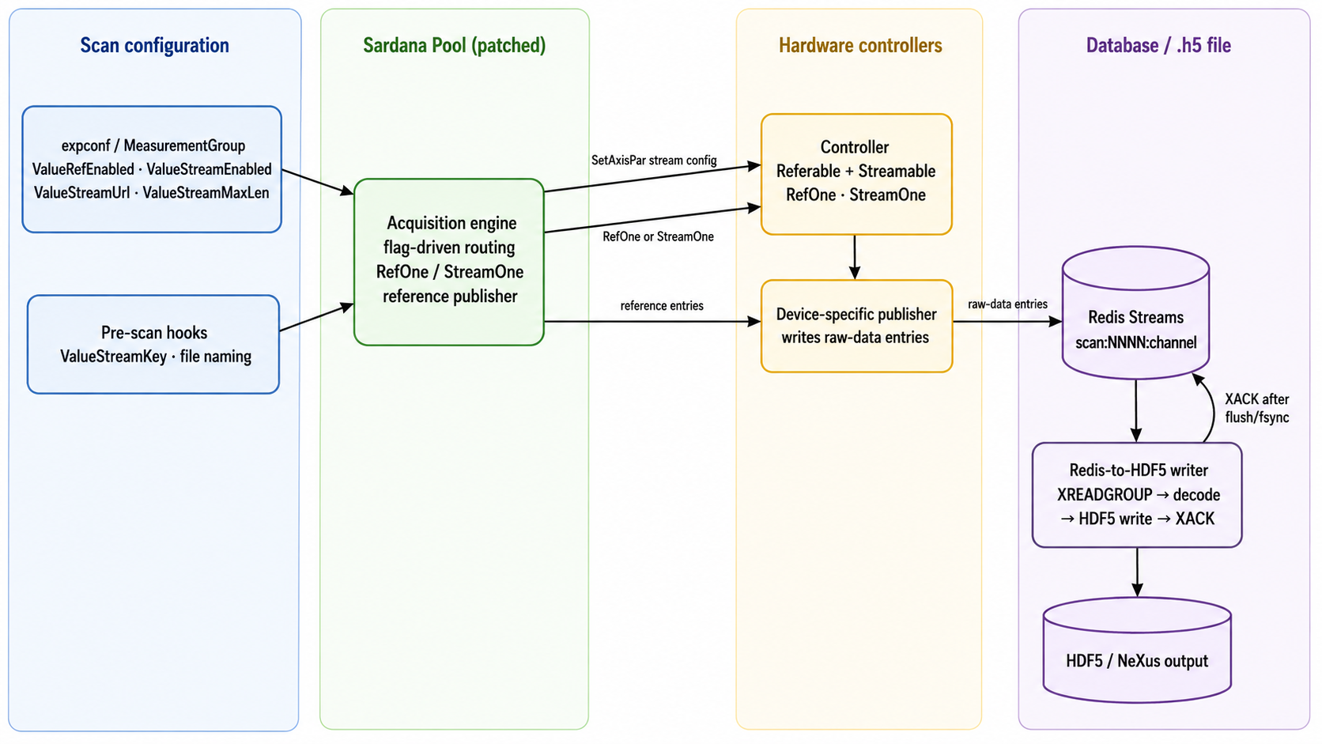
Architecture

Slide 17
Results
MULTIMODAL

Slide 18
Results
MultiSynchDescription feature validated for controllers configuration using multiple trigger-gate axes
We found some synchronization issues when using hardware triggers and different trigger/gate controller axes for the experimental channels. One of the axis would go to running before the acquisition actually start, making the scan to fail and Sardana to report "measurement group is in MOVING state"
Sardana with blissdata was able to write data to Redis, but the data format was not compatible with blissdata
After changing the Redis data format (‘payload’ field), we were still unable to use blisswriter to create the master .h5 file
We prepared a Sardana version with Redis support - in this version with the Streamable class (which works like Referable), writing data to Redis works nicely. However, the Redis data format is still not compatible with blissdata

Slide 19
Next Steps
Investigate the issue with the hardware triggers
Adapt Sardana Redis support to produce a blissdata-compatible Redis format
Adapt the custom writer to support the same blissdata-compatible format
Run multimodal scans using the new Redis-stream support branch

Slide 20

Thank you!
Software group

