Slide 1
LULI Tango Status Report
Stéphane Marchand, Sonia Minolli, Laurent Ennelin
Laboratoire pour l'Utilisation des Lasers Intenses (LULI), Palaiseau, France
Notes:
This presentation provides a quick update on the status of the LULI facilities. The LULI (Laboratoire pour l’Utilisation des lasers intenses) is located 20 km SW from Paris and operates 3 different facilities: LULI2000, Apollon and Hera. The facilities provide high energy or high power laser beams which interact with gas or solid targets. We will refresh the previous status and the current ones with milestones and Command-Controls & Supervision team’s developments.

Slide 2
LULI Facilities
Facilities Status
Apollon:
2 Areas (LFA & SFA), 2 laser beams at fs regime (F1 MPW & F2 ~PW), up to 300 shots/day at 1-min rate, 3+ PW on target in 2023… F1 in SFA, F2 in LFA, 8+ PW in 2025, F1 + F2 in SFA and LFA in 2026
LULI2000:
1kJ in ns regime, 12 shots/day
HERA (mostly fully users-operating) :
200J, ns regime, 20 shots/day

Slide 3
C2S/In previous seasons:
Command-Control & Supervision Status
New/updated devices and GUIs on a regular basis: soon on GitLab 8o)
Damien: I’ll sure give some help on POGO 8o)
Apollon:
Nearly fully operational hdb++ w/ currently filesystem archiving as we need some more time to upgrade our users
New web page (Django) on Apollon for displaying near real time shot data and hdb++ database extraction
LULI2000: gently incorporating Tango
HERA: gently incorporating Tango

Slide 4
C2S/In 2026, season IV (VI… XXV?)
Command-Control & Supervision Status
Devices: 2300 devices running, BUT NOT on GitLab yet 8o/
Damien: I’m still confident that I will soon be able to help on POGO/+ but… 8o/
Apollon:
11 campaigns, 8+PW… end of year, F1+F2 in SFA, F1+F2 in LFA commissioning end of year
Fully operational hdb++ w/ still filesystem archiving as we still need some more time with support for a few users
Django web / hdb++ database extraction: nobody ask for the older version anymore \o/
3 modes of operation: periodic (low rate, day-long monitoring), sequence (1’-shot rate), trigger (user choice for 1’-rate, 0.1Hz or 1Hz)

Slide 5
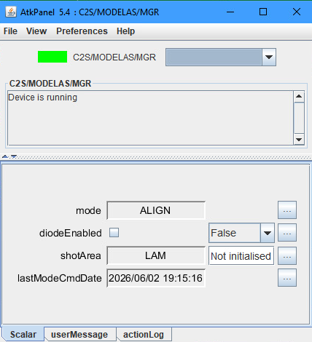
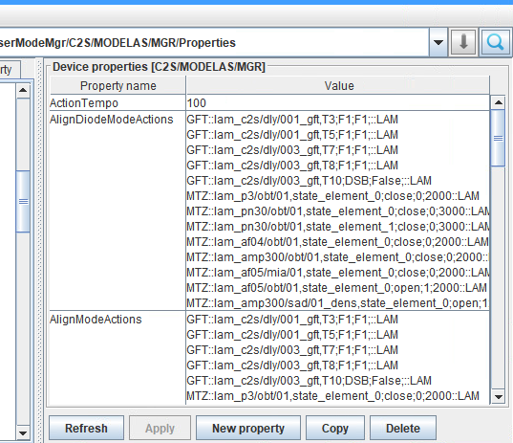
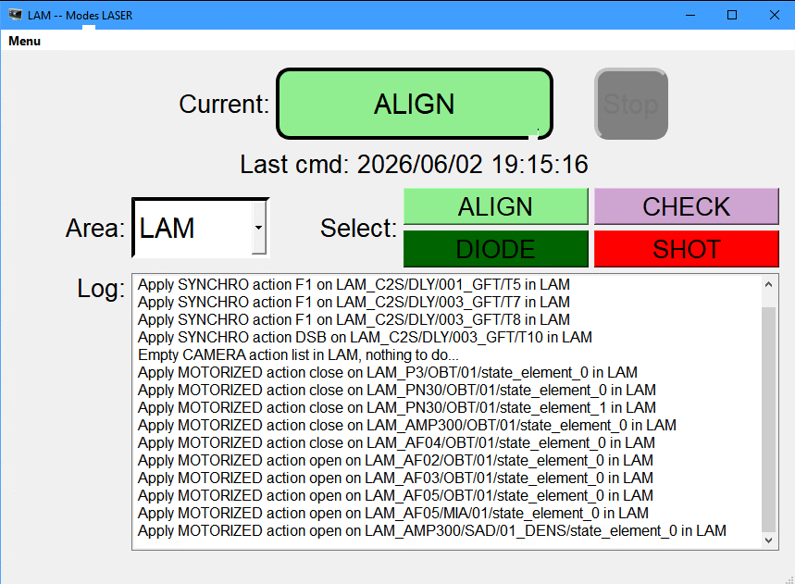
C2S/In 2026, season IV (VI, XXV?)
Command-Control & Supervision Status
DevLaserModeMgr: this ds implements the LASER mode management, i.e. provides an automatization of user actions on LASER configuration before & after shot.

Slide 6
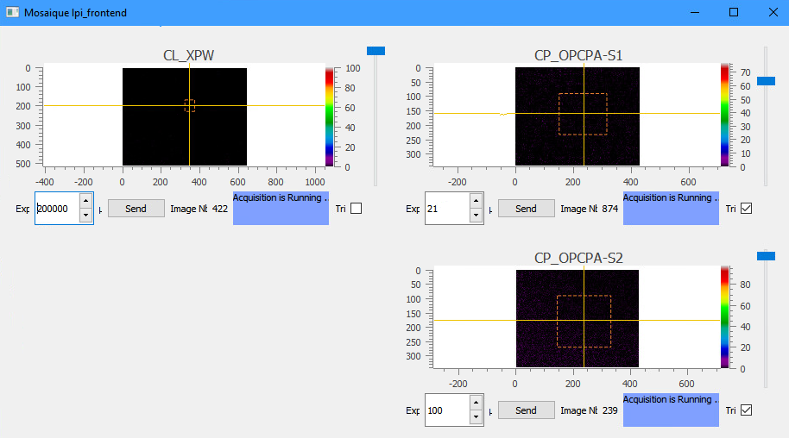
C2S/In 2026, season IV (VI, XXV?)
Command-Control & Supervision Status
DevHMIInterface: this ds provides an interface for external Devices to be easily integrated in Apollon monitoring HMIs. Currently: THALES pilot diags (cameras, energymeters, spectrometers) and motors (PolluxMotors), AMPLITUDE ELITE diags (cameras and energymeters), SOLEIL USB spectrometer, IP cameras.

Slide 7
C2S/In 2026, season IV (VI, XXV?)
Command-Control & Supervision Status
LULI2000:
14 campaigns, 20% with Tango
Hera:
6 campaigns, 90% with Tango

Slide 8
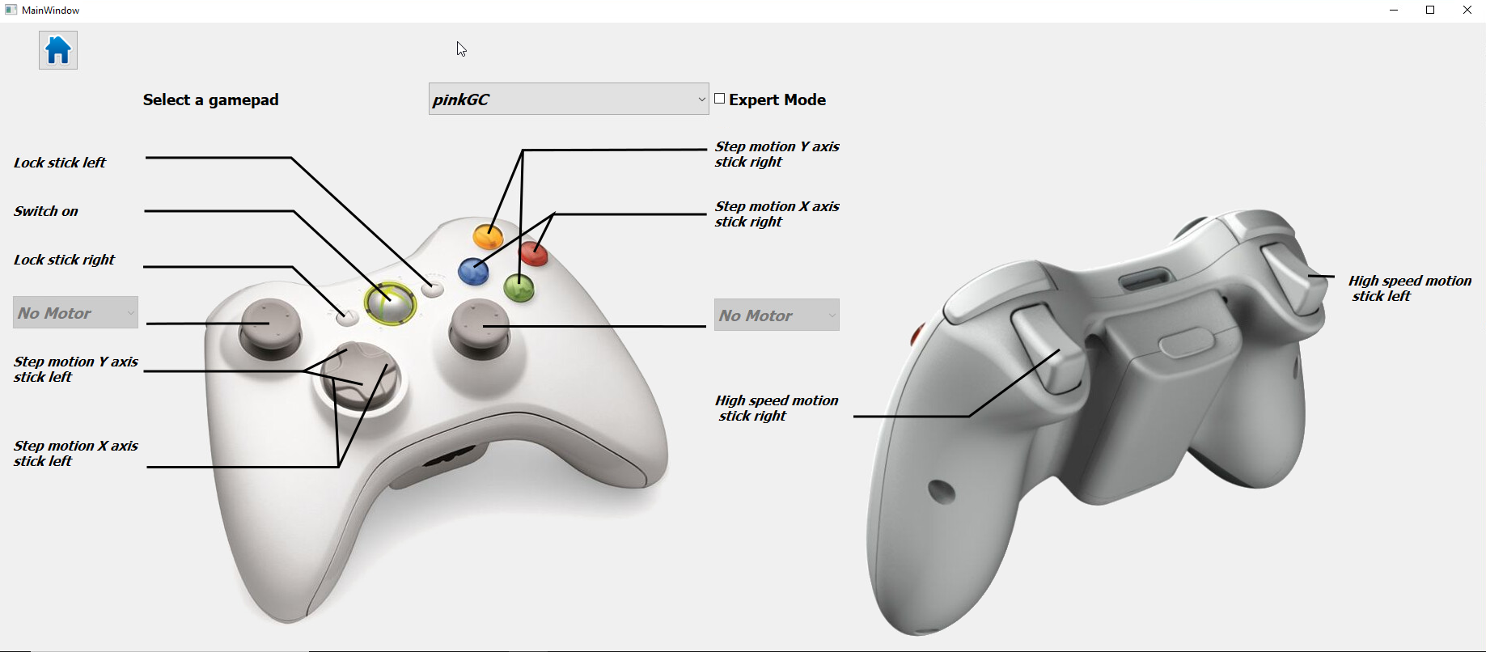
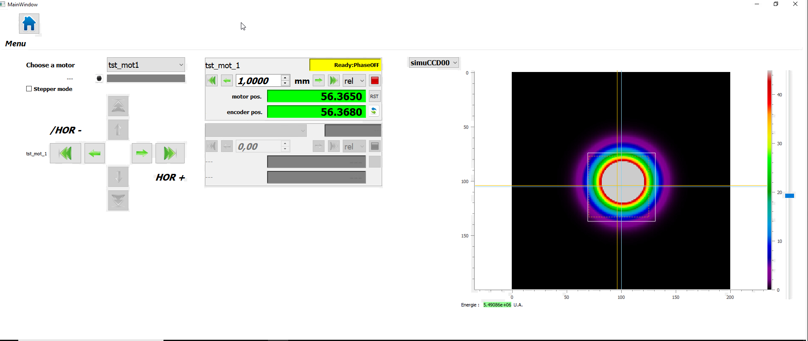
C2S/In 2026, season IV (VI, XXV?)
Command-Control & Supervision Status
A new GUI which provides an interface to configure the gamepads used to easily move the Target Holder.

Slide 9
Thank You!

