Slide 1
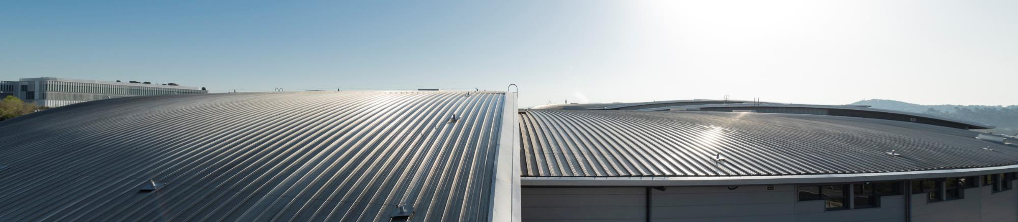
Practical Information
Zbigniew Reszela on behalf of Organizing Committees and ALBA Controls Section
40th Tango Community Meeting – 8-10/06/2026

Slide 2

WiFi
Check the reverse of your badge for the network and password.

Slide 3

Working agreement
This is a hybrid meeting.
The meeting is being recorded:
. The recording will be shared with the Tango Community.
. If you are not fine with that, please let me know.
Raise your (virtual) hand if you want to ask a question.
Respect timeboxes:
. Speakers – for talks duration.
. All – for the sessions start / end times.
Speakers – please upload your presentations well in advance.
Remote participants please stay muted.

Slide 4



Digital coordinates
Zoom Meeting:
https://rediris.zoom.us/j/94788236319?pwd=xTetInaahZaaFfqvezsFUk76UuOJ5N.1
Meeting ID: 947 8823 6319
Passcode: 760147
Indico:
https://indico.tango-controls.org/event/737/
Mattermost:
https://mattermost.hzdr.de/tango-controls/channels/40th-tango-meeting-2026
More details on: https://www.tango-controls.org/community/mattermost/

Slide 5


Breaks and Food
Please check the timetable for the breaks schedule.
Both coffee break and lunch are served in the Tents area (outside).
We move to the Tents area via the back door.

Slide 6
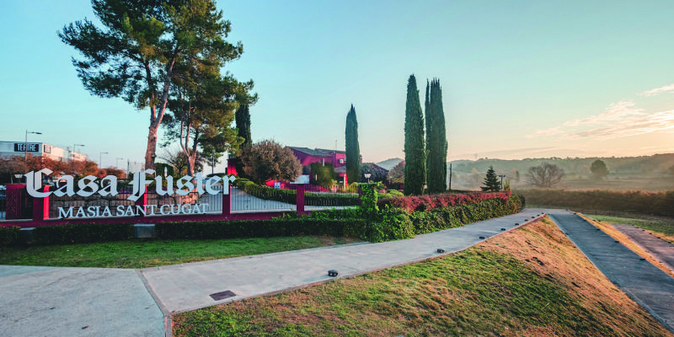
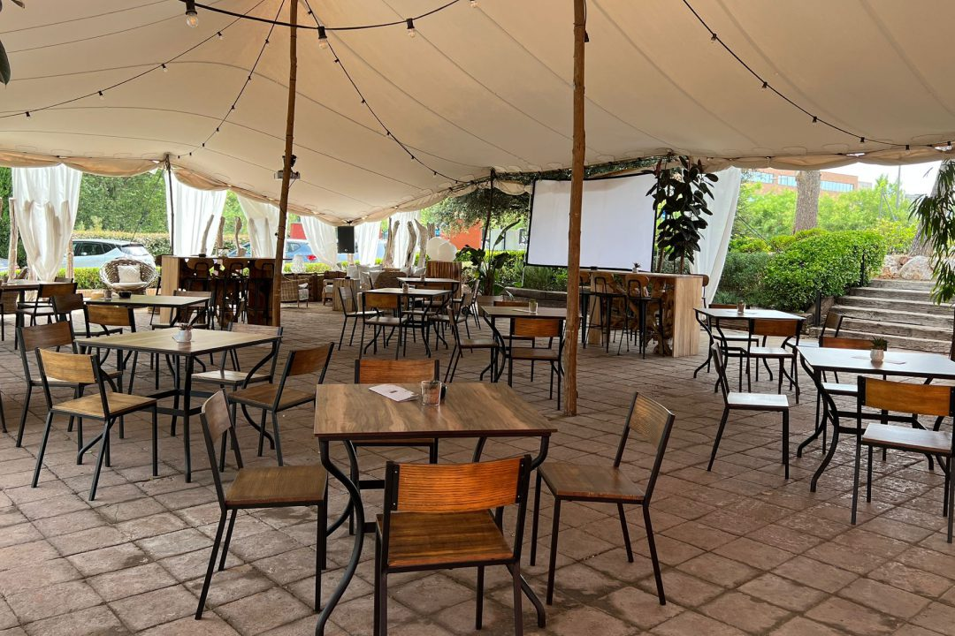
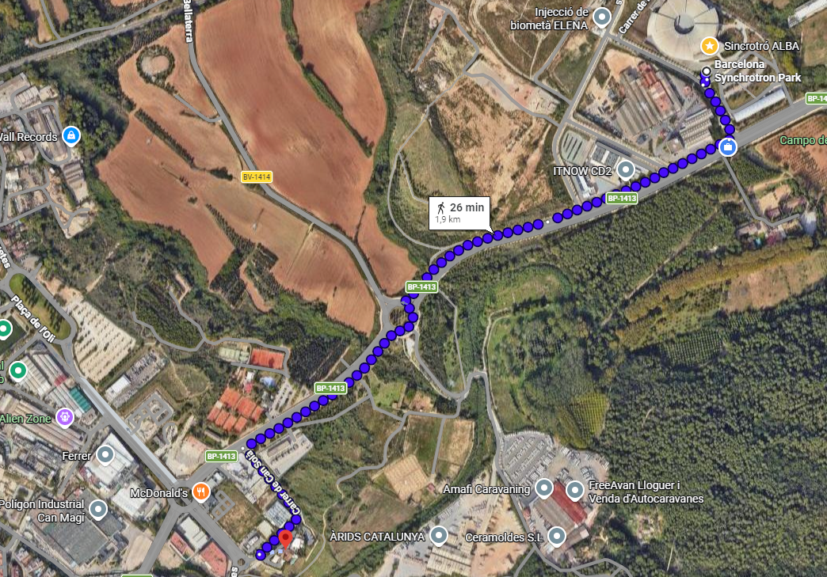
Social Dinner
On Tuesday at 20:00.
In the Masia Casa Fuster.
Please check your registration
in Indico and let me know of any changes.
There is no transportation provided. The walking distance is 26 min from ALBA, and we would like to propose a social walk to the restaurant from ALBA. Leaving at 19:30.
Some colleagues from ALBA can offer a ride if necessary.

Slide 7
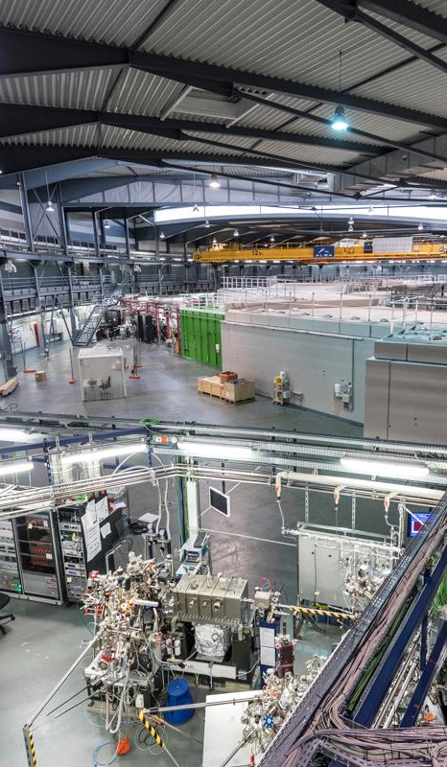
Visit to ALBA
On Wednesday at 14:30.
We will be organized in two groups.
The visit should not take more than 1h – 1h 15 min.
The visit will be coordinated by Fulvio Becheri (ALBA).

Slide 8
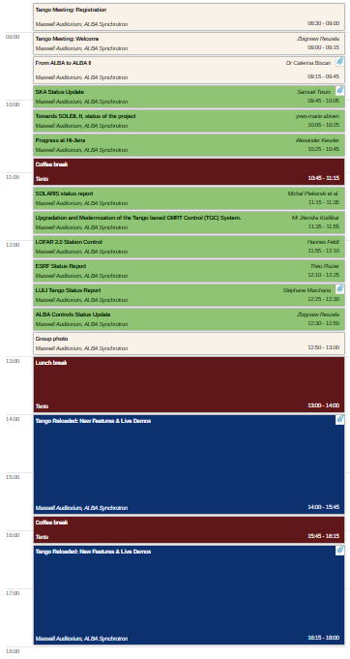
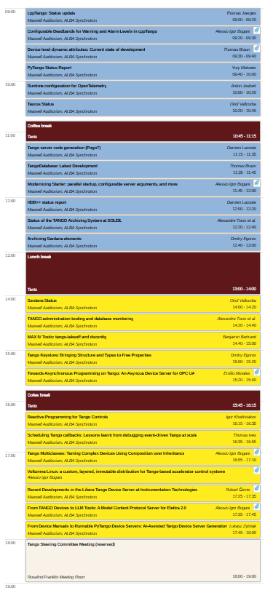
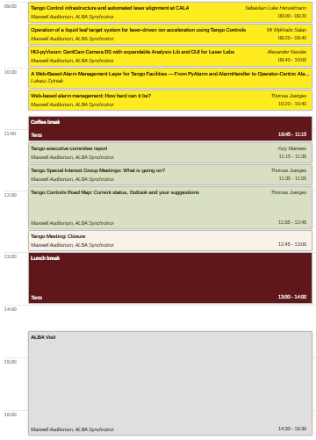
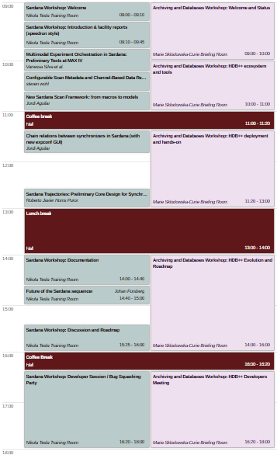
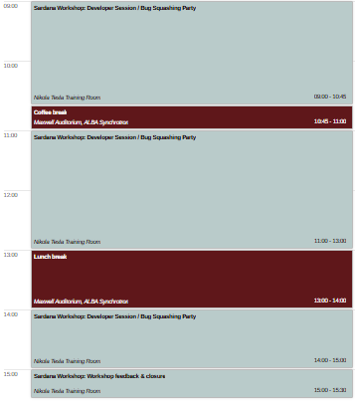
Program
Monday
Tuesday
Wednesday
Thursday
Friday
Workshops
Live Demos
Visit
Dinner

