Slide 1
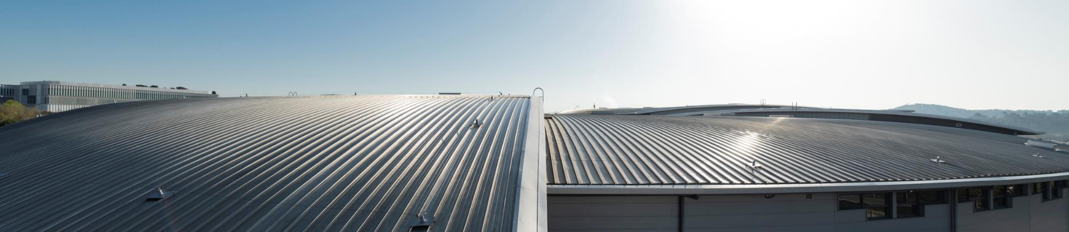
Welcome to 40th Tango Community Meeting
Zbigniew Reszela on behalf of Organizing Committees and ALBA Controls Section
40th Tango Community Meeting – 8-10/06/2026

Slide 2

Welcome
Community!
Notes:
It is a great pleasure to welcome all of you to the 40th Tango Community meeting, both those being here in person and those connecting remotely from different institutions and locations around the world.
My name is Zbigniew Reszela, and I am the Controls Section Head. Before starting, I would also like to acknowledge and introduce the ALBA Synchrotron director – Caterina Biscari, and the Computing Division head – Oscar Matilla, who continue to support the Tango project from the ALBA Management level.
Thank you all for taking the time to participate in this meeting. We know that everyone has demanding schedules, so your presence here today reflects the importance of Tango project, the topics we will discuss, and the value of working together as a community.

Slide 3
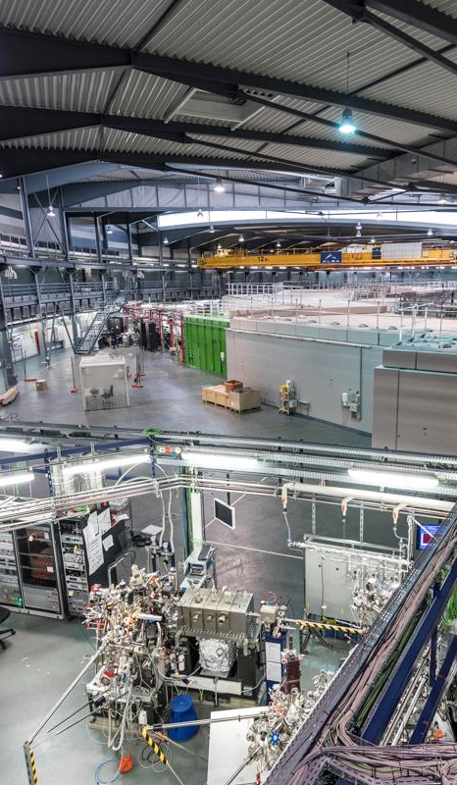
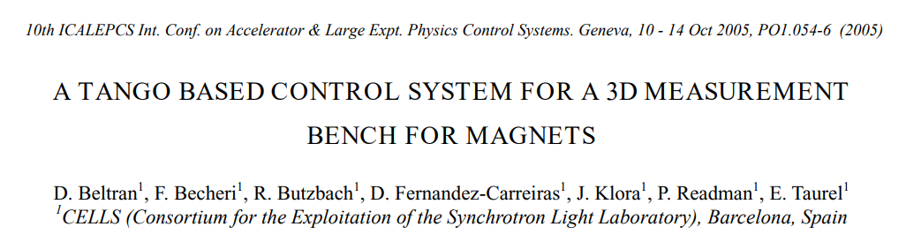
History of TANGO at ALBA
2004 – ALBA Control System will be built with TANGO.
2005 – First ALBA ICALEPCS paper about TANGO:
2010 – ALBA signed the TANGO MoU.
2016 – ALBA signed the Tango Controls Collaboration Agreement.
TANGO is the corner stone of the ALBA Control System.
Notes:
I would like to review with you some key events for the ALBA Control Systems.
First, in 2004 a decision was made to use TANGO in the ALBA project.
Just one year later, in 2005, ALBA presented the first contribution to the ICALEPCS conference on TANGO, it was about the development of the magnetic measurement bench for characterization of ALBA magnets. We have here with us one of the authors of this contribution – Fulvio Becheri.
Second, in 2010, ALBA has signed the TANGO MoU.
Third, in 2016, ALBA has signed the Tango Controls Collaboration Agreement.
This trajectory only confirms the fact that TANGO is the corner stone of the ALBA Control System.

Slide 4
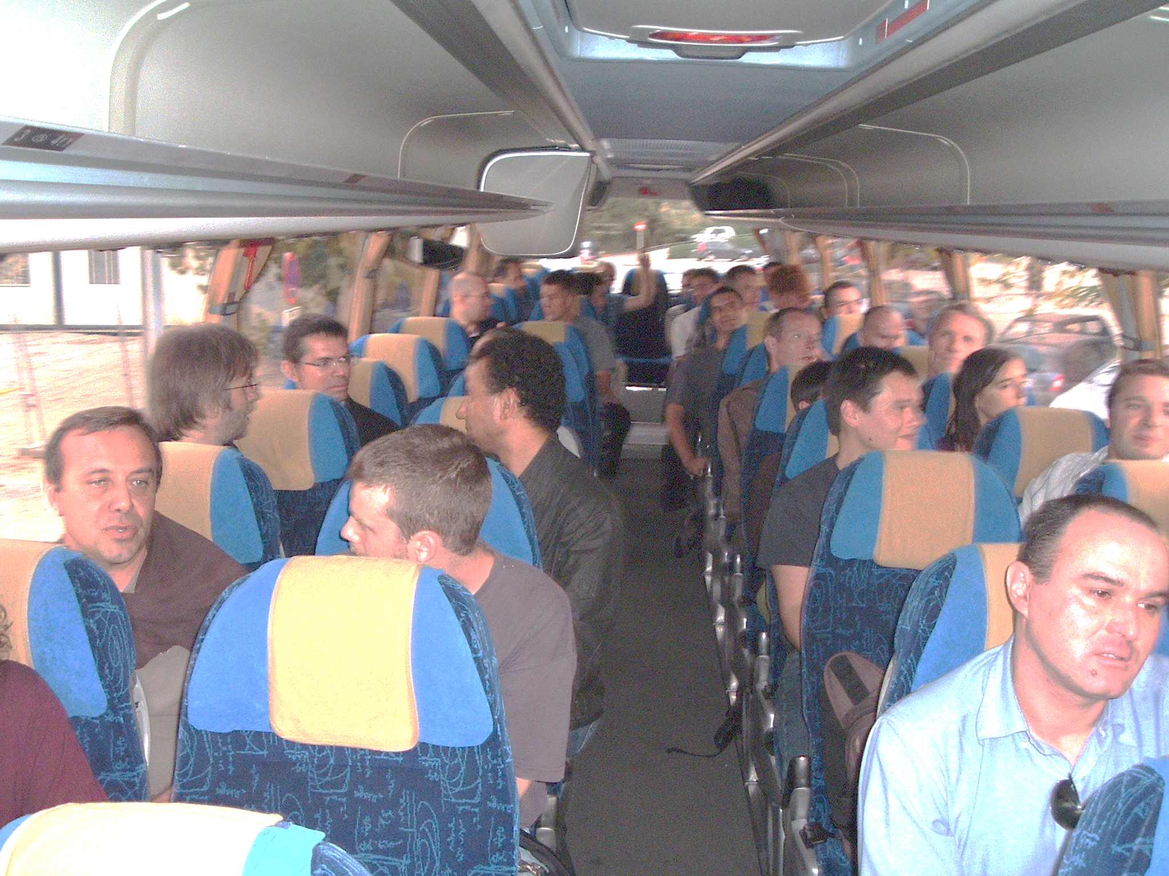
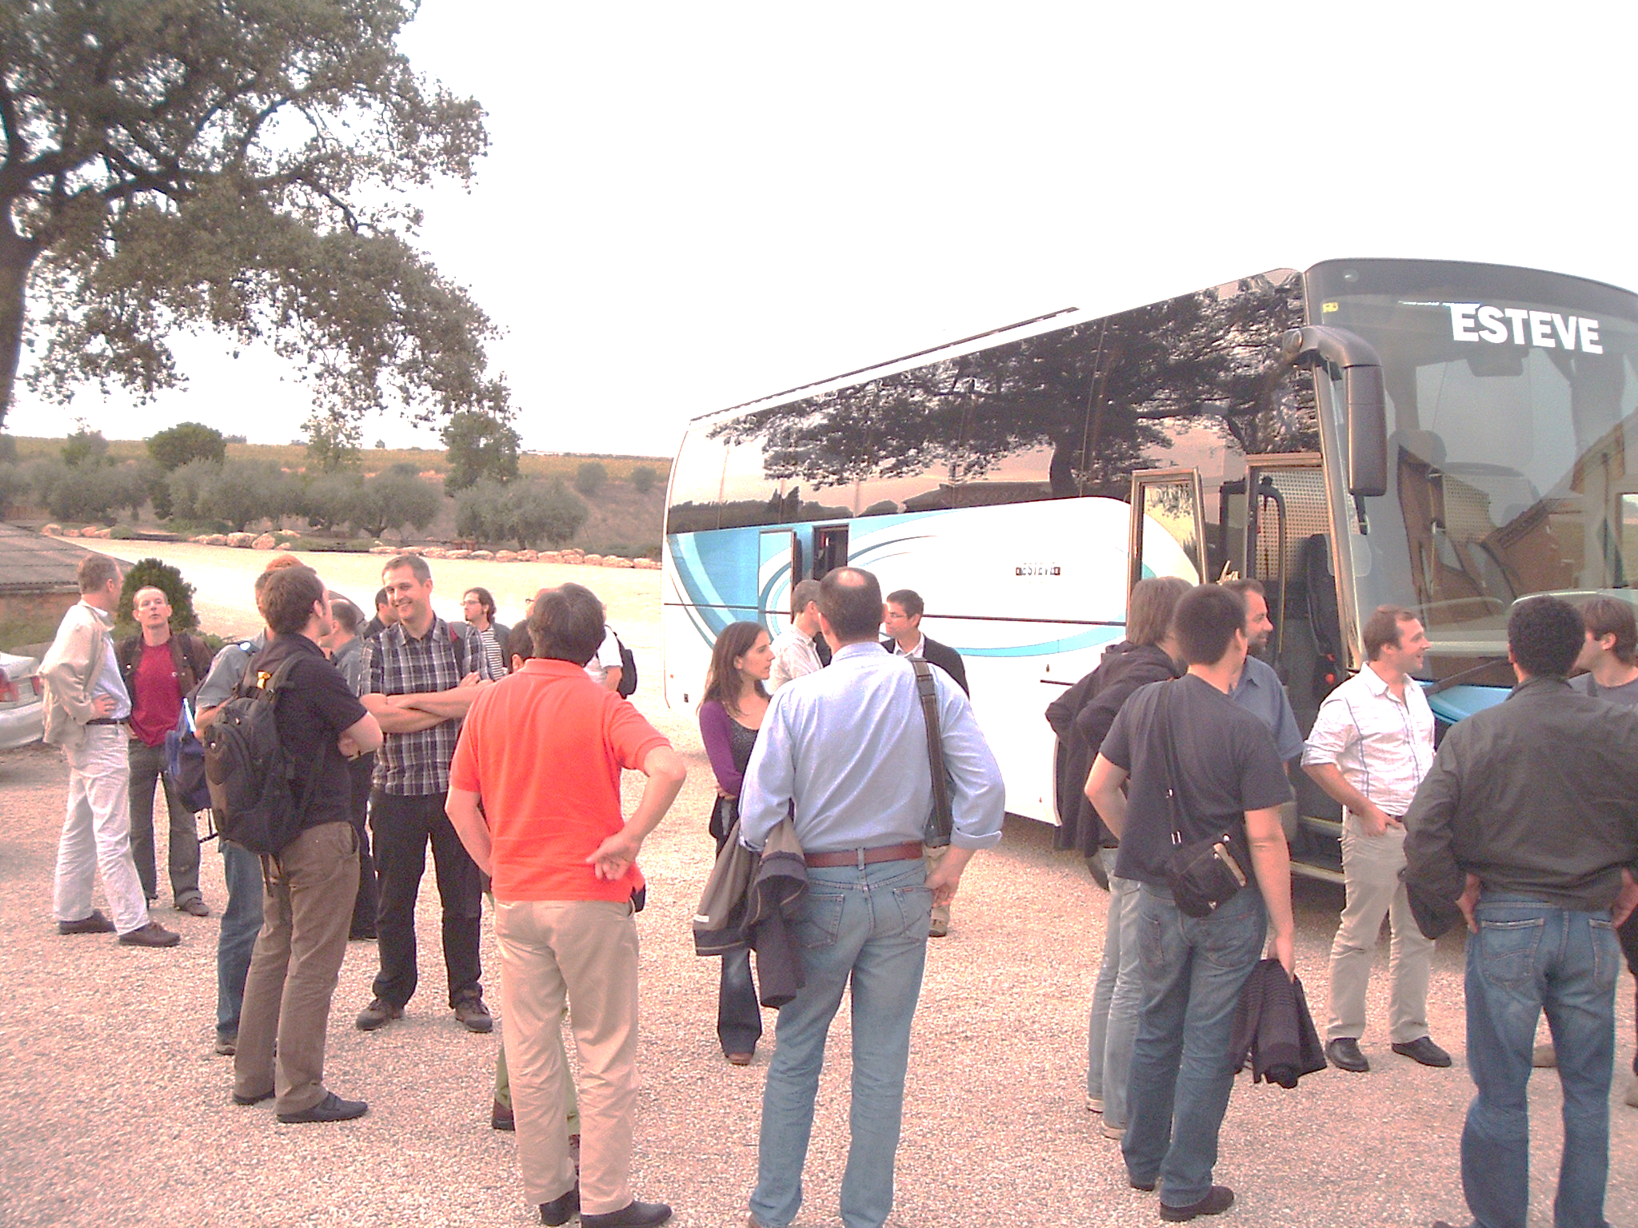
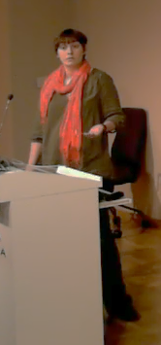
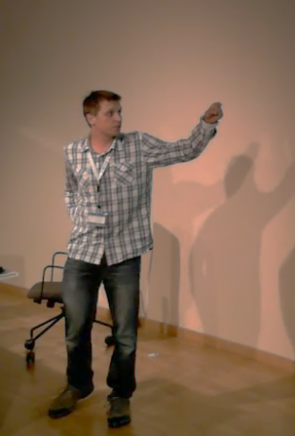
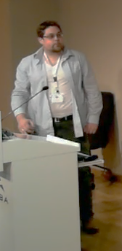
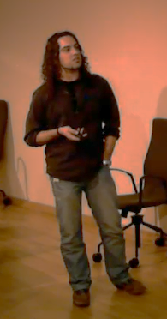
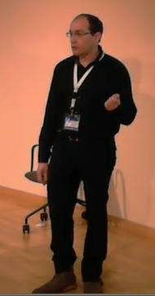
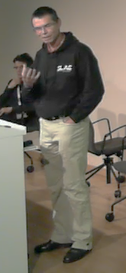
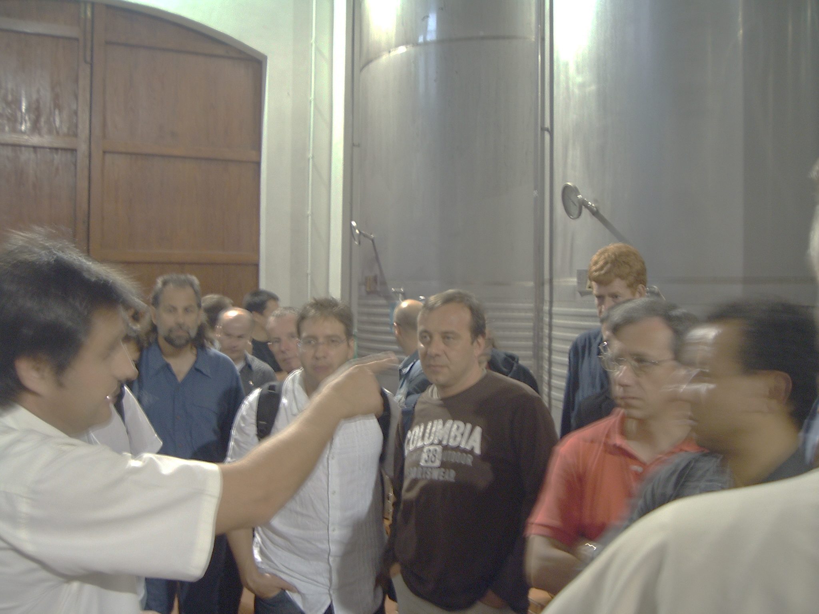
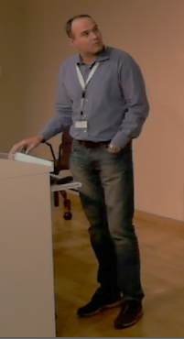
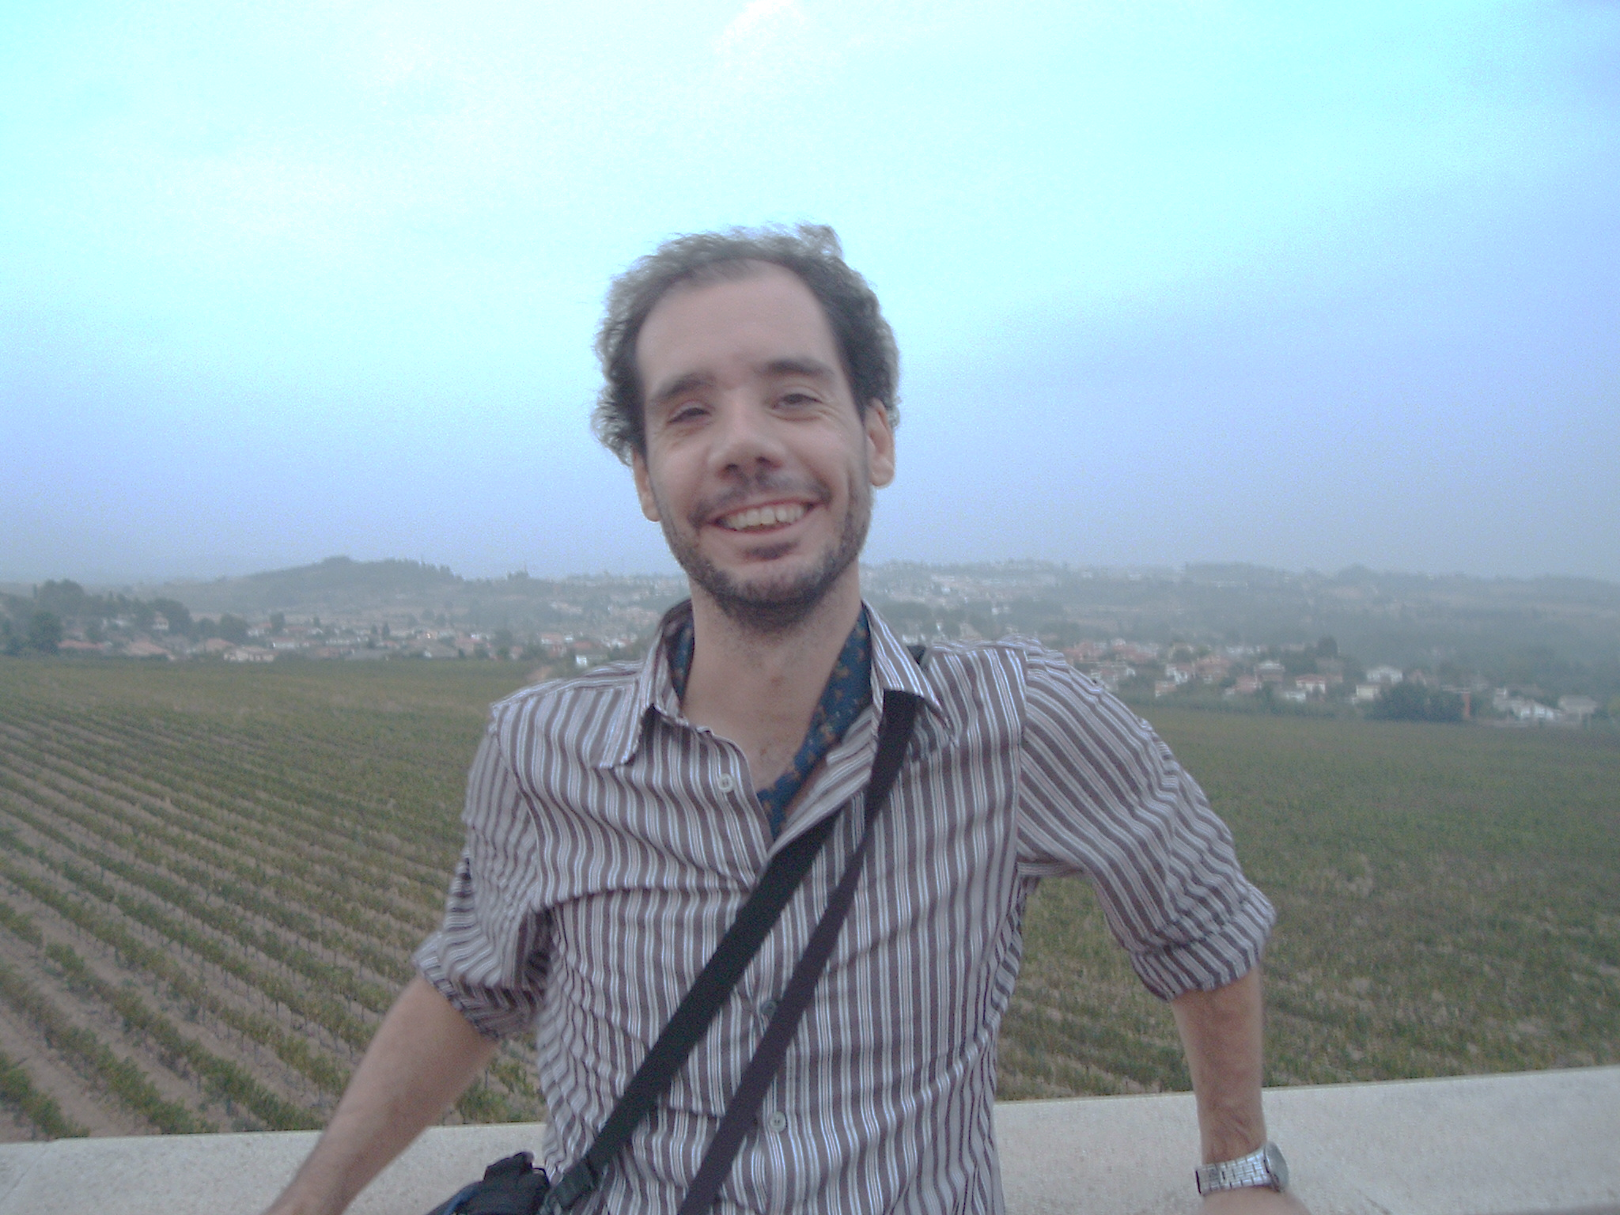
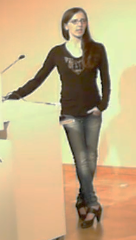
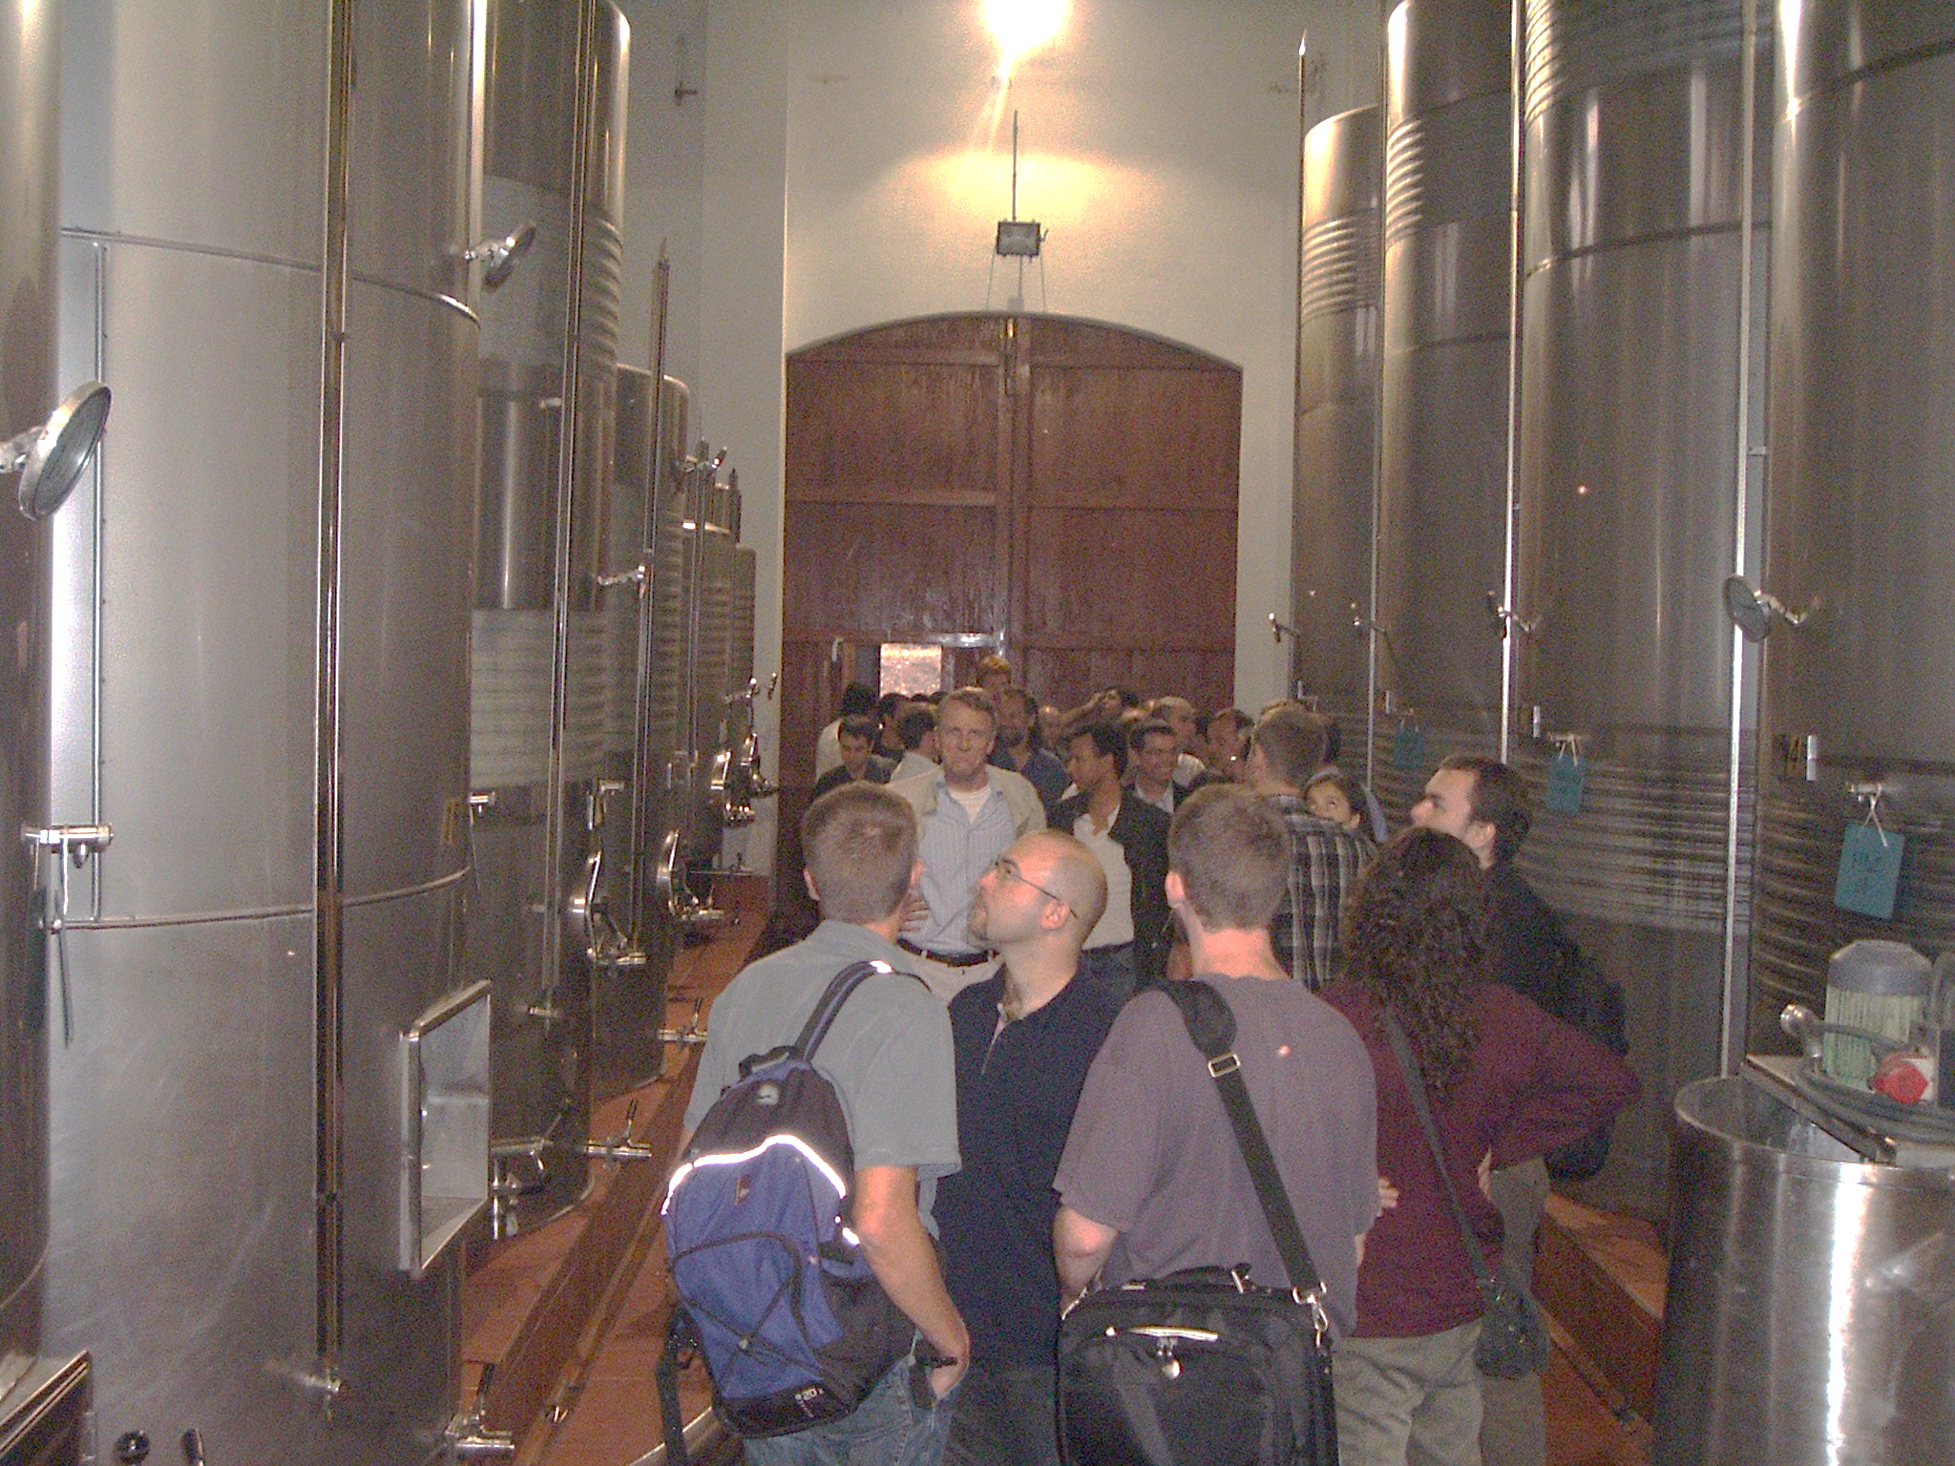
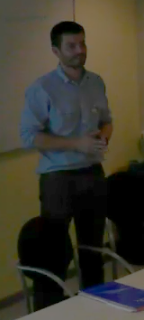
This is not the first Tango Meeting at ALBA…
2013
2008
Notes:
This is not the first Tango Meeting we have organized. But is actually the third one, the two previous ones took place in 2008 and 2013.
When reviewing our archives, I even found some photos from these events.
I could not resist from adding one small photo of me, just as a proof that there was one day I did not have a single grey hair on my head ☺
Looking at the photos of Lorenzo, Fulvio or Caterina, we can observe an interesting pattern. They barely get affected by the passing time. There must be something special with the Italian genes ☺

Slide 5
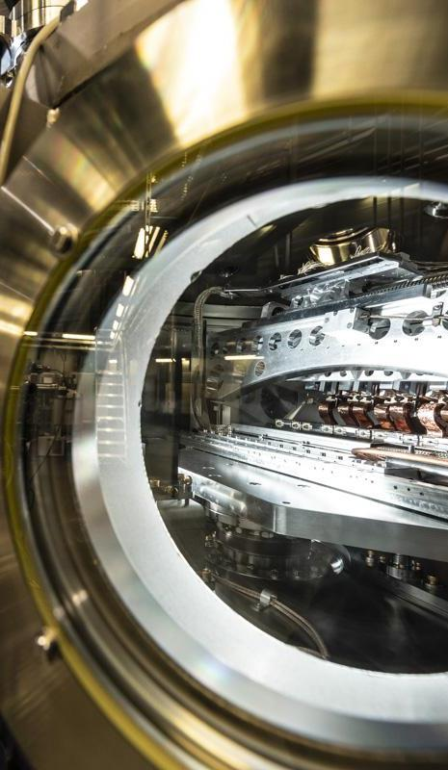
TANGO Collaboration
TANGO core values are collaboration and sharing, these allow us to:
Learn from each other's successes and challenges.
Identify common needs and opportunities.
Avoid duplicating efforts.
Develop more efficient and sustainable solutions.
I hope this meeting will enable these interactions and will strengthen relationships between our institutes.
Notes:
Since its beginning of TANGO its core values are collaboration and sharing.
These allow us to:
Learn from each other's successes and challenges.
Identify common needs and opportunities.
Avoid duplicating efforts.
Develop more efficient and sustainable solutions.
I hope this meeting will be an excellent platform for these interactions and will strengthen relationships between our institutes.

Slide 6
Wishing you fruitful 40th Tango Community Meeting!
Notes:
I encourage everyone, whether participating onsite or remotely, to actively participate in the discussions, ask questions, share experiences, and take advantage of the opportunity to connect with colleagues from other facilities.

