Slide 1


Slide 2

SOLARIS Status Update
Cerdanyola del Vallès, 40th Tango Community Meeting, 8-12.06.2026
Michał Piekarski, Urszula Jachymczyk, SOLARIS CSIT Team
SOLARIS National Synchrotron Radiation Centre

Slide 3

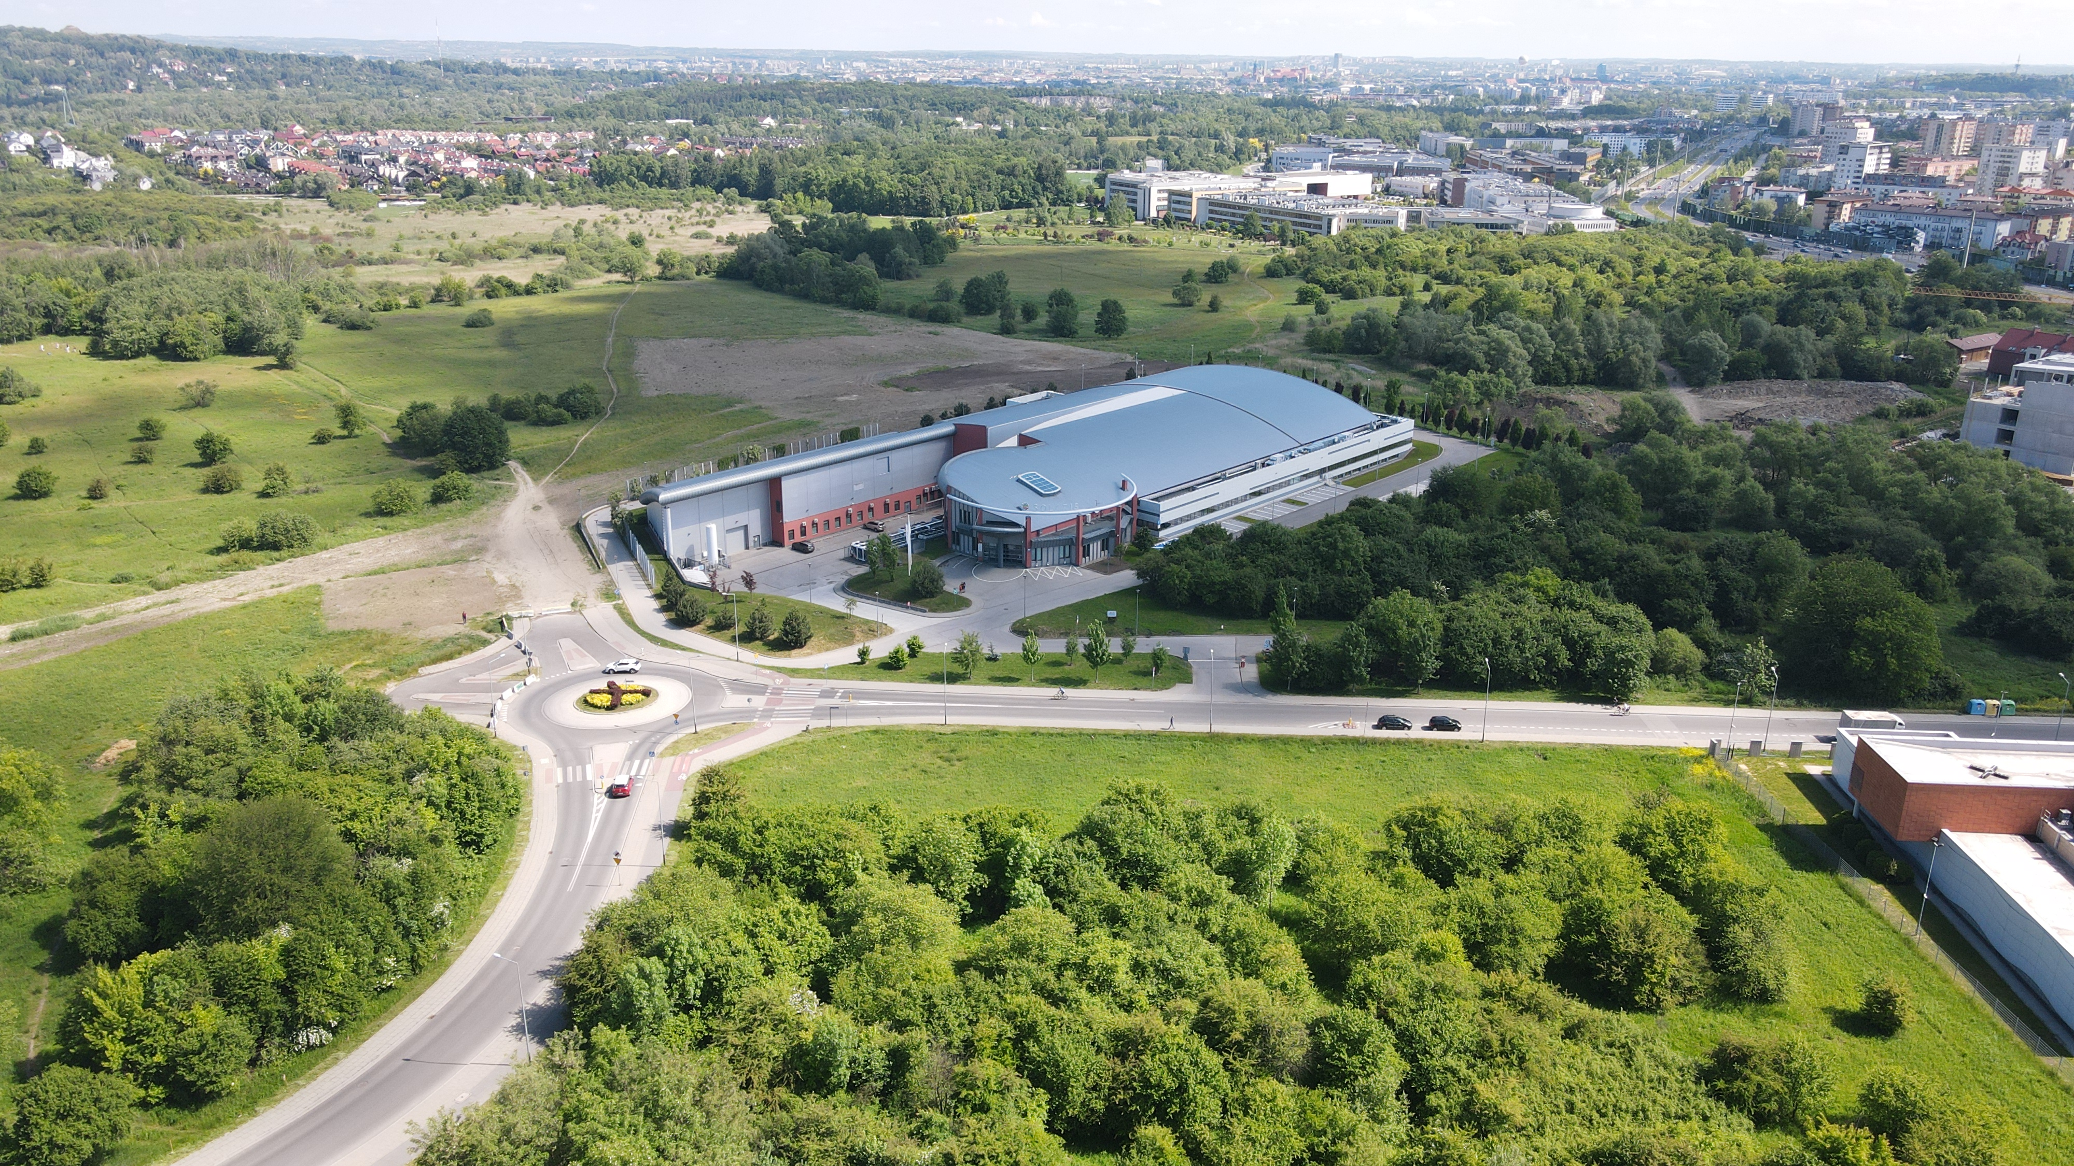
NSRC SOLARIS
Jagiellonian University New Campus
Kraków City Center
SOLARIS
Fot. Aleksander Koczur

Slide 4
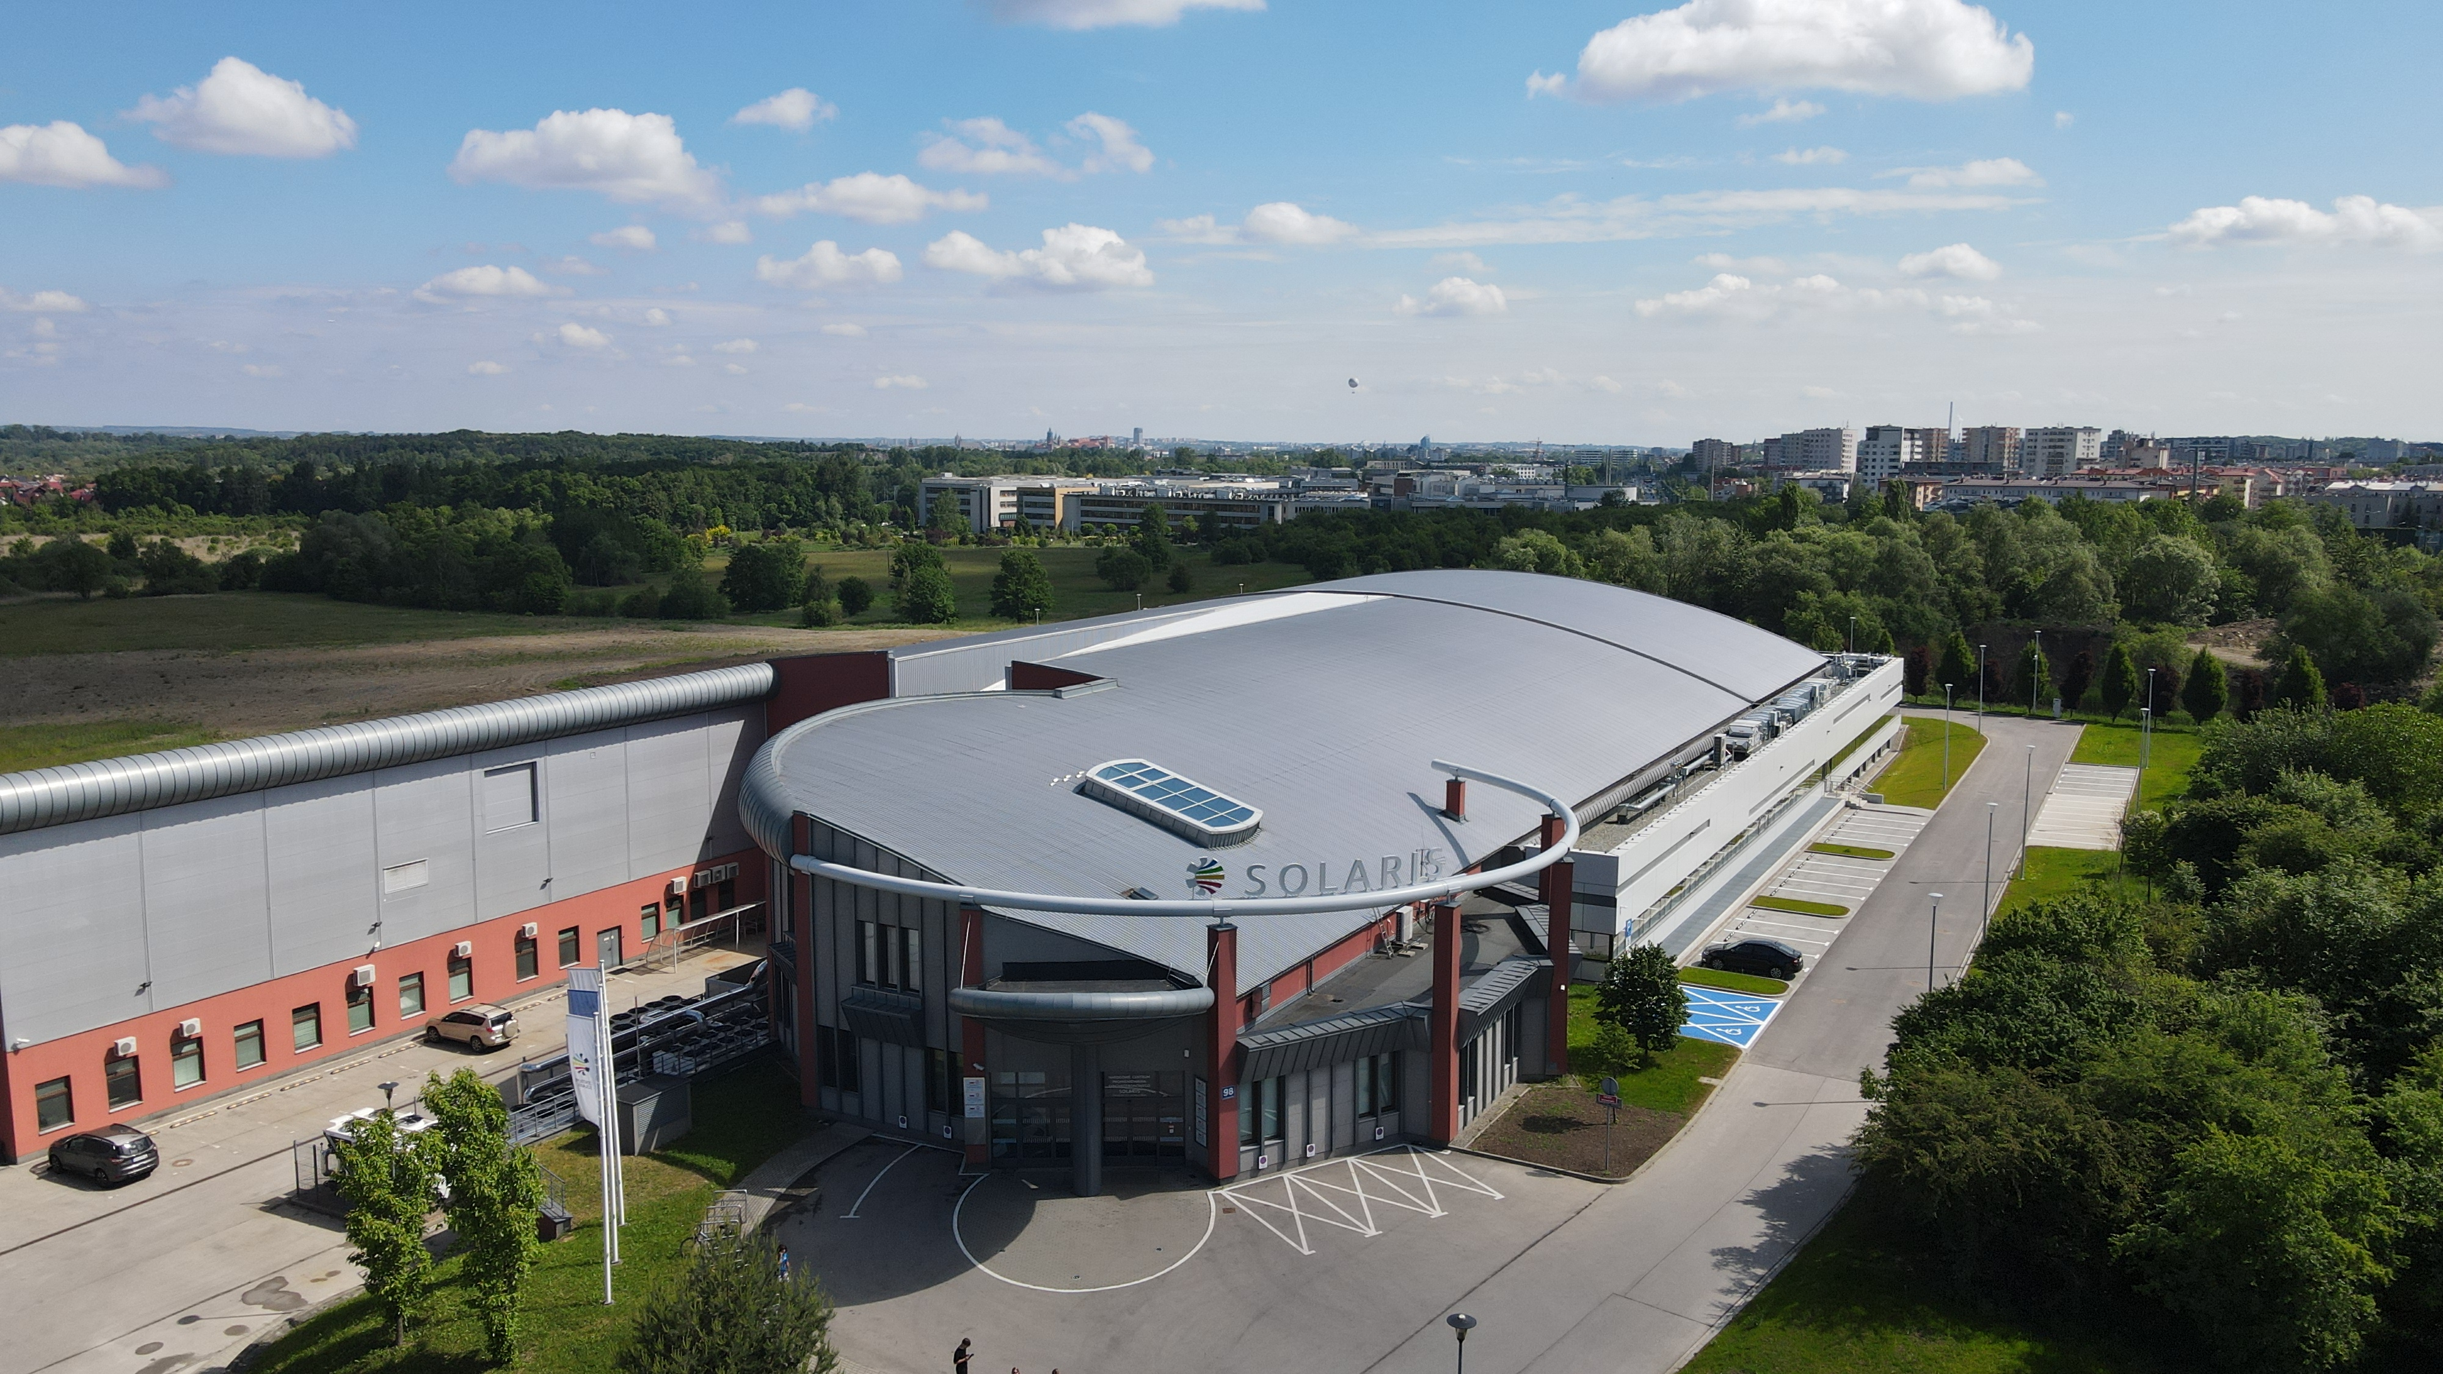
NSRC SOLARIS
Third generation light source.
Constructed 2010 - 2015 in Krakow, Poland.
Between 2015 and 2018 the synchrotron as well as two beamlines (PIRX and URANOS) were commissioned.
First light in May 2016
Since October 2018 Solaris has been in the user operation mode.

Slide 5

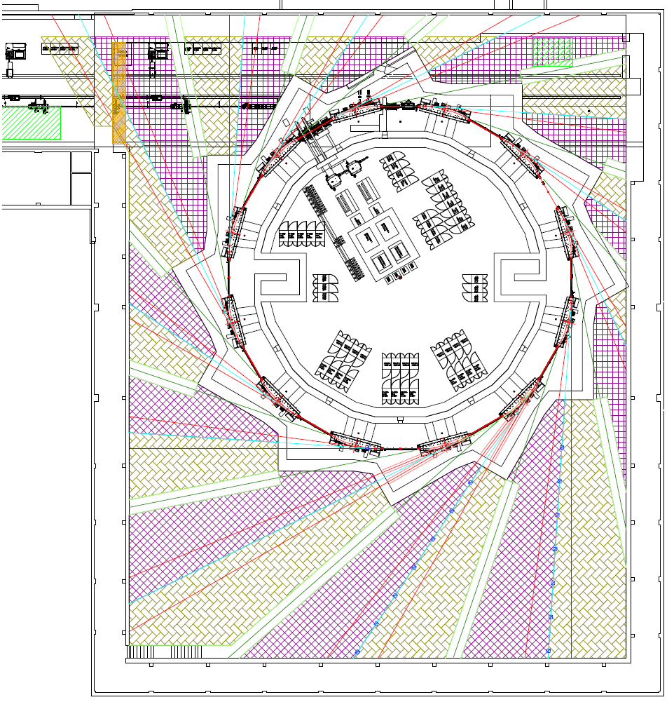


SOLARIS research infrastructure
Available and in user operation
POLYX
ASTRA
LUMOS
PINHOLE
Starting up
Under construction
Project application accepted
Available space for 4-5 beamlines
CIRI
MAVKA
+
CryoEm centre
Neutron-lab
SMAUG (SAXS)
Krios
OPERANDO-XAS
DEMETER
Glacios
ARYA
PHELIX
URANOS
NAP-XPS
PIRX
STXM
PEEM
jakub.szlachetko@uj.edu.pl

Slide 6
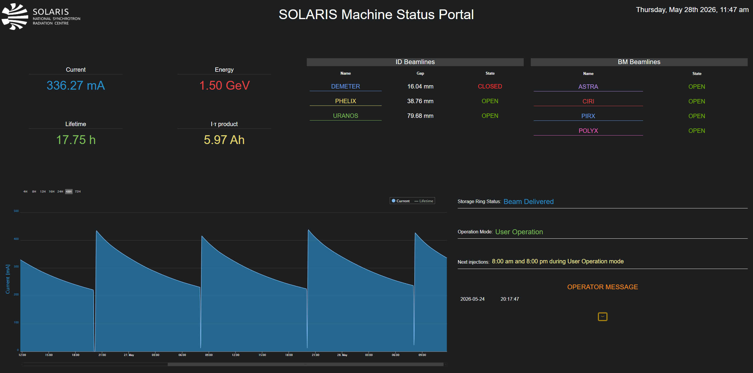
SOLARIS Operation
Operation in the decay mode
Injection twice/day: 8:00 am and 8 pm
Monday – machine days, maintenance
User operation 6 days/week (Tue-Sun)
One operation mode (uniform filling pattern)
Singe bunch operation mode under development

Slide 7

2026

Slide 8
SOLARIS CSIT Department today
24 people in CSIT
  8 Control Systems,
  7 IT
    3 pure IT/helpdesk,
    1 infra admin,
    1 cyber-security + networks,
    2 DevOps,
  7 Web-SUN / CS

Slide 9
Control System upgrade – achievements so far and goal for 2026
AWX/Ansible updated to the latest version (Execution Enviroments) and moved to the Kubernetes cluster
Prepared CI/CD to support two OS (el9 and el10) – for internal and external projects.
Main Tango packages and dependencies have been built (including Tango10/pyTango10)
All workstations in CR and on the beamlines are migrated to Alma 9
  MATE not yet officially available for AlmaLinux10
All of the GUIs migrated to at least Python 3.9 and Taurus 5 – even these in Python 2.7 and Taurus 3.7 version
All VMs on the beamlines migrated to Alma9
GOAL: Migrate all hosts to at least Alma 9 (some already to Alma10),
  Summer shutdown: machine VMs migration (27 VMs, ~100 projects)
    Alma10
    Tango10

Slide 10
Control System stack in NSRC SOLARIS: summary
OS: Alma 9 (mainly) and 10, Windows 10, 11 (mainly) + some embedded custom Linux
Python versions: 3.8 (some web), 3.9 (mainly) and 3.12
Tango versions: 9.3.6 (mainly), 9.2 (embedded) -> soon 10.3.0
Taurus versions: 5.1 (mainly), -> soon 5.4.0
Sardana versions: 3.6 only -> soon 3.7
Additionally, WEB projects use Vue.js, Tango GQL and Taranta
Cryomicroscopes are fully independent and are based on manufacturer software

Slide 11
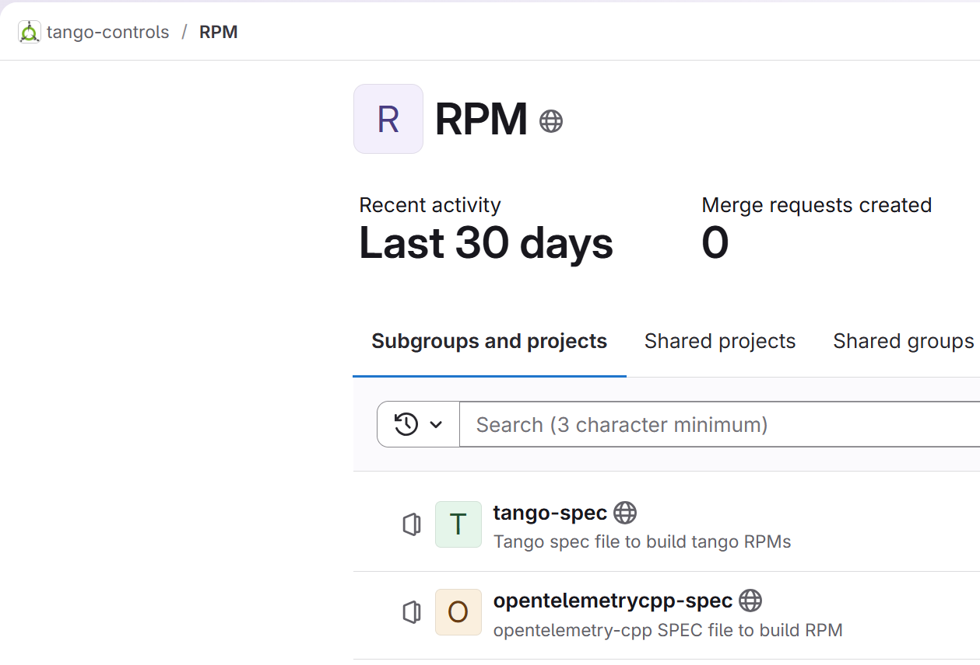
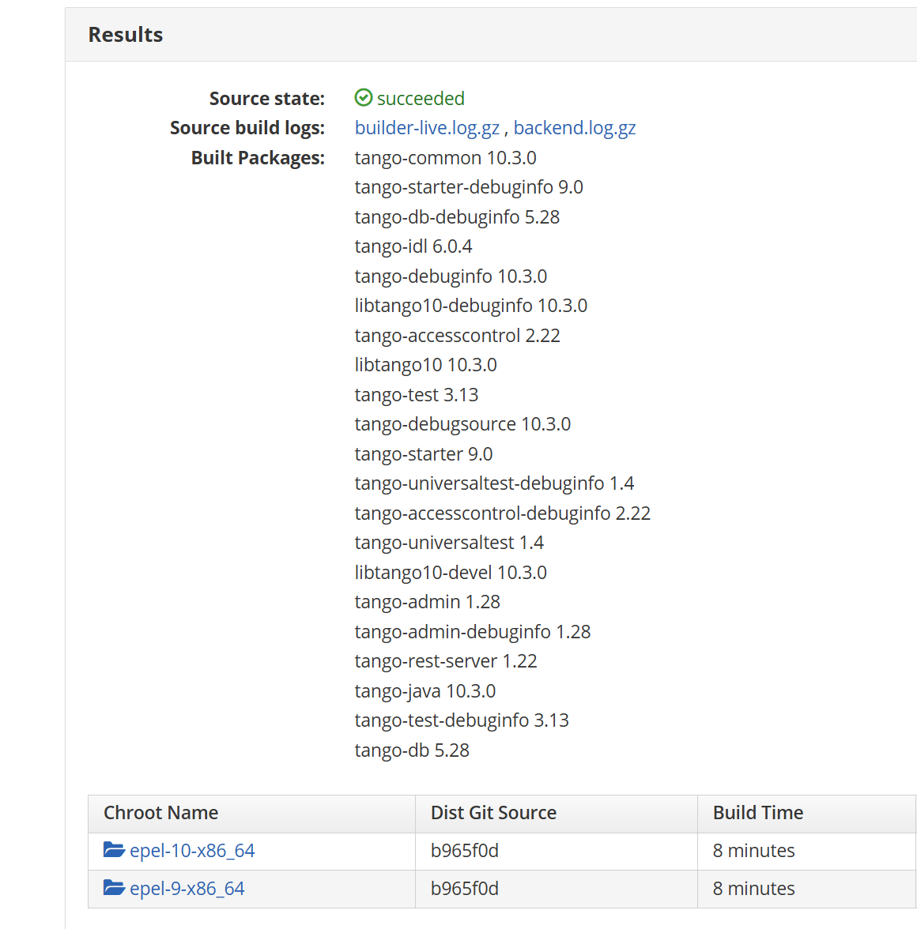


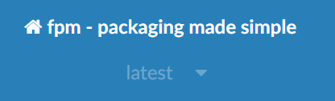
SOLARIS took over Tango RPMs
tricky (with build deps, toml…)
used FPM from wheel to create RPM

Slide 12
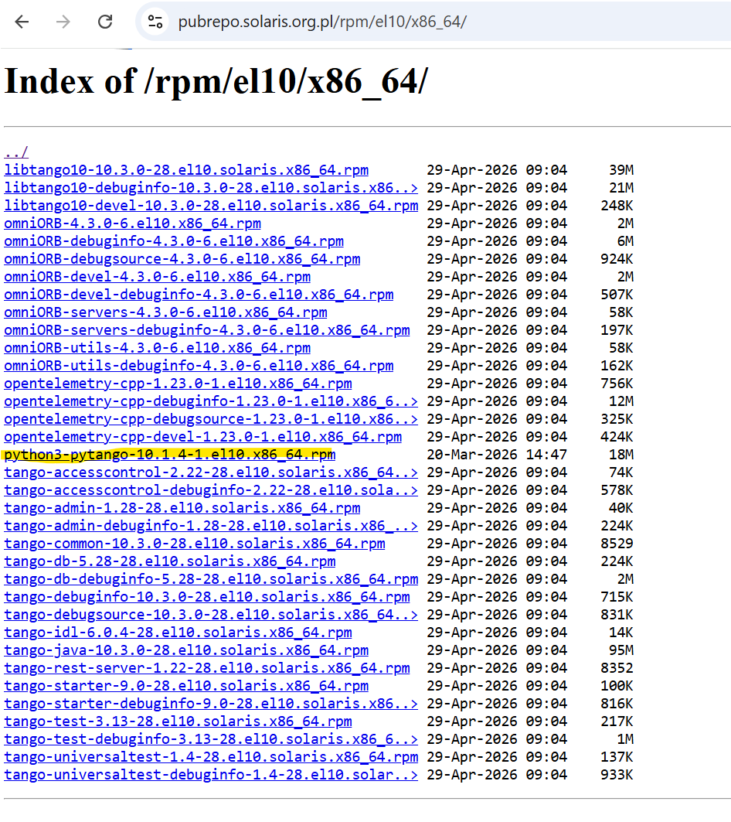
https://pubrepo.solaris.org.pl/rpm

Slide 13
Some new developments

Slide 14


Motors Snapshots Sardana toolset
What do we have so far?
Manages different positions profiles for motors,
Makes snaps and saves them in dedicated catalog,
Maintains snapshots' history for selected mode,
Displays data saved in snap,
Restores motors' config from chosen snap,
Deletes snap.
List & set profile
Notes:
We can manage positions of motors using specific profiles, that are predefined.
All snaps are saved in dedicated catalog as json (profile -> catalog -> snapshots), Format: id, creation date, motors and their params
History of snaps for modes.
Display data from snaps
And restore motors config from snaps
Delete snaps
Ciri profiles: FTIR, OPTIR, NANO-FTIR

Slide 15
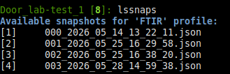
Motors Snapshots Sardana toolset
What do we have so far?
Manages different positions profiles for motors,
Makes snaps and saves them in dedicated catalog,
Maintains snapshots' history for selected mode,
Displays data saved in snap,
Restores motors' config from chosen snap,
Deletes snap.
List & set profile
Lists available snaps
Notes:
We can manage positions of motors using specific profiles, that are predefined.
All snaps are saved in dedicated catalog as json (profile -> catalog -> snapshots), Format: id, creation date, motors and their params
History of snaps for modes.
Display data from snaps
And restore motors config from snaps
Delete snaps
Ciri profiles: FTIR, OPTIR, NANO-FTIR

Slide 16
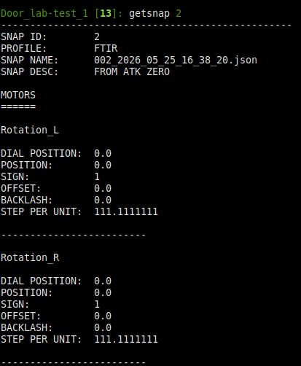
Motors Snapshots Sardana toolset
Display snap file content
What do we have so far?
Manages different positions profiles for motors,
Makes snaps and saves them in dedicated catalog,
Maintains snapshots' history for selected mode,
Displays data saved in snap,
Restores motors' config from chosen snap,
Deletes snap.
List & set profile
Lists available snaps
Notes:
We can manage positions of motors using specific profiles, that are predefined.
All snaps are saved in dedicated catalog as json (profile -> catalog -> snapshots), Format: id, creation date, motors and their params
History of snaps for modes.
Display data from snaps
And restore motors config from snaps
Delete snaps
Ciri profiles: FTIR, OPTIR, NANO-FTIR

Slide 17
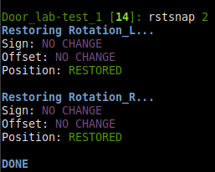
Motors Snapshots Sardana toolset
Display snap file content
What do we have so far?
Manages different positions profiles for motors,
Makes snaps and saves them in dedicated catalog,
Maintains snapshots' history for selected mode,
Displays data saved in snap,
Restores motors' config from chosen snap,
Deletes snap.
Lists available snaps
Restore motors config from snap
List & set profile
Notes:
We can manage positions of motors using specific profiles, that are predefined.
All snaps are saved in dedicated catalog as json (profile -> catalog -> snapshots), Format: id, creation date, motors and their params
History of snaps for modes.
Display data from snaps
And restore motors config from snaps
Delete snaps
Ciri profiles: FTIR, OPTIR, NANO-FTIR

Slide 18
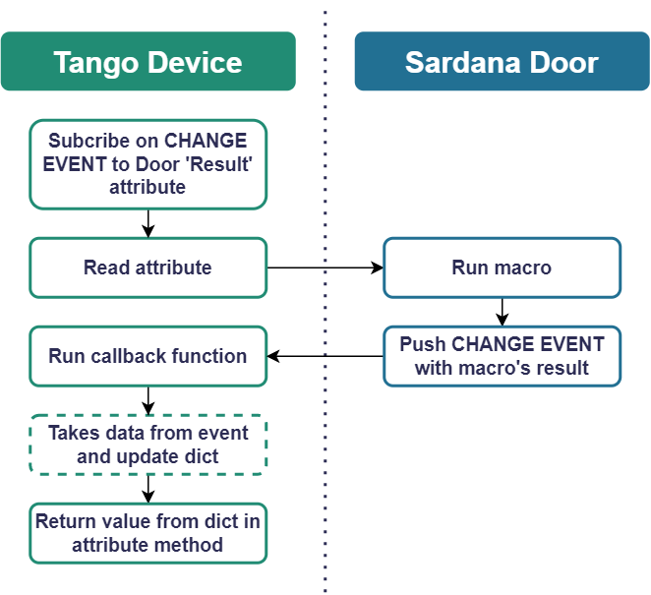
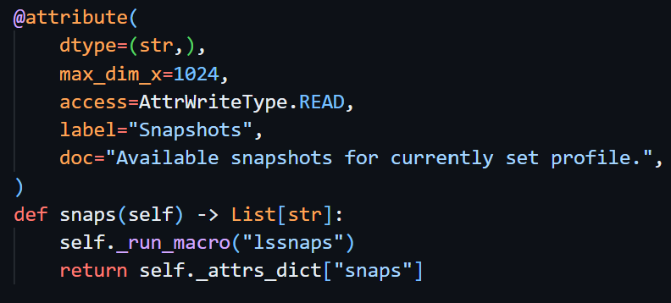
Motors Snapshots Sardana toolset
Workflow details
We are working on:
Logic layer (Tango Device) which implements Attributes and Commands
based on Macro's result,
  Basic attributes – DONE
  Basic commands – DONE
  Command that takes more complex input parameters – IN PROGRESS
GUI build on top of logic layer (tango device) – IN PROGRESS
Attribute 'snaps' - implementation example
Notes:
Now macros are called from spock. In future: combine functionality and add GUI.
Macros are called using door, where is Results – attribute that updates depending on what macro returns and how it executes. It can e.g. return the list of profiles.
Tango device subscribes to change event "Results",
Tango Device calls macro which causes Results to change (push change event)
In callback function the value of event is read and the attribute in Tango Device updated based on that.
QA:
Why not facade -> troubles with local attributes so it is done in DS and events are pushed for future GUI.
It works for macros using single parameter, problem with using more parameters

Slide 19

Banana Collision
config.json
motors_proxy
axes + default ranges
rules
pair_range
pair_function_range
corridor
circle
Notes:
Config is validated. Now only 2 shapes supported.
The movement path can be configured – but doesn’t have to.
Collision logic is being executed by façade (checking for collision, updating allowed ranges) and controller – realising path movement when direct movement is not possible.
All ranges have to be defined in config in dial position.
End stations that need prevention form collision: Ciri, …, ...

Slide 20
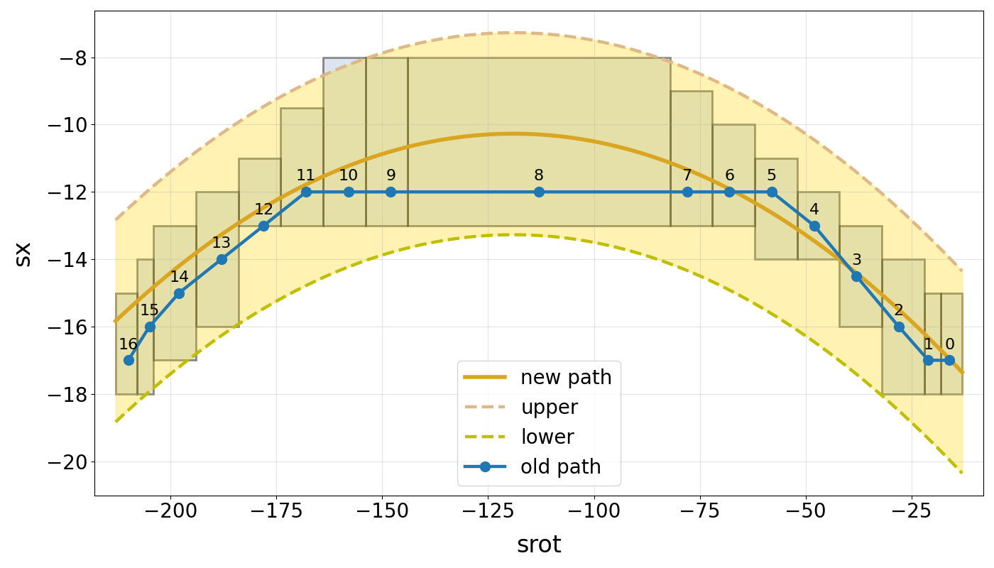
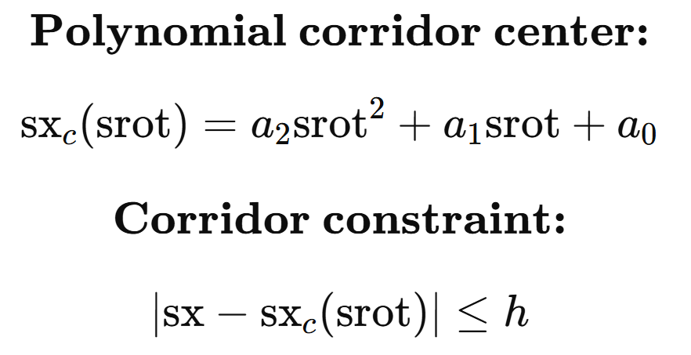
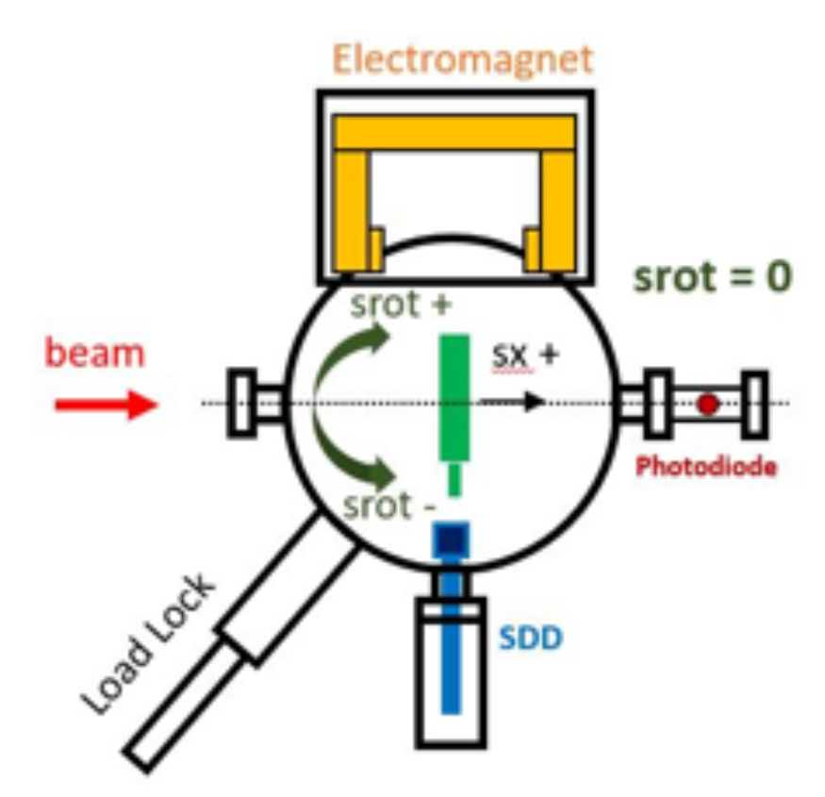
Banana Collision
config.json
motors_proxy
axes + default ranges
rules
pair_range
pair_function_range
corridor
circle
Notes:
Config is validated. Now only 2 shapes supported.
The movement path can be configured – but doesn’t have to.
Collision logic is being executed by façade (checking for collision, updating allowed ranges) and controller – realising path movement when direct movement is not possible.
All ranges have to be defined in config in dial position.
End stations that need prevention form collision: Ciri, …, ...

Slide 21
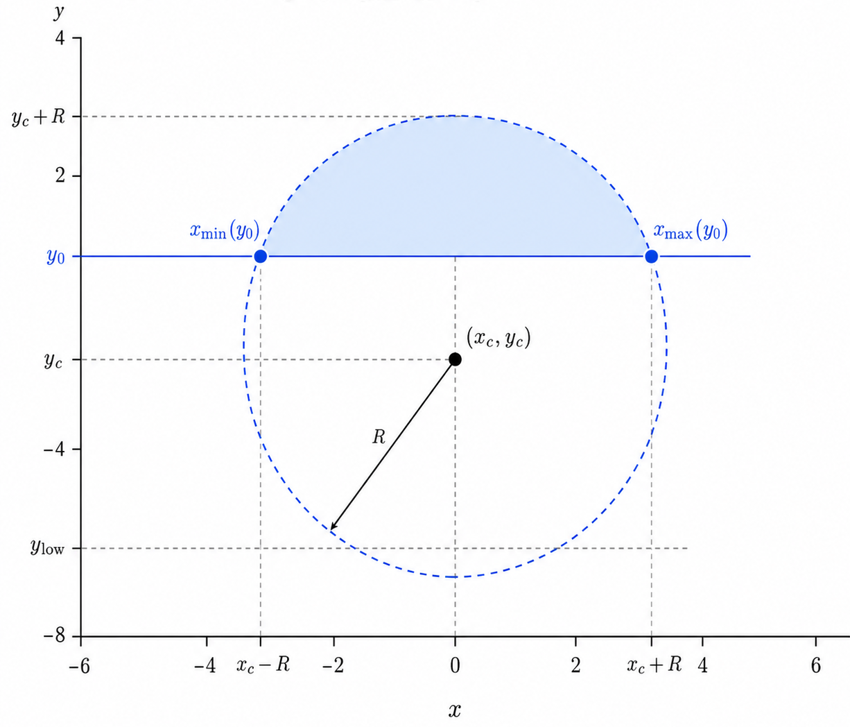
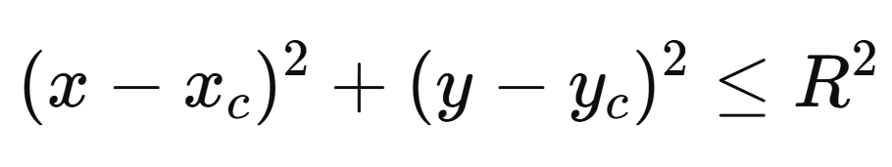
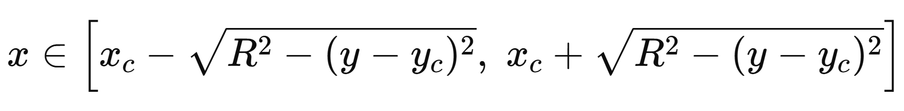
Banana Collision
config.json
motors_proxy
axes + default ranges
rules
pair_range
pair_function_range
corridor
circle
Circle equation:
Circle constrains:
Notes:
Config is validated. Now only 2 shapes supported.
The movement path can be configured – but doesn’t have to.
Collision logic is being executed by façade (checking for collision, updating allowed ranges) and controller – realising path movement when direct movement is not possible.
All ranges have to be defined in config in dial position.
End stations that need prevention form collision: Ciri, …, ...

Slide 22
Banana Collision
config.json
motors_proxy
axes + default ranges
rules
pair_range
pair_function_range
corridor
circle
Circle equation:
Circle constrains:
Function limits work both ways:
Sx Srot
x y
Notes:
Config is validated. Now only 2 shapes supported.
The movement path can be configured – but doesn’t have to.
Collision logic is being executed by façade (checking for collision, updating allowed ranges) and controller – realising path movement when direct movement is not possible.
All ranges have to be defined in config in dial position.
End stations that need prevention form collision: Ciri, …, ...

Slide 23
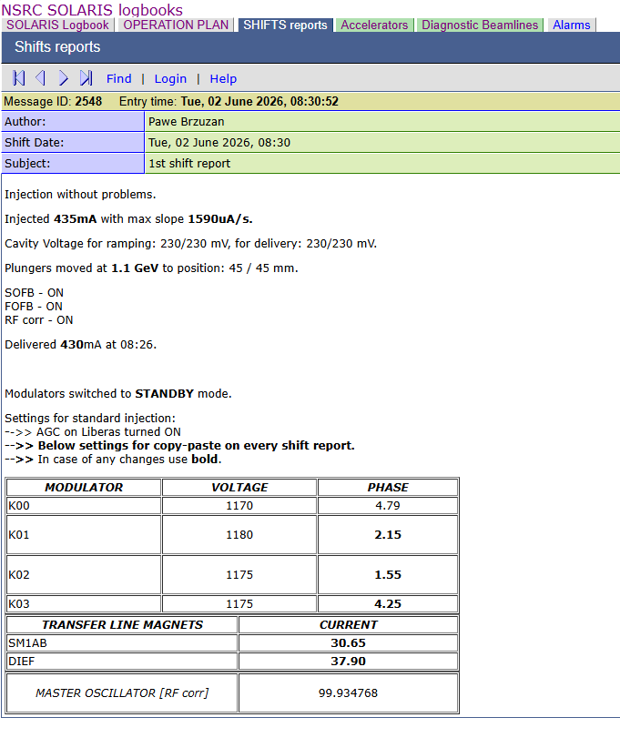

  Automatization
Automatic injection Logbook report
  the report is created by filling the template with data derived from multiple DSs.
  copy + paste, manual attributes searching
Automatic MSP communication after beam lost
  After the logical value for beam dump is met, communication is shown at Machine Status Portal informed users

Slide 24
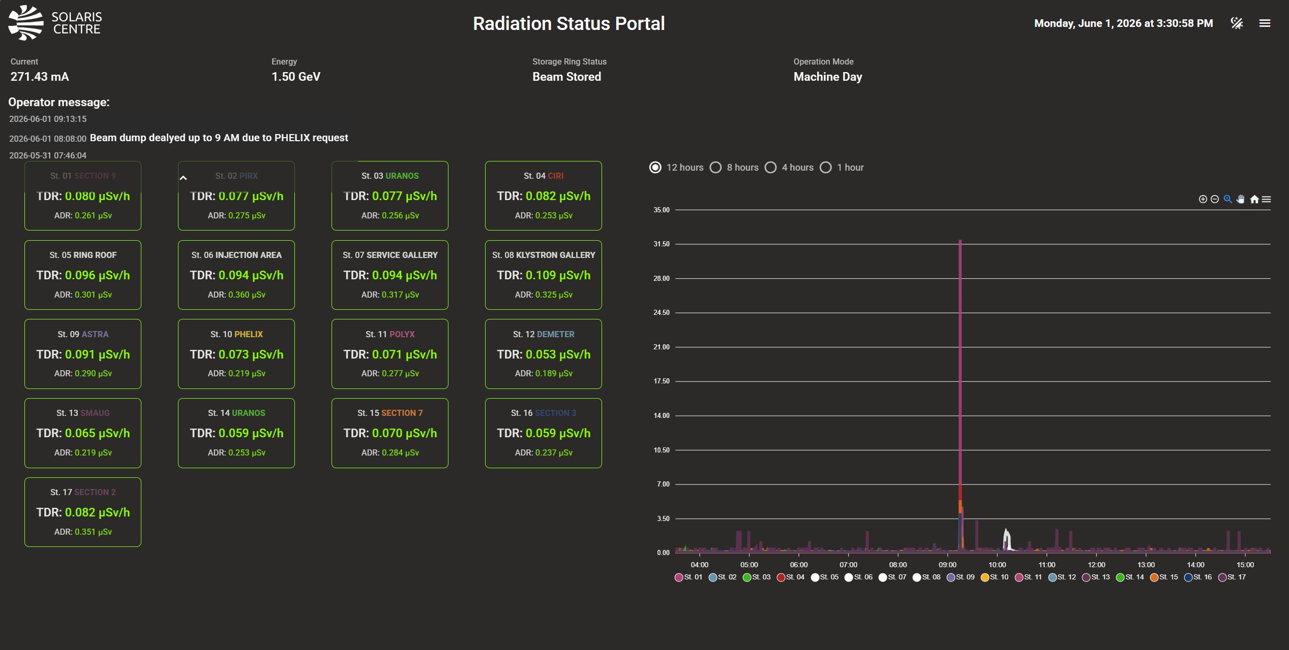
Radiation Status Portal
Upgrade to Vue 3
Introduce new Taranta Adriane with socket/query communication and Tango archiving for chart data
Add a synoptic view (map-based interface) with station hover for quick value lookup
Enable dialog display with more station's attributes (by clicking on stations or on a station card in the status view)
Notes:
Vue 2 -> vue 3
Archived data is used for displaying longer periods of time on graph

Slide 25
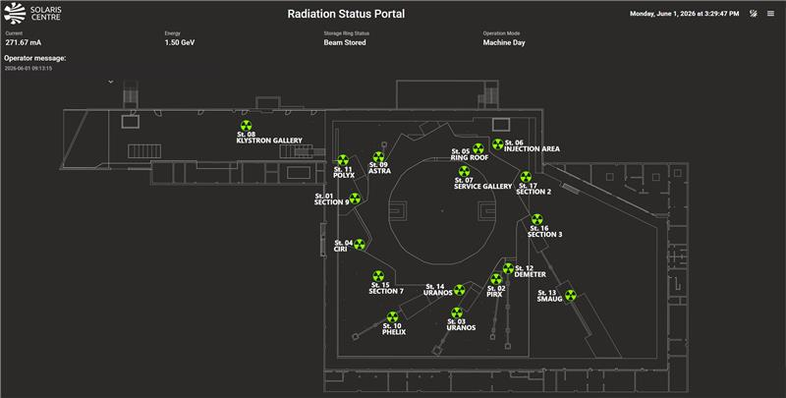
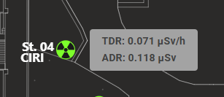
Radiation Status Portal
Upgrade to Vue 3
Introduce new Taranta Adriane with socket/query communication and Tango archiving for chart data
Add a synoptic view (map-based interface) with station hover for quick value lookup
Enable dialog display with more station's attributes (by clicking on stations or on a station card in the status view)
Notes:
Vue 2 -> vue 3
Archived data is used for displaying longer periods f timeon graph
Synoptic view along with station lookup
Dialog display with more stations attributes

Slide 26
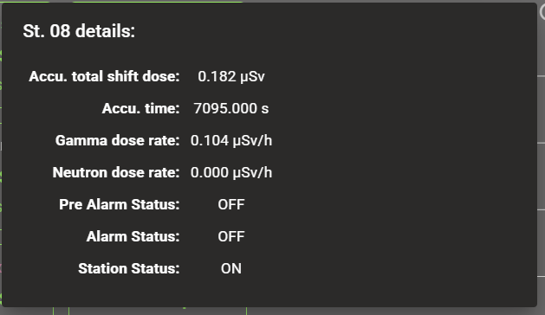
Radiation Status Portal
Upgrade to Vue 3
Introduce new Taranta Adriane with socket/query communication and Tango archiving for chart data
Add a synoptic view (map-based interface) with station hover for quick value lookup
Enable dialog display with more station's attributes (by clicking on stations or on a station card in the status view)
Notes:
Vue 2 -> vue 3
Archived data is used for displaying longer periods of time on graph
Synoptic view along with station lookup
Dialog display with more stations attributes

Slide 27
Thank you!
Questions?

