Slide 1

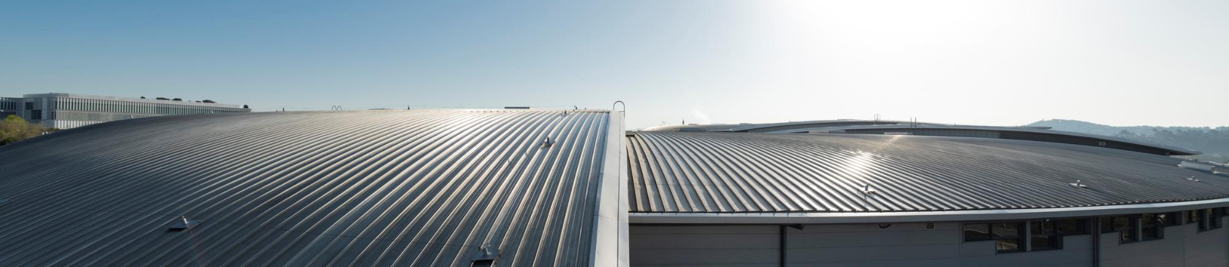
ALBA Controls Status Update
Zbigniew Reszela on behalf of Controls Section
40th Tango Community Meeting – 8/06/2026

Slide 2
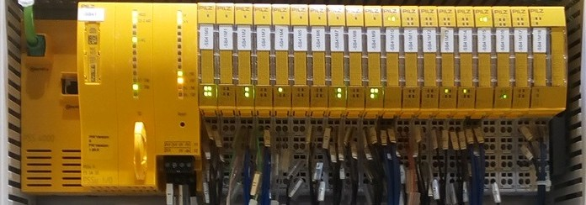
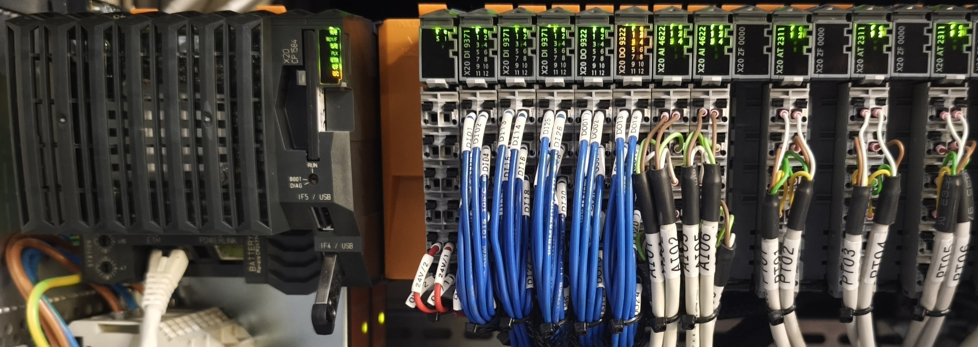
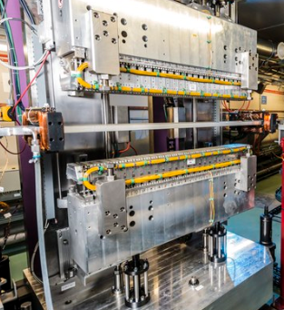
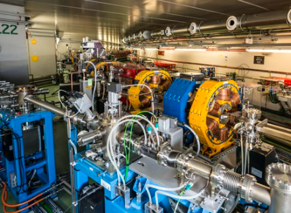
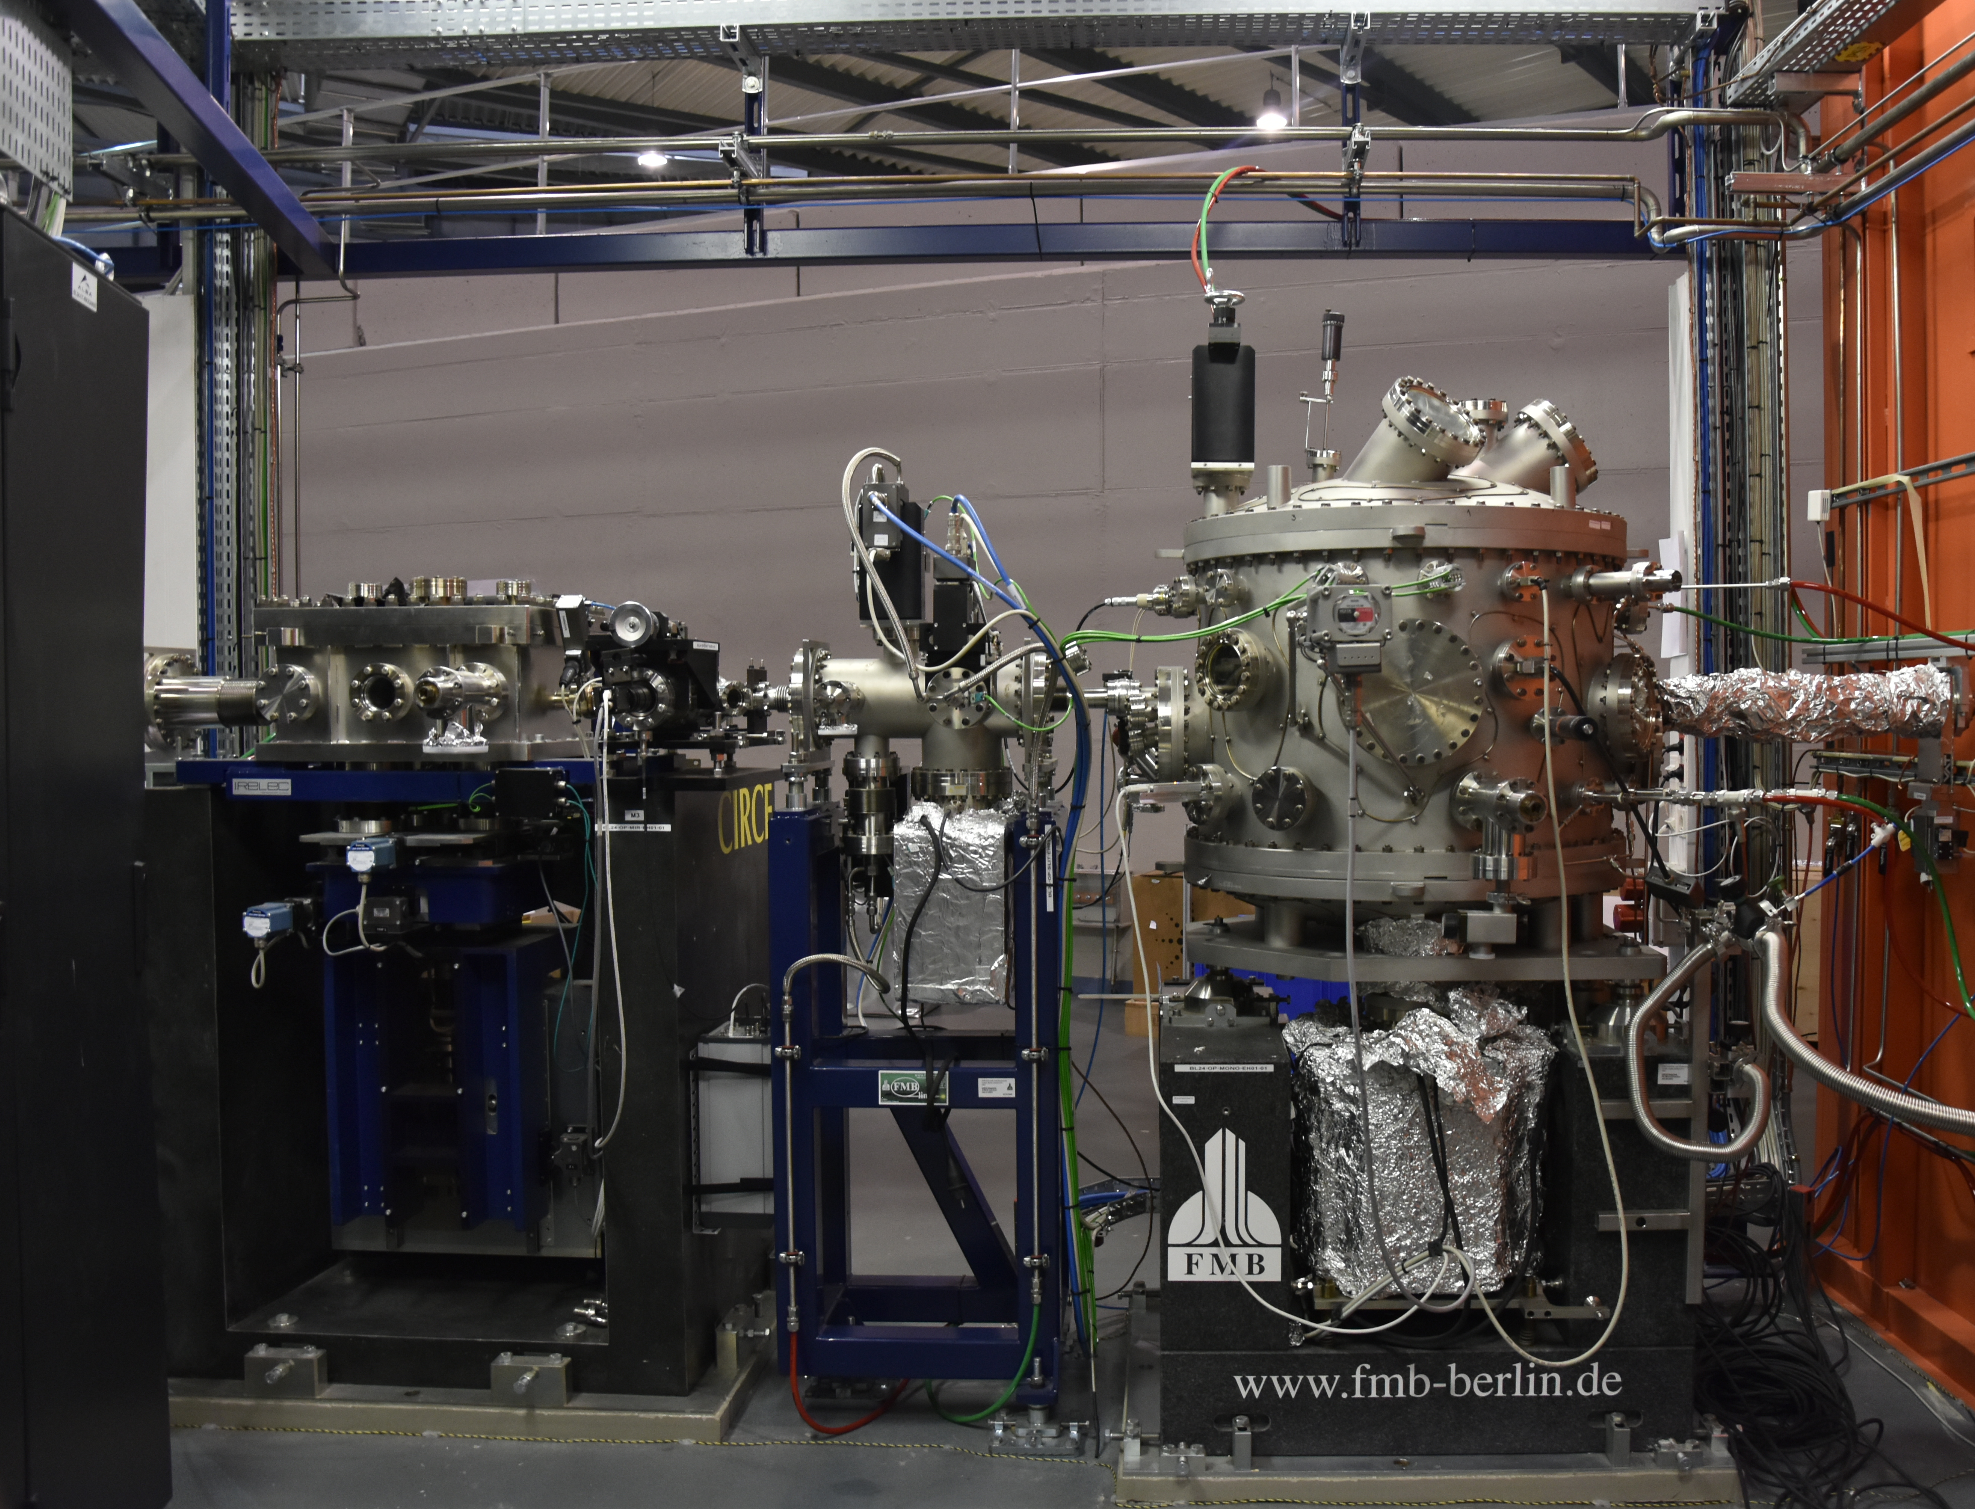
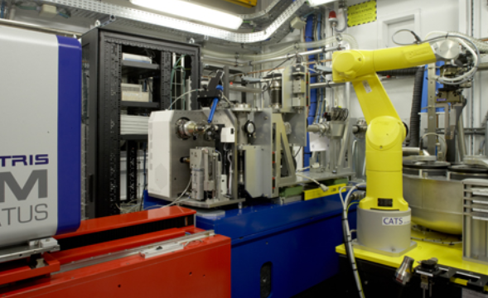




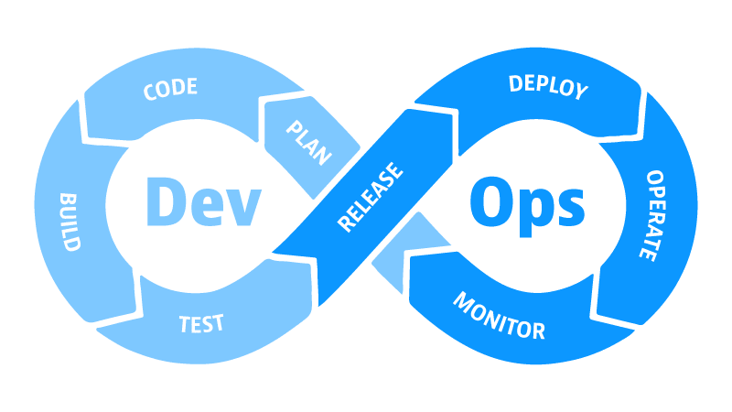
ALBA Controls today
PLC Based Systems
Protection Systems (EPS, PSS, PPS), Automation
Scientific Data Management
(SDM)
Management of Information Systems
(MIS)
Accelerators
LINAC, Booster, Storage Ring
Beamlines
13 BLs in operation + 1 in construction
Generic Software and Tools
TANGO, Taurus, Sardana, Panic, DevOps, …
Electronics
IT Systems

Slide 3

ALBA Controls tomorrow
PLC Based Systems
Protection Systems (EPS, PSS, PPS), Automation
Technical Building
Scientific Data Management
(SDM)
Management of Information Systems
(MIS)
Accelerators
LINAC, Booster, Storage Ring
new Storage Ring
Beamlines
13 BLs in operation + 1 in construction
3 new BLs (2 long), 1 BL moved, BLs adaptations
Generic Software and Tools
TANGO, Taurus, Sardana, Panic, DevOps, …
Web
Electronics
IT Systems
Notes:
At ALBA we have a lot of different equipment at different locations which speak different languages.
By different languages I mean different communication protocols, use different connectivity, etc.
ALBA Distributed Control System integrates all these equipment into a whole and is crucial to ALBA Accelerators and Beamlines operation.
Controls section built, maintain and enhance this system.

Slide 4
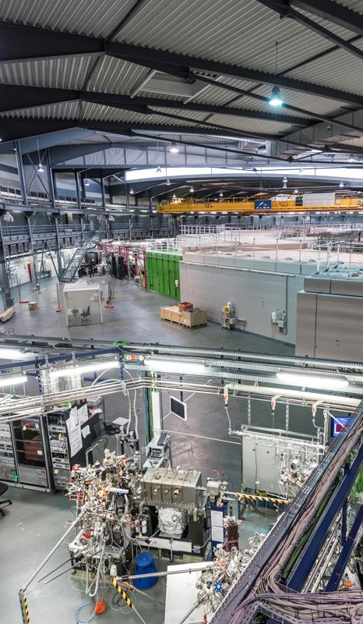
Accelerators Projects

Slide 5
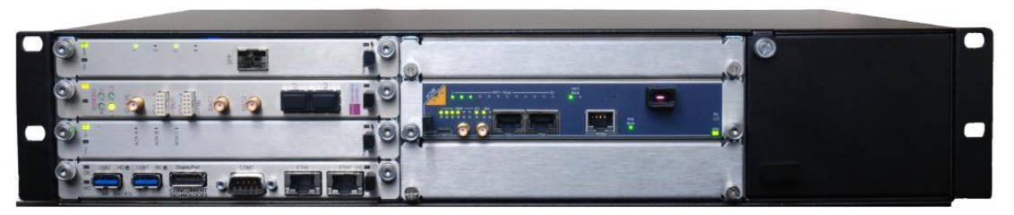
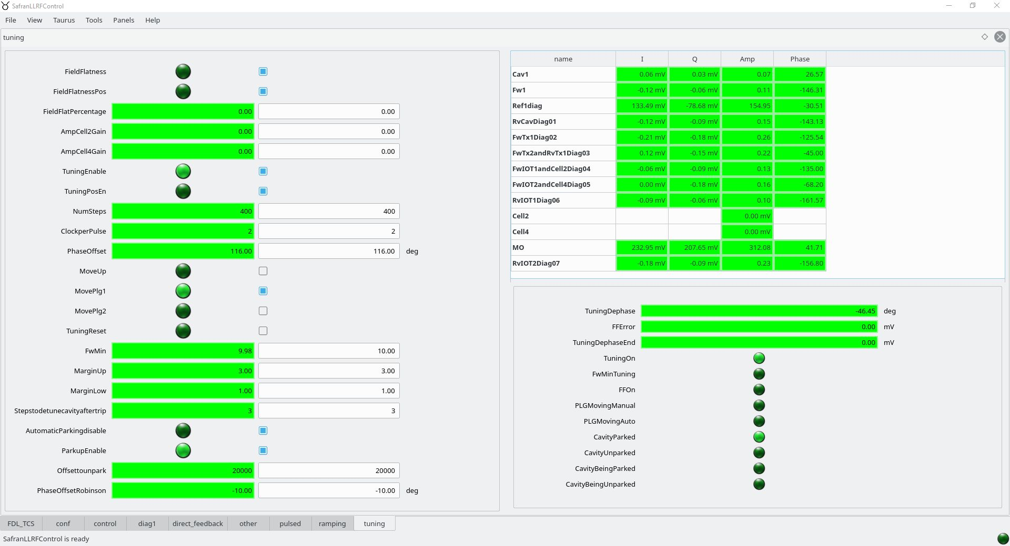
New DLLRF
New Digital Low-Level RF (DLLRF) system:
DLLRF controls the amplitude, phase, and frequency of RF signals.
New DLLRF is developed by the SAFRAN company, and based on FPGA in MTCA format. FPGA program is developed by ALBA RF team.
The Tango DS is running with Tango 10.1 on custom Linux for the ARM platform (build w/ buildroot).
Due to the systemd identified issue regarding DNS resolution in the host we suffered from CORBA timeouts when writing memorized attributes into the Tango DB and on server startup.
Our workaround meanwhile the issues is solved by systemd: avoid using DNSSEC and DNSOverTLS.
The DS and Taurus GUIs are highly dynamic, they are generated based on YAML configuration files with memory addresses to access and GUI configuration.
Control of the ALBA DLLRF in MTCA format
Primary: [
{name: Kp, access: read_write, dataType: short,
max_value: 128, min_value: 0,
read_address: 0, formula: f4,
gui_tab: control, write_address: 0, unit: ''},
{name: Ki, access: read_write, dataType: long,
max_value: 32767, min_value: 0,
read_address: 1, formula: f1,
gui_tab: control, write_address: 2, unit: ‘’},
...
]
DS and GUI YAML configuration file
Taurus GUI for DLLRF
5/52
Notes:
Introduction:
RF system has two roles: accelerate the electrons and keep them synchronized and stable.
RF system typically consists of: Digital Low Level RF system (DLLRF), power amplifier, waveguides and cavities.
Fundamental RF system at 500 MHz recovers the last turn electron’s energy loss due to synchrotron radiation.

Slide 6
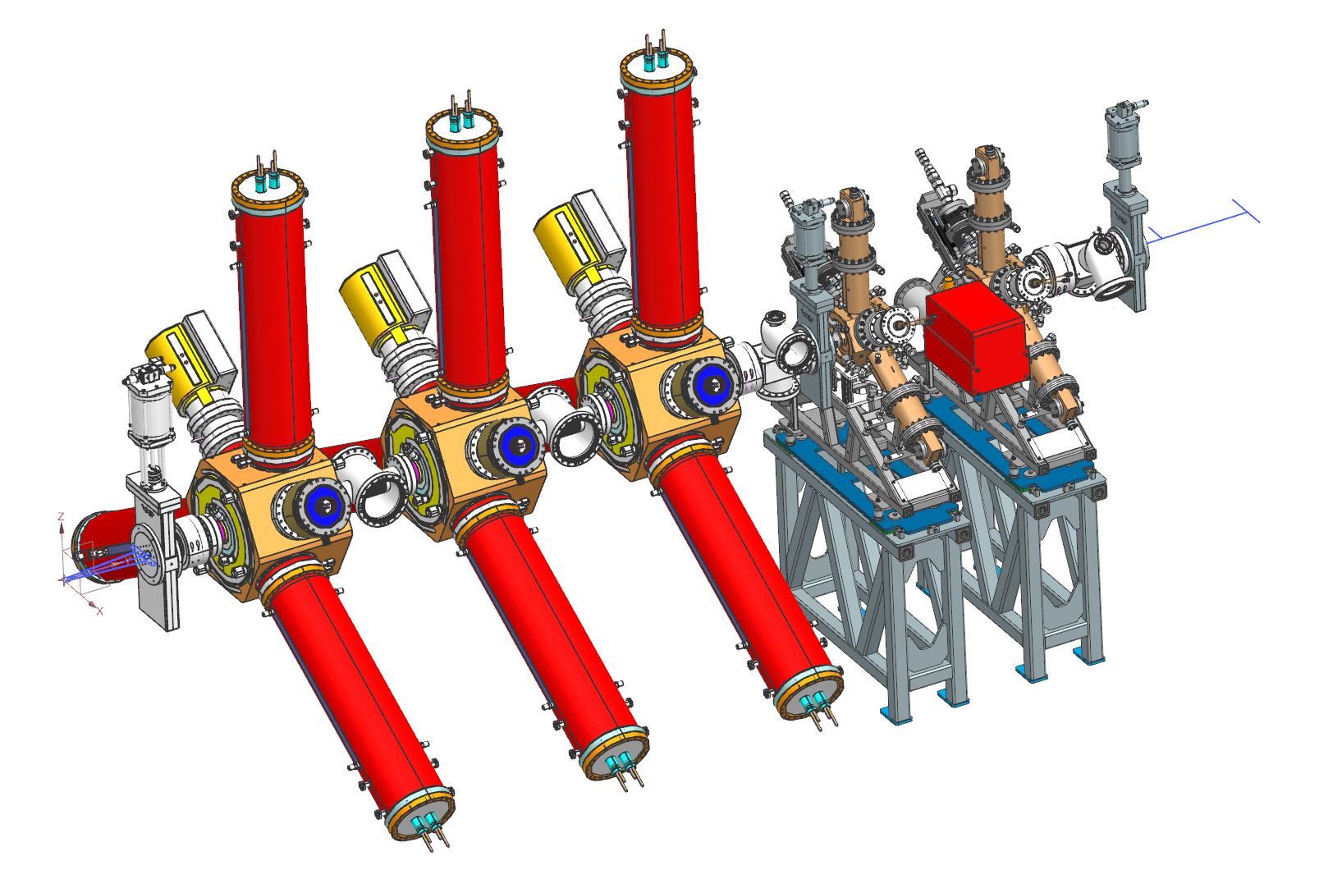
3rd HC
3rd Harmonic Cavity System (3HC):
3HC system (1.5 GHz) is being installed at ALBA and will be used for bunch lengthening to increase the lifetime in ALBA II.
The 3rd HC will be installed this year.
Currently we are integrating 3rd HC into the Equipment Protection System (EPS), deploying the DLLRF, and soon will integrate the SSPA into Tango via OPC UA communication.
LINAC RF
Booster RF
Storage Ring RF
RF System in ALBA
2 x RF Plants in ALBA II (SR):
3 x FC + 2 x 3HC
6/52

Slide 7
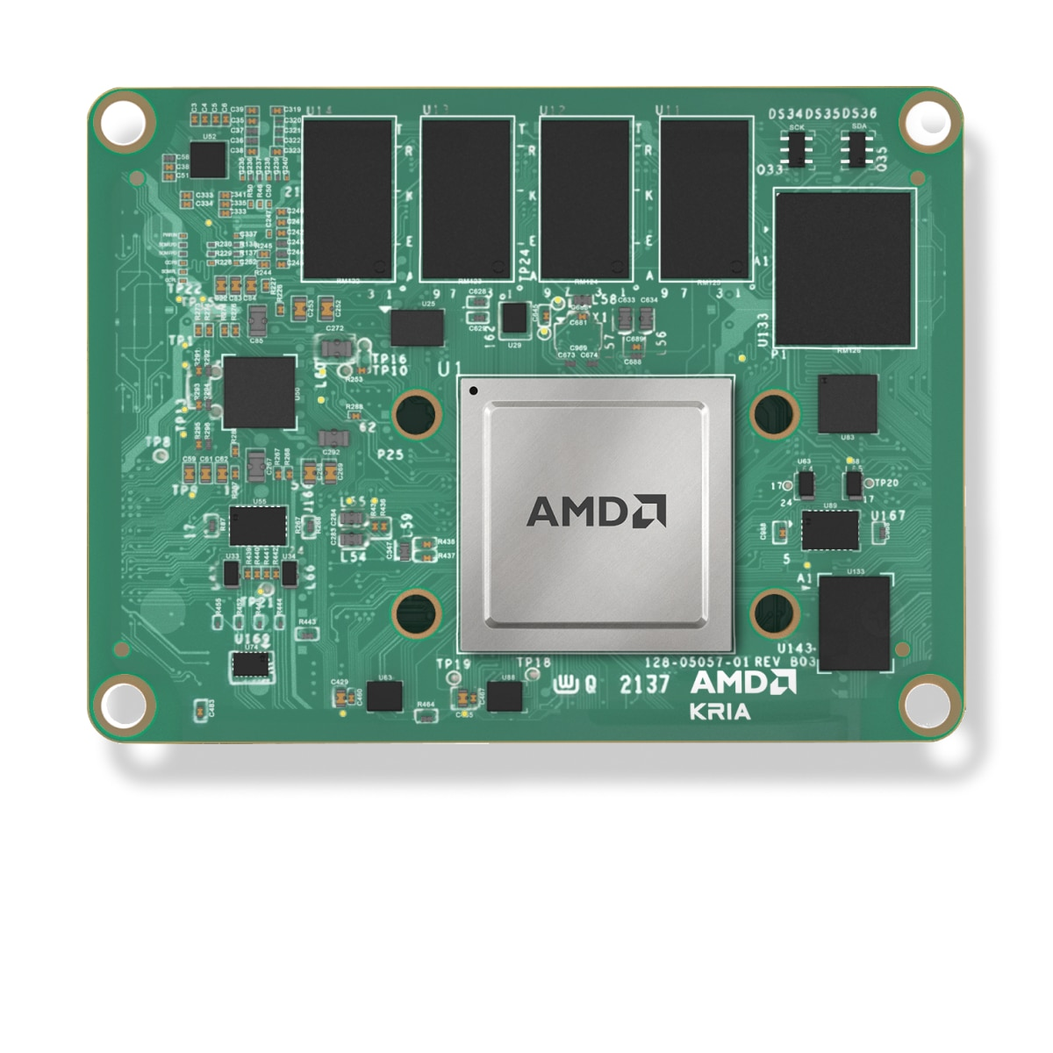
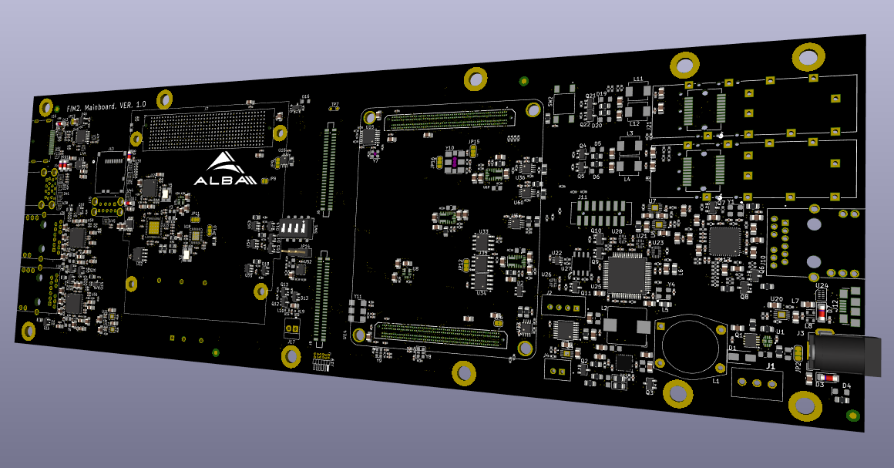
New FIM
New Fast Interlock Module (FIM2):
FIM manages the alarm conditions of an RF plant to stop it and inform other systems in a short time (~200 ns).
FIM2 is being developed by ALBA Electronics group, and based on KRIA K26 SoM with Zynq UltraScale+ SoC (FPGA + ARM).
We have tried the custom Linux distribution from Xilinx (build w/ Yocto).
We will evaluate embedding Tango DS using meta-tango layer from Voltumna Linux (Elettra).
KRIA K26 SoM
FIM2 main board (w/o KRIA K26)

Slide 8
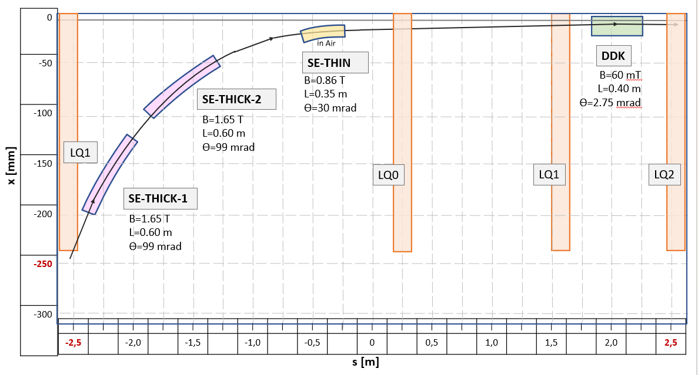
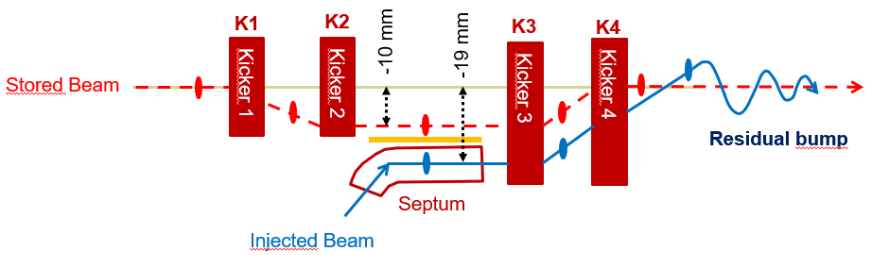
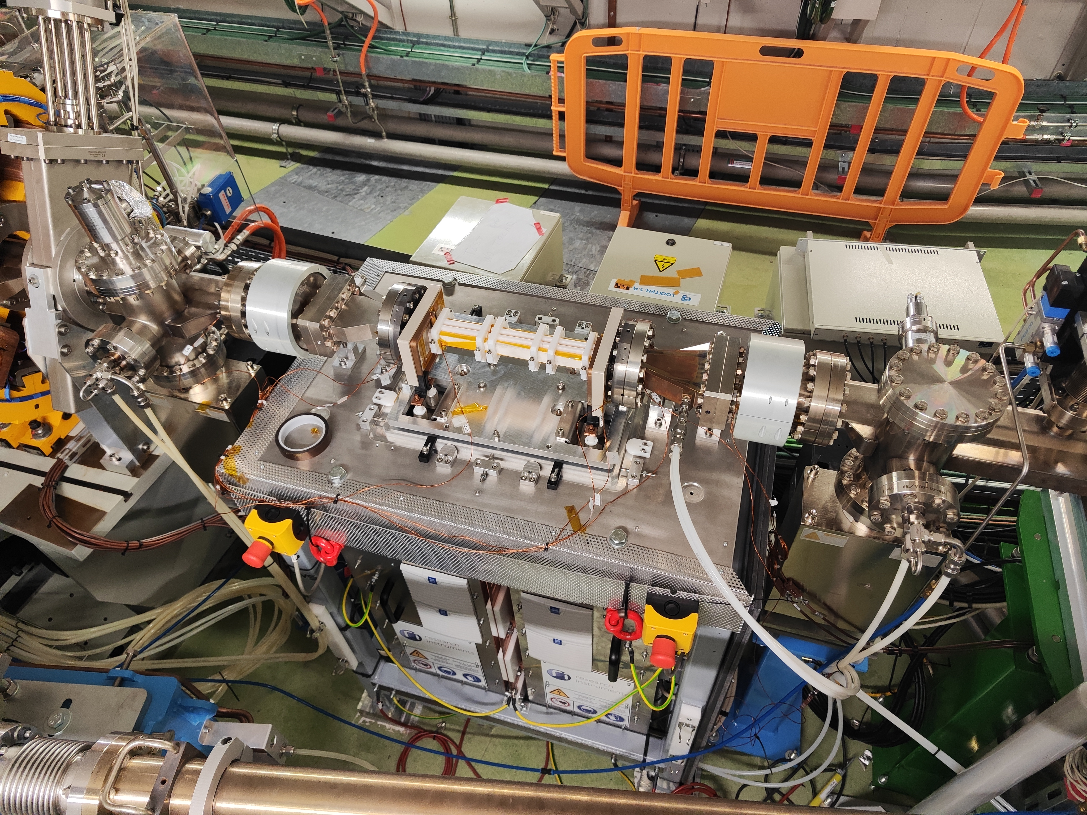
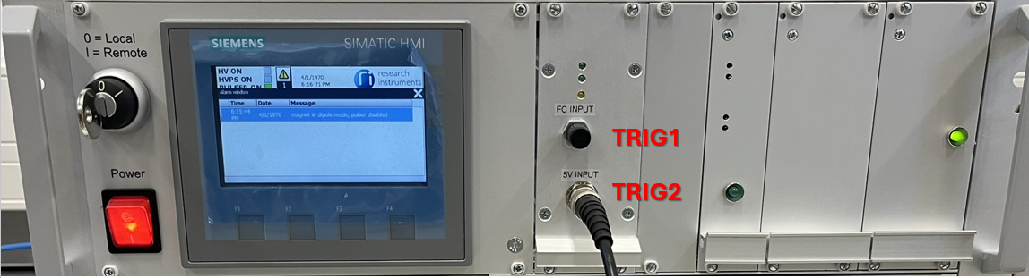
New Kicker
Dual Dipol Kicker (DDK):
A DDK is a type of Non-Linear-Kicker (NLK) magnet designed by the ALBA Beam Dynamics group.
The DDK plays the equivalent role than the 4-kicker bump scheme, but it provides better performance.
The Pulsed Power Supply (PPS) and its Magnet Control Unit (MCU) were developed by the RI company.
The MCU is based on a Siemens PLC and expose two remote communication interfaces: socket with custom protocol, and the OPC UA server.
We have adapted the pulsed magnets Tango DS (socket) and developed another one, as a pilot project, for the OPC UA.
Injection scheme in ALBA
Planned injection scheme in ALBA II
DDK and its two PPS installed in ALBA SR.
Magnet Control Unit for the DDKPPS

Slide 9
Beamlines Projects

Slide 10
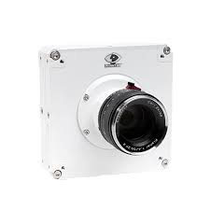
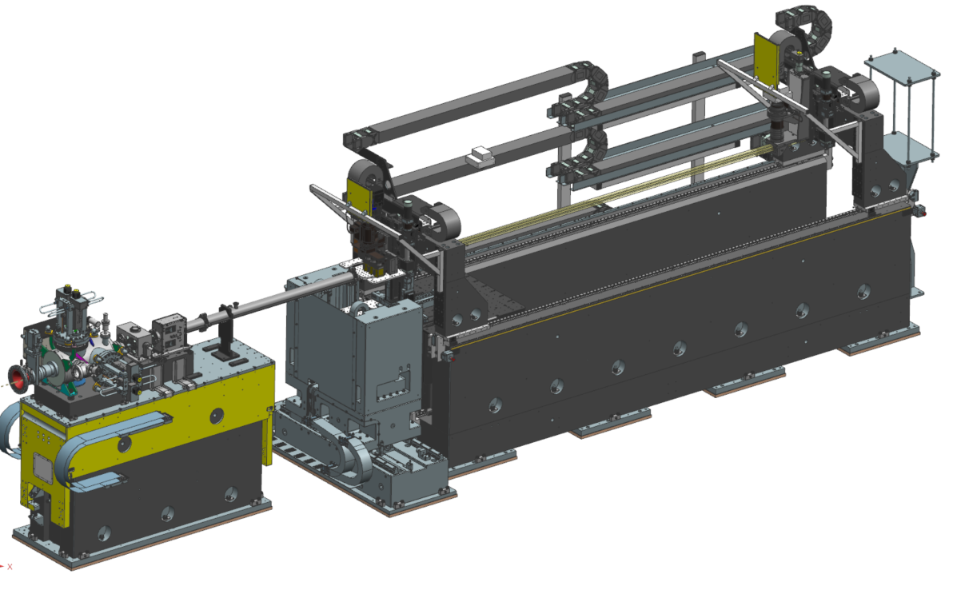
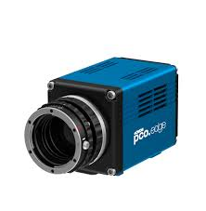
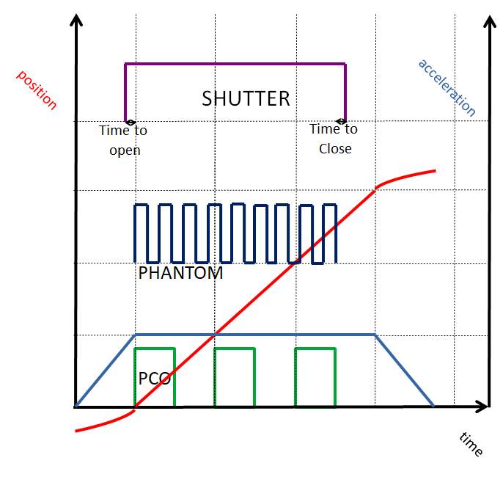
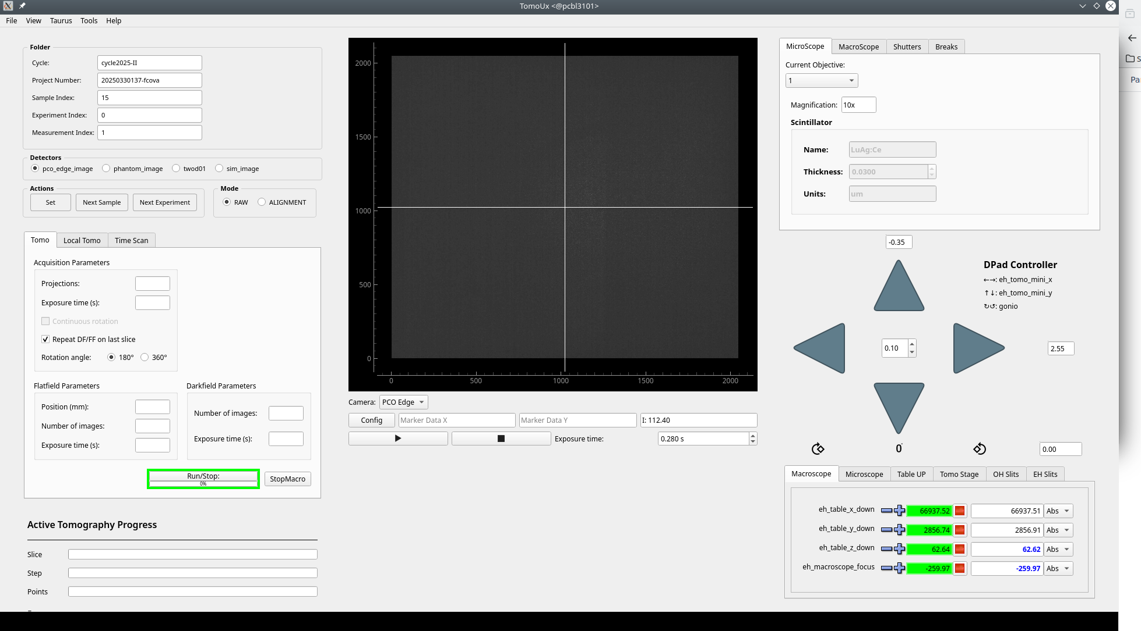
FAXTOR
FAXTOR - fast tomography beamline:
Tomography experiments are implemented as continuous scans with Sardana and involve:
. Multiple detectors (4 in total, 2 used simultaneously)
. Shutter (allows 10 ms opening)
. Goniometer (max. rotation speed: 4860 deg/s - 15 tomos/s)
. Synchronization implemented using NI6602 (counting card)
Phantom – high speed camera:
(max. acq. rate: 7000 fps in 8bit mode (60 Gbit/s))
. Control is implemented with the REST server.
. Data transfer is implemented with the HDF5 file writer.
. Files written into the IBM Storage Scale clustered file system (GPFS) – data transfer rate up to 30-40 Gbit/s.
The other detectors are integrated in Tango using LImA (ESRF): PCO Edge, PCO DiMax, C-BLUE.
Beamline GUI implemented using Taurus and LaVue (DESY).
Phantom S710
PCO Edge 4.2
Shutter
Beam
Goniometer
(LabMotion)
Chopper
(in the future)
FAXTOR layout (Experimental Hutch) with elements involved in tomography experiments
Example of synchronization description used at FAXTOR
TomoUX (based on Taurus and LaVue)

Slide 11
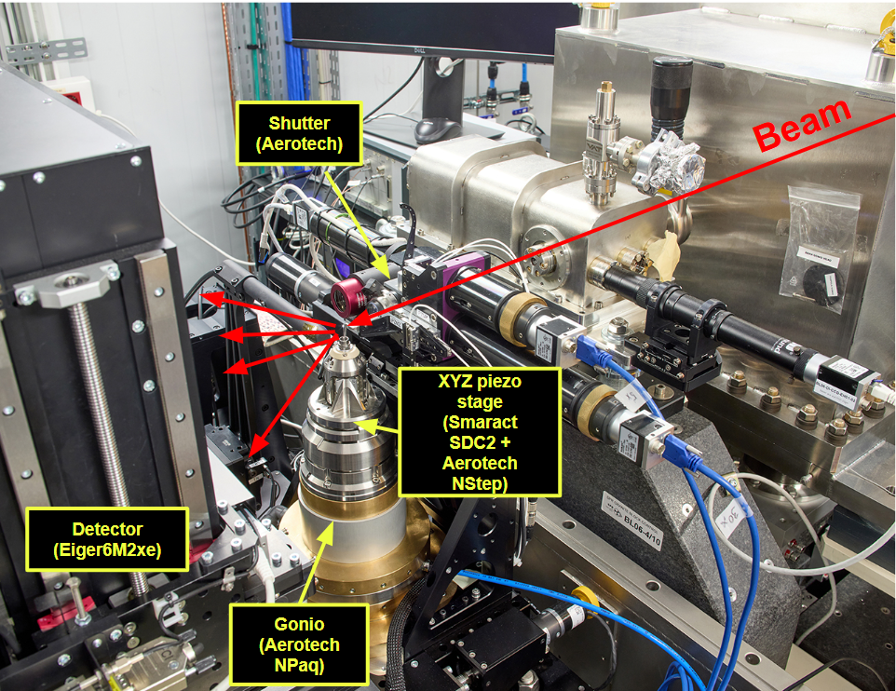
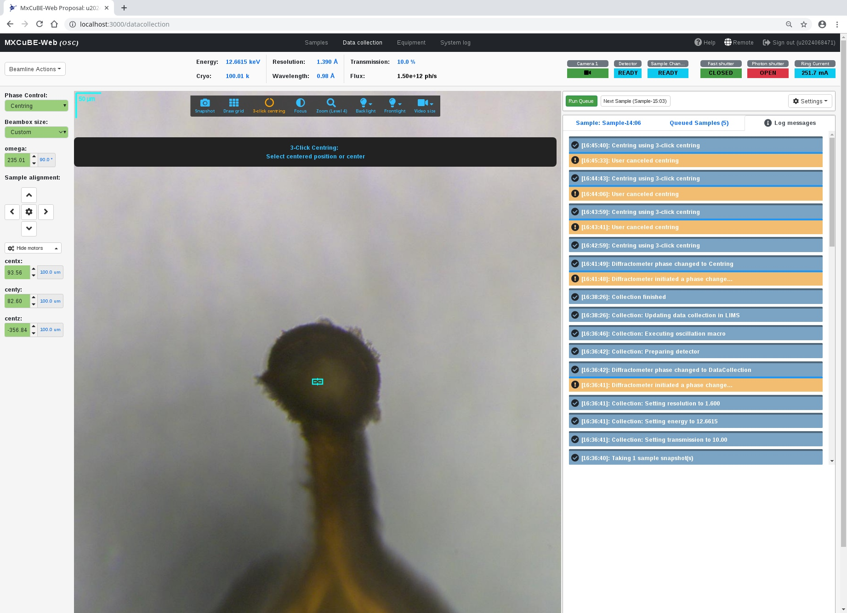
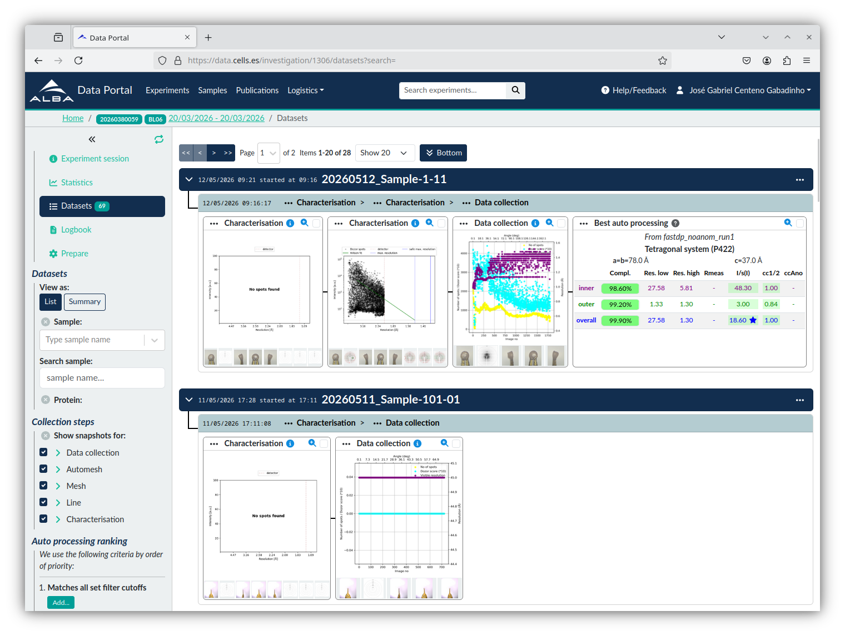
XAIRA & XALOC
XAIRA – microfocus MX beamline in He atmosphere:
MX experiments are implemented as continuous scans (oscillation: simple and helical and X-ray centering: raster scan) with Sardana and involve:
. Eiger2xe 6M detector
. Shutter
. Goniometer / XYZ piezo stage (Aerotech + Smaract)
. Synchronization implemented using Aerotech motion controller
MXCuBE Web (ESRF et al.) – data acquisition:
Mounts sample → Centers it → Uses online processing → Collects a full dataset
iCAT DRAC (ESRF et al.) – work of the SDM and MIS sections:
Gives access to raw and processed data.
XALOC (another MX beamline) refactoring:
New diffractometer – HiDiffX – from IRELEC will be installed this summer. Currently working on:
. The Tango DS for the diffractometer control
. LImA plugin for its OAV camera
Soon after we will migrate the MXCuBE Qt to MXCuBE Web and iCAT DRAC.
XAIRA End Station
MXCuBE Web at XAIRA
iCAT DRAC at XAIRA

Slide 12
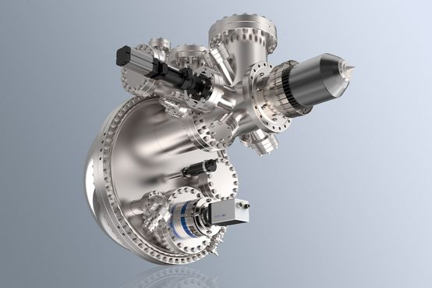
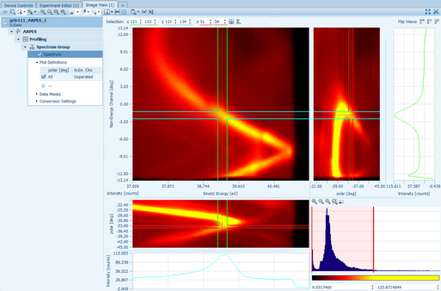
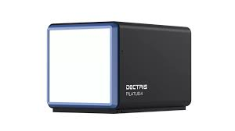

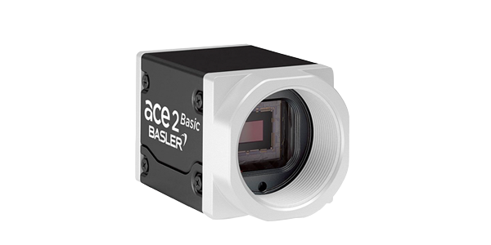
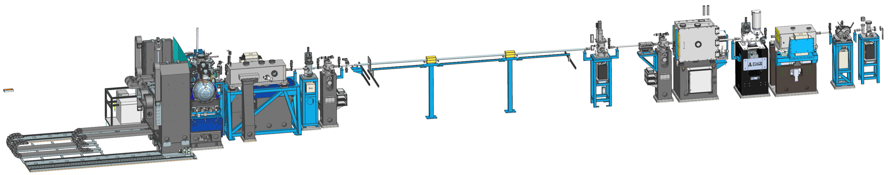
3Sbar
3Sbar: surface diffraction and surface spectroscopy at high pressure beamline:
In construction, beam in the OH in Nov’26.
Prodigy (SPECS):
. Rich software application to control and perform XPS acquisitions. Allows remote connections.
. Integrated with an async Tango DS (MAXIV), and extended with a Sardana controller.
Detectors:
. Pilatus4 2M (Si) (Up to 4kHz and 80Gbit/s). – Dedicated server and fiber optics link. Still evaluating definitive software solution to integrate it in the controls system. Most probably LImA with hardware saving mode.
. Lambda 750 k (Up to 100 Hz) - Integrated with Tango via LImA (ESRF).
2x PandABox connected via SFP will allow for a fast acquisition of analog signals, synchronized with motion and the rest of hardware-triggered devices.
Diagnostics cameras: extensive setup with 11 Basler Ace cameras located along the optics and end station.
. Our plan is to use LImA and the already tested LaVue application for live view.
Hemispherical electron energy analyzer developed by SPECS Group
Prodigy software by SPECS Group
Pilatus4 2M (Si)
Lambda 750 k
2x (via SFP) PandABox
11x Basler Ace cameras
3sbar layout Optical Hutch (right) and Experimental Hutch (left)

Slide 13
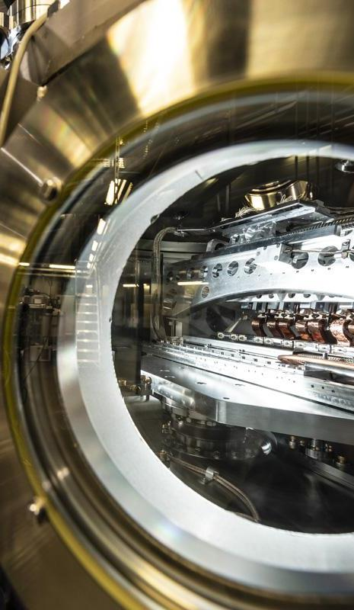
Generic Projects

Slide 14



Control System Base Stack Dependency
ALBA Control System was released in 2012 with OpenSUSE 11, Python 2.6, and Tango 7.
. No major OS upgrade until 2018, but:
. workstations → OpenSUSE 12 and 13
. some systems → Tango 8.
. The main difficulties were the DAQ cards Linux drivers and Tango version upgrades.
Started gradual migration to Debian 9 and Tango 9 in 2018.
Our Service Area diskless image was migrated to Debian 10 in 2022.
We are currently evaluating the migration to Debian 12:
. Adlink 2005 and NI6602, were successfully migrated to Debian 12.
. Currently new systems are being built with Debian 12.
. Our diskless image is ready for migration to Debian 12.
Few remaining big projects are being migrated to Python 3: EPS Expert GUI, VACCA.
2
7
3
9
 | OpenSUSE | Debian 9 | Debian 10 | Debian 12
Service Area | 6 | 5 | 23 | 2
Control Room | 1 | 0 | 13 | 0
Beamlines | 14 | 56 | 55 | 19
TOTAL | 21 | 61 | 91 | 21
Number of Linux Controls machines and their OS (w/o diskless cPCI which use Debian 10)

Slide 15


Conda Packaging and Salt Stack
Evaluated new software distribution approaches to improve dependency management and maintainability.
Conda introduced in 2020, initially using multiple channels (Anaconda, esrf-bcu, conda-forge) and locally built ALBA packages.
Adoption grew rapidly, especially in Beamlines, leading to many unmanaged environments.
In 2024, a project was launched to define Conda policies, automate package creation through CI pipelines, and enable reproducible deployments with Salt Stack.
Packaging workflow is based on MAX IV approach, using Micromamba/Miniforge3, rattler-build, conda-forge, esrf-bcu, and internal ALBA channels.
Environment deployment is automated with Salt services, with centralized configuration and version management through Pillars.
A stable controls software stack is maintained across services, ensuring consistent versions of Python, Tango, Taurus, Sardana, and Fandango.
Salt Monitor – a web tool to inspect the status of Salt services deployment in production machines.

Slide 16
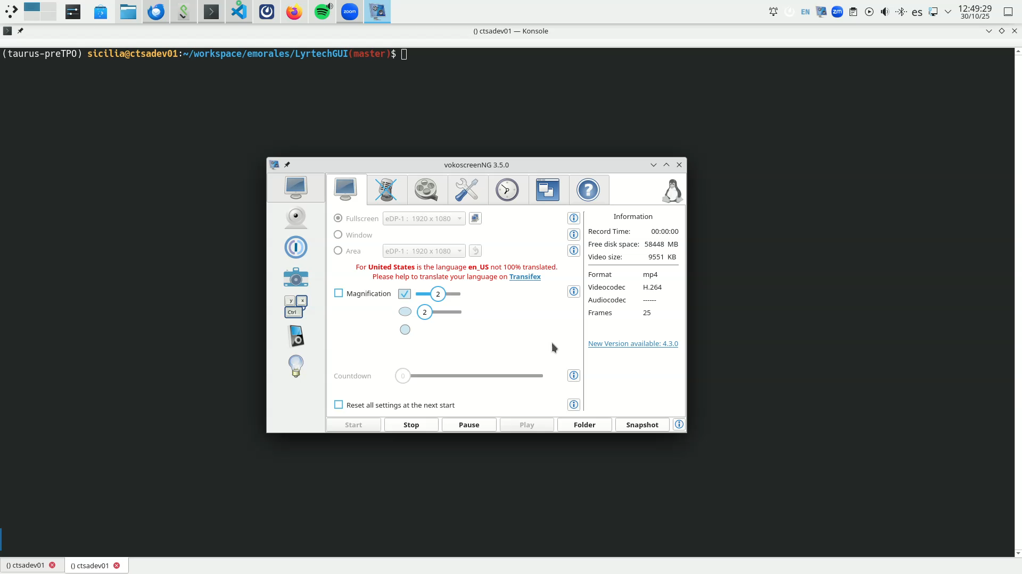
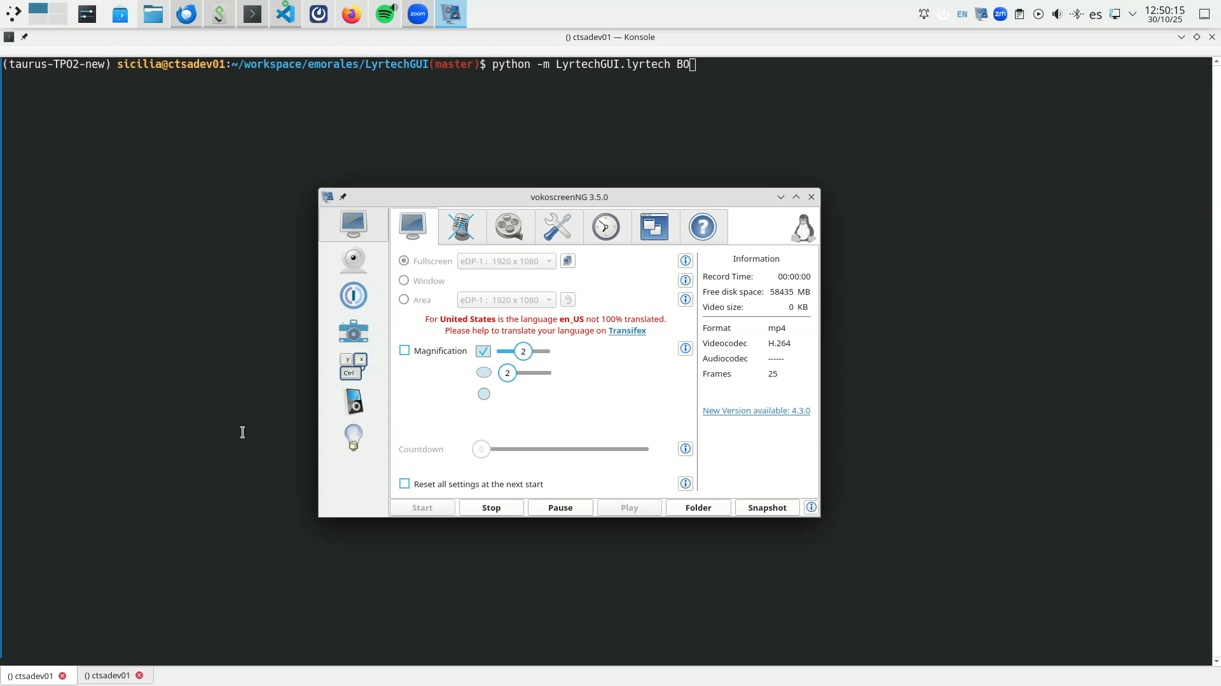
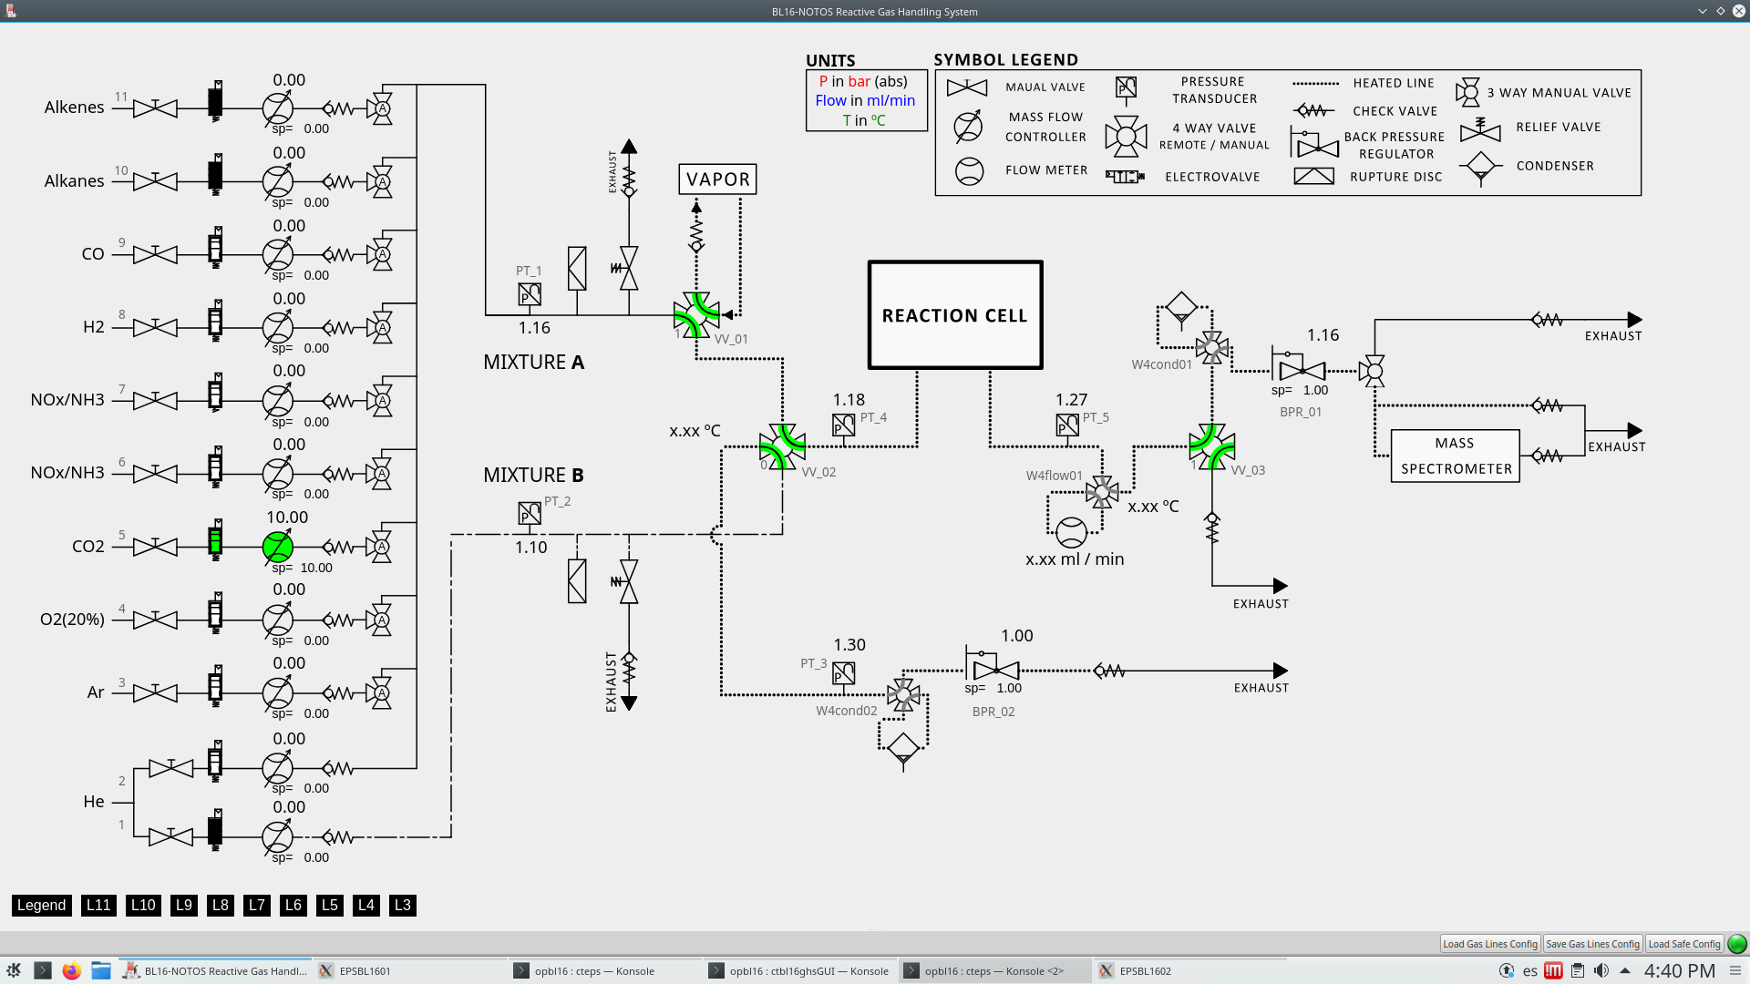
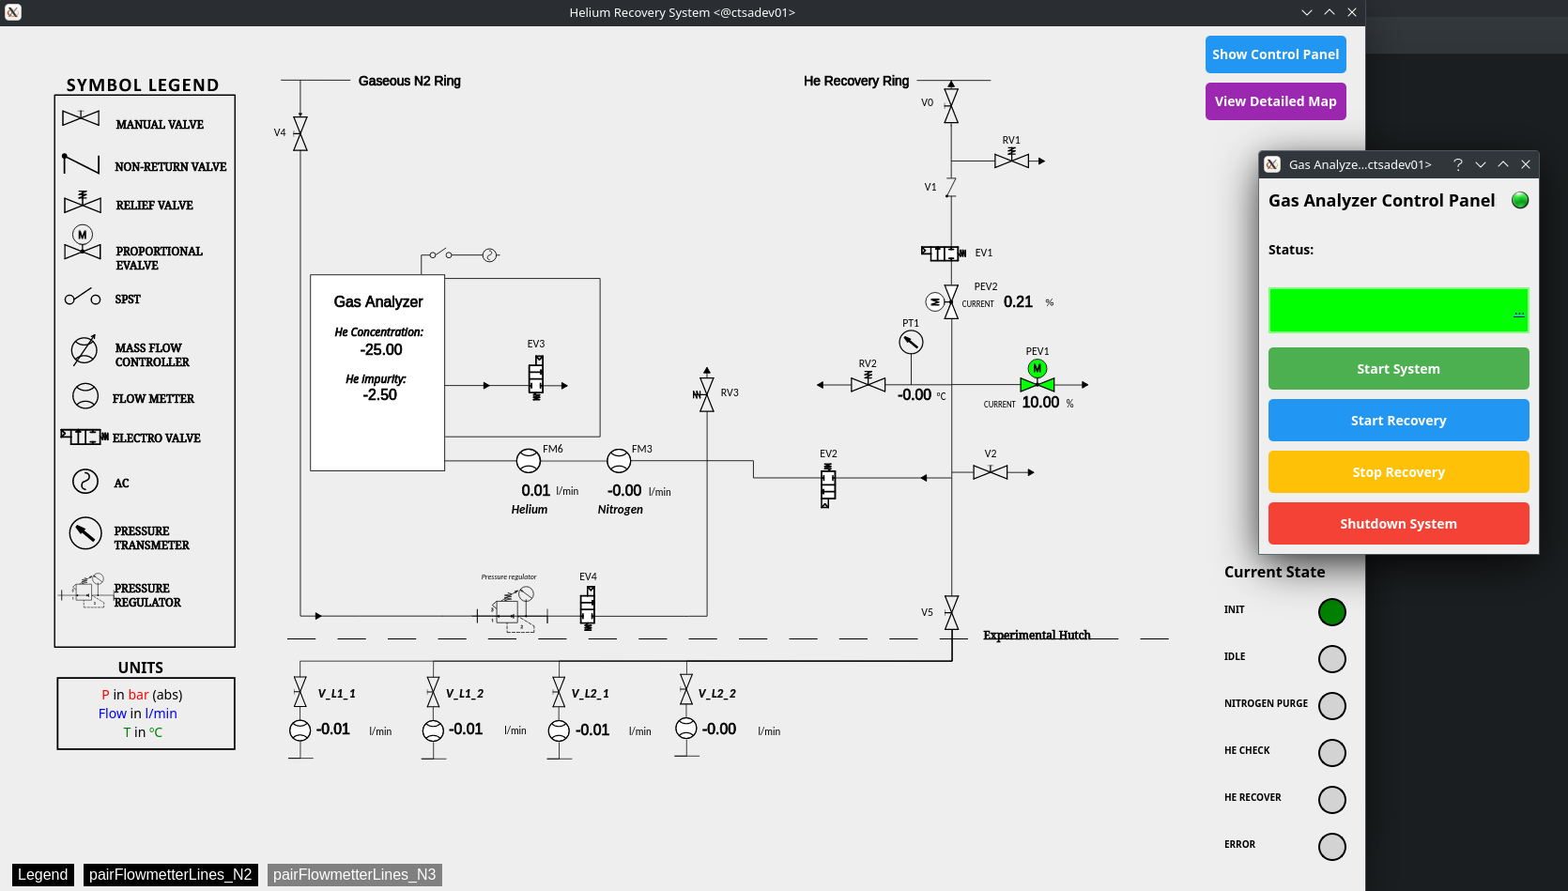
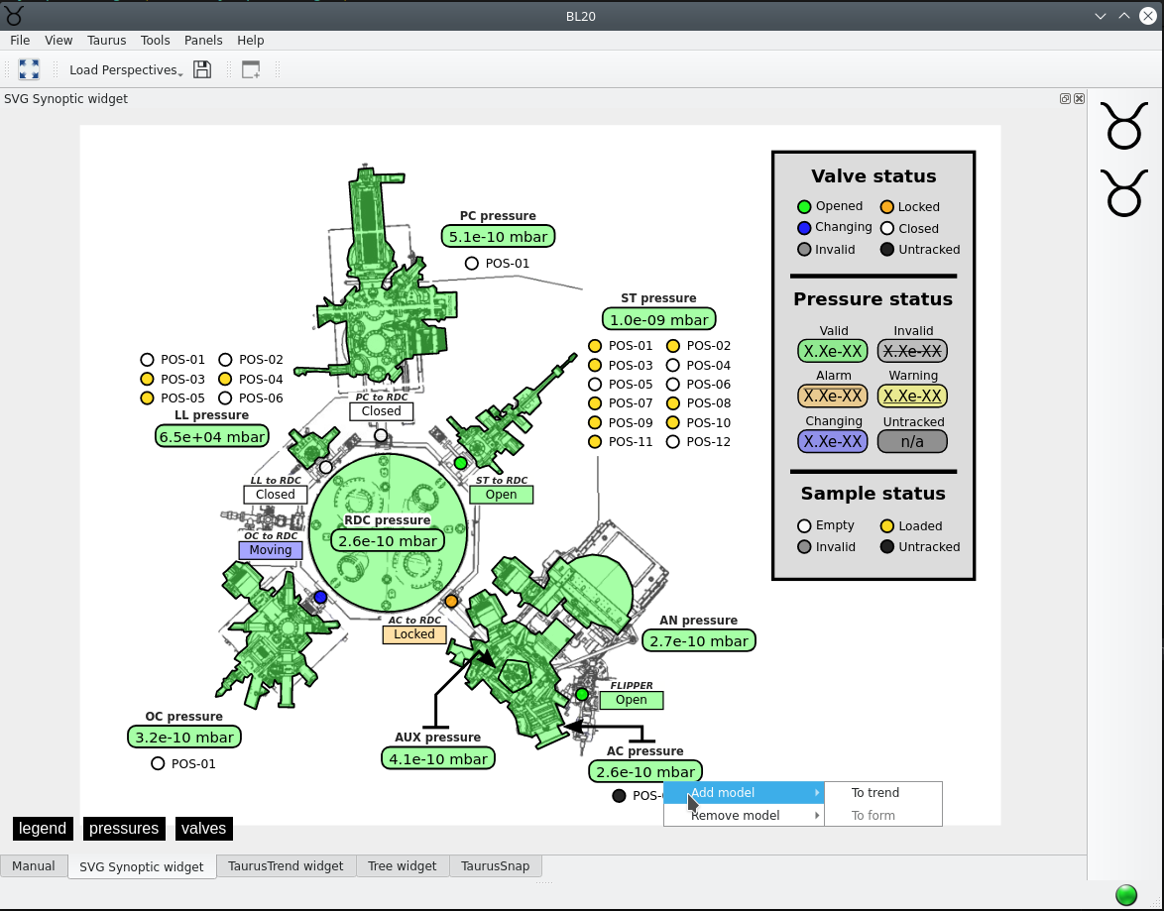

Taurus & SVG Synoptic
Performance and stability issues affecting GUIs connecting to hundreds of attributes had driven the Taurus Performance Optimization (TPO) project.
Results – Taurus applications are now more stable and up to 3x faster at startup.
To fully benefit from the improvements, Taurus requires Tango 10.1, then we started testing the Accelerators GUIs in Control Room with Conda.
We developed several SVG Synoptic (MAXIV) GUIs, for gas handling systems and vacuum control.
More about Taurus, not only at ALBA, in Oriol’s talk tomorrow.
Before optimization: 20 s
After optimization: 10 s
Example: Booster DLLRF (Lyrtech) connecting to approx. 500 attributes.
SVG Synoptic for BL16 gas handling system
SVG Synoptic for BL04 He recovery line
SVG Synoptic for BL20 end station vacuum
Taurus Performance Optimization – testing Tango 10.1
SVG Synoptic
2D widgets
User Training and Community Support
More about Sardana in Oriol Talks

Slide 17
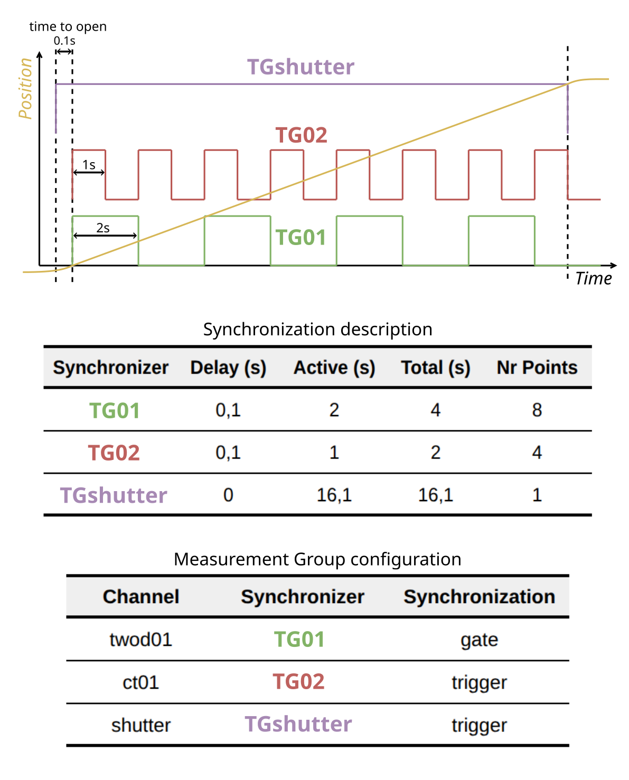
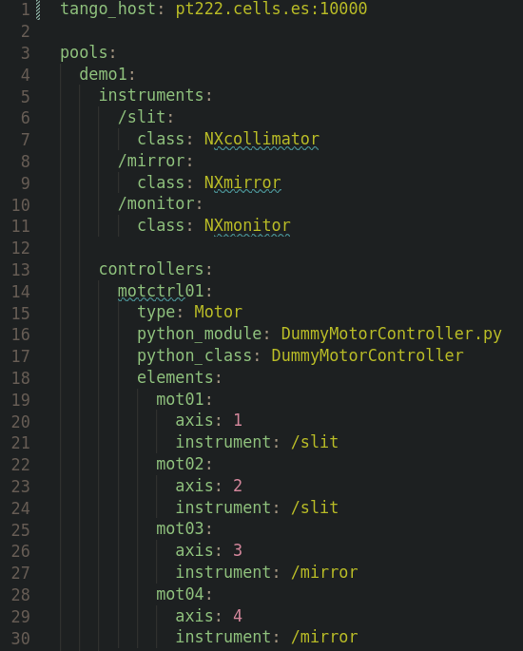
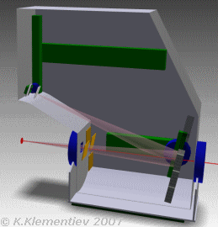
Sardana
FAXTOR and XAIRA requirements had driven our recent Sardana developments – enhancing the configuration of synchronization elements in continuous scans.
We are finishing migration (13/14 BLs done) of the Sardana deployment at ALBA from Debian to conda. Next step is use Sardana with Tango 10.1.
This year our objectives are:
. Implement data publishing using blissdata (ESRF).
. Use in production at all beamlines the Sardana configuration tool.
. Introduce synchronized motion (trajectories) in the core following MAXIV advances from last years.
. Offer Sardana training to ALBA BL scientists.
More about Sardana, not only at ALBA, in Oriol’s talk tomorrow.
10.1
Multiple synchronization description
Example of the sardana configuration file (YAML).
Example of synchronized motion in CLEAR spectrometer (by K. Klementiev)

Slide 18
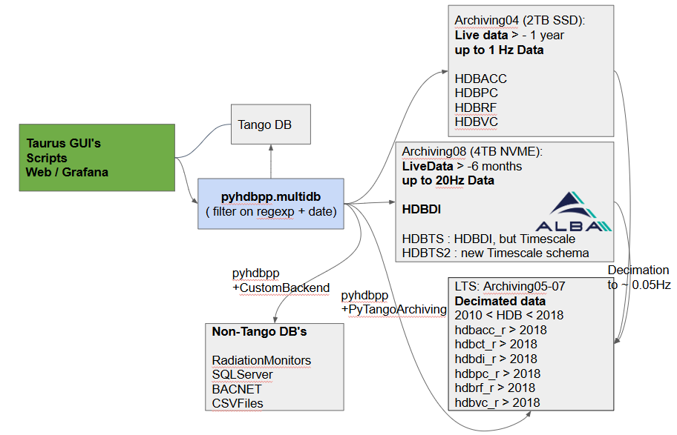
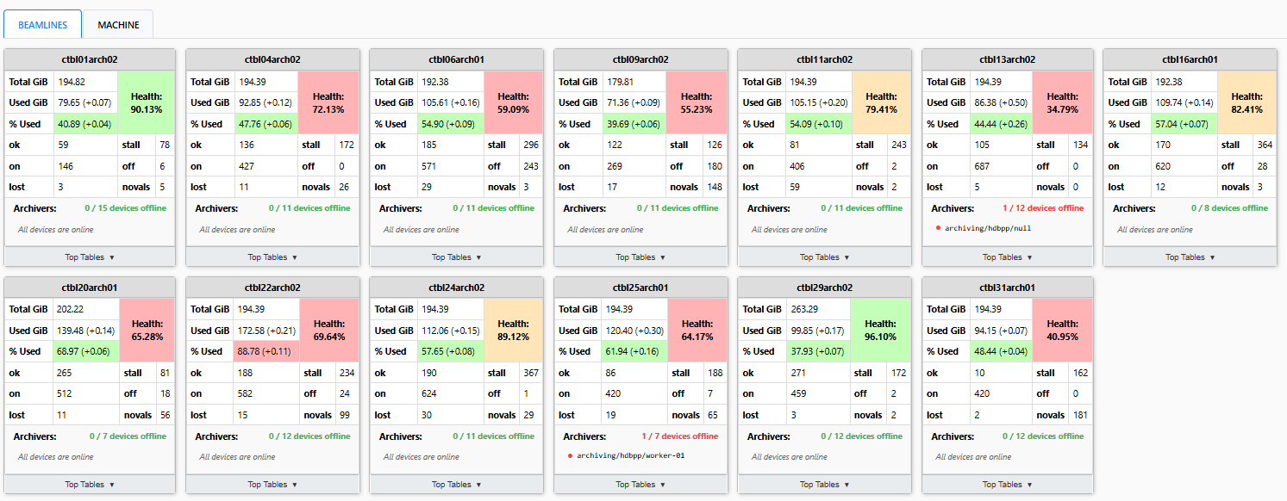
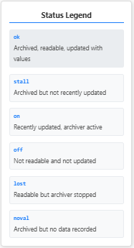
Tango Archiving
We use HDB++ with MariaDB backend since 2018.
All data are stored at change event rates (0.1 - 20Hz) (change events, archive events, and periodic archiver).
pyhdbpp library provides transparent access to data for both GUI and CLI extraction, including the multidb extraction.
Accelerators archiving architecture: multiple databases per subsystem, live data and decimated data. All on physical machines.
Beamlines archiving architecture: one database per beamline on a VM.
This year our objective is to define the Archiving Architecture for ALBA II: we are evaluating TimescaleDB and Grafana.
More in Sergi’s talk on Thursday (Archiving Workshop).
Tango archiving database architecture for Accelerators
WIP: web dashboard for Tango Archiving health check (tab with Beamlines databases)

Slide 19
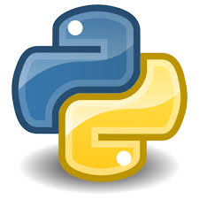

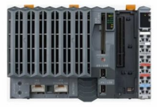
Software for PLC systems
PyPLCua – Tango DS for OPC UA:
Currently we use PyPLC based on Modbus TCP.
PLC code and configuration is autogenerated from the cable database. The configuration CSV file is used to generate Tango DS dynamic attributes.
As study of technologies for ALBA II we have developed the PyPLCua DS which uses:
. self-descriptive model (no need for configuration files)
. Client-Server Events (no need for polling)
We have benchmarked both implementations and OPC UA shows better performance than Modbus.
More about PyPLCua in Emilio’s talk tomorrow.
PyPLCua
asyncua

Slide 20
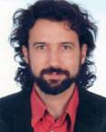
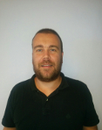

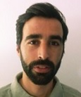

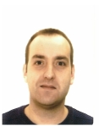



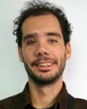









ALBA Controls Team today
PLC Based Systems
Protection Systems (EPS, PSS, PPS), Automation
Scientific Data Management
(SDM)
Management of Information Systems
(MIS)
Accelerators
LINAC, Booster, Storage Ring
Beamlines
13 BLs in operation + 1 in construction
Generic Software and Tools
TANGO, Taurus, Sardana, DevOps, Panic, …
Transversal Groups (there are more…)
Electronics
IT Systems

Slide 21
ALBA Controls Team tomorrow
PLC Based Systems
Protection Systems (EPS, PSS, PPS), Automation
Scientific Data Management
(SDM)
Management of Information Systems
(MIS)
Accelerators
LINAC, Booster, Storage Ring
+ 2 PLC engineers
Beamlines
13 BLs in operation + 1 in construction
+ 3 Controls Software engineers
Generic Software and Tools
TANGO, Taurus, Sardana, Panic, DevOps, …
Electronics
IT Systems

Slide 22

Summary & Acknowledgement
✅
Multiple Accelerators (new DLLRF, 3rd HC, FIM2, DDK), Beamlines (new BLs: FAXTOR, XAIRA, 3Sbar; XALOC), Generic (DevOps, Sardana, Taurus, Archiving, PLC Software) were presented.
TANGO Community for developing and sharing the TANGO and its ecosystem projects.
Controls Section and Computing Division for your hard work.
ALBA Customer Units for the excellent collaboration.

Slide 24
ALBA II Core Data Services Project
ALBA Controls is involved in all ALBA II Controls Programs: Experiments, Accelerators, Computing & Data, Infrastructure* and Implementation.
The Core Data Services Project, within the Computing & Data program, is focused on defining the ALBA II Control System and Electronics architecture and developing generic solutions and tools to serve other programs. It is composed, so far, from 6 Work Packages and 19 projects:
* We will start to be involved soon in the Infrastructure program.
Low Level Architecture
IOC Architecture
PLC Architecture
Virtualization and controls software packaging strategy
Detectors Integration Strategy
Instrumentation, Motion, and Synchronization
Beamlines Instrumentation and DAQ
Experiment Synchronization Platform
Motion Control Platform
Fast/Real Time Control Loops
Tango, Archiving, and Alarms
Tango Enhancements
Tango Archiving Architecture
Alarms Enhancements
Experiment Orchestration
Sardana Enhancements
User Interfaces
Taurus Enhancements
User Interfaces
Vacca (Vacuum Control) enhancements
Sustainability and Quality
Control System configuration and management
Controls software quality
Controls software configuration
CS observability
Core Data Services Project (gray – work packages, blue – projects in progress, yellow – projects in definition.

Slide 25




Kanban Work Organization (Software Teams)
Too many hats
KISS: Keep It Super Simple
We use two dimensional classification of activities: category & size.
Engineers act as either Service Support or Development on a given day.
Local resource management
Priorities are set by those who benefit from the work
Projects are prioritized by Management (ALBA Activity Plan).
~30 backlogs are directly prioritized by Customer Units.
Accumulation of Work in Progress
Stop starting, start finishing
The board was initially cleaned up to remove outdated tasks.
We use distributed and asynchronous pull board replenishments.
More details can be found in “Towards sustainable work management in scientific facilities: applying Kanban at ALBA Controls” - TUMR007. I can share the poster with you with better graphics.

Slide 26




Software for PLC systems
PyPLCua – Tango DS for OPC UA:
Currently we use PyPLC based on Modbus TCP.
PLC code and configuration is autogenerated from the cable database. The configuration CSV file is used to generate Tango DS dynamic attributes.
As study of technologies for ALBA II we have developed the PyPLCua DS which uses:
. self-descriptive model (no need for configuration files)
. Client-Server Events (no need for polling)
We have benchmarked both implementations and OPC UA shows better performance than Modbus.
More about PyPLCua in Emilio’s talk tomorrow.
We are deploying EPS User GUI (Taurus), a user oriented tool which provides an easy to interpret visual representation of the EPS logic.
Example: Beamline not ready to open FE, what to do?
1
2
vs.
EPS Expert GUI
EPS User GUI
PyPLCua
asyncua
Panel with the PLC logic (EPS User GUI)
Panel with signals corresponding to
a given group (EPS User GUI)

