Slide 1

Towards SOLEIL II, status of the project
40th Tango Community meeting at ALBA – June 2026
Yves-Marie ABIVEN on behalf of the SOLEIL II Project
Coordinator of the Program Overhaul of the Information System of SOLEIL II
Control and Acquisition Group Leader
yves-marie.abiven@synchrotron-soleil.fr

Slide 2
Outline
SOLEIL II Scope and Organization
Progress Report for the First 1.5 Years of the Construction Stage
Focus on the Overhaul of the Information System
Next Steps for SOLEIL II

Slide 3
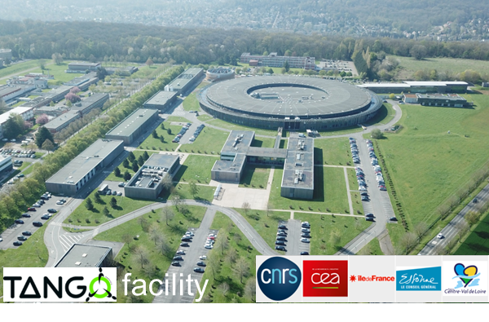
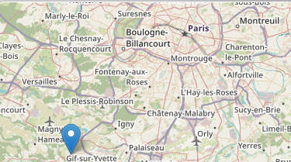
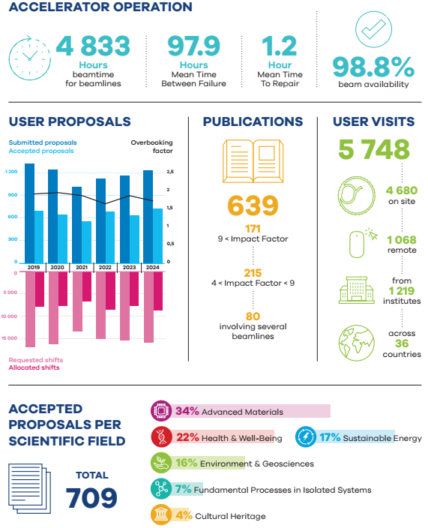
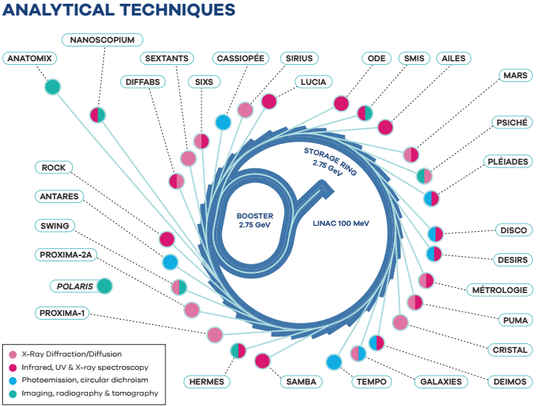
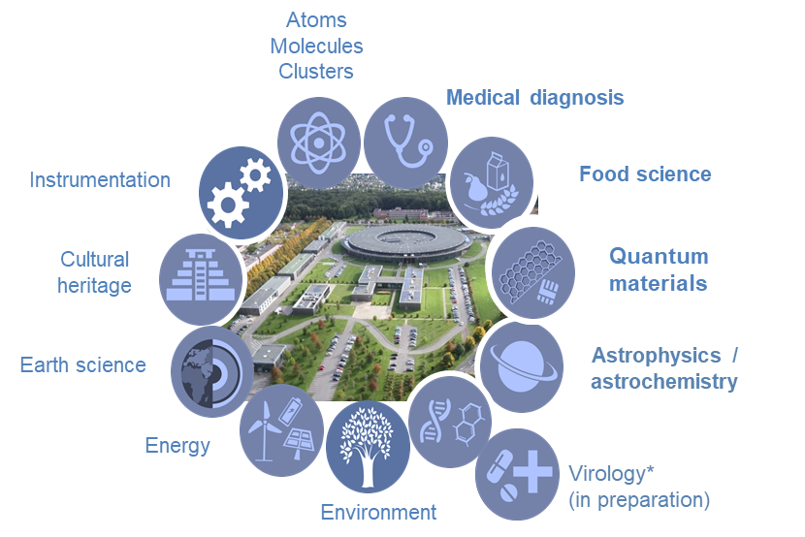
SOLEIL in a nutshell
Storage ring 354m, 2.75GeV
29 beamlines
1 CRYO-EM microscope
9 orders of magnitude in energy from far IR to hard X-rays
Open to external users in 2008
~ 450 staff members

Slide 4
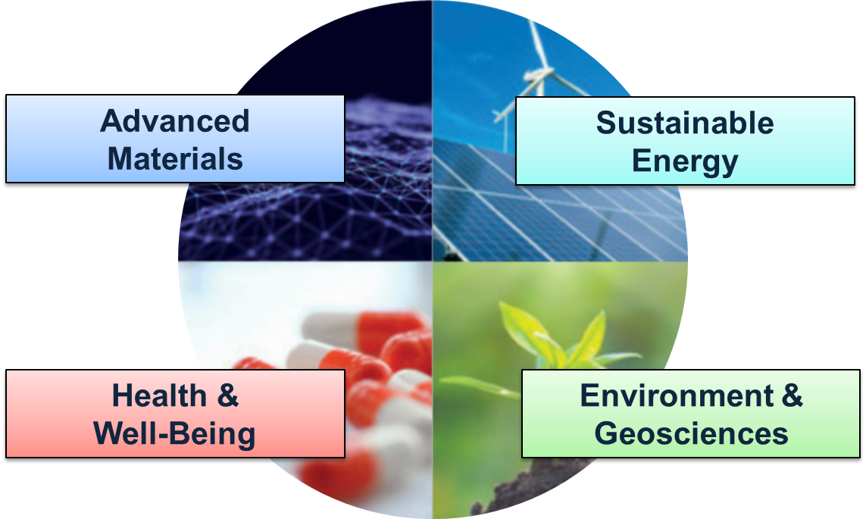
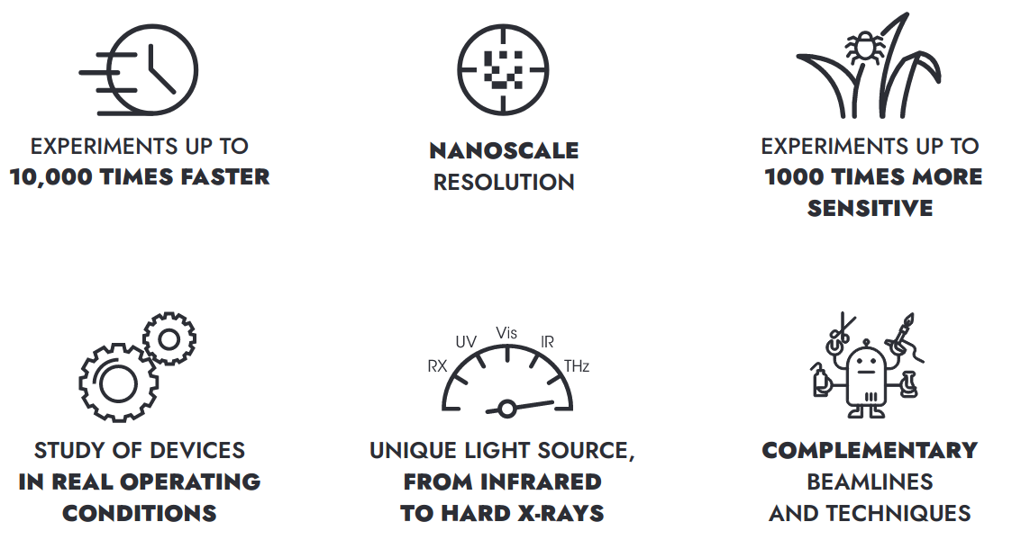
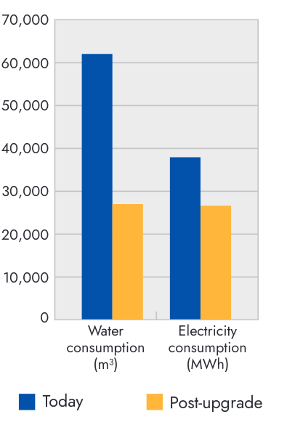
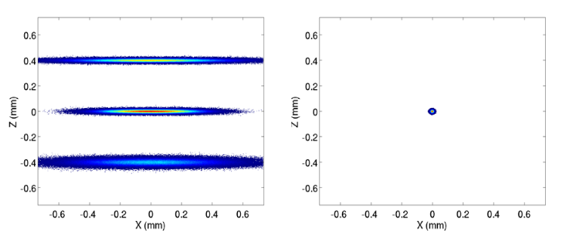
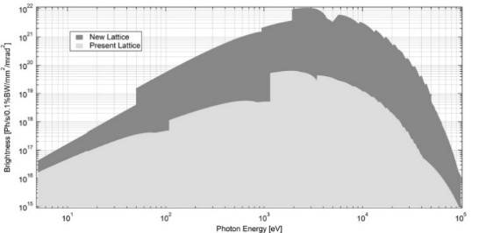
SOLEIL II, an upgrade for tomorrow’s science
SOLEIL II Science drivers
Better performances for Accelerator and photon sources
  Reaching an emittance < 100 pm.rad.
  Keeping the same electron beam energy : 2.75 GeV
  Preserving a maximum current of 500 mA in the multibunch mode.
  LINAC upgrade
  New low-emittance Booster (5 nm.rad)
New access mode with more efficient use of the SOLEIL Beamline
Green infrastructure
  Reduction in the facility
  environmental footprint
  Lower power and water
  consumption
  Reduce operational cost
Beam SIZES
Brightness
< 10 μm x 10 μm

Slide 5
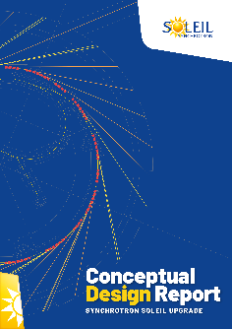
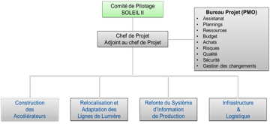
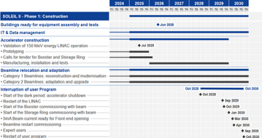
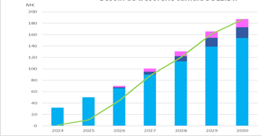
Chronology and Structuration of SOLEIL II Project
Machine shutdown + restart + commissioning = 24 months
External users come back: October 2030
Shutdown
Dark period
2020
2021
2022
2023
2024
2025
2026
2027
2028
2029
2030
2031
2032
2033
2034
2035
CDR
(Conceptual Design report)
TDR
(Technical Design Review)
STAGE 1:
CONSTRUCTION
STAGE 2:
TOWARDS FULL PERFORMANCE
Shutdown and dismantling of the existing machine
Commissioning of the new booster and storage ring
Adaptation and restart of the beamlines
Information System Overhaul
Modernization of the support labs
R&D program on instrumentation
Complete Modernization of the beamlines
Full performance of the accelerators
Modernization of the support labs
R&D program on instrumentation
Evolution towards innovative analysis techniques
STAGE 1 (6 years) : ~ 186 M€
SOLEIL II Budget
~ 309 M€
(includes 8% contingency)
STAGE 2 (5 years) : ~ 123 M€
40th TANGO meeting | SOLEIL II | Y.M.ABIVEN | juin 2026
Notes:
Premiers financements de la Loi de Programmation de la Recherche
Message très fort de soutien -> Débuter sereinement la réalisation du projet avec le lacement des premiers appels d’offre et commandes.

Slide 6
SOLEIL II, Project Organization for the Construction stage 1
Council
CAF
CCA
CEAC
MAC
SAC
External Reviews
Steering Committee
SOLEIL II
Project Management Office
Administrative support
Planning
Resources
Budget
Purchasing
Risks
Quality
Safety
Change Management
1. SOLEIL II Project Phase 1
Project Leader: Amor Nadji
Deputy: Javier Perez
Hélène Rozelot
1.1 Construction
of
Accelerators
1.2 Relocation and adaptation of Beamlines
1.3 Overhaul of the information system
1.4 Infrastructure
&
Logistics
Laurent Nadolski
Patrick Alexandre
Kewin Desjardins
Stephanie Blanchandin
Yves-Marie Abiven
Emiliano Fonda
Christian Herbeaux Mohamed Nouna

Slide 7
Status of the Accelerator Construction

Slide 8
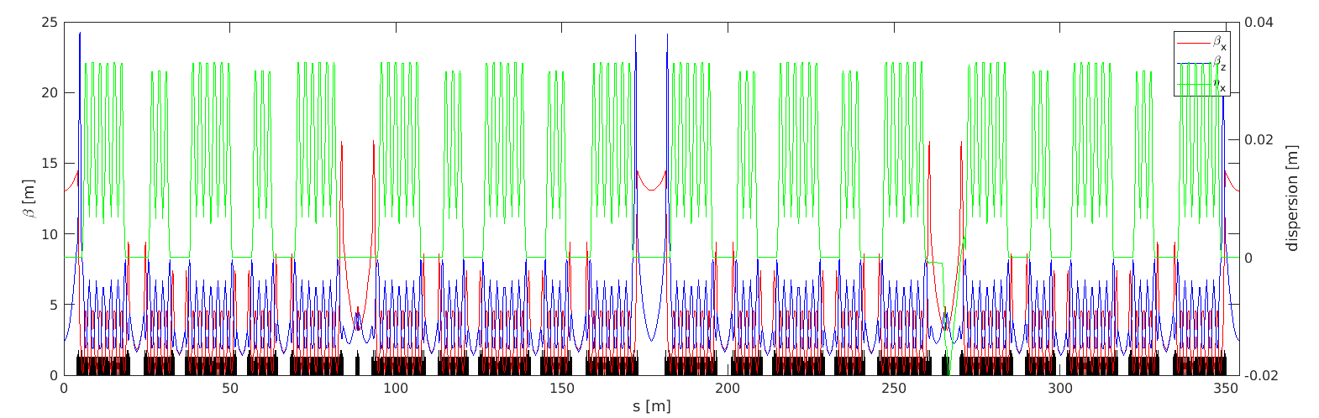
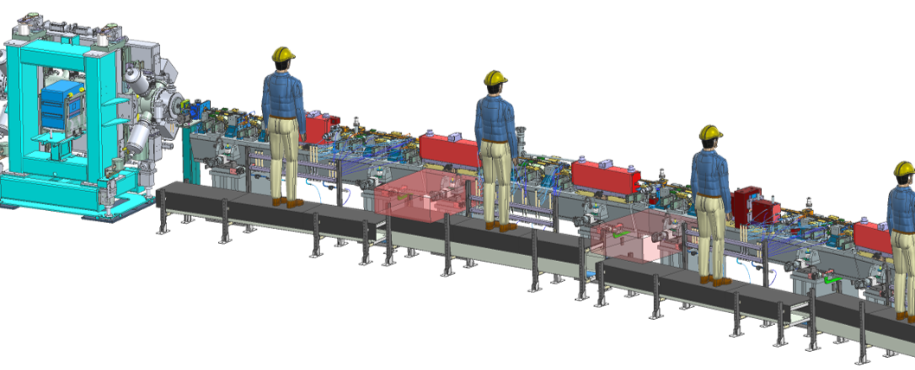
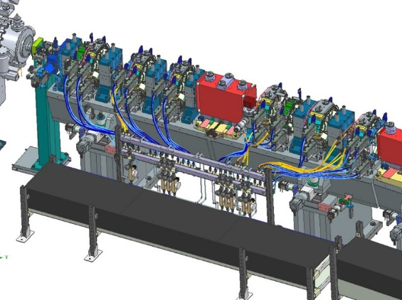
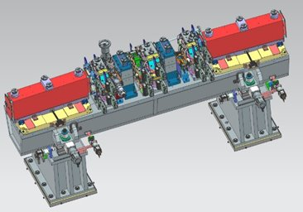
Accelerator Construction Program
Lattice frozen end of January 2026
Continuation of simulations to refine specifications:
  Loss simulations: collimator design, interlock definition
  Stability simulations: feedback and FFWD design, power supply control
  Radiation protection simulations to validate the collimator design and beam dump chamber, as well as to prepare the decommissioning report
Consolidation of mechanical integration
Study of specific extraction lines for beamlines (IR, UV, MRSV, MARS…)
Interface refinement for cooling, electrical cabling, etc..
Lattice V3635(6): 3D mechanical integration done at 80%

Slide 9
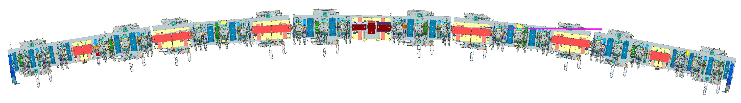
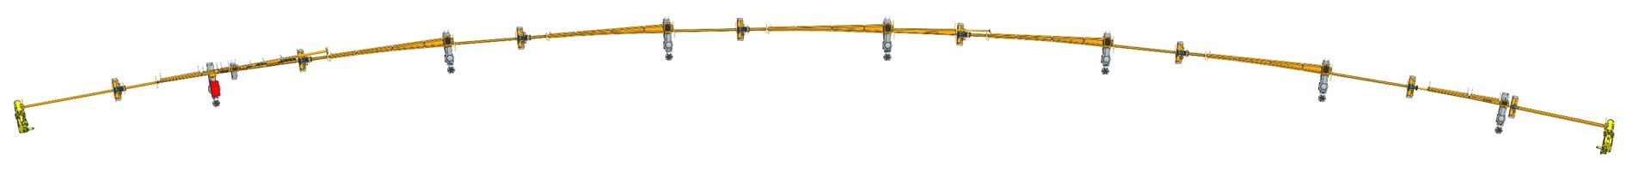
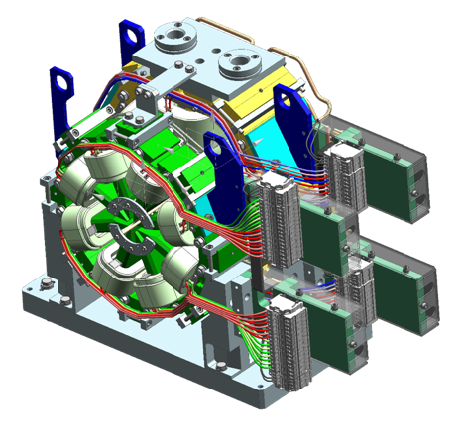
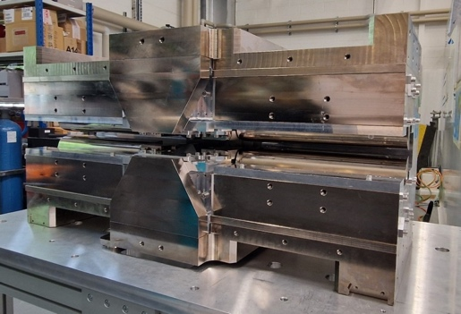

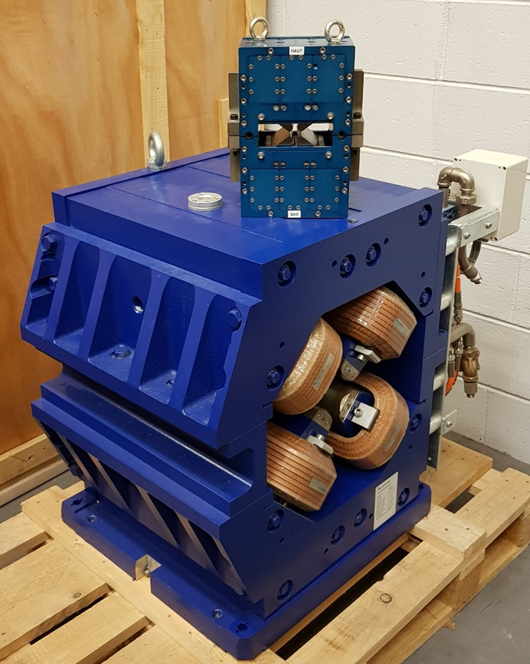
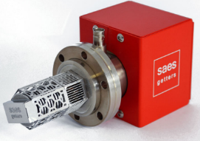
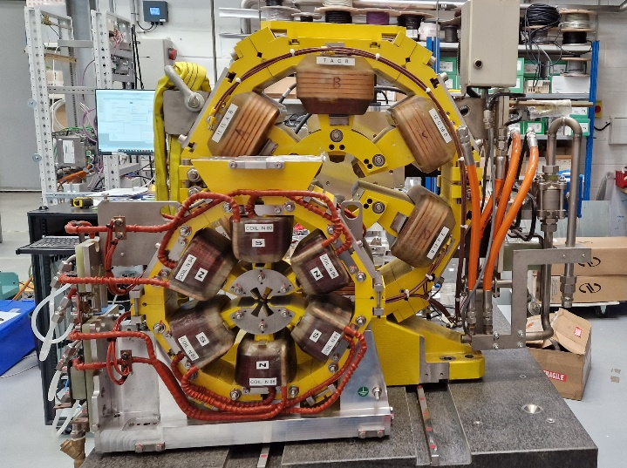
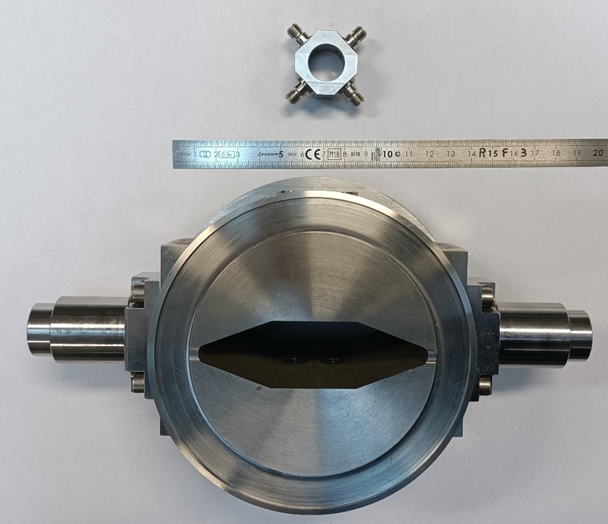
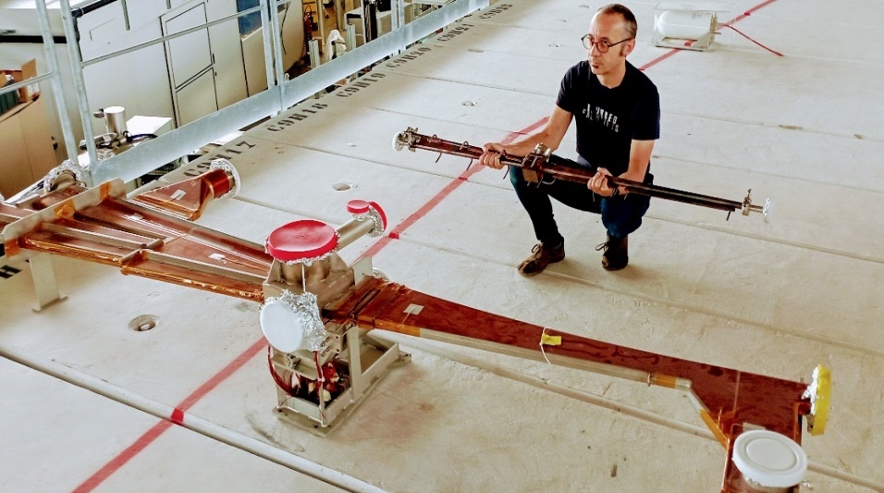
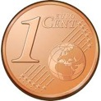
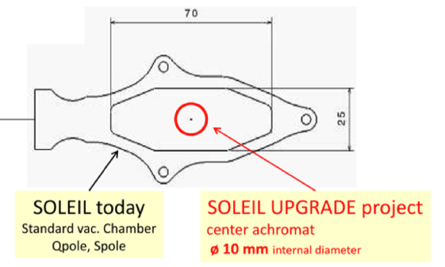
Integration challenge of the 20 Arcs of the Storage Ring
Sextupoles
Reverse Bends
Octupole (QP + SQ)
Quadrupoles
DNL1.03
DNL1.04
DNL1.05
DNC1.01
DNL1.02
DNL1.06
DNC1.07
Pump
Doublet :
sextupole / octupole
3T magnet prototype
(Old design)
Valve
Quadrupole SOLEIL/SOLEIL II
Smaller than a 1-cent coin:
Its diameter is 16.25 mm
Sextupole SOLEIL/SOLEIL II
BPM vacuum chamber SOLEIL/SOLEIL II
Dipole Arc Vacuum chamber SOLEIL/SOLEIL II
Ø 12 mm internal
Notes:
Non-standard MBA lattice: 12 x 7BA + 8 x 4BA (20 cells)
Vacuum chamber for a standard 7BA cell (16 m)
Assembly of 10 chambers into a single sector (ex-situ bakeout)

Slide 10
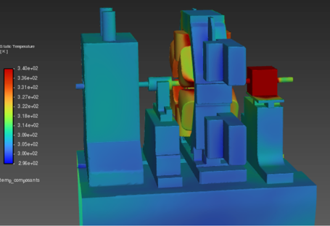
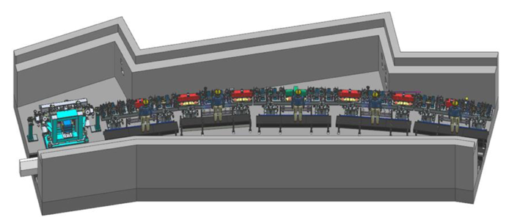
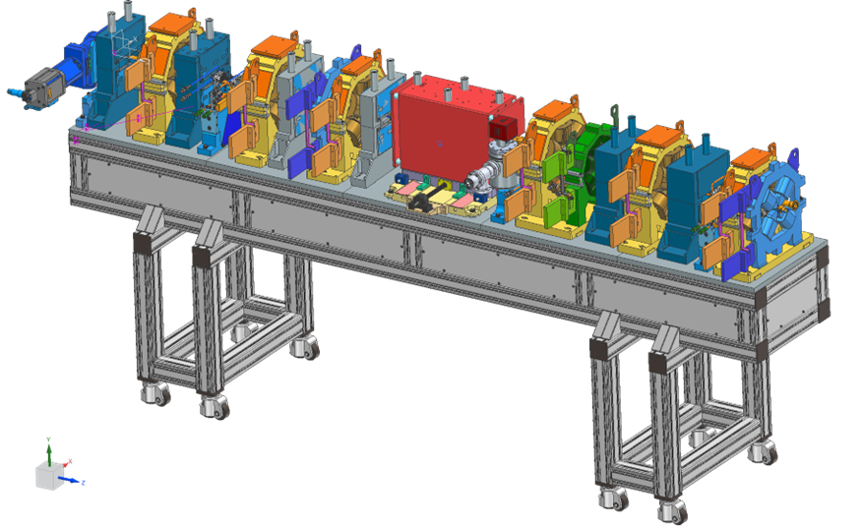
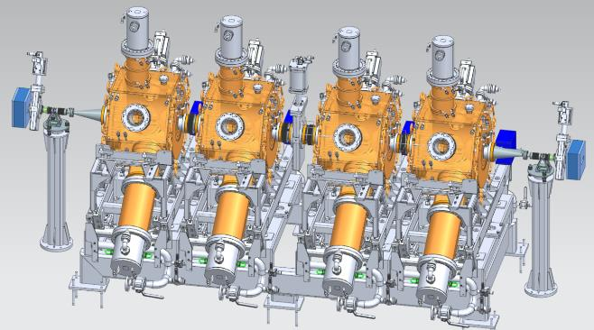
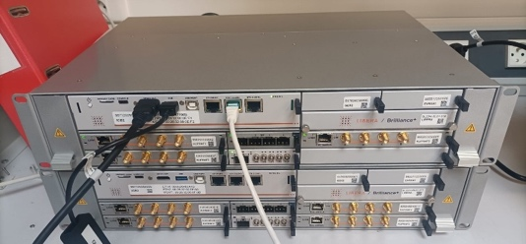
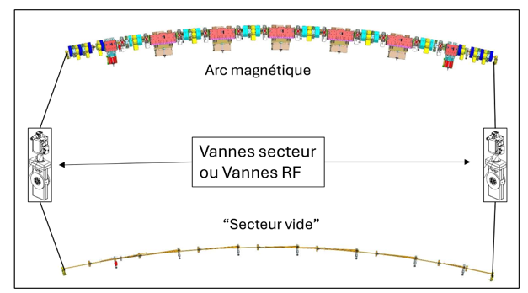
Accelerator Construction Program
150 MeV LINAC Upgrade
  Increase the LINAC energy and its associated transfer line to 150 MeV (compared to the current 110 MeV) by summer 2026, to support injection into the new low-emittance booster of SOLEIL II.
Several equipment already in the construction phase (for example):
  Fundamental radiofrequency cavities
  Position monitor electronics
  Ultra-high vacuum systems: valves, pumps
  The MIK (elements at the heart of transparent injection for the beamlines)
Procurement of all RF systems largely launched in 2025 with additional orders in 2026
2026: year to launch of the main calls for tender
  Vacuum chambers for the storage ring (148)
  Magnets (1287)
  Synchronization (Machine and Beamlines)
  BPM buttons
  ...
Finalisation of prototypes and studies (machine safety, air conditioning to be replaced...)
Cell integrated in the tunnel
3D thermal simulations of the tunnel
Main RF cavities
Pre-mockup of a girder design
RF valve
BPM electronics
SOLEIL / SOLEIL II

Slide 11
Status for
Beamlines Relocation & Adaptation

Slide 12
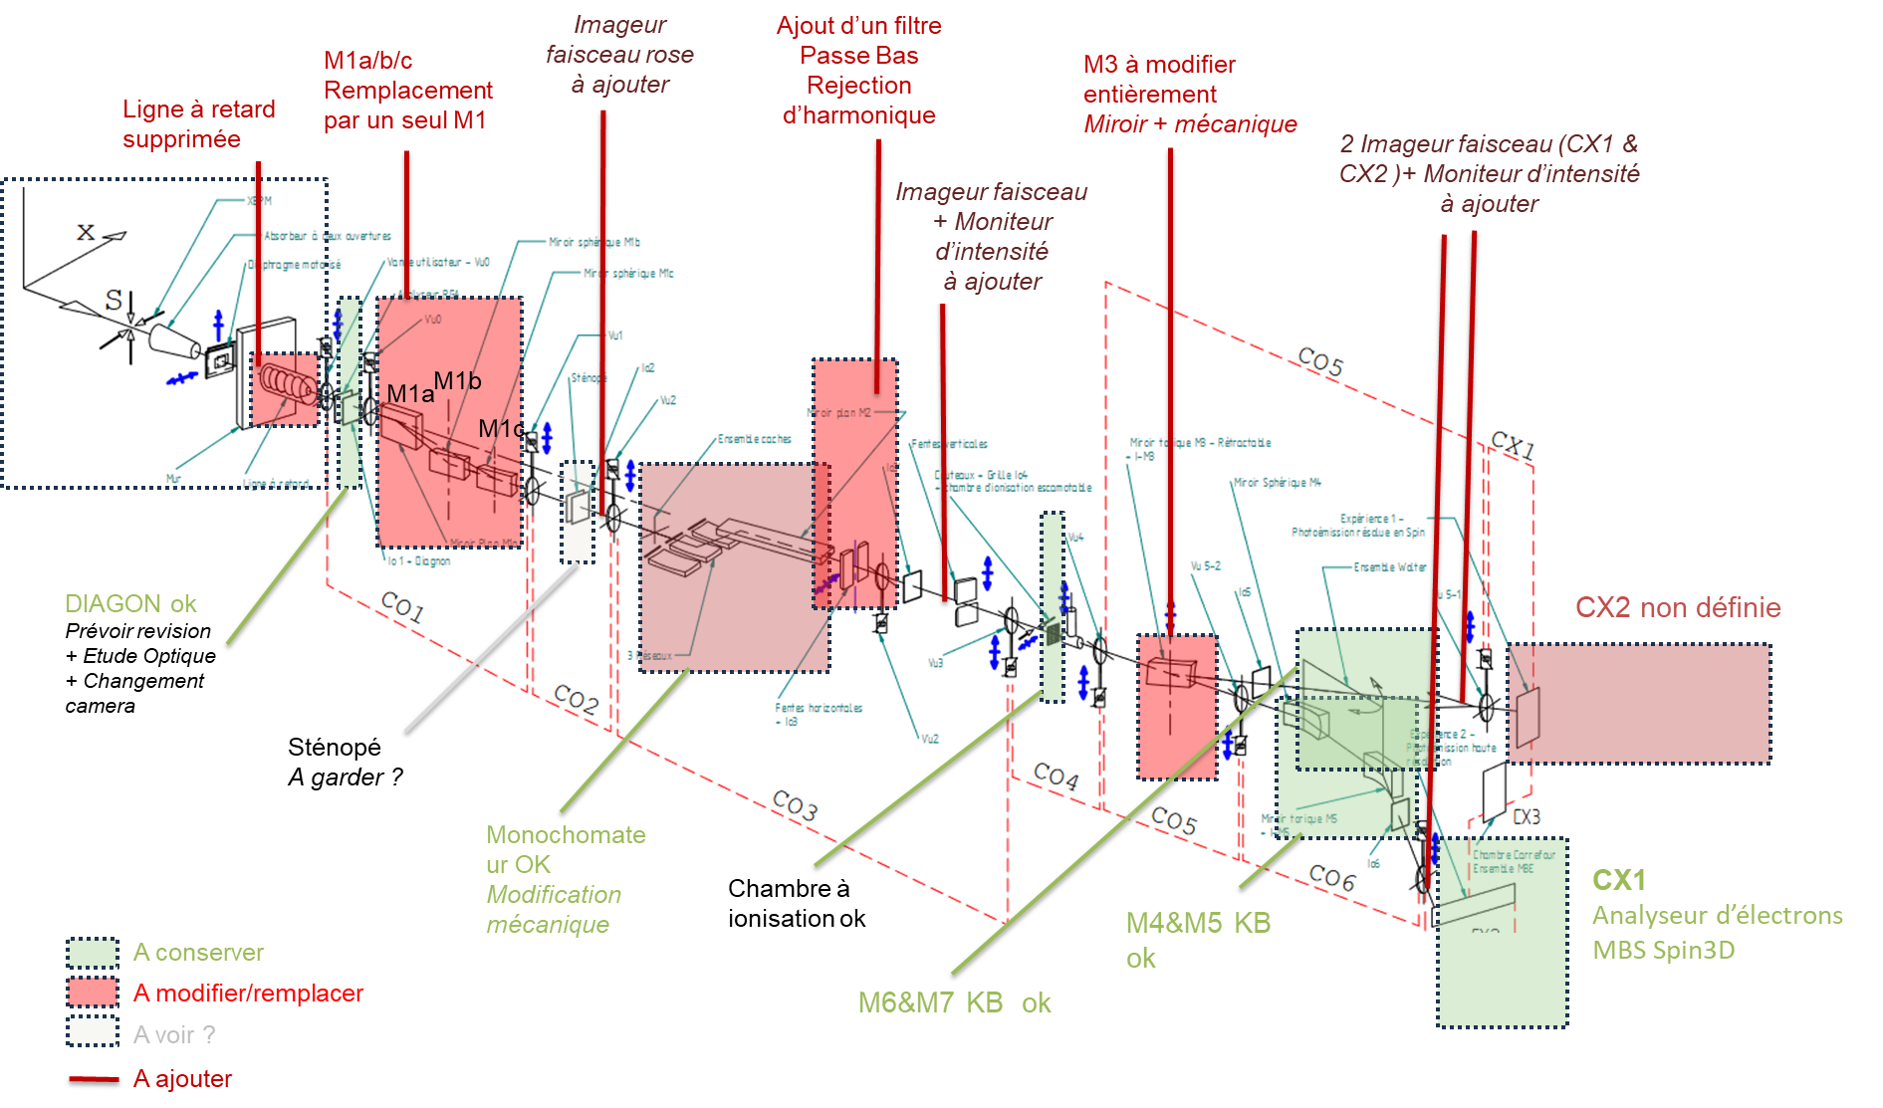
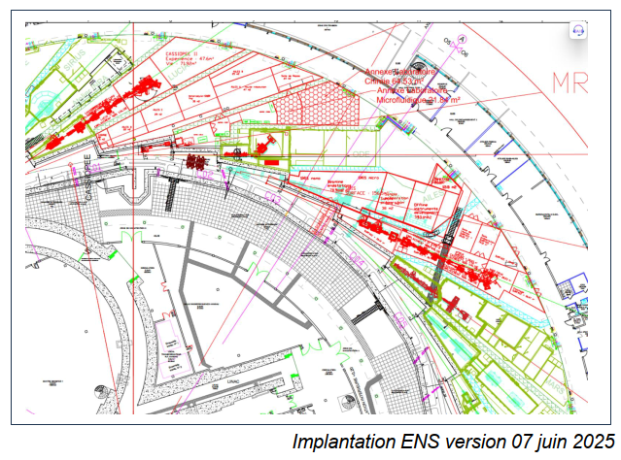
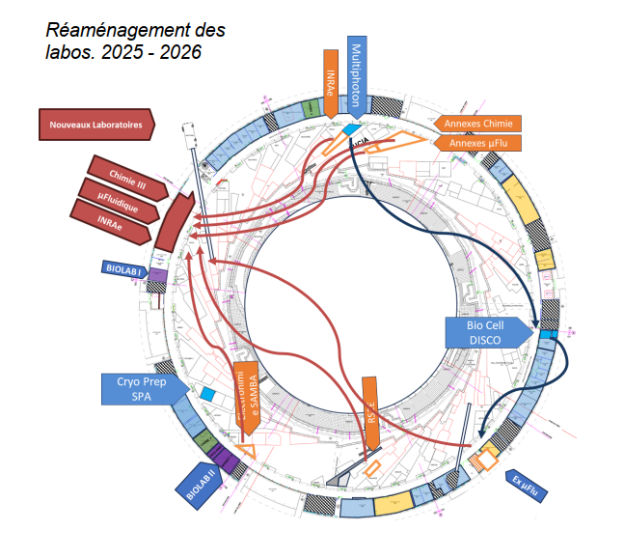
Beamlines Relocation & Adaptation
Study of upcoming adaptations for the beamlines
Study of beamline hutch adaptations
Study of logistics for the beamlines
Study of support laboratory reorganisation
Studies of interfaces with the storage ring
  FE adaptations
  Infrared extraction

Slide 13
Status for
Building Infrastructure and Logistics

Slide 14
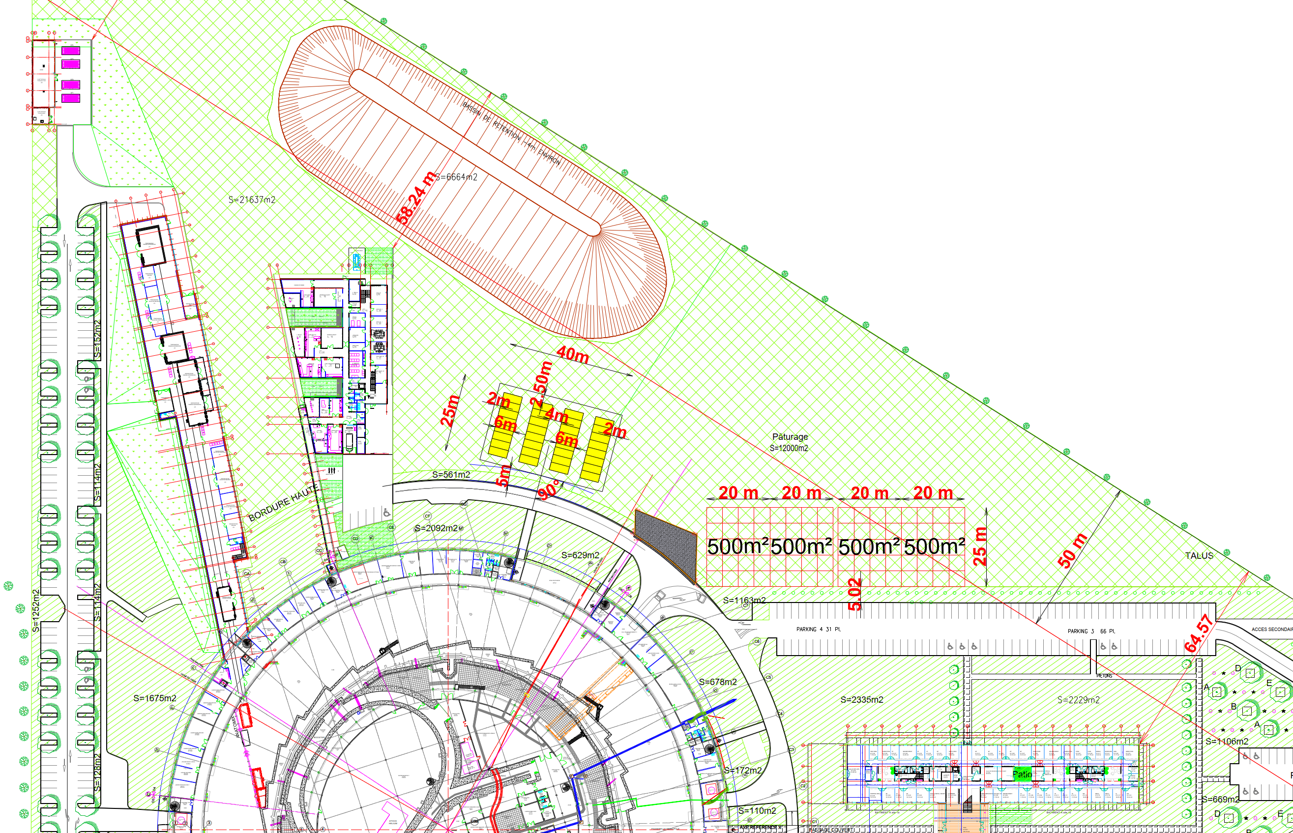
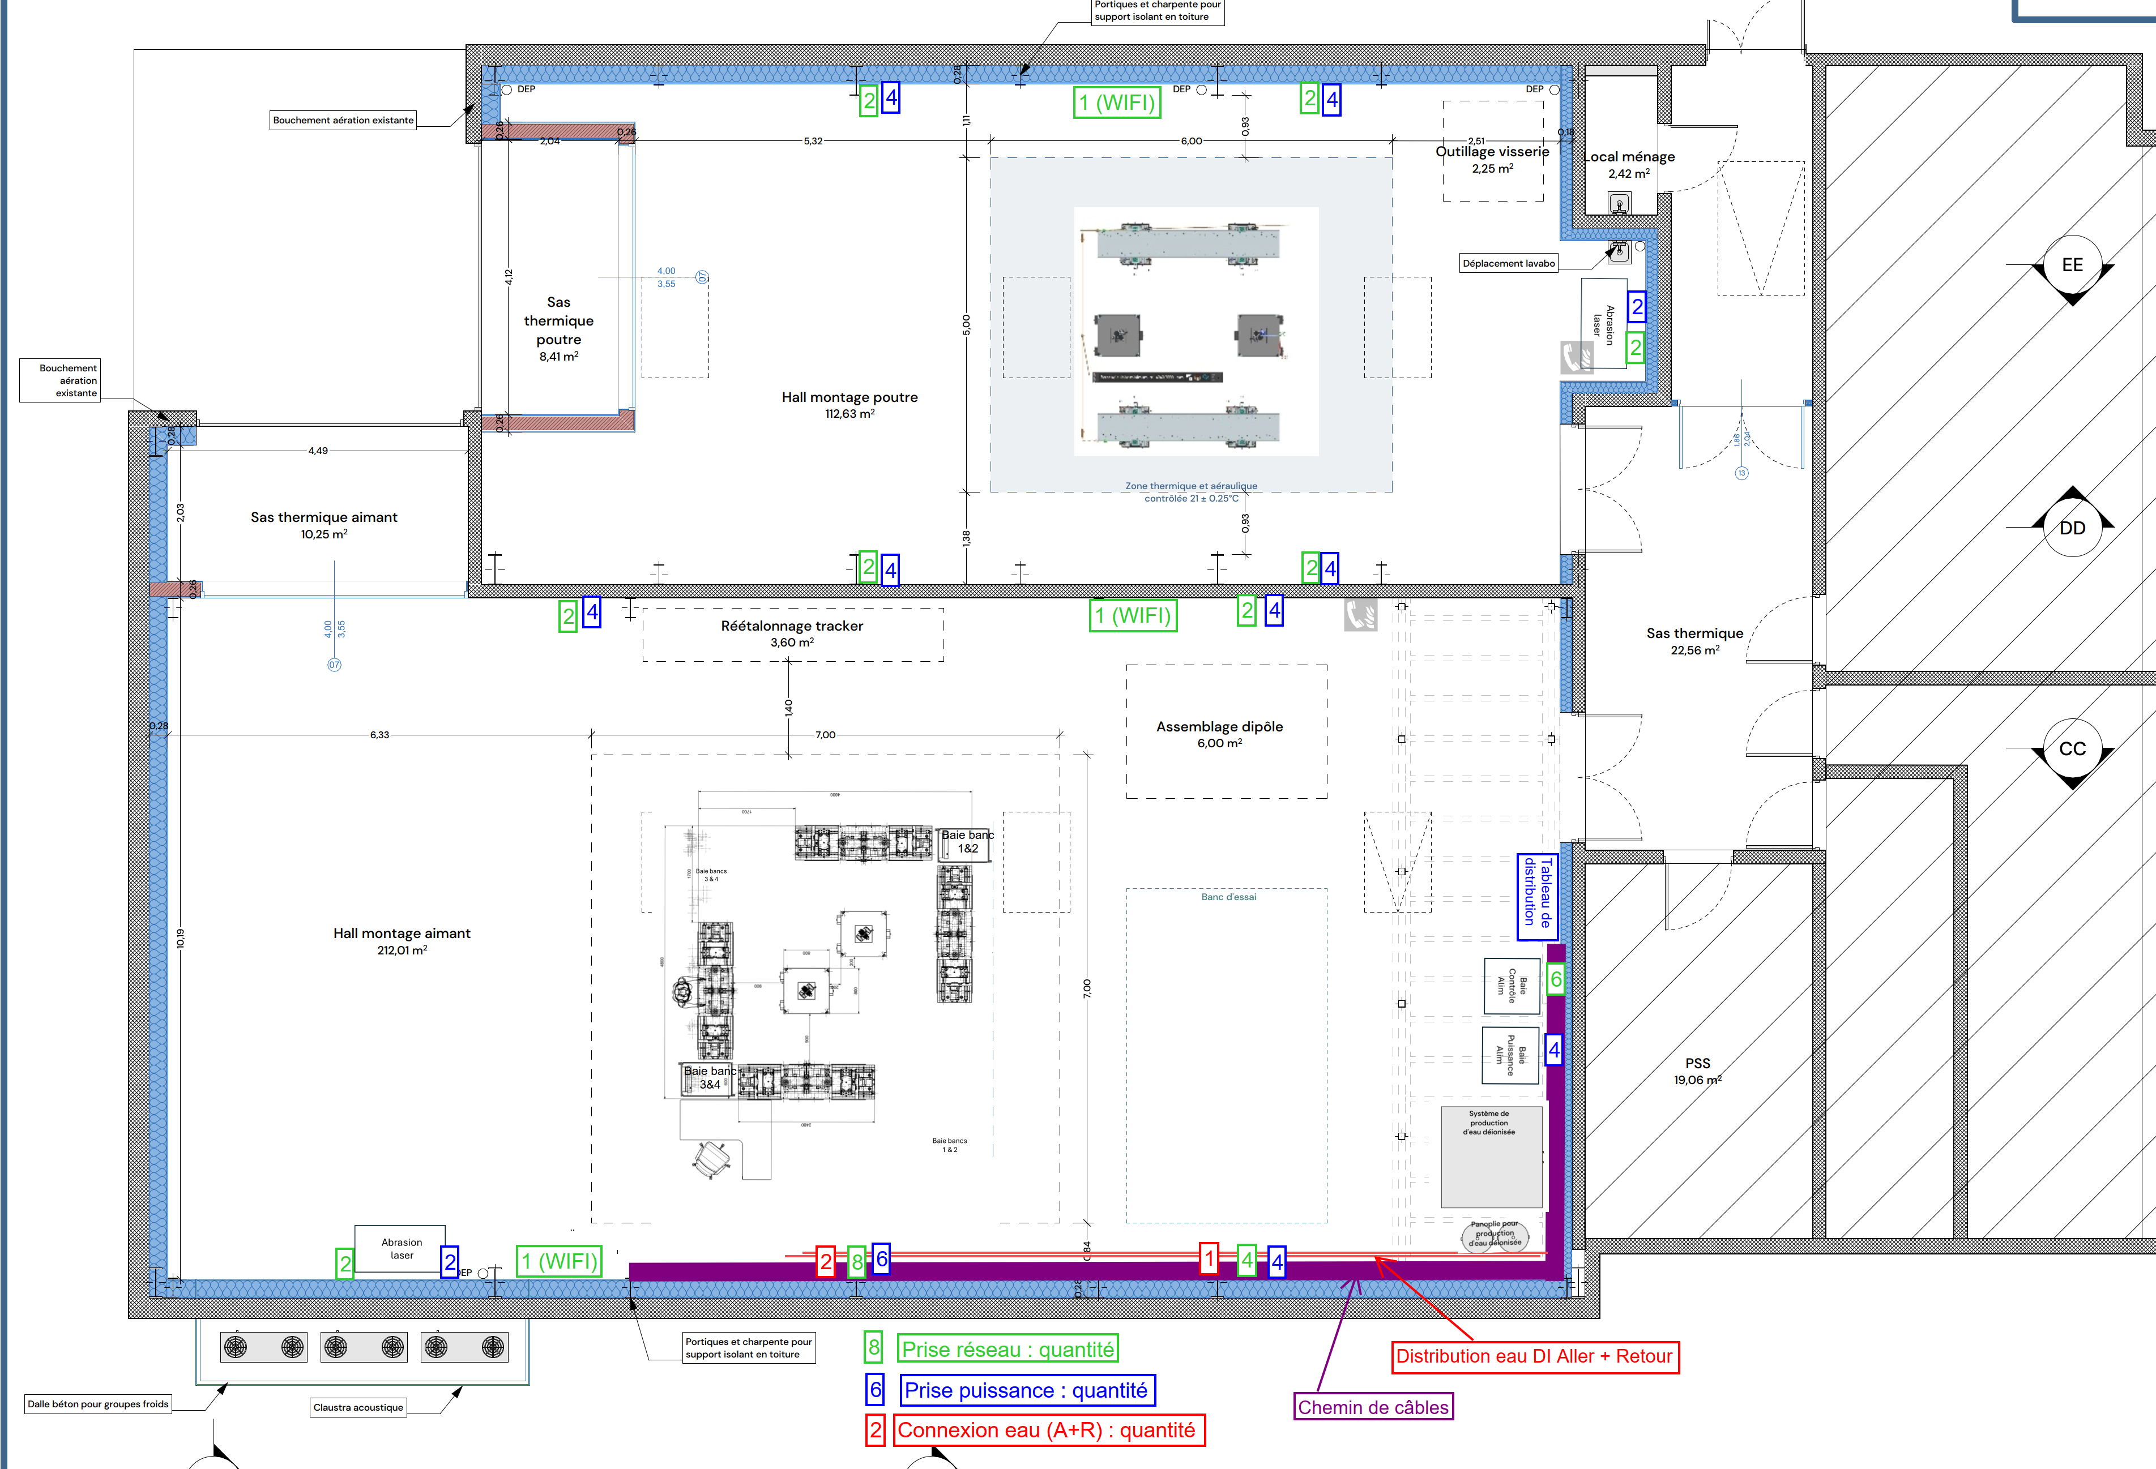
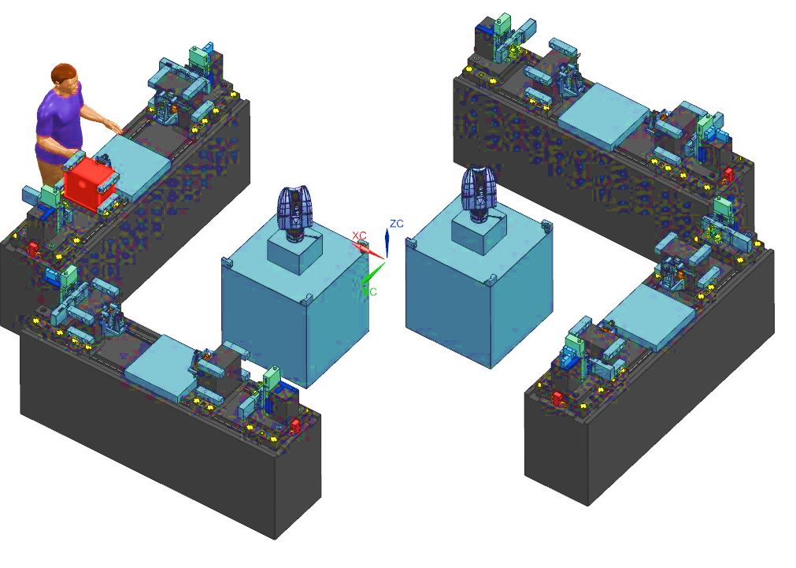
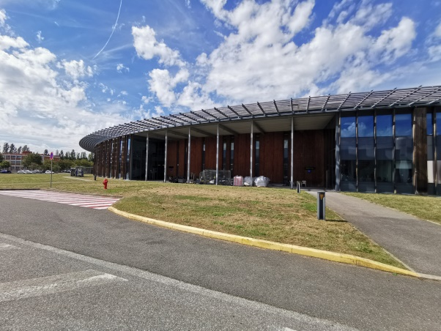
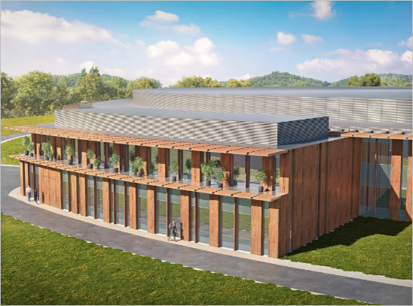
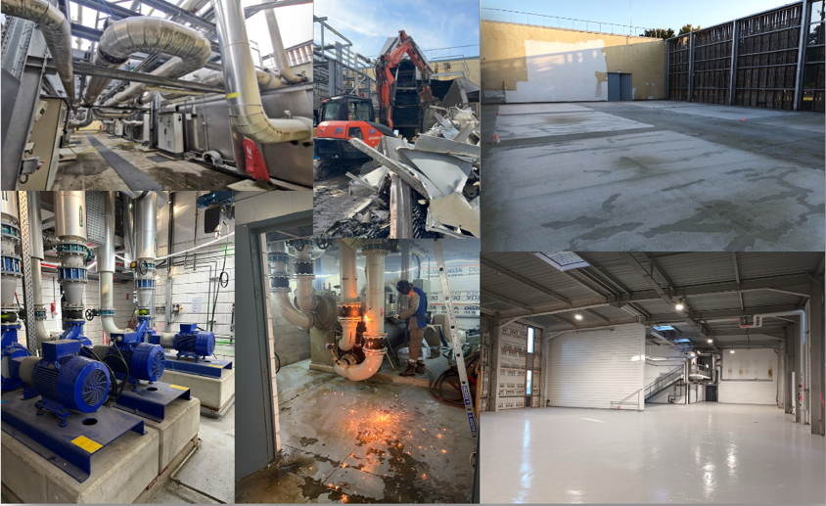
Extension Buildings for Assembly and Pre-Staging
Future Magnetic Bench (T5)
2027 - 2032
Thermal control 21°C +/- 0.25°C
Site office for outside contractors
SOLEIL Storage
Outside Contractors Storage
5 m x 5 m
granite
Building Refurbishment
Delivery Unloading
of heavy trucks
SOLEIL Storage Facility 1,000 m² + Storage Facility (Area) for External Contractors 1,000 m²
2028
The East extension (OREST) will have a ground surface area of 715 m² and a floor surface area of 680 m², i.e. a total of 1395 m².

Slide 15
Status for
Overhaul of the Information System

Slide 16
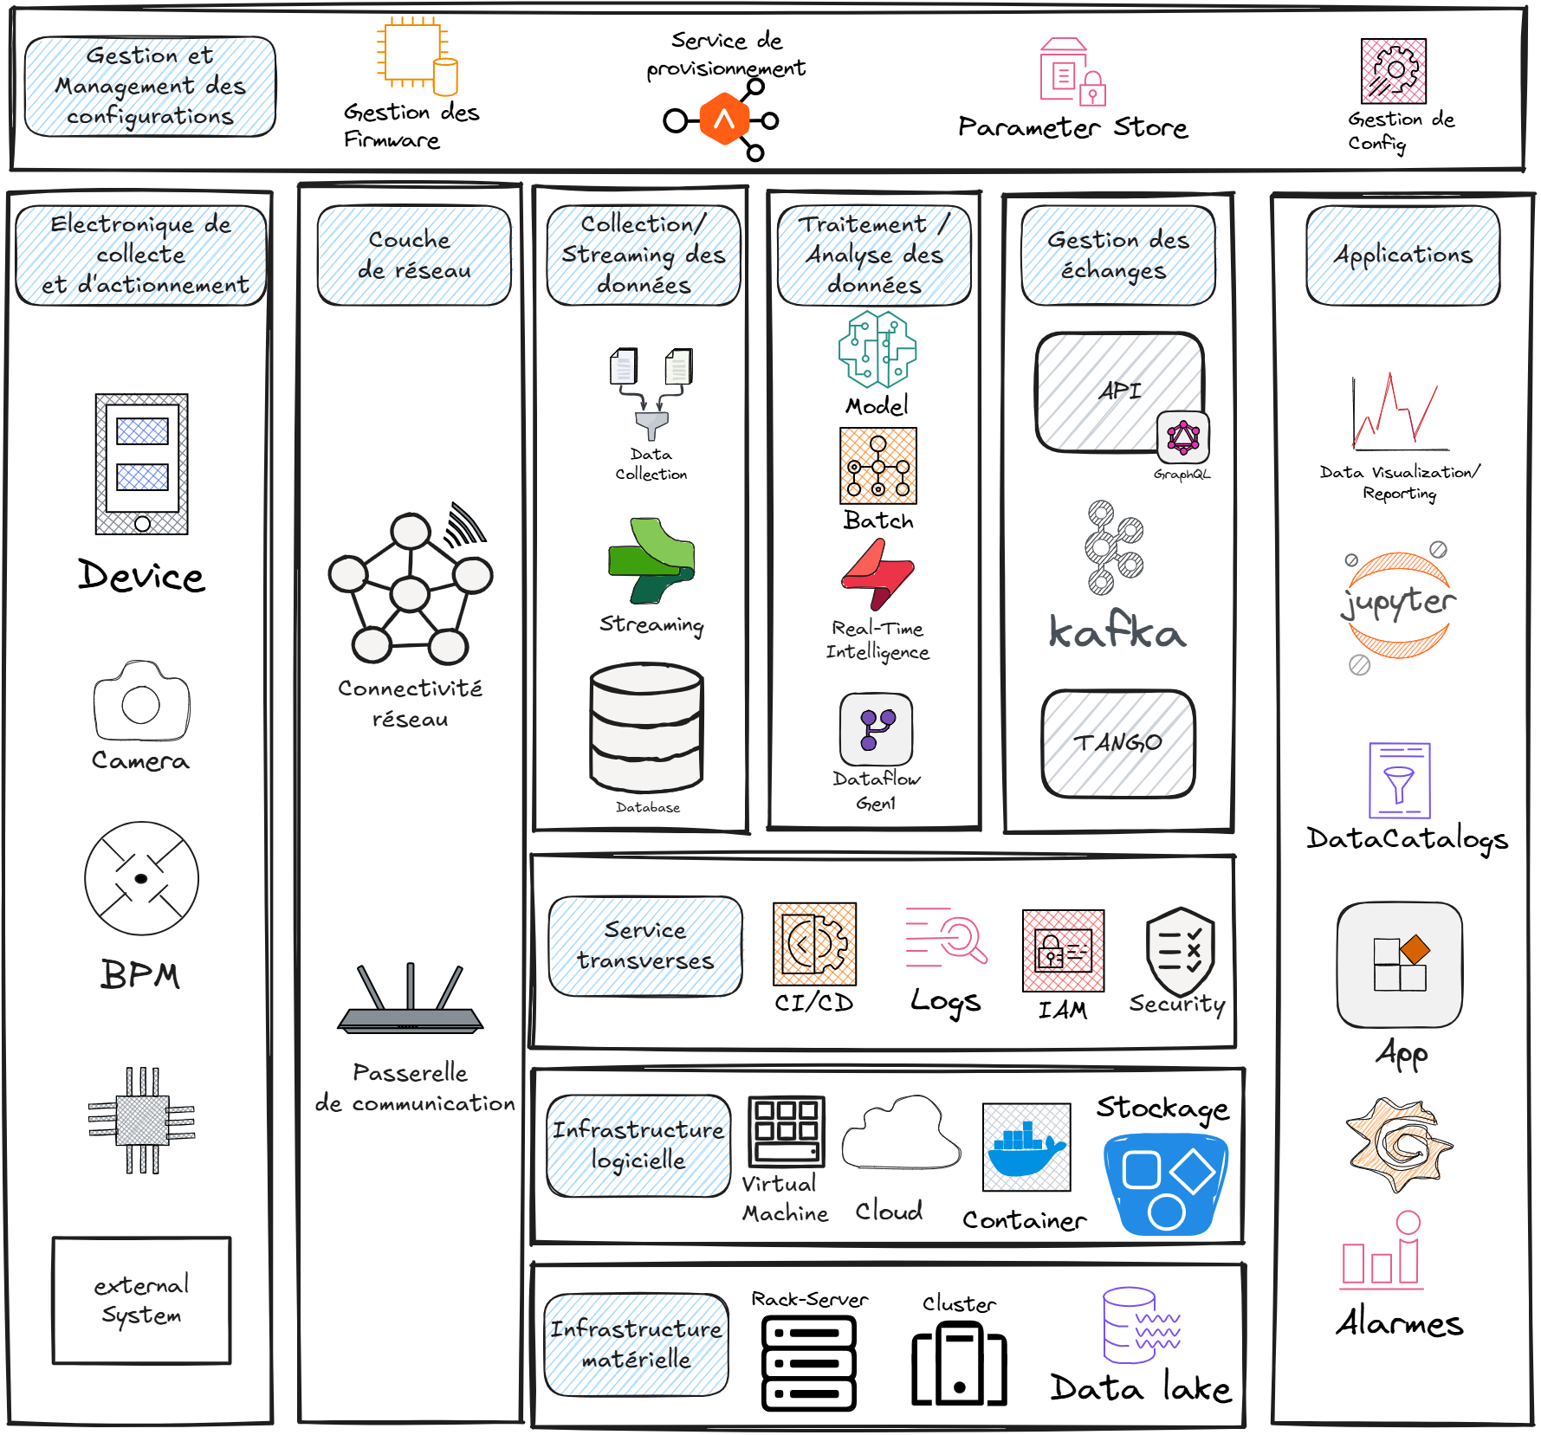
Overhaul of the Information System
Modernize IT infrastructures, systems and services so that the Information System:
Adapts to new scientific contexts and challenges
Remains modular, performant and resilient
Deliver and/or integrate all systems and services that will support the ramp-up to full performance at stage 2 for:
The commissioning and operation of the accelerators
The beam recovery on the beamlines and the restart of the user programme
The means for infrastructures and logistical tracking to efficiently prepare the SOLEIL II components

Slide 17
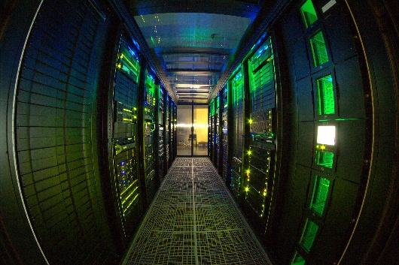


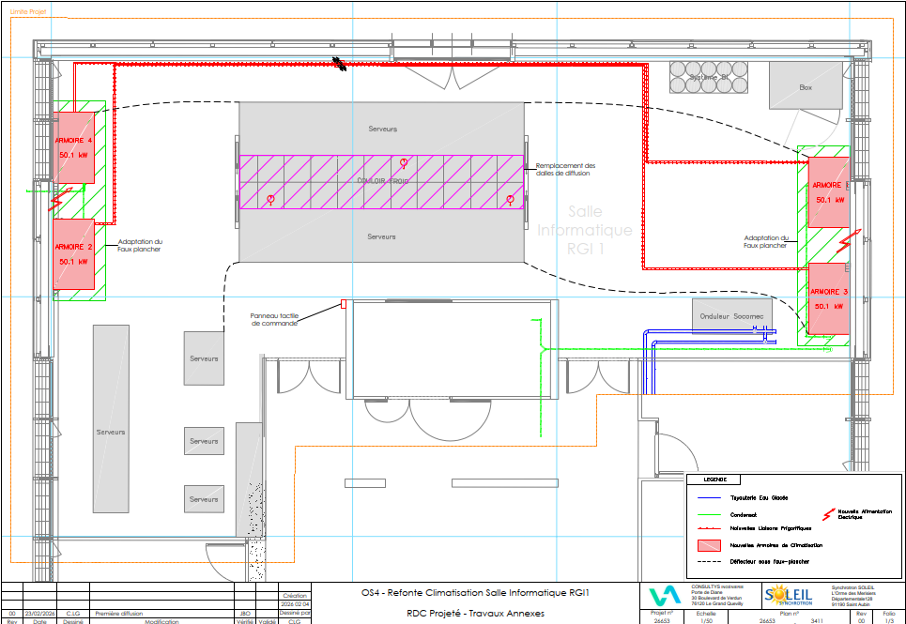

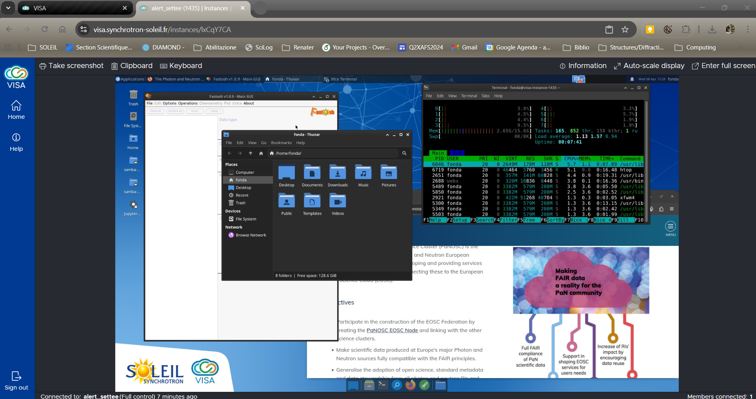

Ongoing infrastructure upgrades
IT transformation
  RGI1 Data Center air conditioning study
  HPC GPU sizing an increase
  Network segmentation study
  Study of the centralisation of control servers and computing resources
  Installation of GPFS storage for data coming from acquisition
Hosting infrastructures
  Implementation of a Docker Swarm cluster to provide resilience, scalability and ease of management
  OpenStack deploy for VISA
  VISA : PANOSC : https://www.panosc.eu/panosc-eosc-node/
Data center RGI 1
RGI1 cooling and ventilation overhaul study

Slide 18
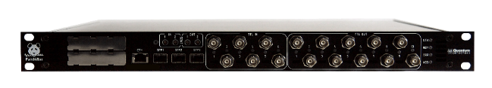
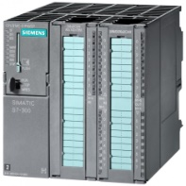















Control and Acquisition Hardware transformation
< 1kHz: New generation PLCs
>1kHz: DAQ Hardware
Analog and Digital signals
Preferred | Also supported | Not supported
0-10V / 0-5V 4-20mA / 0-20mA 24V I/O Dry contacts RTD Thermocouple | Open collector I/O | TTL signals Reed contacts
S7-300
S7-1500
PandABox II
Collaboration SOLEIL, DIAMOND, MAX IV, ALBA, and DESY
On the fly sample scanning, feedback, power supply control
Digital Protocols
Preferred | Also supported |  | Not supported
Protocols natively supported by SIEMENS PLC | Protocols requiring additional programming work | Protocols requiring gateways and/or programming | Media incompatibilty
Ethernet-based ProfiNet OPC UA ProfiBus DP | ModBus TCP ASCII protocols based on TCP/IP frame | EtherCAT CAN ASCII or RTU ModBus on RS232/485 | USB
Beam diagnostics, FOFB, DLLRF
Compact PCI
RF cavities
Industrial
Rapsberry Pi
Magnet power supplies
Hirschmann GECKO series
Switchs/routers
MOXA
Function Generator/ Controller
(CERN FGC)

Slide 19







Enhancement of the Data Platform and Software Lifecycle Management
The data platform
  TANGO will remain the framework for controlling the systems and collecting the data
  Engineering and experimental data catalogue
  Deployment of TANGO archiving and Grafana
  See talk G.Abeillé about Status of the TANGO Archiving System at SOLEIL
Common framework for developing, integrating and deploying
  Development environments (Conda, Python, C++, Java)
  Controlled lifecycle (CI/CD, packaging, deployment)
  Simulated platforms (dev, test, integration)
  Deployment of TAURUS, graphical interface development environment
  Development of PyAML and the Digital Twin of the accelerators
  Implementation of common CI/CD practices and training to develop collaboratively within the Information System
Taurus Workshop — May 12–13 at SOLEIL

Slide 20









Specific Accelerators Services
Digital twin
Smart systems
Reliable, high-efficiency accelerators

Slide 21
















Ongoing development for Accelerators
Upgraded control for TL1:
Gamma monitor control refurbishment based on PLC
Charge measurement and injection efficiency developed with PandABox
Fluorescence Screen and ARMO (Beam stop)
control, upgraded with PLC
PSS permits control upgraded with MOXA server
Neutron monitor control upgraded on MOXA server
Vacuum control migration on new PLCs
Magnet Power Supplies control on PLCs. Nearly ready, installation foreseen in May 2026
Shutdown the RF cavity
<200 µs
Machine Status
TL1 with 150 MeV Linac
Machine Protection System
New FOFB architecture
Coupling Feedback
DLLRF
PLC
Power supply and magnet control
FGC
PandABox

Slide 22


Commissioning Tools: Progress Report
Python Accelerator Middle Layer (pyAML)
  A joint technology platform for design, commissioning and operation of particle accelerators
  Hackathon in January 2026
  Available in the control room for testing Python Software
  Hardware abstraction done: hardware-to-physics conversion​
  A set of basic tools available : chromaticity, tune, orbit response matrix​
  User-friendly API: device arrays, yellow pages, …
  Based on PyAT​
Digital Twin for Acclerator
  All major hardware devices are simulated: BPMs, Magnets, RF, …​
  A monitoring device for simulator actions (reset) and some data aggregation​
  One configuration file and a lattice are enough to launch a complete simulator​
  Ability to launch only a subset of simulated devices​
  Still an on-going development, no release yet​
  Works with both EPICS and Tango​
  Based on PyAT​
3rd Accelerator Middle Layer Workshop!
https://indico.synchrotron-soleil.fr/event/125/overview

Slide 23



Work in Progress between IT teams and the beamlines
Collect the information regarding the instrumentation upgrade for SOLEIL II.
Communicate the ongoing transformation from the Information System perspective:
  Network, Server centralization, Storage, etc.
Preparing future requirements for data acquisition architecture:
  Detector throughput, streaming requirements, online data processing, workflow (Ewoks@ESRF).
Working on higher degree of automation of instruments/processes
    Automatic beam and samples alignment
Diagram of the CASSIOPEE beamline adaptations
Today
SOLEIL II
Eiger 16M (133 fps) → ≈ 40 Gbps
    “CITIUS 16M” (17.4 kfps) → ≈ XXXX Gbps

Slide 24











Digitalization of Logistics Processes
Suppliers
Logistics Team
Business Units
Finance
SOLEIL Organization
Project Team
Purchasing
Naming convention
Radian (Cabling Database)
Logistic tracking tool
See A.Tison talk aboutTANGO administration tooling and database monitoring

Slide 25
Next step for SOLEIL II

Slide 26
Conclusions and Perspectives
SOLEIL II: an ambitious project
  A new SOLEIL for tomorrow's science
  The Information System must be ready to easily move toward full performance with:
    Secured and robust infrastructure
    Ready to manage high data throughput
    Automation at the heart of the data-driven strategy
    Providing Data with FAIR Principles
Human resources challenges
  Balance between project and operation
  Ring-fence the project teams in a complex context to hire computing skills
  Reinforcement of the teams through subcontractor procurement
Securing integration and IT transformation
  Validation of the full stack integration
  Building development, test and production environments to develop applications for commissioning and operation
  Enhance automation to facilitate development and Business As Usual
Collaboration
  Collaborative development with friendly colleagues at other facilities will be pursued: TANGO, TAURUS, PandABox, PyAML, LEAPS, …
  New collaborative developments are welcome!
We are hiring !
Motivated by an ambitious project and enthusiastic to contribute to new IT challenges
We are hiring !
Full stack Engineer
FPGA developpers
Cloud & DevOps Engineer
SysOps Engineer
…
See positions
https://www.synchrotron-soleil.fr/en/job-offers
Contact:
yves-marie.abiven@synchrotron-soleil.fr
Notes:
Organization
Nouvelle structure projet en place.
Travail au niveau des interfaces
Objectif : mise à jour des plannings en fin d’année
At AT level agile work has been introduced withh all the stakeholder including the 4 programs
Collaboration
Cybertsecurity integration in the control architecture remains challenging bein que essentiel
Produire un Avant-Projet Détaillé allant jusqu’aux cahiers des charges permettant de lancer les premiers appels d’offres dès l’approbation du projet.
Poursuivre l’étude de risques et le programme de prototypage permettant de réduire les risques techniques.
• Produire un planning détaillé de la construction et un profil budgétaire incluant les ressources humaines et prenant en compte la logistique.
• Préparer les procédures d’appels d’offres et identifier les entreprises capables de répondre.
• Préparer l’évaluation de l’impact socio-économique du projet.
• Anticiper les besoins logistiques et en bâtiments avec en particulier la construction de l’extension du bâtiment synchrotron (Oreille Est) et du bâtiment T7 (nouvelle station de refroidissement).

Slide 27






TAURUS Collaboration workshop
Passionate minds, shared knowledge: the formula for great collaboration !

Slide 28


Questions

