Slide 1
Tango Keystore
40th Tango Community meeting
Jun 8 – 12, 2026
ALBA Synchrotron
Ezequiel Panepucci
Anton Joubert
Benjamin Bertrand
Dmitry Egorov
Claude

Slide 2
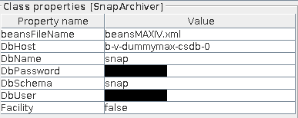

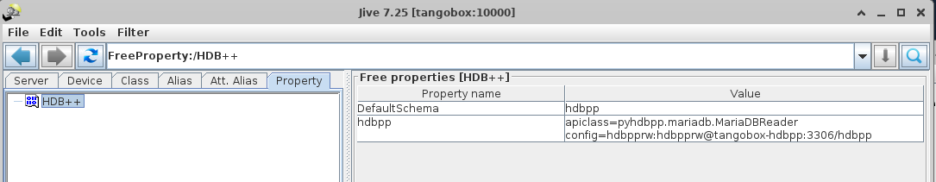
Different ways to store configuration in Tango
Device Properties
Class Properties
Files on disk
Free Properties

Slide 3
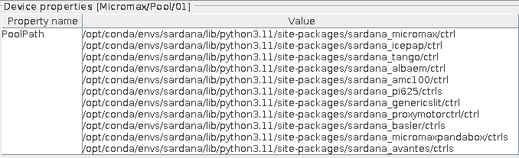
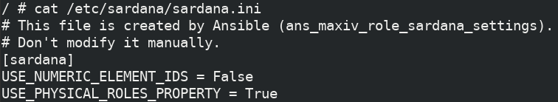
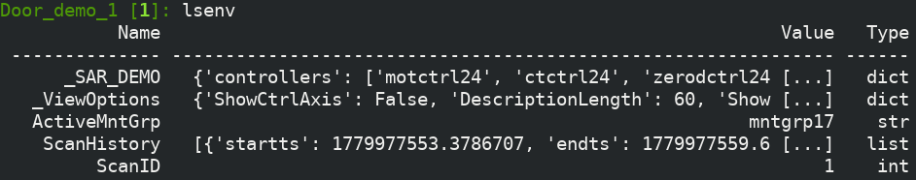
Sardana configuration
Tango Properties
(modules can be reloaded during the runtime)
Sardana custom settings file
(Permanent settings)
Macro environment variables (also saved in macro.properties file)
The variables are fully accessible and can be modified
It’s now possible to use TangoDBEnvironmentBackend in Sardana 3.7.0!

Slide 4

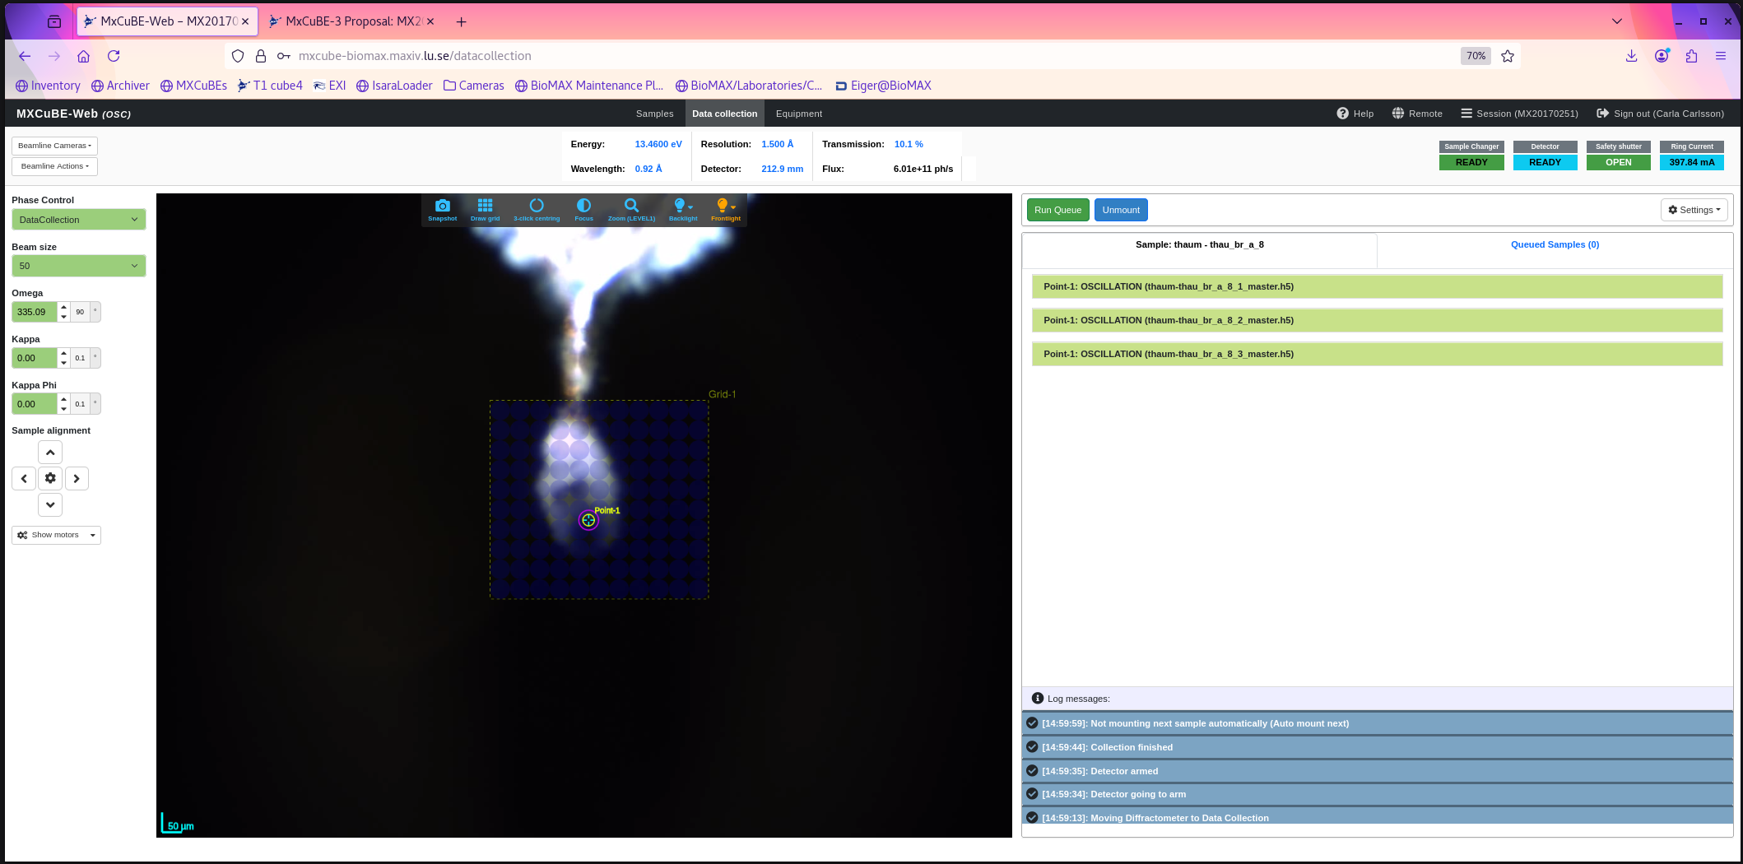
MxCube
UI (REACT)
Web (Flask)
Core (Python)
Tango
Sardana
Vendor API
ISPyB, SDM, …
Hardware Objects
mxcubeweb
mxcubecore
Detector, Sample Changer, Beamline, HPC
Real World
Controls
Hardware Objects
Configuration
Core Abstraction
Adapters / Models
Flask
REDUX
REACT UI
Classes dynamically loaded from YAML/XML. Can’t be “reloaded” without restart.

Slide 5
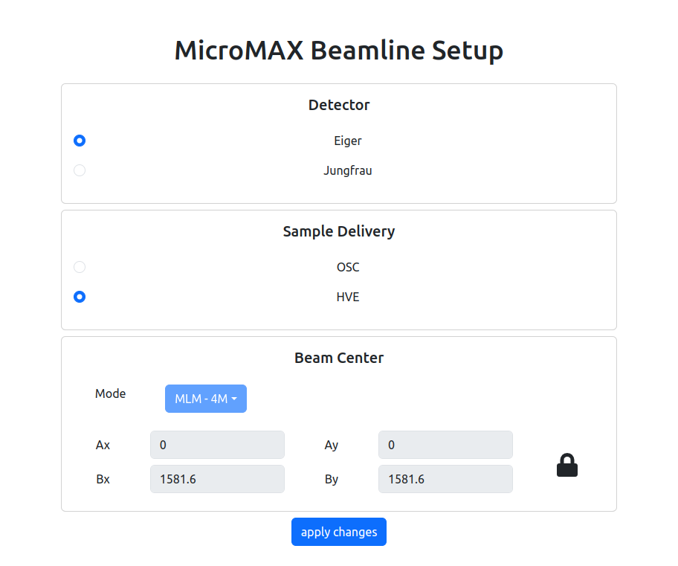
MicroMAX MXCuBE configuration dashboard
👍Web interface, easy to use
🙈Not so easy to extend and adapt to all beamline requirements
👎Needs to be hosted and configured independently
👎Attached to one instance of MXCuBE – hard to switch between test and production
Can we use TangoDB and Free properties?

Slide 6
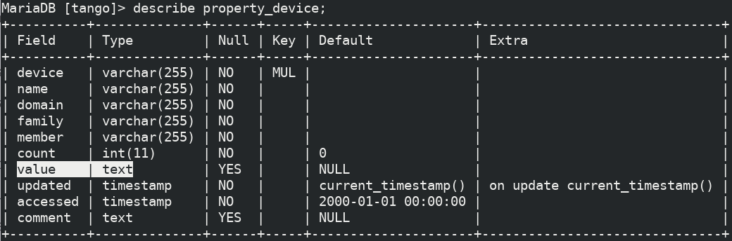
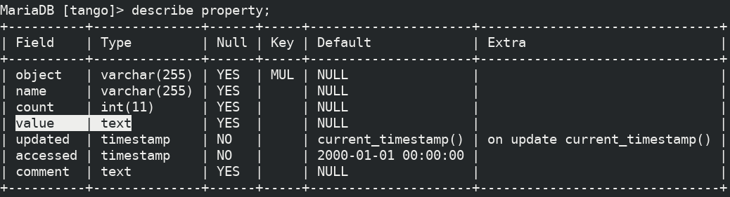
How Tango properties are stored and read
Property values can come in several different data formats,
depending on the complexity and requirements of the device or class. (Tango documentation)
Types for device and class properties are defined in the device code
Free properties have no “owner” and different clients must know
how to interpret and parse it!

Slide 7
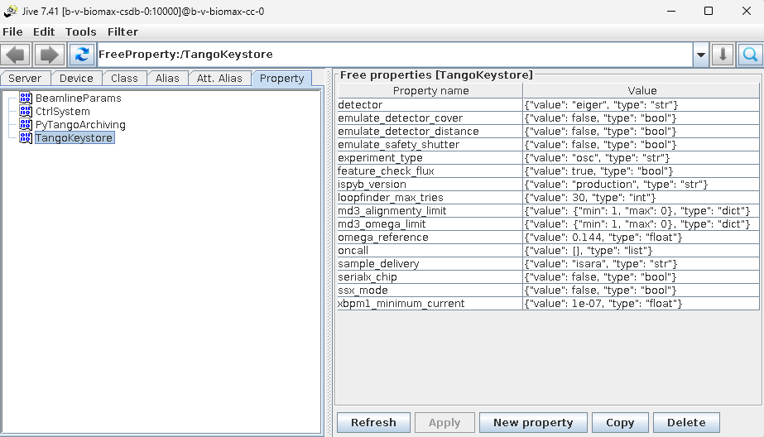
Tango Keystore
A Python module for managing key-value pairs in Tango database’s Free Property section while preserving Python types.

Slide 8
Tango Keystore features
Preserves original Python types (int, float, str, bool, list, dict, None)
Key name validation, which means that keys are also valid Python identifiers
Automatic serialization/deserialization using JSON
Key existence checking. No default values, keys must exist before being accessed
Bulk operations (get_all, clear)
Save to and load from files
Create and restore tags - “snapshots” of values to switch between different set of values
Can be used as CLI or imported package

Slide 9
Tango Keystore CLI
$ tango-keystore
{
"detector": "eiger",
"emulate_detector_cover": false,
"emulate_detector_distance": false,
"emulate_safety_shutter": false,
"experiment_type": "osc",
"feature_check_flux": true,
"ispyb_version": "production",
"loopfinder_max_tries": 30,
"md3_alignmenty_limit": {
"min": 1,
"max": 0
},
"md3_omega_limit": {
"min": 1,
"max": 0
},
"omega_reference": 0.144,
"oncall": [],
"sample_delivery": "isara",
"serialx_chip": false,
"ssx_mode": false,
"xbpm1_minimum_current": 1e-07
}
$ tango-keystore new_dict='{"foo": 1, "bar": 2}'
Error: Key 'new_dict' does not exist. Use -c to create.
$ tango-keystore -c new_dict={}
Set new_dict = {} (dict)
$ tango-keystore new_dict='{"foo": 1, "bar": 2}'
Set new_dict = {'foo': 1, 'bar': 2} (dict)
Create new keys
Set values
List all keys and values in “namespace” (TangoKeystore by default)

Slide 10
Tango Keystore CLI
$ tango-keystore feature_check_flux=false
Set feature_check_flux = False (bool)
$ tango-keystore xbpm1_minimum_current=1e-10
Set xbpm1_minimum_current = 1e-10 (float)
$ tango-keystore detector=10
Error setting detector: Type mismatch for key 'detector': expected str, got int; try deleting and re-creating with the correct type
Set new values with type preservation
$ tango-keystore new_dict
{"new_dict": {"foo": 1, "bar": 2}}
$ tango-keystore new_dict > new_dict_dump.json
$ echo '{"new_dict": {"foo": 123, "bar": 456}}' > new_dict_dump.json
$ cat new_dict_dump.json
{"new_dict": {"foo": 123, "bar": 456}}
$ tango-keystore --bulk-load new_dict_dump.json
Loading keys from new_dict_dump.json
$ tango-keystore new_dict
{"new_dict": {"foo": 123, "bar": 456}}
Save to and load from files

Slide 11
Tango Keystore CLI
$ tango-keystore detctor=eiger
Error: Key 'detctor' does not exist. Did you mean '['detector']'?
use -c to create otherwise.
$ tango-keystore --history new_dict
┏━━━━━━━━━━┳━━━━━━━━━━━━━━━━━━━━━━━━━━┳━━━━━━┳━━━━━━━━━━━━━━━━━━━━━┓
┃ Key ┃ Value ┃ Type ┃ Timestamp ┃
┡━━━━━━━━━━╇━━━━━━━━━━━━━━━━━━━━━━━━━━╇━━━━━━╇━━━━━━━━━━━━━━━━━━━━━┩
│ new_dict │ {} │ dict │ 2026-05-28 17:10:20 │
│ new_dict │ {'foo': 1, 'bar': 2} │ dict │ 2026-05-28 17:10:23 │
│ new_dict │ {'foo': 123, 'bar': 456} │ dict │ 2026-05-28 17:16:52 │
└──────────┴──────────────────────────┴──────┴─────────────────────┘
$ tango-keystore --find max
┏━━━━━━━━━━━━━━━━━━━━━━━━━━━┳━━━━━━━┓
┃ jq Path ┃ Value ┃
┡━━━━━━━━━━━━━━━━━━━━━━━━━━━╇━━━━━━━┩
│ .loopfinder_max_tries │ 30 │
│ .md3_alignmenty_limit.max │ 0 │
│ .md3_omega_limit.max │ 999 │
└───────────────────────────┴───────┘
$ tango-keystore --delete new_dict
Deleted key: new_dict
Key name suggestion on get/set
Check history (property history in TangoDB)
Recursively find keys matching
Remove keys

Slide 12
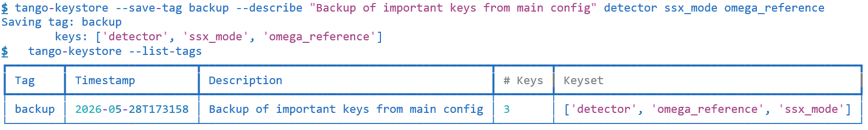

Tango Keystore CLI
“Tags” feature - save/restore a subset of keys under a "tag“ for a given namespace. A typical use case for this is to save certain values for specific configurations or state of your system and then be able to restore them later.
Create new tag for the active namespace with description and subset of tags
Check which tags exist
Creates new “Free property”
in TangoDB

Slide 13
Tango Keystore CLI
$ tango-keystore detector=eiger
Set detector = eiger (str)
$ tango-keystore --compare-tags backup
┏━━━━━━━━━━━━━━━━━━━━━━━━━━━┳━━━━━━━━━━━━━━━━━━━━━━━━━━━━━━━━━━━━━━━━━━━━━┳━━━━━━━━━━━━━━━━━━━━━━━━┓
┃ Key ┃ backup ┃ current ┃
┡━━━━━━━━━━━━━━━━━━━━━━━━━━━╇━━━━━━━━━━━━━━━━━━━━━━━━━━━━━━━━━━━━━━━━━━━━━╇━━━━━━━━━━━━━━━━━━━━━━━━┩
│ _keystore_description │ Backup of important keys from main config │ <missing> │
│ _keystore_keyset │ ['detector', 'omega_reference', 'ssx_mode'] │ <missing> │
│ _keystore_timestamp │ 2026-05-28T173158 │ <missing> │
│ detector │ jungfrau │ eiger │
│ emulate_detector_cover │ <missing> │ False │
│ emulate_detector_distance │ <missing> │ False │
│ emulate_safety_shutter │ <missing> │ False │
│ experiment_type │ <missing> │ osc │
│ feature_check_flux │ <missing> │ False │
│ ispyb_version │ <missing> │ production │
│ loopfinder_max_tries │ <missing> │ 30 │
│ md3_alignmenty_limit │ <missing> │ {'min': 1, 'max': 0} │
│ md3_omega_limit │ <missing> │ {'min': 0, 'max': 999} │
│ oncall │ <missing> │ [] │
│ sample_delivery │ <missing> │ isara │
│ serialx_chip │ <missing> │ False │
│ xbpm1_minimum_current │ <missing> │ 1e-10 │
└───────────────────────────┴─────────────────────────────────────────────┴────────────────────────┘
Compare current config and tags

Slide 14
Tango Keystore CLI
$ tango-keystore --save-tag backup detector
Updating tag: backup
keys: ['detector', 'omega_reference', 'ssx_mode’]
$ tango-keystore --dump backup
{
"detector": "eiger",
"omega_reference": 0.144,
"ssx_mode": false
}
$ tango-keystore --save-tag backup sample_delivery
Updating tag: backup
keys: ['detector', 'omega_reference', 'ssx_mode']
new keys: ['sample_delivery’]
$ tango-keystore --dump backup
{
"detector": "eiger",
"omega_reference": 0.144,
"sample_delivery": "isara",
"ssx_mode": false
}
Update tag keys from the main namespace
Add new keys to tags

Slide 15
Tango Keystore CLI
$ tango-keystore --load-tag backup
$ tango-keystore _keystore_last_loaded_tag
{"_keystore_last_loaded_tag": "backup"}
$ tango-keystore --dump backup > backup_config.json
$ cat backup_config.json
{
"detector": "jungfrau",
"omega_reference": 0.144,
"ssx_mode": false
}
$ tango-keystore --delete-tag backup
Are you sure you want to delete the tagged snapshot 'backup'?
Type confirmation code to continue => 6432: 6432
Deleted tagged snapshot: backup
Restore values from tag (last loaded tag name is saved in the main namespace)
Dump tags to files
Delete tags (with “fool-proofing”)

Slide 16
Tango Keystore as imported package
from tango_keystore import TangoKeystore
# Initialize
keystore = TangoKeystore()
# Store values with automatic type preservation
keystore.put("omega_reference", 1.2, must_exist=False)
keystore.put("iteration_count", 42, must_exist=False)
keystore.put("is_enabled", True, must_exist=False)
# Retrieve with correct types
omega = keystore.get("omega_reference") # Returns float 1.2
count = keystore.get("iteration_count") # Returns int 42
enabled = keystore.get("is_enabled") # Returns bool True
print(type(omega)) # <class 'float'>
Most features available for CLI can be used in the code

Slide 17
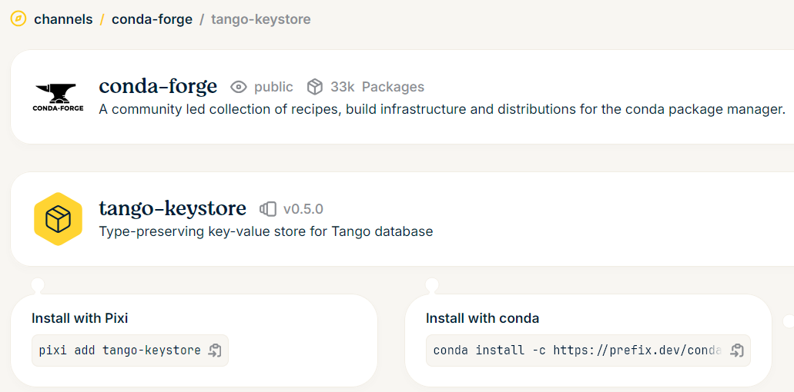
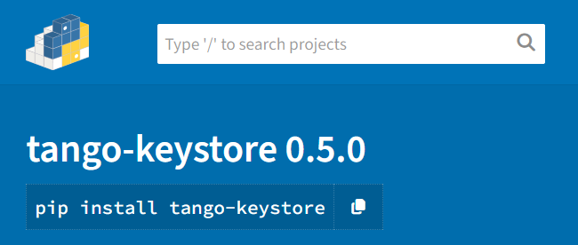
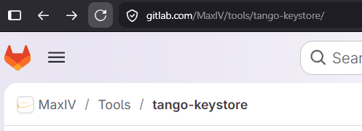
Tango Keystore is already available!
https://gitlab.com/MaxIV/tools/tango-keystore/
https://pypi.org/project/tango-keystore/
https://prefix.dev/channels/conda-forge/packages/tango-keystore

Slide 18
Thank you!

