Slide 1
MAX IV Tools: tango-takeoff and dsconfig
^{40th} Tango Community Meeting, 2026.06.08-12
B. Bertrand

Slide 2
Outline
takeoff and dsconfig as cli
takeoff and dsconfig as Ansible modules
Demo

Slide 3
Acknowledgement
takeoff was initially created by Emil Rosendahl
dsconfig was initially created by Johan Forsberg

Slide 4
takeoff and dsconfig cli
Notes:
Sardana and itango demo

Slide 5
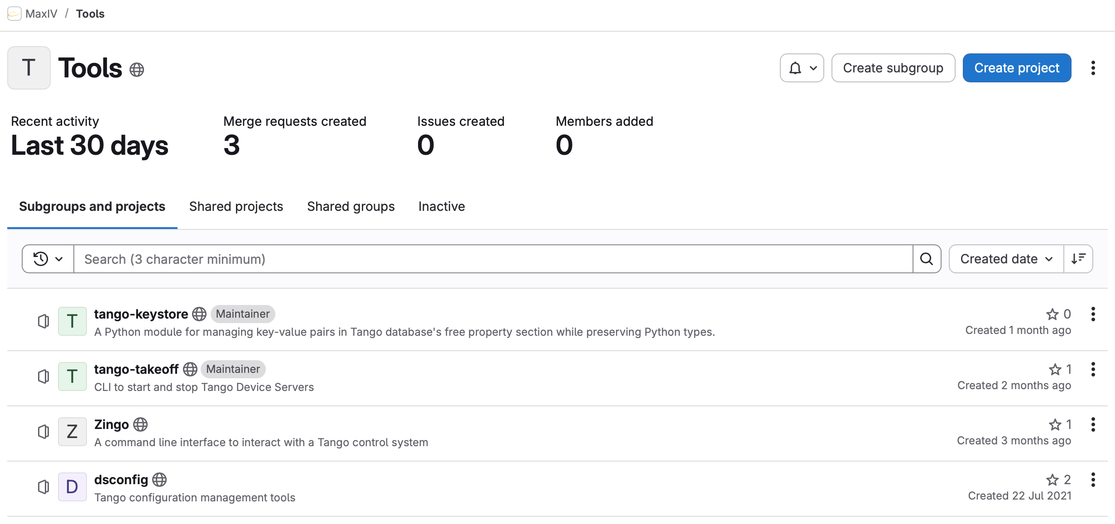
takeoff and dsconfig
https://gitlab.com/MaxIV/tools
PyPI: https://pypi.org/project/tango-takeoff/
https://pypi.org/project/dsconfig/
conda-forge: https://github.com/conda-forge/tango-takeoff-feedstock
https://github.com/conda-forge/dsconfig-feedstock
Notes:
takeoff was created internally in 2020 – dsconfig is from 2014

Slide 6
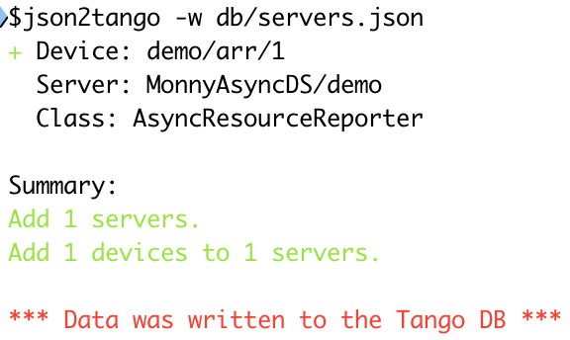
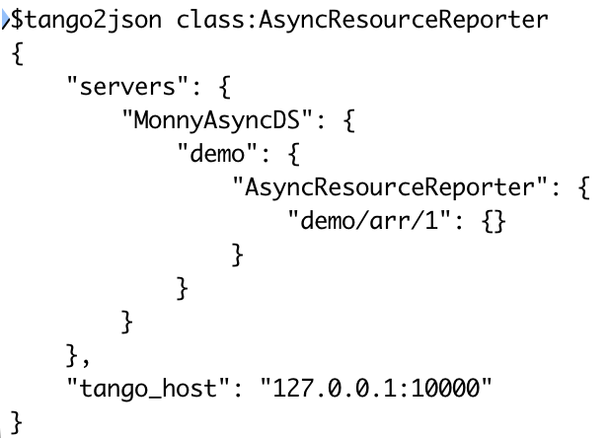
dsconfig
Python package that provides a set of command line tools for managing configuration of Tango device servers
tango2json: dump the database to json
json2tango: modify the database

Slide 7
takeoff
usage: takeoff [-h] [--version] {find,up,start,down,stop,restart} ...
Start (up), stop (down) or restart (restart) Tango Device Servers
positional arguments:
{find,up,start,down,stop,restart}
find Finds servers based on terms and shows the 'dry run' version of what will be used in 'up' and 'down'
up (start) Bring servers up based on terms
down (stop) Bring servers down based on terms
restart Restart servers based on terms
options:
-h, --help show this help message and exit
--version show program's version number and exit

Slide 8
takeoff cli examples
$ takeoff find "Basler/*"
Host Name Level Running
-----------------------------------------------------------------------------------------
b-v-finest-ec-1 Basler/B112A-OA05-3 5 running
b-v-finest-ec-1 Basler/B112A-O02-3 5 running
b-v-finest-ec-1 Basler/B112A-OB05-2 5 running
b-v-finest-ec-1 Basler/B112A-OB04-1 5 running
b-v-finest-ec-1 Basler/B112A-OA04-1 5 running
b-v-finest-ec-1 Basler/B112A-OB05-1 5 running
$ takeoff restart "Basler/*"
Notes:
Always good to check with find first which servers will be selected

Slide 9
takeoff cli examples
$ takeoff find "Pool/*" "MacroServer/*"
Host Name Level Running
-----------------------------------------------------------------------------------------
b-v-dummymax-ec-0 Pool/dummymax 1 running
b-v-dummymax-ec-0 MacroServer/dummymax 2 running
$ takeoff restart -v "Pool/*" "MacroServer/*"
2026-06-04 14:31:22,605 [INFO] MacroServer/dummymax stopped on b-v-dummymax-ec-0
2026-06-04 14:31:28,628 [INFO] Pool/dummymax stopped on b-v-dummymax-ec-0
2026-06-04 14:31:34,660 [INFO] Pool/dummymax started on b-v-dummymax-ec-0
2026-06-04 14:31:42,735 [INFO] MacroServer/dummymax started on b-v-dummymax-ec-0
Started servers: Pool/dummymax MacroServer/dummymax
Stopped servers: MacroServer/dummymax Pool/dummymax
Notes:
Respect Starter levels

Slide 10
takeoff cli examples
[host,]<server-name>[,<level>]
$ takeoff find "TangoTest/*"
Host Name Level Running
-----------------------------------------------------------------------------------------
TangoTest/test3 0 stopped
TangoTest/test2 0 stopped
b-v-dummymax-ec-0 TangoTest/test 3 running
$ takeoff up --default-host b-v-dummymax-ec-0 "TangoTest/test2,3" "TangoTest/test3,1"
$ takeoff restart -v "TangoTest/*"
2026-06-04 14:40:49,690 [INFO] TangoTest/test2 stopped on b-v-dummymax-ec-0
2026-06-04 14:40:50,694 [INFO] TangoTest/test stopped on b-v-dummymax-ec-0
2026-06-04 14:40:58,725 [INFO] TangoTest/test3 stopped on b-v-dummymax-ec-0
2026-06-04 14:41:04,752 [INFO] TangoTest/test3 started on b-v-dummymax-ec-0
2026-06-04 14:41:08,776 [INFO] TangoTest/test started on b-v-dummymax-ec-0
2026-06-04 14:41:09,787 [INFO] TangoTest/test2 started on b-v-dummymax-ec-0
Notes:
Send command on same level in parallel

Slide 11
takeoff cli examples
$ takeoff down --json "TangoTest/*"
{
"result": {
"started": [],
"stopped": [],
"already_running": [],
"already_stopped": [
"TangoTest/test2",
"TangoTest/test",
"TangoTest/test3"
],
"failed_to_start": [],
"failed_to_stop": [],
"changed_info": []
},
"changed": false
}
Notes:
Json output – important for use from Ansible role

Slide 12
takeoff and dsconfig
Ansible modules
Notes:
Sardana and itango demo

Slide 13
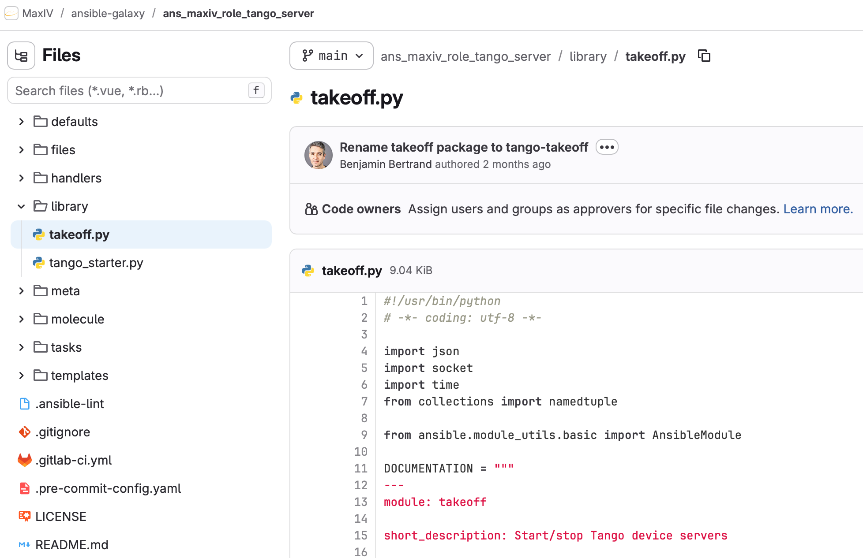
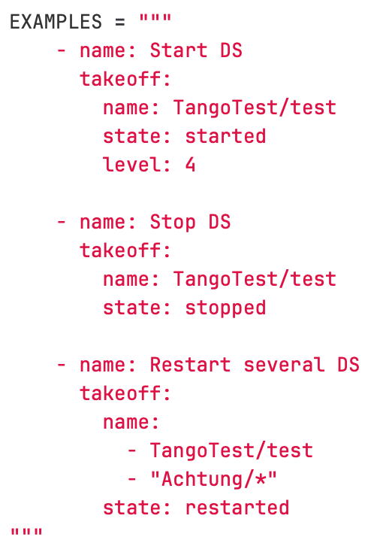
takeoff Ansible module

Slide 14
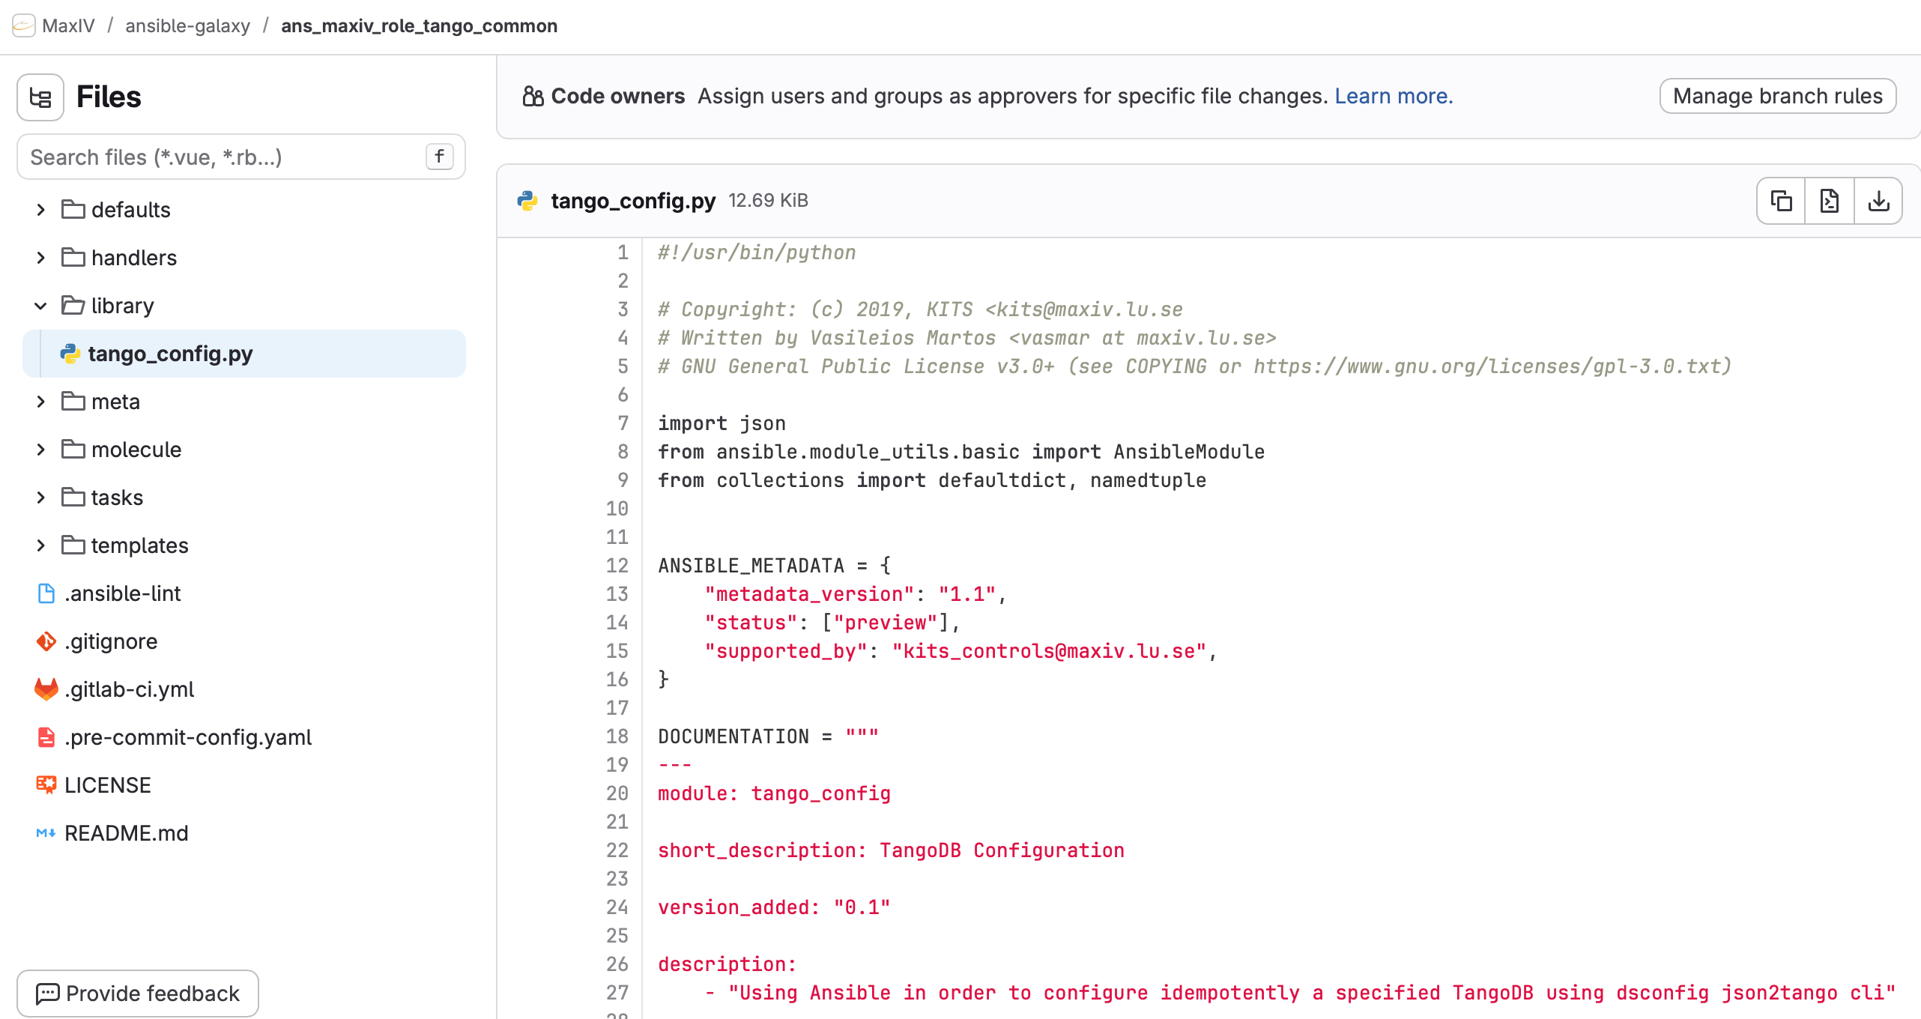
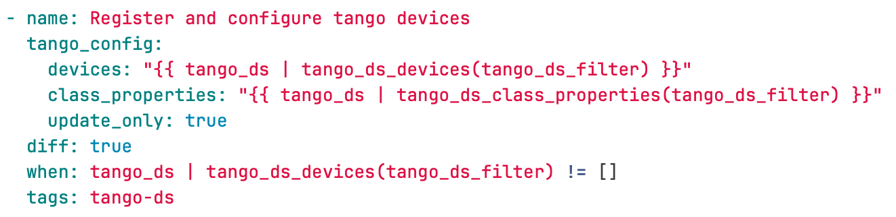
tango_config Ansible module
Use json2tango (dsconfig)
Used in tango_ds role
Notes:
Tango_config

Slide 15
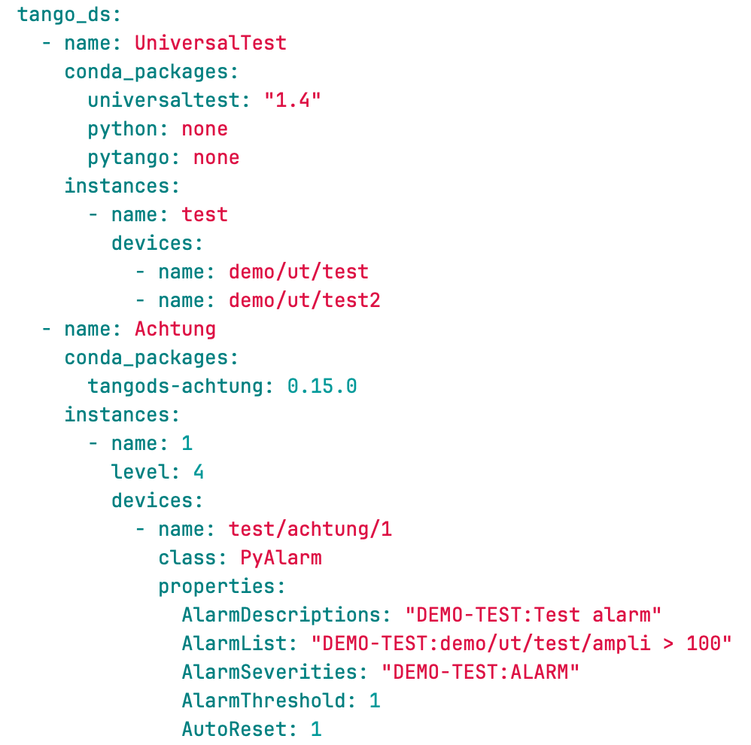
ans_maxiv_tango_ds Ansible role
Ansible role to deploy Tango Device Servers.
Role Variables
Tango device servers are defined using a nested list of servers -> instances -> devices
Notes:
Add python and pytango automatically to the env. Can set them to “none” for C++ devices.

Slide 16
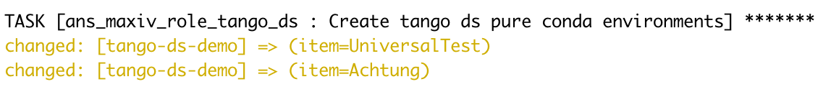
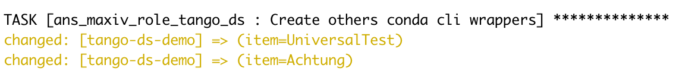
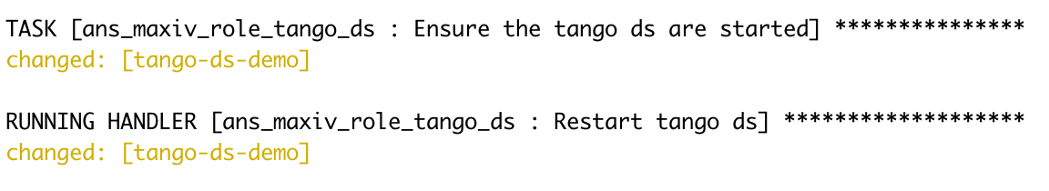
Ansible deploy playbook
tango_config (dsconfig)
conda role
conda role
takeoff

Slide 17
Demo
Notes:
Sardana and itango demo

Slide 18
Conclusion
CLI tools available for the community
  Use them!
  Give feedback
Interested in Ansible roles on official Ansible Galaxy?

Slide 19
Links
https://gitlab.com/MaxIV/tools
https://gitlab.com/MaxIV/ansible-galaxy

