Slide 1
MAX IV Archiving
Dmitry Egorov

Slide 2
HDB++ at MAX IV
Upgrade to PostgreSQL 18+ and TimescaleDB 2.26+ is planned during the summer shutdown
Configuration using “yaml2archiving”
Interest in archiving at beamlines is growing - few beamlines have their own dashboards in Grafana to monitor the accelerator and the experiment status
Setup
One HDB++ setup (single archiver) per BL
One for accelerator (42 archivers, ~90% of data volume)
Single Postgres database cluster, 3 nodes (1 write, 2 read-only)
Separate schema for each control system
Some statistics
~ 24000 attributes
~ 3000 events per second
~ 20 control systems
~ 250 billion rows in TimescaleDB
~ 8TB disk space used (with compression)

Slide 3
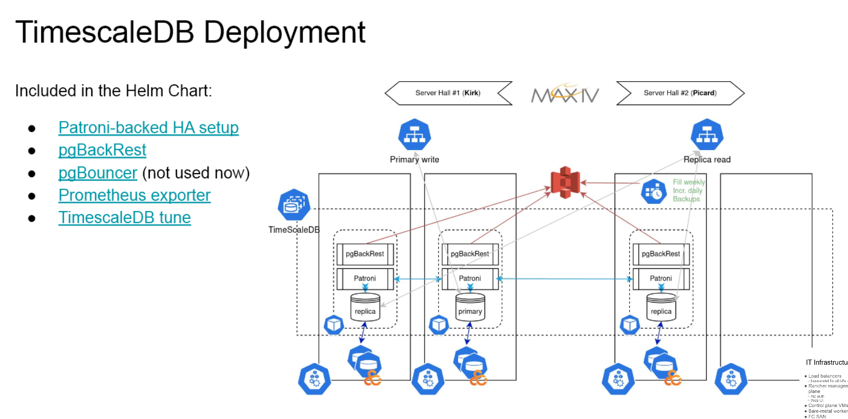
Infrastructure deployment at MAX IV

Slide 4
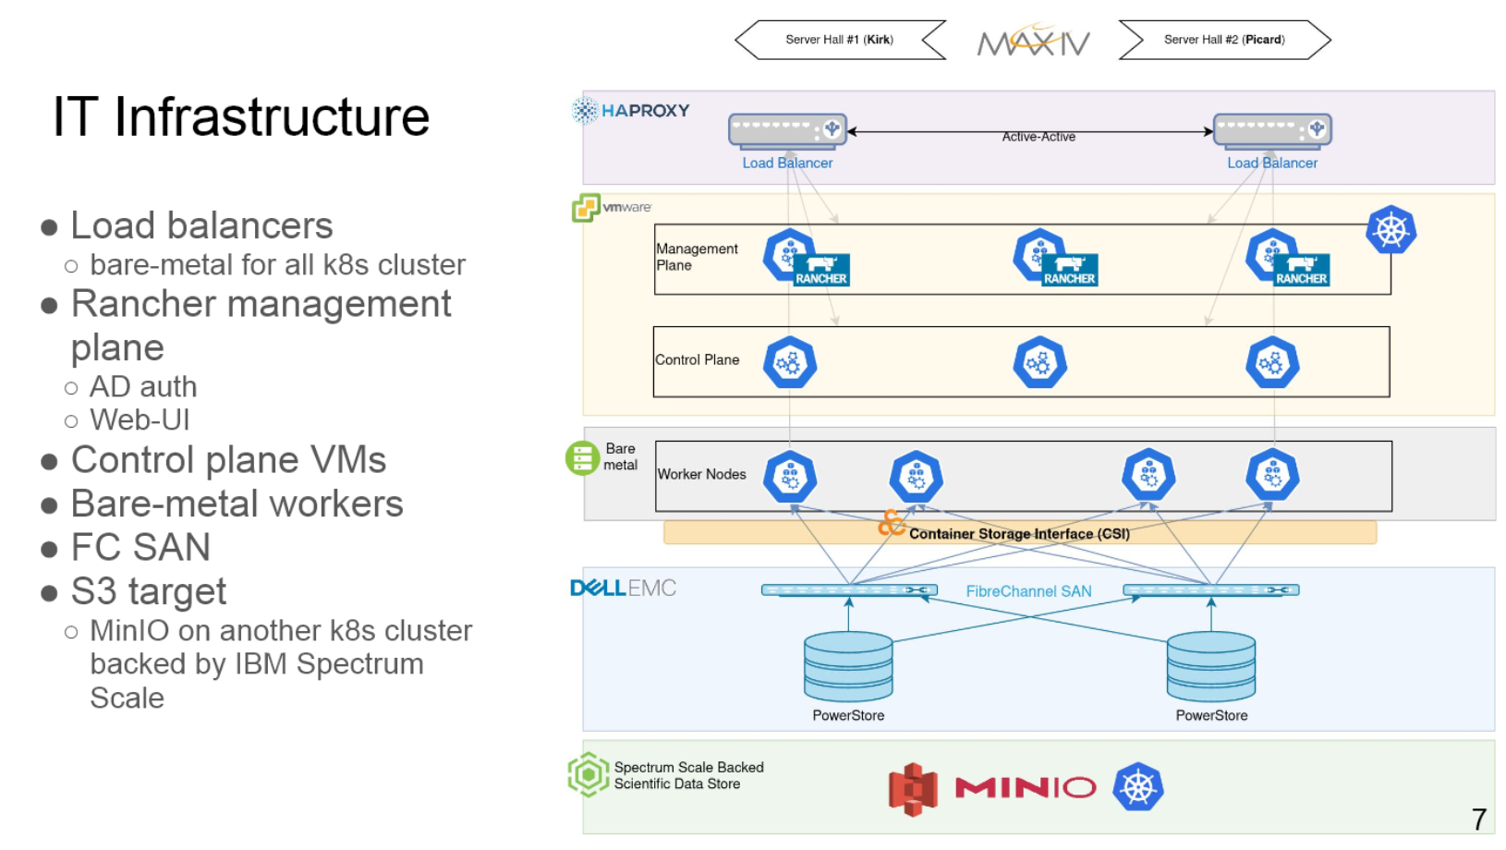
Infrastructure deployment at MAX IV

Slide 5

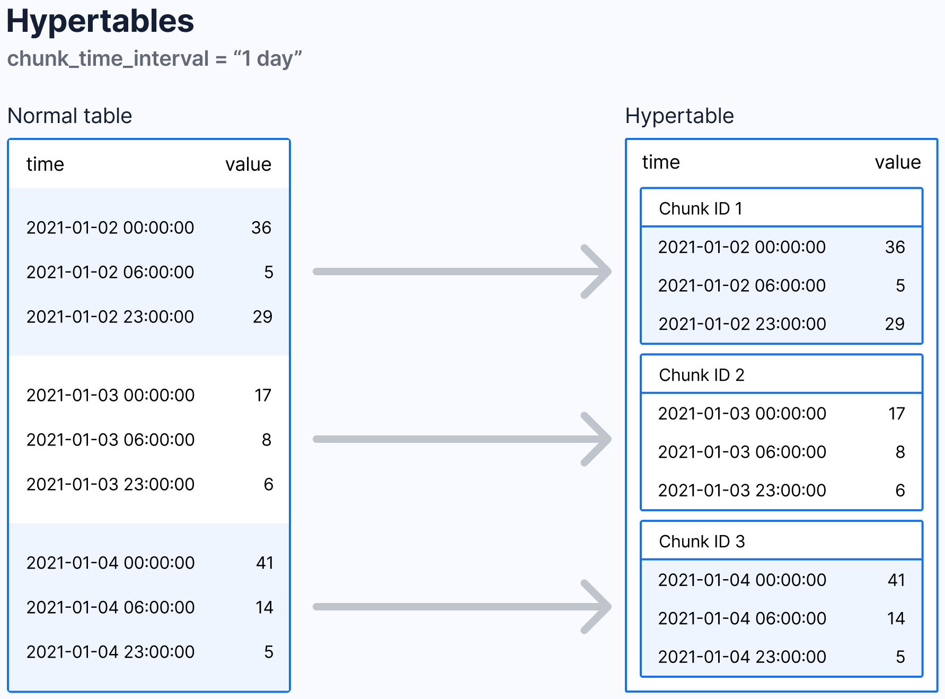
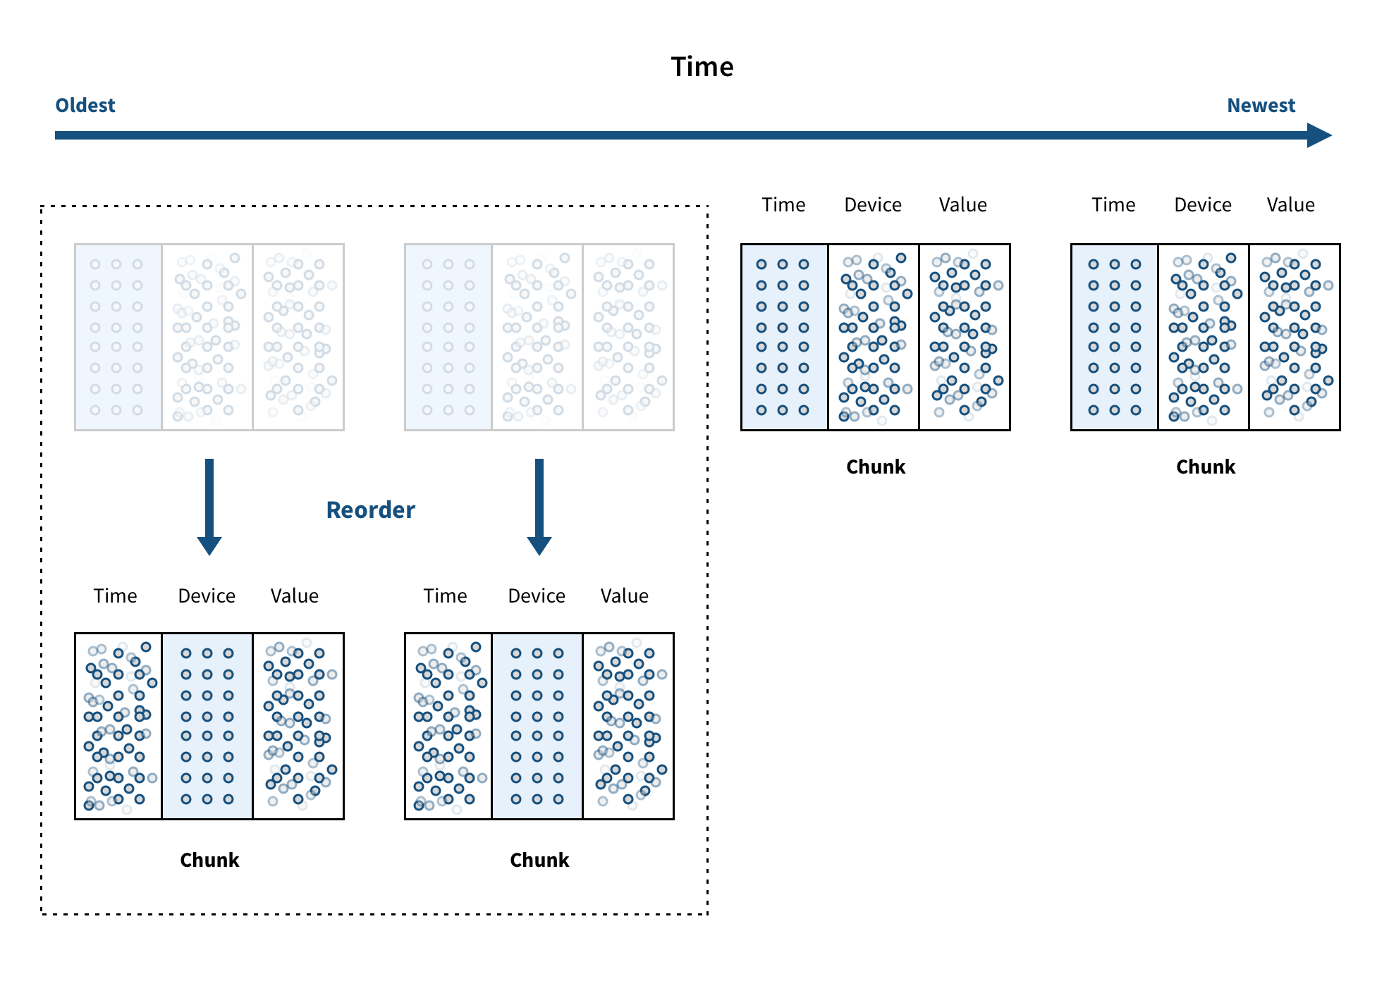

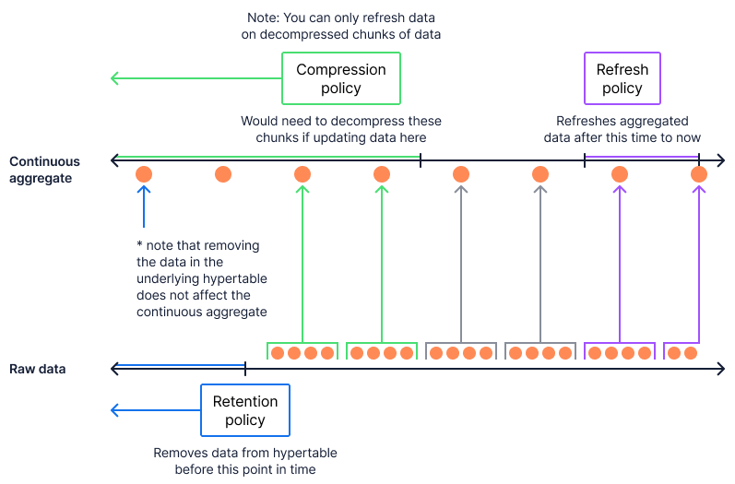
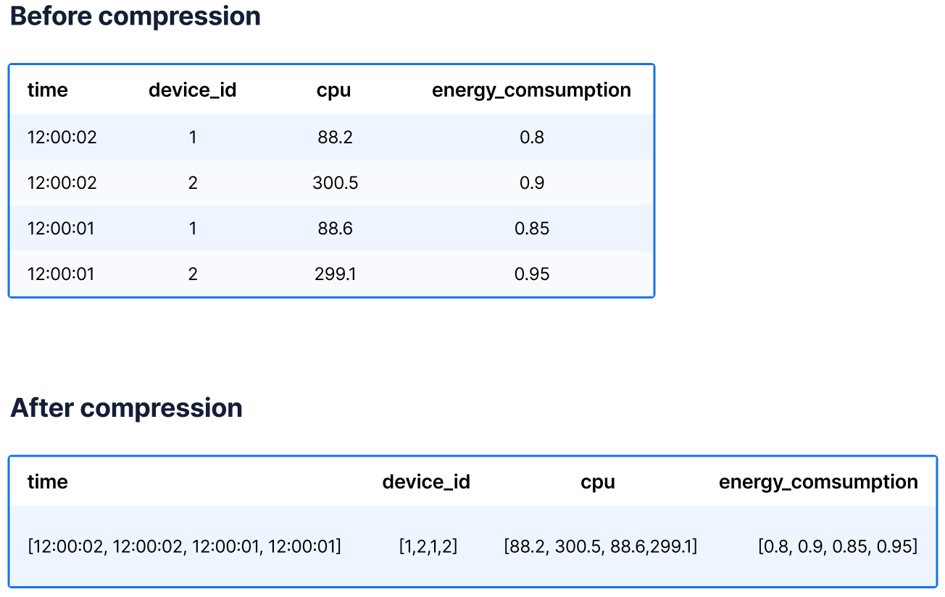
TimescaleDB Features

Slide 6
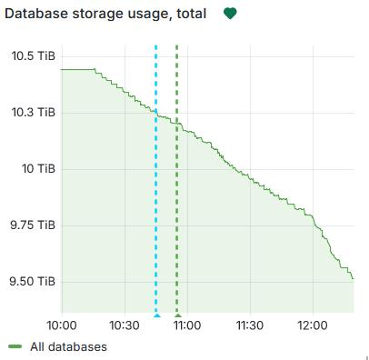
Compression applied

Slide 7
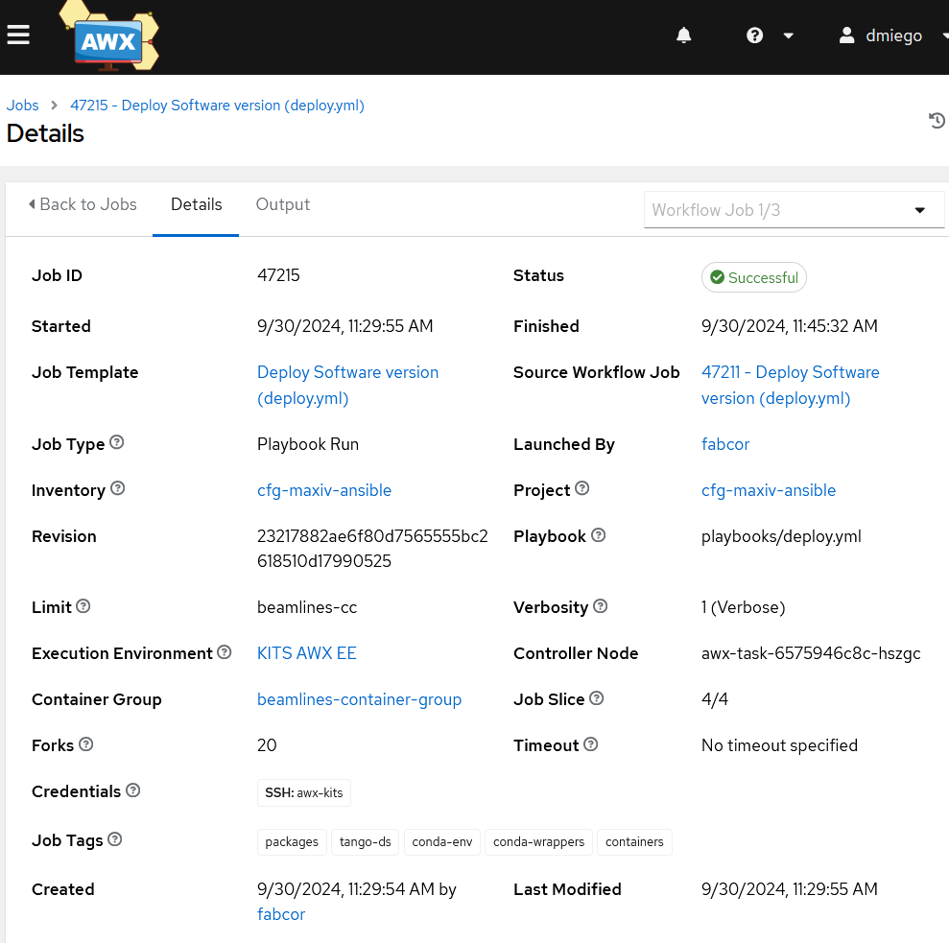
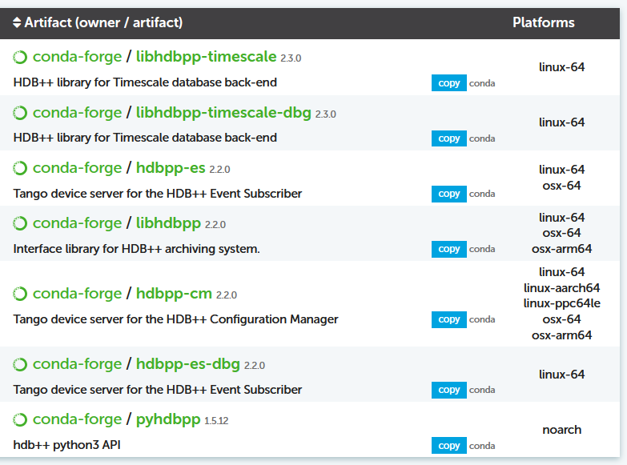


HDB deployment at MAX IV
tango_ds_hdbconfigurationmanager_timescale:
name: hdb++cm-srv
conda_env_name: hdbpp-timescale
conda_packages:
cpptango: "{{ hdbpp_cpptango_version }}"
pytango: "{{ hdbpp_pytango_version }}"
hdbpp-cm: "{{ hdbpp_cm_version }}"
hdbpp-es: "{{ hdbpp_es_version }}"
libhdbpp-timescale: "{{ libhdbpp_timescale_version }}"
instances:
- name: 1
devices:
- name: SYS/HDBPP/MANAGER-01
class: HdbConfigurationManager
properties:
ArchiverList:
- SYS/HDBPP/ARCHIVER-01
LibConfiguration:
- libname=libhdb++timescale.so
- connect_string=user=……
- logging_level=info
- log_file=true
- log_syslog=false
- log_console=false
- log_file_name=/tmp/hdb-cm-timescale.log
https://gitlab.com/MaxIV/lib-maxiv-dsconfig

Slide 8
Configuration (yaml2archiving)
Yaml2archiving aims to ease the configuration of the HDB++ Archiving by using YAML format files in order to add/remove/update archived attributes. Each YAML file corresponds to one HdbEventSubscriber device and can include the state of the archived attributes with their settings.
db: b-v-dummymax-csdb-0.maxiv.lu.se:10000
manager: SYS/HDBPP/MANAGER-01
archiver: SYS/HDBPP/ARCHIVER-01
configuration:
- class: TangoTest
filtering:
device: sys/tg_test/1
attributes:
double_scalar:
polling_period: 3000
archive_period: 10000
short_scalar:
polling_period: 3000
archive_period: 10000
db: g-v-csdb-0.maxiv.lu.se:10000
manager: sys/hdbpp/manager-01-timescale
archiver: i/mag/archiver-01-timescale
defaults:
- "../mag_defaults.yaml"
configuration:
- class: MagnetCircuit
filtering:
device:
- "i-.*"
attributes:
mainfieldcomponent:
archive_rel_change: 1.0
archive_period: 60000
polling_period: 1000
https://gitlab.com/tango-controls/hdbpp/yaml2archiving

Slide 9
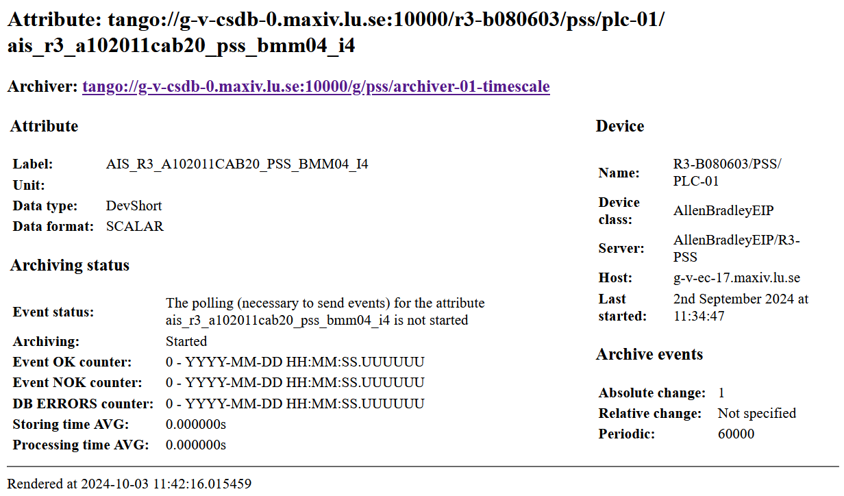
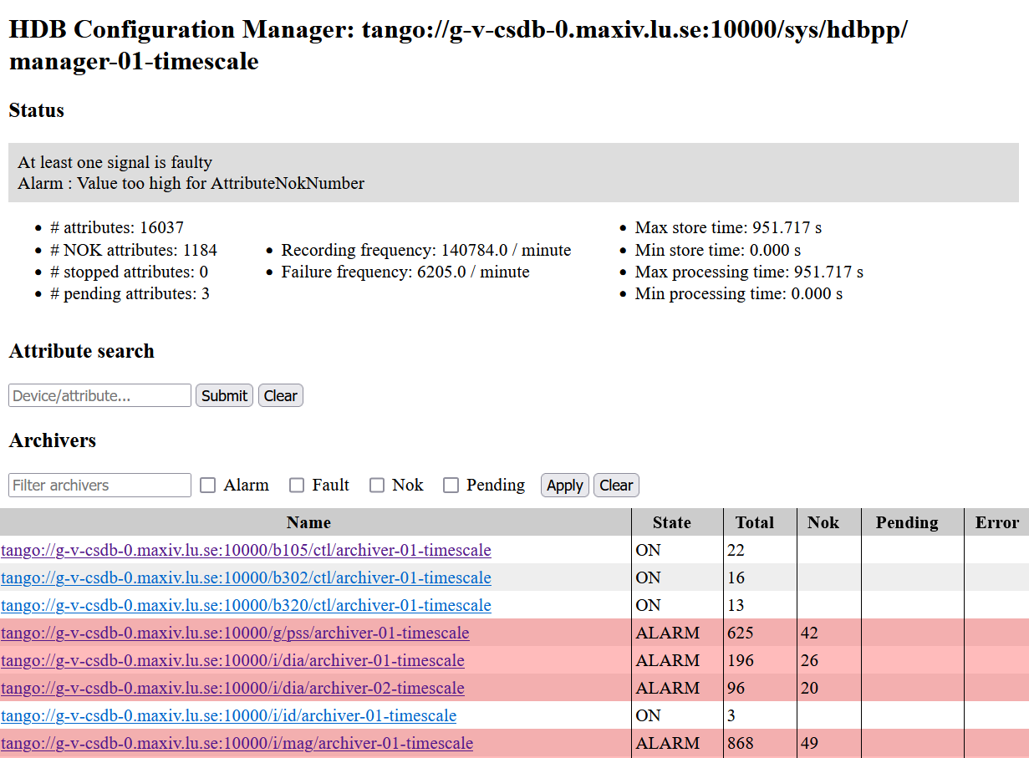
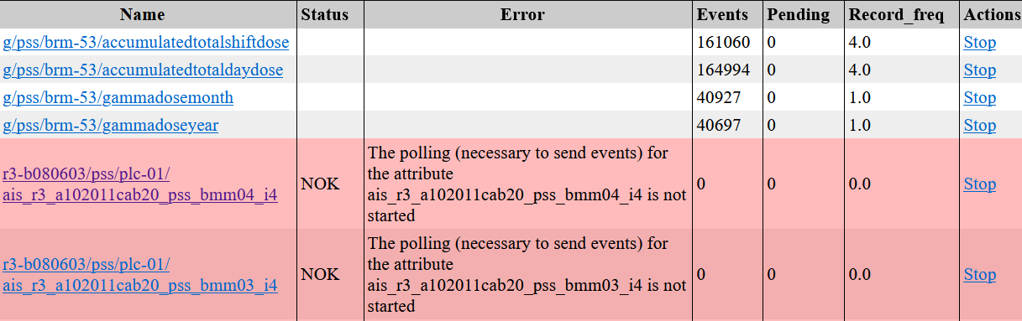
Monitoring (ArchWizard)
"ArchWizard 🧙" is a simple web interface to the HDB++ archiving system.
It is intended for monitoring and troubleshooting, not maintenance such as adding and removing attributes.
It's built using Python, FastAPI, Jinja2 and PyTango.
https://gitlab.com/tango-controls/hdbpp/archwizard

Slide 10
Monitoring (hdbpp-exporter)
Prometheus HDB++ exporter
An exporter is a small webserver that publishes metrics data in a text format readable by the Prometheus monitoring service.
This exporter connects to all HdbEventSubscriber devices and exports several diagnostics attributes, such as AttributeNumber, AttributeNokNumber etc.
Example output:
# HELP hdbpp_eventsubscriber_AttributeNokNumber Attribute 'AttributeNokNumber' on HdbEventSubscriber
# TYPE hdbpp_eventsubscriber_AttributeNokNumber gauge
hdbpp_eventsubscriber_AttributeNokNumber{device="SYS/HDBPP/ARCHIVER-01"} 10.0
# HELP hdbpp_eventsubscriber_AttributeNumber Attribute 'AttributeNumber' on HdbEventSubscriber
# TYPE hdbpp_eventsubscriber_AttributeNumber gauge
hdbpp_eventsubscriber_AttributeNumber{device="SYS/HDBPP/ARCHIVER-01"} 451.0
# HELP hdbpp_eventsubscriber_error_periodic_event_timeout Attribute 'AttributePendingNumber' on HdbEventSubscriber
# TYPE hdbpp_eventsubscriber_error_periodic_event_timeout gauge
hdbpp_eventsubscriber_error_periodic_event_timeout{device="SYS/HDBPP/ARCHIVER-01"} 10.0

Slide 11
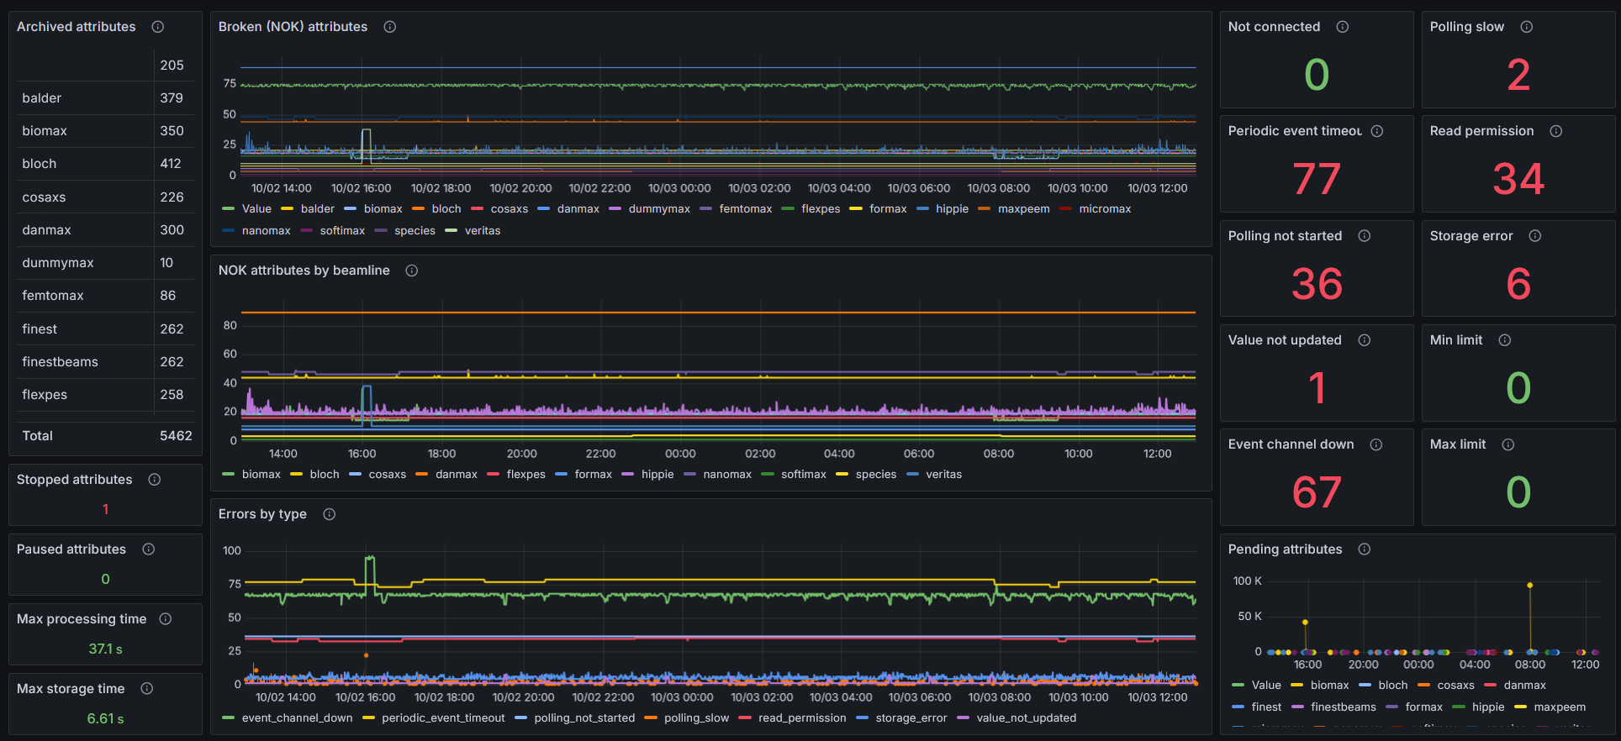


Monitoring (hdbpp-exporter)

Slide 12
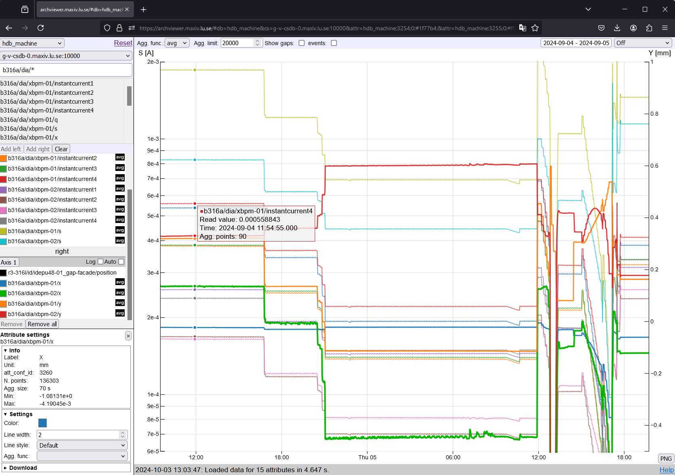
Data viewer (Archviewer)
https://gitlab.com/tango-controls/hdbpp/archviewer

Slide 13
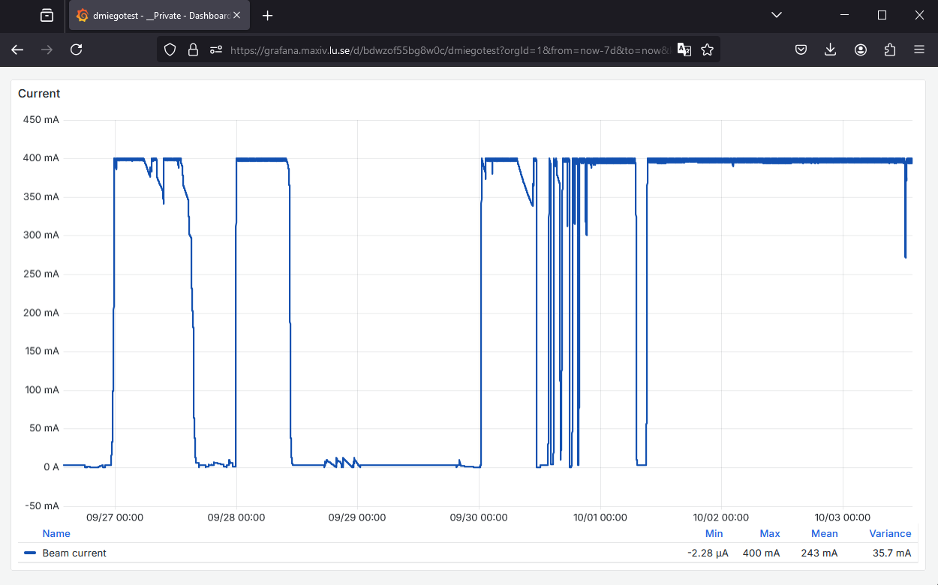
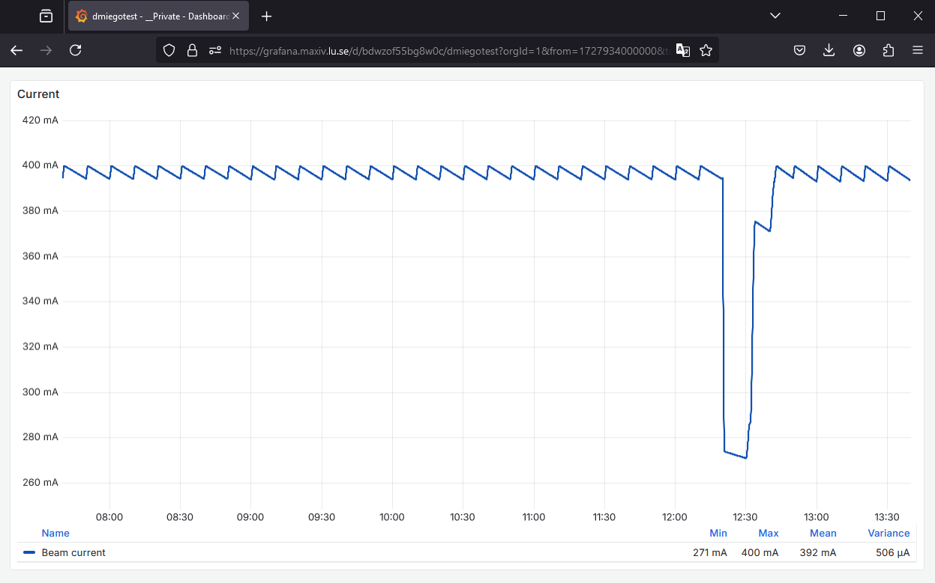
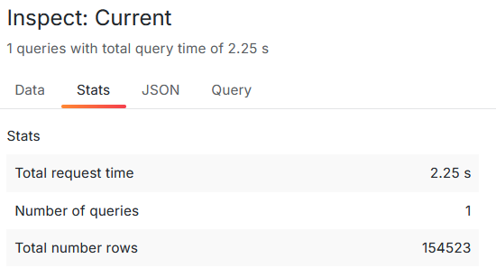
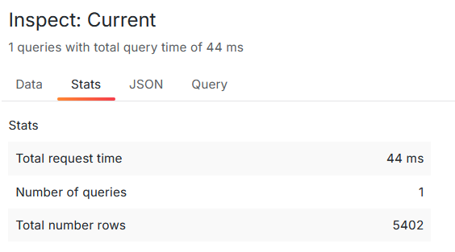
Data view with Grafana
SELECT
data_time AS "time",
value_r as "Beam current"
FROM att_scalar_devdouble
WHERE
$__timeFilter(data_time)
and
att_conf_id = (select att_conf_id from att_conf where att_name='tango://g-v-csdb-0.maxiv.lu.se:10000/r3-319s2/dia/dcct-01/current')
ORDER BY 1
SELECT
data_time AS "time",
value_r as "Beam current"
FROM att_scalar_devdouble
WHERE
$__timeFilter(data_time)
and
att_conf_id = 15713
ORDER BY 1

Slide 14
Downsampling (Timebucket)
SELECT
time_bucket(‘1 min', data_time) AS time,
AVG(value_r) as "Beam current"
FROM
att_scalar_devdouble
WHERE
$__timeFilter(data_time)
and
att_conf_id = (select att_conf_id from att_conf where att_name='tango://g-v-csdb-0.maxiv.lu.se:10000/r3-319s2/dia/dcct-01/current')
GROUP BY
time
ORDER BY
time;
https://www.timescale.com/blog/simplified-time-series-analytics-using-the-time_bucket-function/

Slide 15
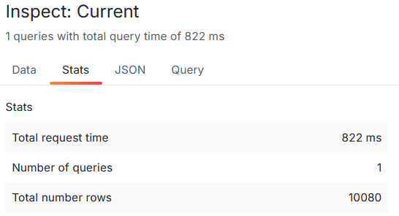
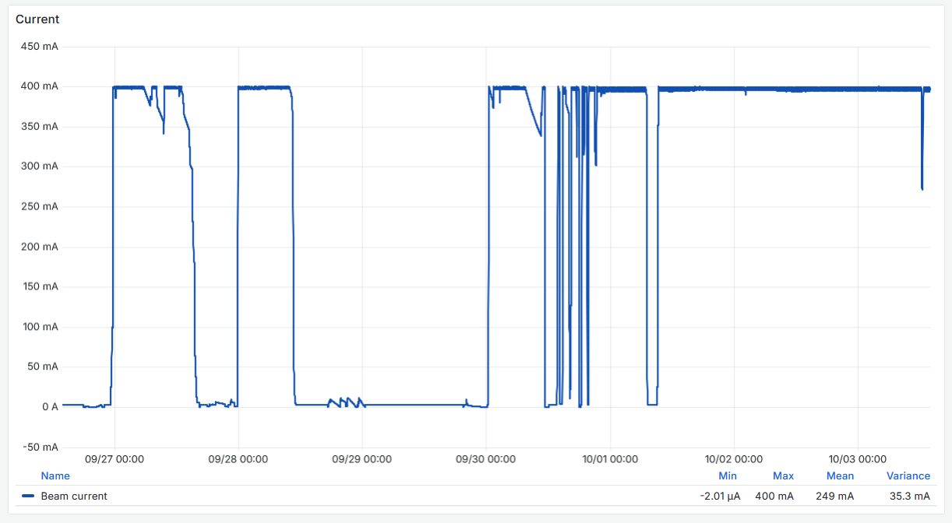
Downsampling (Timebucket)

Slide 16
Downsampling (LTTB)
SELECT
time AS "time",
value AS "Beam current"
FROM unnest((
select lttb(data_time, value_r, (($__to - $__from) / $__interval_ms)::int)
FROM att_scalar_devdouble
WHERE
$__timeFilter(data_time)
and
att_conf_id = (select att_conf_id from att_conf where att_name='tango://g-v-csdb-0.maxiv.lu.se:10000/r3-319s2/dia/dcct-01/current')
))
ORDER BY 1;
https://www.timescale.com/blog/slow-grafana-performance-learn-how-to-fix-it-using-downsampling/
https://skemman.is/bitstream/1946/15343/3/SS_MSthesis.pdf

Slide 17
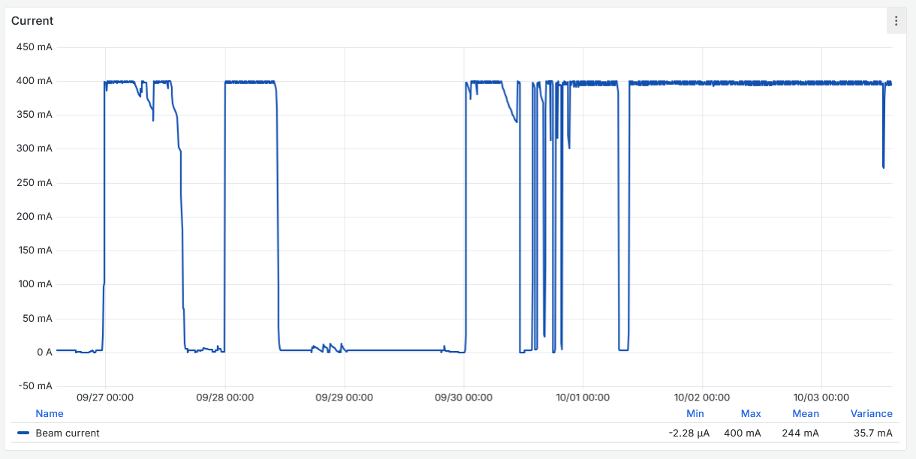
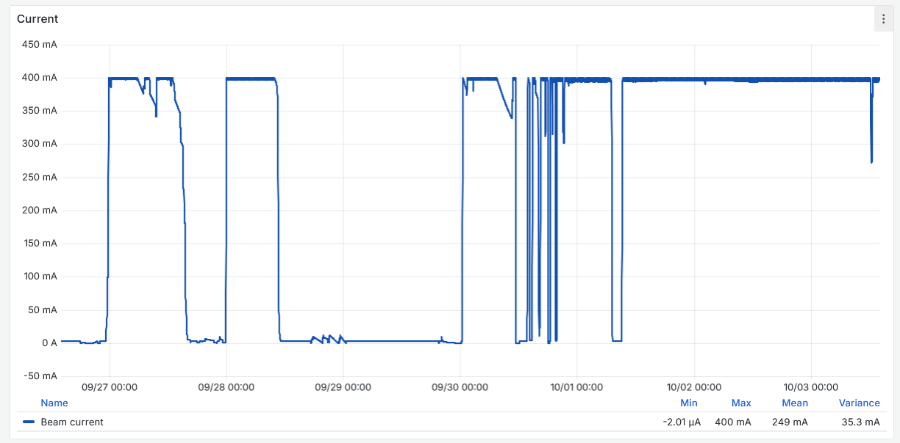
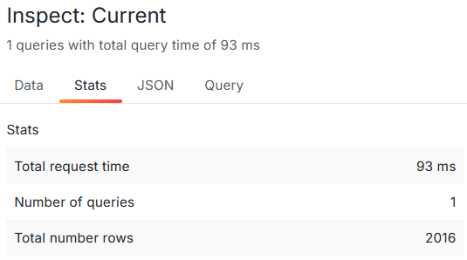
Downsampling (LTTB)

Slide 18
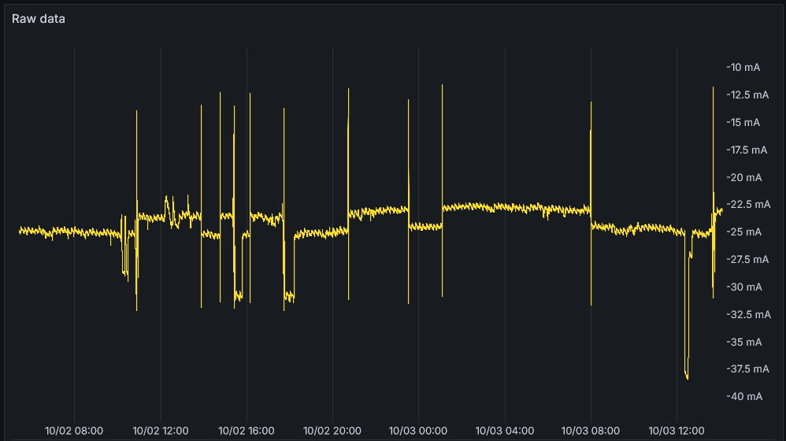
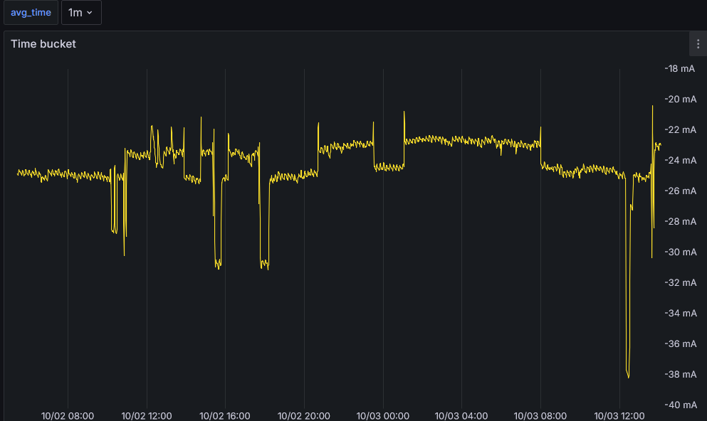
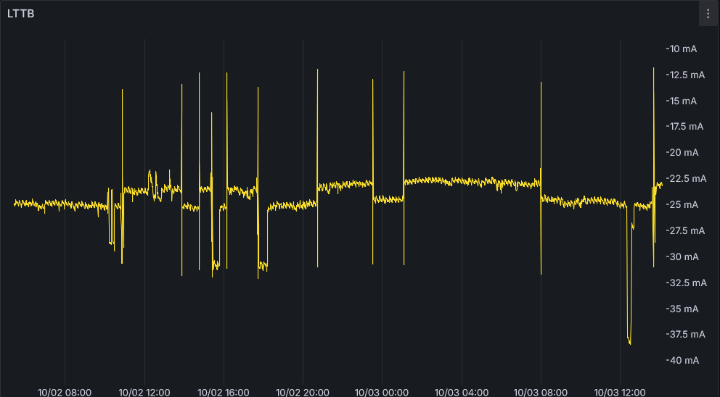
Downsampling trickiness

Slide 19
Downsampling (Continuous aggregations)
WITH conf_id AS (
SELECT att_conf_id
FROM att_conf
WHERE att_name='tango://bmn-sc-tangodb.he.jinr.ru:10000/fsd/plane0_top/adcsc_8_temp/temp_4'
),
varname AS (
SELECT 'P0-4-0/22-B' AS varname
)
SELECT
data_time AS "time",
avg_r AS varname
FROM att_scalar_devdouble_1hour
WHERE $__timeTo()::timestamp - $__timeFrom()::timestamp >= '12 hours'::interval
AND $__timeFilter(data_time)
AND att_conf_id = (SELECT att_conf_id FROM conf_id)
UNION ALL
…………
SELECT
data_time AS "time",
value_r AS varname
FROM att_scalar_devdouble
WHERE $__timeTo()::timestamp - $__timeFrom()::timestamp < '30 minutes'::interval
AND $__timeFilter(data_time)
AND att_conf_id = (SELECT att_conf_id FROM conf_id)
ORDER BY 1;
Not fully implemented at MAX IV (yet), example from another facility

Slide 20
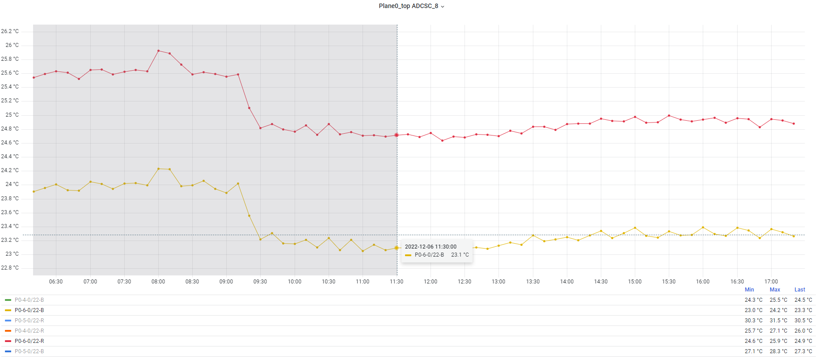
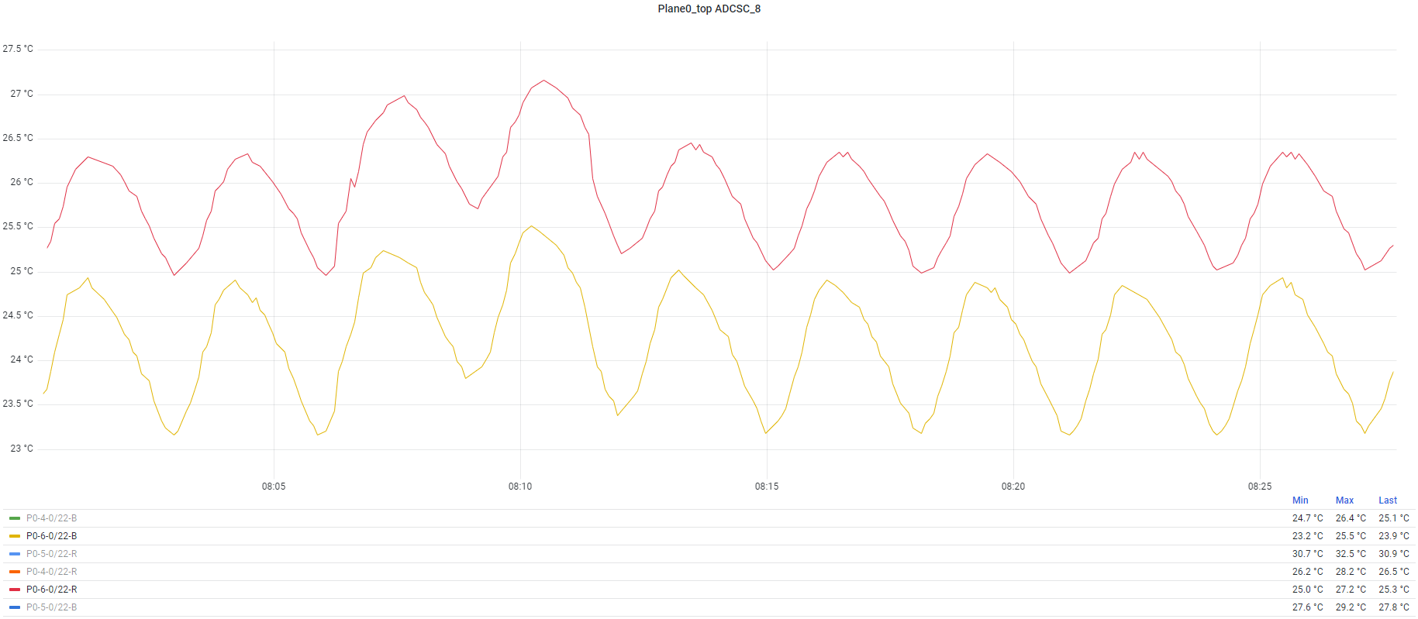
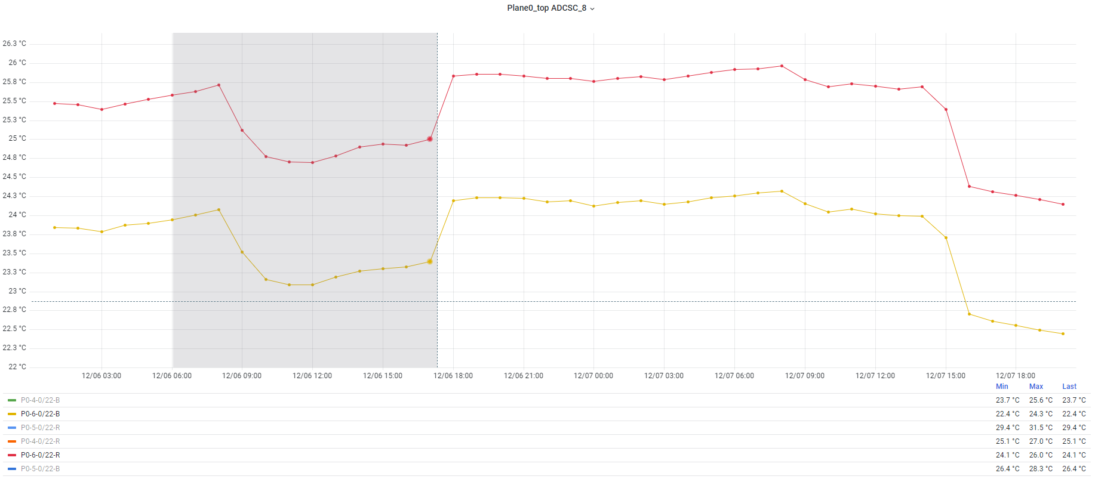
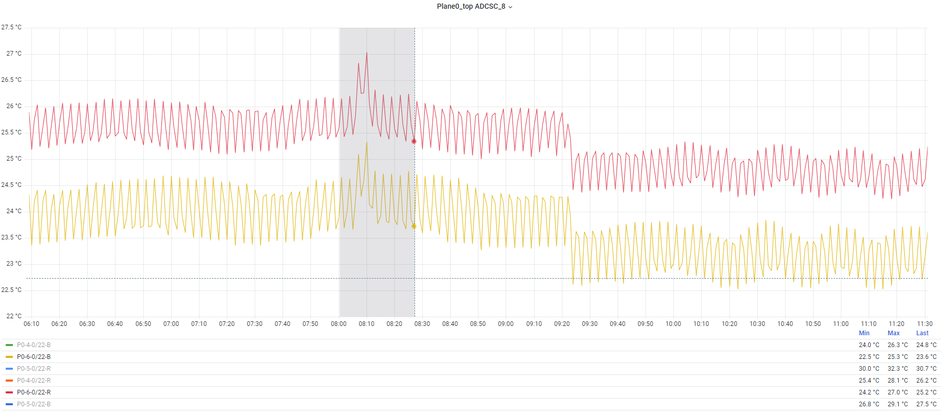
Downsampling (Continuous aggregations)

Slide 21
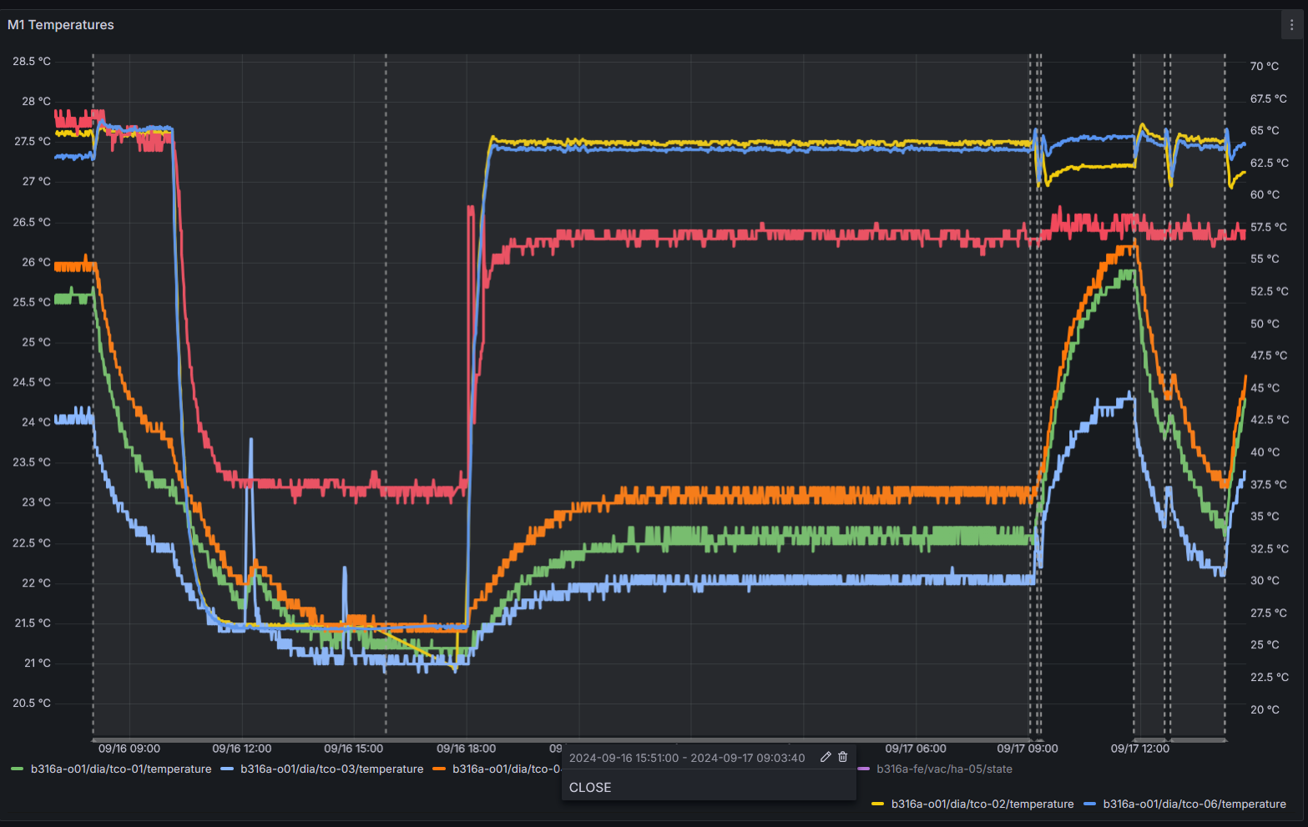
More ways to display data
Display annotation when Heat Absorber is CLOSE

Slide 22
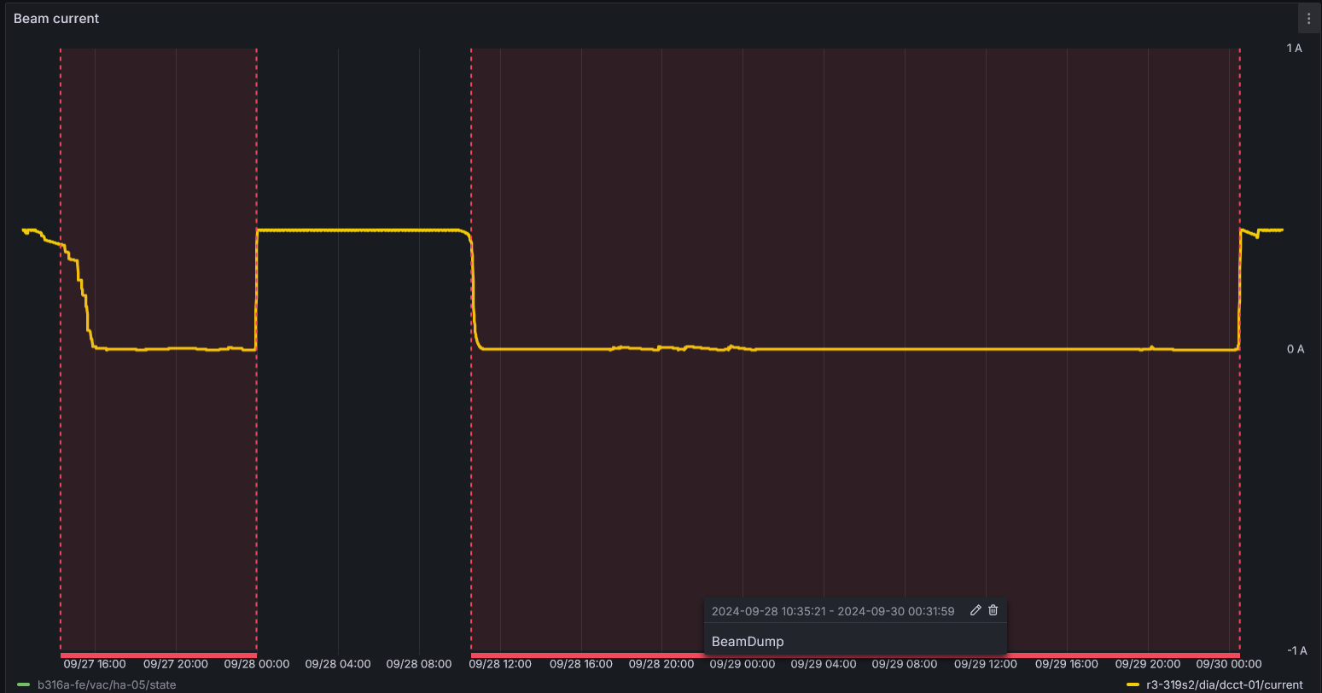
More ways to display data
Display annotation when Beam Current < 350 mA

