Slide 1

http://www.tango-controls.org/
Tango Polling
Tango Polling Loop SIG Workshop @ MAX IV
14/04/2026
Reynald Bourtembourg

Slide 2
The Polling – Use Cases
Polling a device ⬄ periodically executing command on a device (or reading device attribute) and storing the results (or the thrown exception) in a polling buffer (circular buffer).
Goals:
Speed-up response time for slow device
Keep a history of device command outputs or attribute values
Be the data source for the Tango event system and detect when something changes. Periodic events are heavily relying on the polling to be done at precise time intervals.

Slide 3
The Polling – Use Cases
Command polling exists, but not often used
Only commands without input argument can be polled
It is not possible to poll the Init command
Attribute polling is very useful when:
Device has many clients and slow hardware to read
The data will be read from cache (last value read by polling)
When event communication is used
The event will be sent during polling phase
An history of read values is expected with a fixed period (polling buffer)
Tango Polling Loop SIG Meeting - April 2026

Slide 4
The Polling
Each device has its own polling buffers
Polling buffer depth is tunable
By device (default is 10) - poll_ring_depth device property
Tango Polling Loop SIG Meeting - April 2026

Slide 5
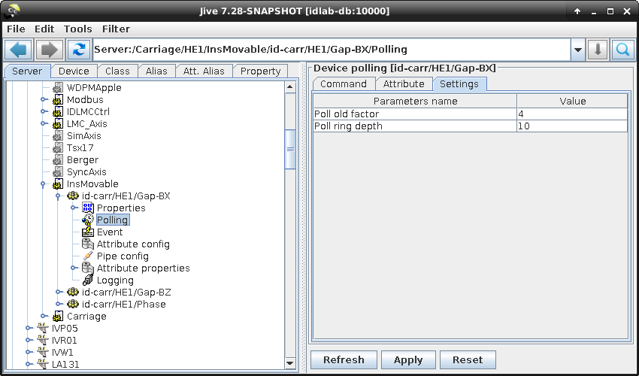
The Polling
Tango Polling Loop SIG Meeting - April 2026

Slide 6
The Polling
Each device has its own polling buffers
Polling buffer depth is tunable
By device (default is 10) - poll_ring_depth device property
Tango Polling Loop SIG Meeting - April 2026

Slide 7
The Polling
Each device has its own polling buffers
Polling buffer depth is tunable
By device (default is 10) (poll_ring_depth device property)
By command/attribute (cmd_poll_ring_depth and attr_poll_ring_depth device properties) Syntax = object name, ring depth e.g.: State,100,Status,15
https://tango-controls.readthedocs.io/en/latest/development/advanced/reference.html?#the-device-polling
Tango Polling Loop SIG Meeting - April 2026

Slide 8
The Polling
A client is able to read data from
The real device (DEVICE)
The last record in the polling buffer (CACHE)
The polling buffer and in case of error from the real device (CACHE_DEV)
The choice is done with the DeviceProxy::set_source(Tango::DevSource source) method
Tango Polling Loop SIG Meeting - April 2026

Slide 9
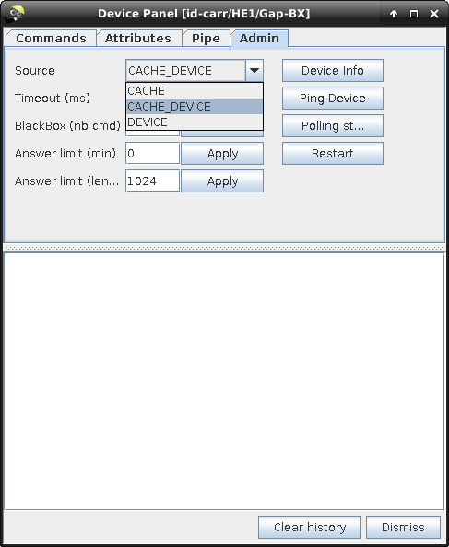
The Polling
A client is able to read data from
The real device (DEVICE)
The last record in the polling buffer (CACHE)
The polling buffer and in case of error from the real device (CACHE_DEV)
The choice is done with the DeviceProxy::set_source(Tango::DevSource source) method
Tango Polling Loop SIG Meeting - April 2026

Slide 10
The Polling
Reading from the polling buffer introduces a delay
Depends on the polling period
A network call to read the complete polling buffer is also provided (command_inout_history or read_attribute_history defined in the Tango IDL)
DeviceProxy::command_history() or DeviceProxy::attribute_history()
Tango Polling Loop SIG Meeting - April 2026

Slide 11
Polling Threads
Suppose a server with 2 devices dev1 and dev2.
Each device has 2 attributes (att1 and att2) polled at 1 Hz.
The default configuration for a server is 1 polling thread.
In a perfect world, the polling thread execution will look like:
t0
t0 + 1s
Read dev1/att1
Read dev2/att1
Read dev1/att2
Read dev2/att2
Read dev1/att1
Running time
Sleeping time
t
Tango Polling Loop SIG Meeting - April 2026

Slide 12
Polling Threads
But in a real world, the read attributes could have different durations and be quite long (hardware access, waiting monitors,...).
In a real world, the polling thread execution could look like:
t0
t0 + 1s
Read dev1/att1
Read dev1/att2
Read dev2/att2
Read dev1/att1
Running time
Sleeping time
Read dev2/att1
t
To avoid this problem the first solution is to tune polling thread using Jive
Tango Polling Loop SIG Meeting - April 2026

Slide 13
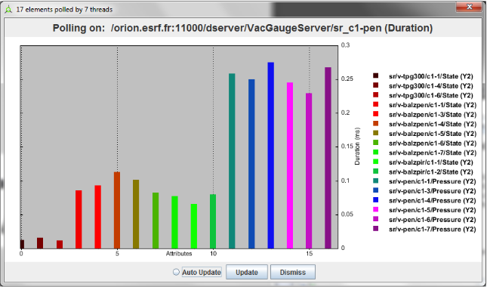
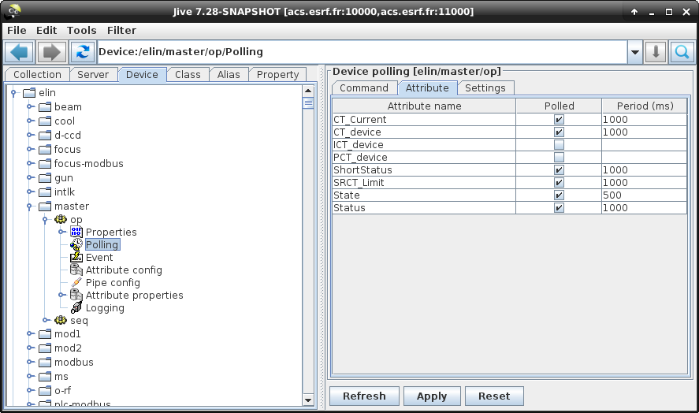
Polling tuning
To tune the polling, you can use:
Astor to profile polling (more useful when using Tango < 9 polling algorithm)
Pogo/Jive to set polling period

Slide 14
Pool of Polling Threads
To improve the polling with many attributes on several devices, Tango provides a pool of polling threads
Same example with a pool of 2 polling threads:
t0
t0 + 1s
Read dev1/att1
Read dev1/att2
Read dev1/att1
Thread 1 Running time
Thread 1 Sleeping time
Thread 2 Running time
Thread 2 Sleeping time
Read dev2/att1
Read dev2/att2
Read dev2/att1
t

Slide 15
Pool of Polling Threads
All attributes of a device are polled by the same thread
The pool configuration is defined by admin device properties:
Polling_threads_pool_size: number of threads
Polling_threads_pool_conf: For each thread a list of devices to poll 1 line for each thread, devices separated by comma
Tango Polling Loop SIG Meeting - April 2026

Slide 16
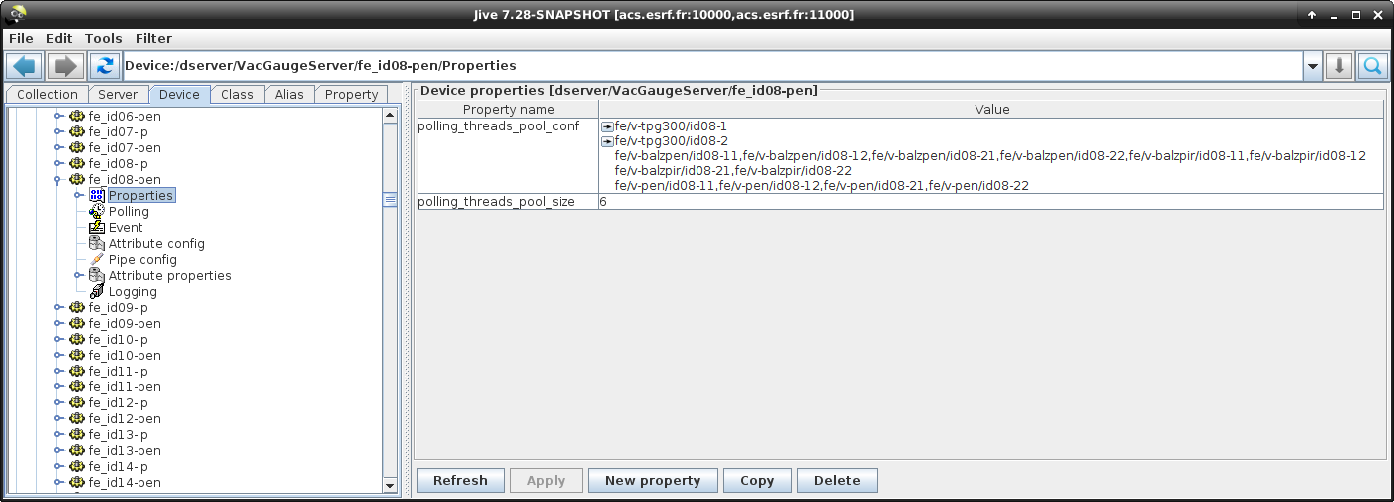
Pool of Polling Threads
VacGaugeServer example:

Slide 17
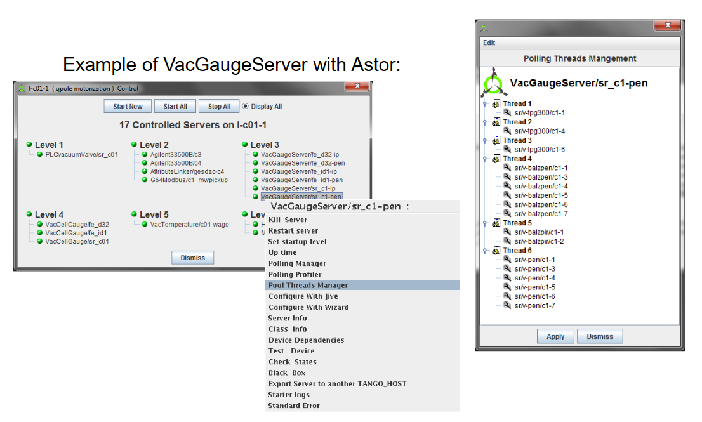
Pool of Polling Threads

Slide 18
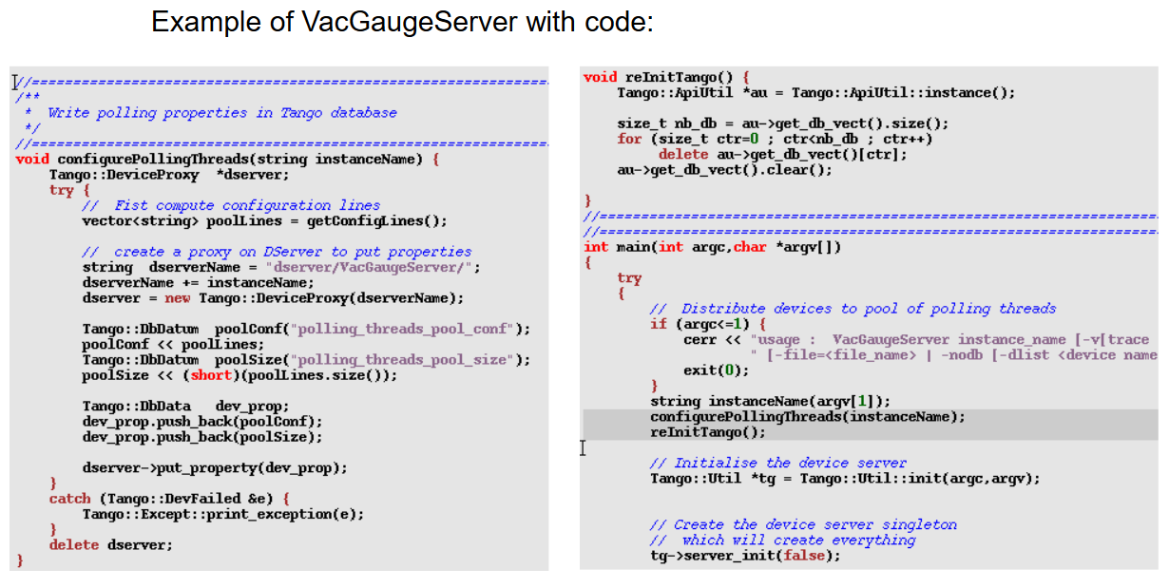
Pool of Polling Threads

Slide 19
Polling algorithm
Starting with Tango 9, you can choose between 2 different polling algorithms:
Old Algorithm (Pre-Tango 9)
Think of this like checking each item on your to-do list one by one:
If you have 5 attributes to poll every second, it calls read_attribute() 5 separate times
Strict timing: If the thread falls behind schedule, it discards the late items and reports an error (the famous polling thread is late)
Drawback: Waste some time when multiple attributes need reading at the same interval
New Tango 9 Default Algorithm
Think of this like batching similar tasks together:
If you have 5 attributes that all need reading every second, it calls read_attributes() once to get them all together
Flexible timing: The thread is allowed to be slightly late, as long as it catches up over time => Fewer polling thread is late errors.
Benefit: More efficient when multiple attributes share the same polling period (less device occupation time)

Slide 20
Polling algorithm
Advantages of new Tango 9 polling algorithm:
In case of several attributes polled on the same device at the same period, a lower device occupation time by the polling thread (due to a single read_attributes() call instead of several single read_attribute() calls)
Less “Polling thread is late” errors in the event system in case of device with non constant response time
Tango Polling Loop SIG Meeting - April 2026

Slide 21
Polling algorithm
The drawback of new polling algorithm is:
The loss of attribute individual timing data reported in the polling thread status
Tango Polling Loop SIG Meeting - April 2026

Slide 22
Polling algorithm
Set polling_before_9 admin device property to true to use the pre-release 9 polling algorithm.
Can be set from the device server code too by calling the Util::set_polling_before_9() method from the main function of the Device Server.
➔You cannot currently choose different polling algorithms for different devices in the same device server instance (process)

Slide 23
The Polling
7 administration (Dserver) device commands allow the polling configuration
AddObjPolling
RemObjPolling
UpdObjPollingPeriod
StartPolling
StopPolling
PolledDevice
DevPollStatus

Slide 24
The Polling
AddObjPolling command
Add a new object in the list of object(s) to be polled
Takes a DevVarLongStringArray as input param (3 strings and 1 long):
Command parameter | Parameter meaning
svalue[0] | Device name
svalue[1] | Object type (“command“ or “attribute“)
svalue[2] | Object name
lvalue[0] | polling period in mS

Slide 25
The Polling
RemObjPolling command
Remove a new object in the list of object(s) to be polled
Takes a DevVarStringArray as input param (3 strings):
Command parameter | Parameter meaning
svalue[0] | Device name
svalue[1] | Object type (“command“ or “attribute“)
svalue[2] | Object name

Slide 26
The Polling
UpdObjPollingPeriod command
Change the polling period for a specified object
Takes a DevVarLongStringArray as input param (3 strings and 1 long):
Command parameter | Parameter meaning
svalue[0] | Device name
svalue[1] | Object type (“command“ or “attribute“)
svalue[2] | Object name
lvalue[0] | New polling period in mS
Tango Polling Loop SIG Meeting - April 2026

Slide 27
The Polling
PolledDevice command
Return the name of the devices which are polled.
Each string in the Tango::DevVarStringArray returned by the command is a device name which has at least one command or attribute polled.
The list is alphabetically sorted.

Slide 28
The Polling
DevPollStatus command
Return a polling status for a specific device (given as input param).
The input parameter is a device name.
Each string in the Tango::DevVarStringArray returned by the command is the polling status for each polled device objects (command or attribute).
For each polled objects, the polling status is :
The object name
The object polling period (in mS)
The object polling ring buffer depth
The time needed (in mS) for the last command execution or attribute reading
The time since data in the ring buffer has not been updated. This allows a check of the polling thread
The delta time between the last records in the ring buffer. This allows checking that the polling period is respected by the polling thread.
The exception parameters in case of the last command execution or the last attribute reading failed.
A new line character is inserted between each piece of information.

Slide 29
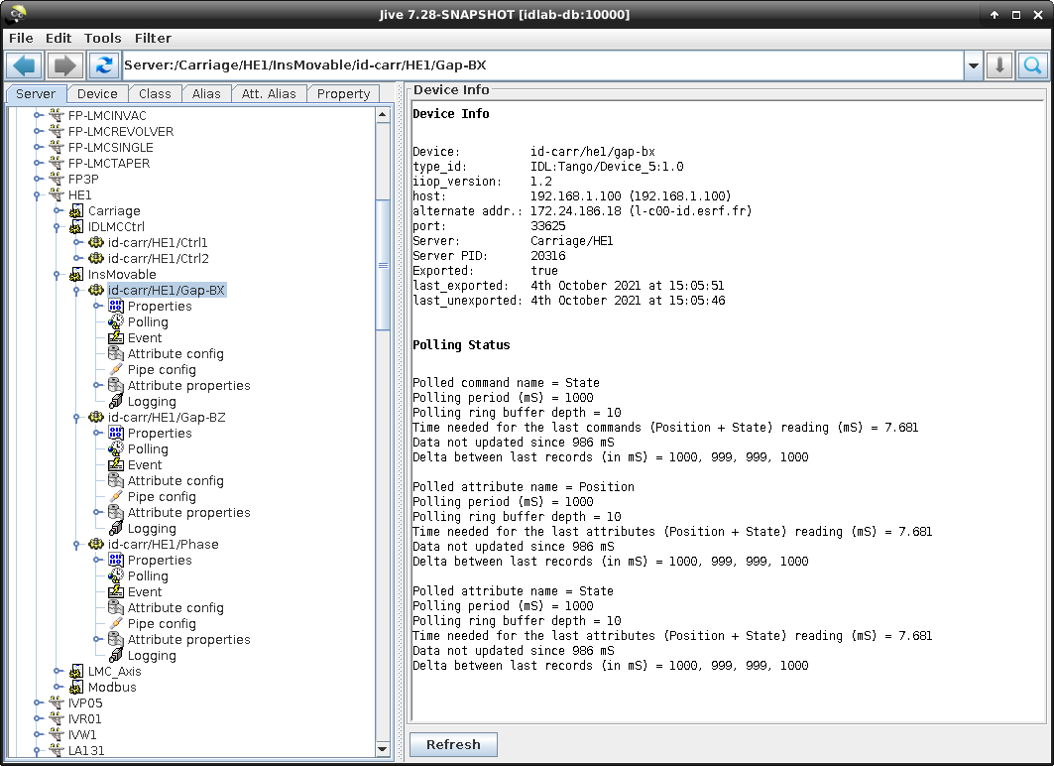
The Polling
The polling status can be seen from jive by clicking on a device node:

Slide 30
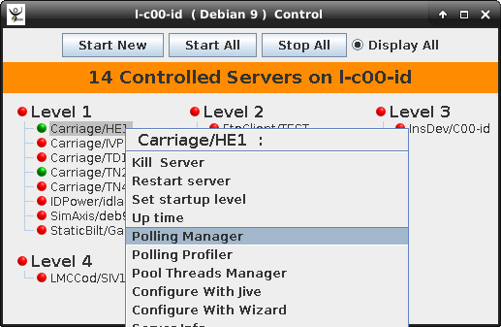
The Polling
The polling status can be seen from Astor using the polling manager:

Slide 31
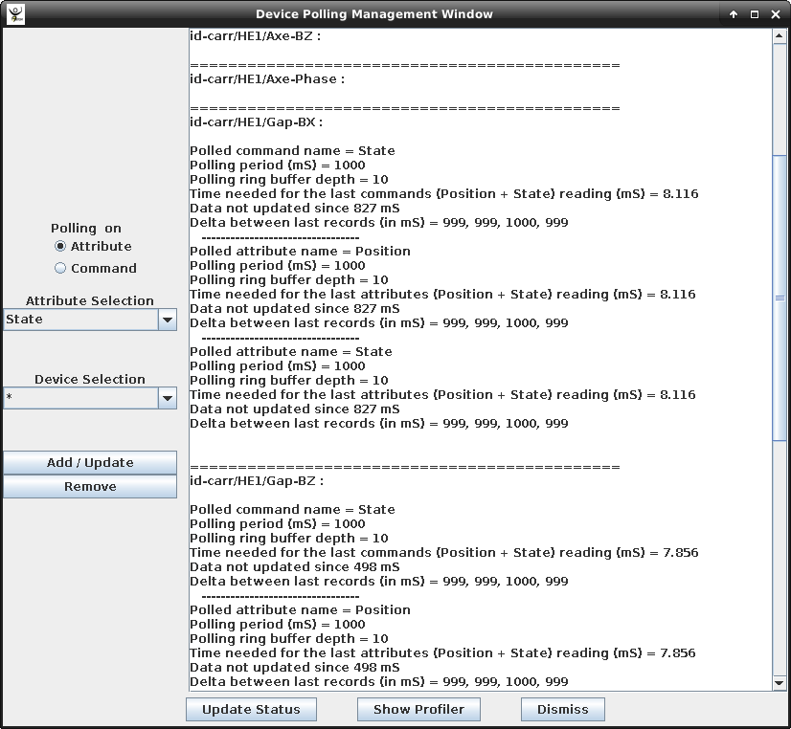
Astor Polling Management Window

Slide 32
Exercise
Add an attribute (Counter – Scalar – RO – DevULong) which needs 300 mS before returning (usleep)
Start the polling from Jive and look at the response time according to the “source” parameter
Stop polling with Jive
Mark the attribute as polled in Pogo
Make
Restart and check what happens

Slide 33
Polling related device properties
poll_ring_depth (default = 10): Polling Buffer Depth
cmd_poll_ring_depth: Commands Polling Buffer Depth
attr_poll_ring_depth: Attributes Polling Buffer Depth
poll_old_factor: Data too old factor ⬄Exception returned to the caller if :
user req time – last data record time > poll_old_factor * polling_period
min_poll_period: minimum polling period
cmd_min_poll_period: minimum polling period for specific commands (e.g.: MyCmd,400)
attr_min_poll_period: minimum polling period for specific attributes (e.g.: MyAttr, 200)
cmd_min_poll_period and attr_min_poll_period have higher priority over min_poll_period
By Default: min poll period properties not defined but hard coded limit MIN_POLL_PERIOD = 5ms in cppTango

Slide 34
Polling related device properties
polled_cmd: to memorize the names of the device polled commands
polled_attr: to memorize the names of the device polled attributes
non_auto_polled_cmd: to memorize the name of the commands which should not be polled automatically
non_auto_polled_attr: to memorize the name of the attributes which should not be polled automatically
These 4 properties are normally automatically created/modified/deleted by Tango core classes

Slide 35
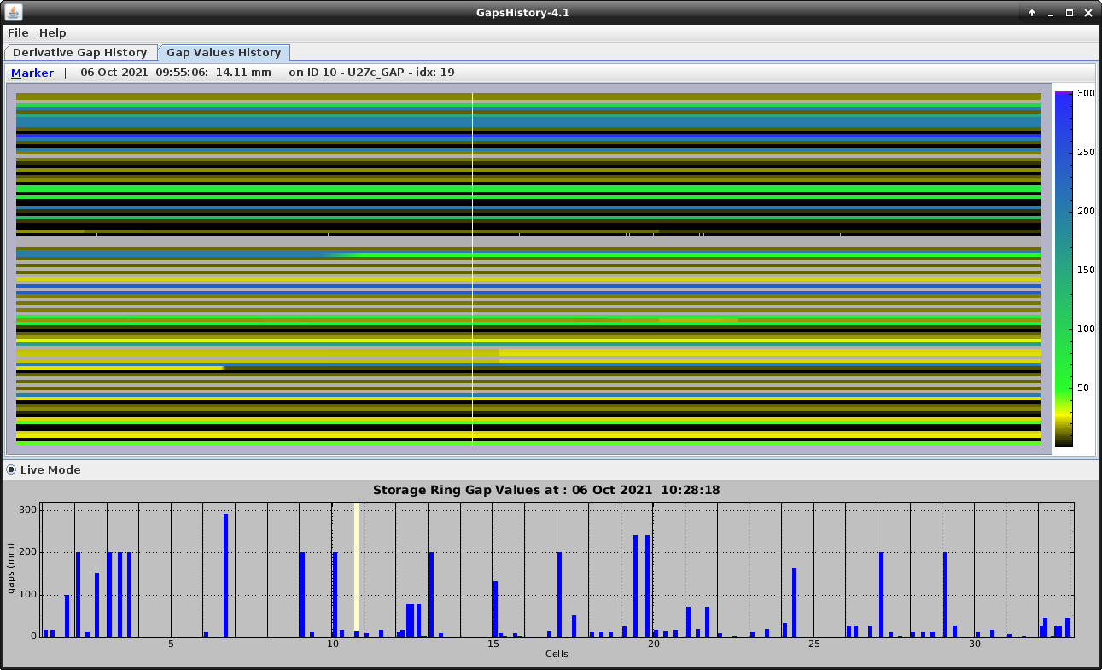
Retrieving command/attribute history
Clients can use command_inout_history_[2,4] and read_attribute_history_[2-5] CORBA operations to retrieve the polled commands/attributes circular buffers history
For instance, atkmoni appli automatically retrieves and display the attribute history when starting the monitoring of an attribute
Please refer to https://tango-controls.github.io/cppTango-docs and https://tango-controls.readthedocs.io/en/latest/development/advanced/IDL.html#structs to see the different returned structures (DevCmdHistory_[2,4] and DevAttrHistory_[2-5]).
Notes:
Sometimes, rather than polling a command or an attribute regulary with a fixed period, it is more interesting to manually decides when the polling must occurs. The Tango polling system also supports this kind of usage. This is called externally triggered polling. To define one attribute (or command) as externally triggered, simply set its polling period to 0. This can be done with the device server administration device AddObjPolling or UpdObjPollingPeriod command. Once in this mode, the attribute (or command) polling is triggered with the trigger_cmd_polling() method (or trigger_attr_polling() method) of the Util class. The following piece of code shows how this method could be used for one externally triggered command.
line 3 : The externally polled command name
line 4 : The device object
line 8 : Trigger polling of command MyCmd

Slide 36
Externally Triggered Polling
Manually decide when the polling must occur
Enabled by setting the cmd or attr polling period to 0
the attribute (or command) polling is triggered with the trigger_attr_polling() method (or trigger_cmd_polling() method) of the Util class:
1 .....
2
3 string ext_polled_cmd("MyCmd");
4 Tango::DeviceImpl *device = .....;
5
6 Tango::Util *tg = Tango::Util::instance();
7
8 tg->trigger_cmd_polling(device,ext_polled_cmd);
9
10 .....
Notes:
Sometimes, rather than polling a command or an attribute regulary with a fixed period, it is more interesting to manually decides when the polling must occurs. The Tango polling system also supports this kind of usage. This is called externally triggered polling. To define one attribute (or command) as externally triggered, simply set its polling period to 0. This can be done with the device server administration device AddObjPolling or UpdObjPollingPeriod command. Once in this mode, the attribute (or command) polling is triggered with the trigger_cmd_polling() method (or trigger_attr_polling() method) of the Util class. The following piece of code shows how this method could be used for one externally triggered command.
line 3 : The externally polled command name
line 4 : The device object
line 8 : Trigger polling of command MyCmd

Slide 37
Manually Filling the Polling Buffer
1 ....
2
3 Tango::DevVarLongArray dvla_array[4];
4
5 for(int i = 0;i < 4;i++)
6 {
7 dvla_array[i].length(3);
8 dvla_array[i][0] = 10 + i;
9 dvla_array[i][1] = 11 + i;
10 dvla_array[i][2] = 12 + i;
11 }
12
13 Tango::CmdHistoryStack<DevVarLongArray> chs;
14 chs.length(4);
15
16 for (int k = 0;k < 4;k++)
17 {
18 time_t when = time(NULL);
19
20 Tango::TimedCmdData<DevVarLongArray> tcd(&dvla_array[k],when);
21 chs.push(tcd);
22 }
23
24 Tango::Util *tg = Tango::Util::instance();
25 string cmd_name("MyCmd");
26 DeviceImpl *dev = ....;
27
28 tg->fill_cmd_polling_buffer(dev,cmd_name,chs);
29
30 .....
Useful when hardware delivers values with precise timestamp
Possible only when the attribute/command is polled
Get data with the command_inout_history or read_attribute_history calls
Notes:
The piece of code fills the polling buffer for a command called MyCmd which is already in externally triggered mode. It returns a DevVarLongArray data type with three elements. This example is not really something you will find in a real hardware interface. It is only to demonstrate the fill_cmd_polling_buffer() method usage. Error management has also been removed.

Slide 38
Tuning the polling from a Tango Class or Tango Client
A set of methods belonging to the DeviceImpl and DeviceProxy classes allows the user to deal with polling. These methods are:
is_attribute_polled() and is_command_polled() to check if one command/attribute is polled
get_attribute_poll_period() and get_command_poll_period() to get polled object polling period
poll_attribute() and poll_command() to poll command or attribute
stop_poll_attribute() and stop_poll_command() to stop polling a command or an attribute

Slide 39
Tuning the polling from a Tango Class
1 void MyClass::read_attr(Tango::Attribute &attr)
2 {
3 ...
4 ...
5
6 string att_name("SomeAttribute");
7 string another_att_name("AnotherAttribute");
8
9 if (is_attribute_polled(att_name) == true)
10 stop_poll_attribute(att_name);
11 else
12 poll_attribute(another_att_name,500);
13
14 ....
15 ....
16
17 }

Slide 40
Polling algorithm
PollThread::run_undetached() ⬄ The polling thread loop
Using a list of work items corresponding to the elements to be polled and with some computed wake up times
The last needed time to execute each work item is stored and can be used to tune the work items list

Slide 41
Polling algorithm
PollThread::tune_list()
Assigning wake up times for each item of the works list of the current Polling Thread based on the items execution needed time and minimum polling period.
Called regularly (every 500*min. polling period or when number of items to poll changes)
Don’t do anything if total needed time > min. polling period

Slide 42
Polling algorithm
PollThread::compute_sleep_time () (called at the end of the Polling Loop)
Tango >=9 default algorithm
If we are late for some item(s):
item considered late if more than 20 ms (DISCARD_THRESHOLD) late compared to what was foreseen
- Seriously late (number of late items equal number of items) → We will discard items
- Late for the first time: Poll immediately the next item but memorize the number of items for which we are late
- Late again: If the number of late items increases → Discard items

Slide 43
Thank you!
Questions?
https://www.tango-controls.org
https://tango-controls.readthedocs.io
https://gitlab.com/tango-controls
cpptango Doxygen doc: https://tango-controls.gitlab.io/cppTango
https://tango-controls.readthedocs.io/en/latest/Reference/presentations/training_C-plus-plus.html

