Slide 1
Tango Polling @ MAX IV
Tango Polling Loop: A Special Interest Group Workshop
14-16 April 2026, MAX IV

Slide 2
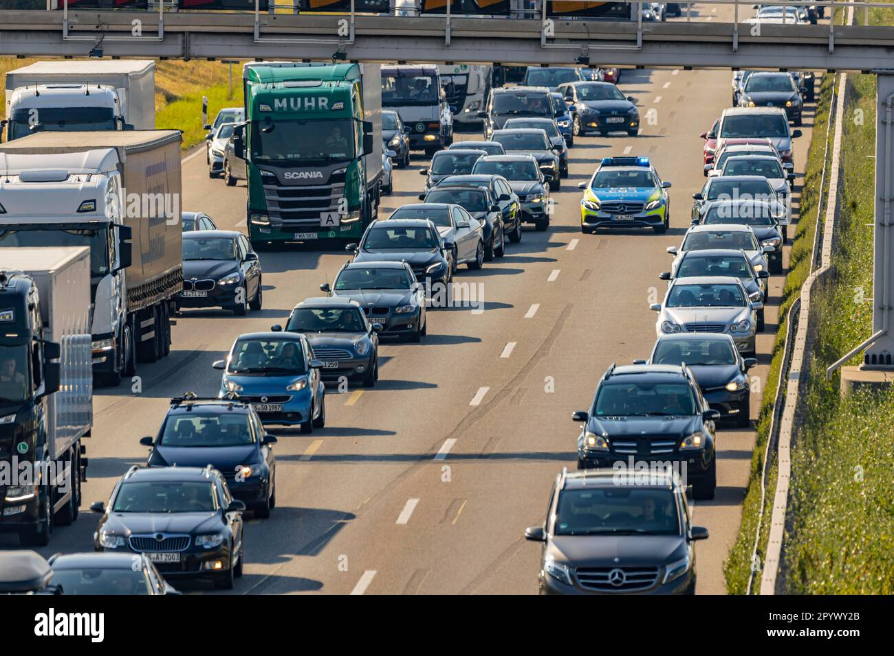
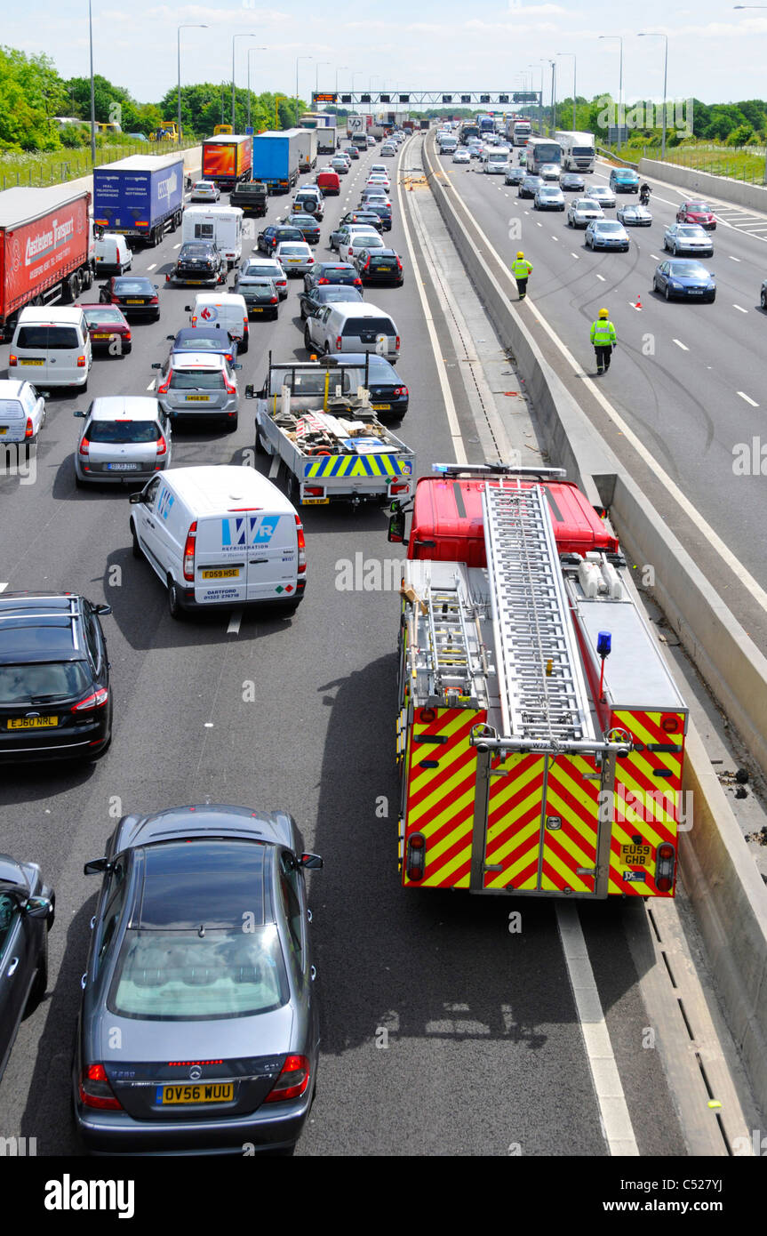
Polling + Sardana
Sardana devices (that represent hardware) run in one Device Server
Sardana is written in Python – even if we increased number of polling threads, we still have GIL
Sardana wants to read motor positions every 10 ms
Sardana elements can't be polled without the fear of breaking scans, because they end up in the same thread(s).

Slide 3
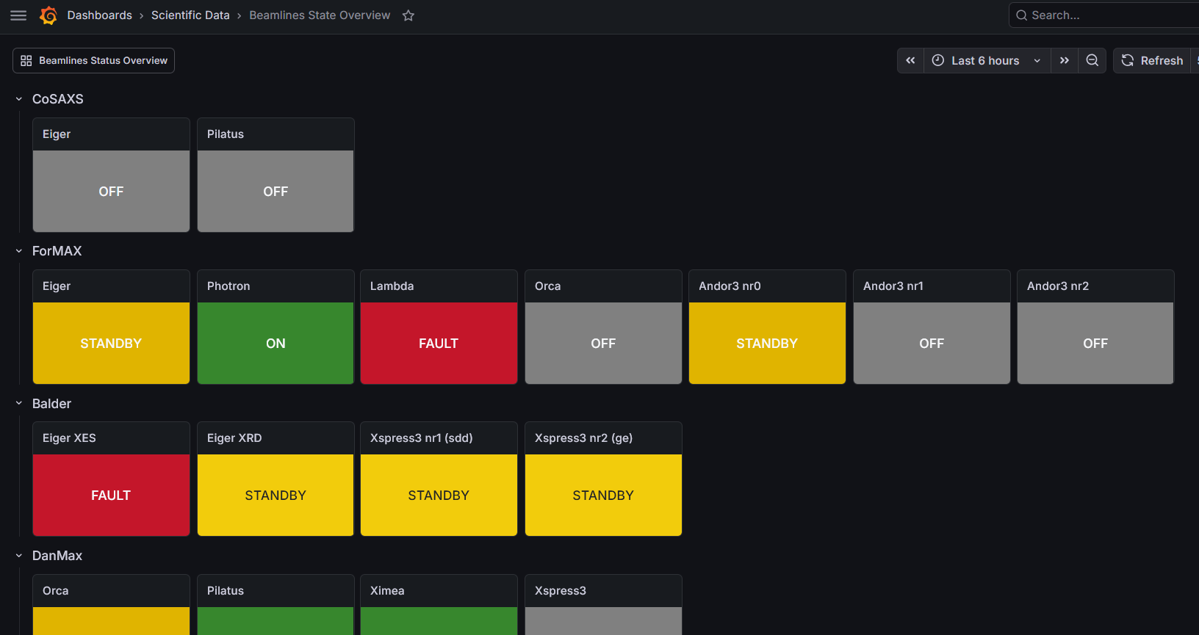
Polling + Sardana + Archiving
Sardana elements can use other devices as DeviceProxy
If we want to archive attributes from these devices, for example State and Status – we enable polling
Polling enables CACHE source
Sardana is confused because returned values are not latest values :(

Slide 4
Polling + Sardana + Archiving
In addition to the previous slide:
We use the same data from hardware to “calculate” State and Status.
dev_state() and dev_status() call the same update_state_status() function to return the latest values.
Which means we query the same data fields from the hardware twice for the same purposes.
read_attr_hardware() doesn’t recognize State and Status as attributes
https://gitlab.com/tango-controls/cppTango/-/work_items/1582

Slide 5
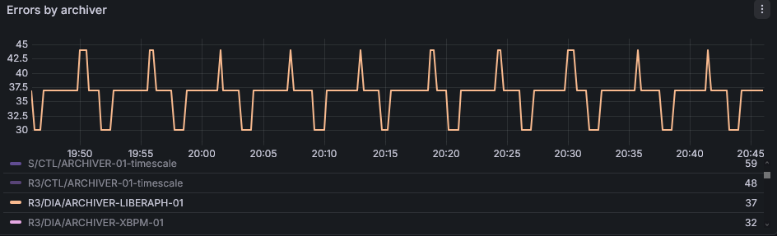
Polling + Archiving
Small inconvenience: if periodic event interval is not multiple of polling period, e.g., 3 seconds polling with 10 seconds archiving period – we have intermittent errors in archiver
https://gitlab.com/tango-controls/hdbpp/hdbpp-es/-/work_items/46

Slide 6
Polling + Archiving
Intermittent problems with polling are hard to catch and debug.
Polling status is the place where these errors are displayed, but it’s not convenient to query it as fast as possible to not miss the error message.
Can it be an attribute in DServer?

Slide 7
Polling configuration + Archiving
We use yaml2archiving to configure our HDB++
It doesn’t “slow down” attributes if they were changed manually later.
We tried to use attr_min_poll_period, but it crashed device if there is poll_attr property lower that this number
https://gitlab.com/tango-controls/cppTango/-/work_items/1600
WARNING:yaml2archiving.action:Polling for 'tango://g-v-csdb-0.maxiv.lu.se:10000/r1/ctl/sofb-01/gain' would be slowed down from 1000 to 10000; not changing.

